Slide 1
The future of Energy
2CP Resources Ltd
Overview 12.08.22

Slide 2
Disclaimer & Confidentiality
The following proprietary presentation (the “Presentation”) is given for general informational purposes only and shall be kept strictly confidential. Until a Definitive Agreement is executed and delivered, there shall be no legal obligations owed by either party of any kind whatsoever (other than those relating to confidentiality) with respect to any of the material contained in the Presentation. The duty of confidentiality includes the confidentiality requirements to be adhered to when sharing such information with another individual or entity. The term “Definitive Agreement” shall mean a legally binding agreement setting forth the terms and conditions and other provisions relating to any transaction. All of the information contained in the Presentation is subject to further modification and any and all forecasts, projections or forward-looking statements contained herein shall not be relied upon as facts nor relied upon as any representation of future results which may materially vary from such projections and forecasts. You agree that you are not relying and will not rely on any communication (written or oral) of 2CP as a recommendation to enter into any transaction, and that you are capable of assessing the merits of and understanding of any transaction.

Slide 3
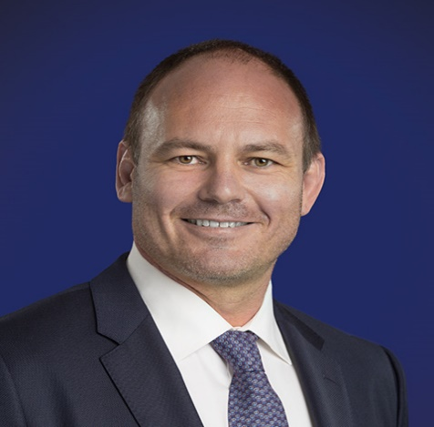
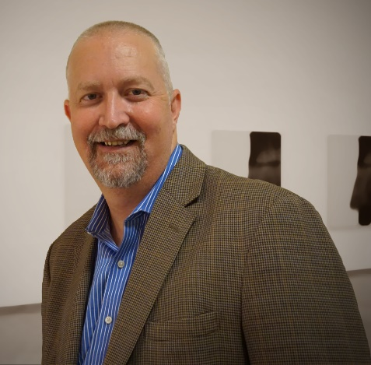
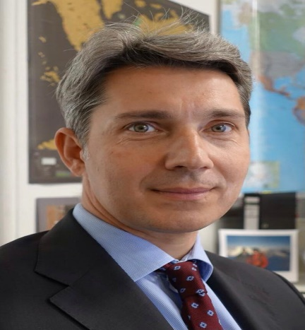

Founding Shareholders and Director
Aaron Cameron
Co-Founder
UK
Aaron Close
Co-Founder
USA
James Platania
Co-Founder
UK
Alessandro Palladino
Director
BVI
Well Control Operations 25 yrs.
Previously CEO & Principle of BVI Commodity Hedge Fund
Governance & Compliance
Business owner
Geoscientist – Nth. American unconventional oil and gas SME
Previously CEO of AIM listed energy company
Entrepreneur & Business owner
Legal, Mergers & Acquisitions
Energy, VC & Fintech experience
Previous head of prominent MENA Family office & Oil Company
20 Years Offshore Fund & Pension Industry
Software Engineer
© August 2022 – 2CP Resources

Slide 4
Introduction
2CP Resources comprise a team of experienced Energy and Financial Professionals
Leveraging historical data and career skill sets to target scalable opportunities in traditional and transitional energy markets across N. America
2CP has a portfolio of resource prospects + energy storage project at concept stage
  Energy Transition and the Future of Mobility - Lithium
  Helium – The High-Tech Gas
  Traditional Energy - Natural Gas & Oil (potential Lithium resource)
  Utility Scale Green Energy Storage & Release
Each project is significant, together they make a compelling offering
Capital raising activities are ongoing with operations expected in Q3 2022

Slide 5
Lithium
Powering the
Future of Mobility

Slide 6
Why Lithium?
Key material in the electrification of world economies
USA & European governments mandating EV targets
Global EV battery demand to grow 1500% by 2030 ⁽³⁾
Lithium Demand vs Supply Forecast ⁽¹⁾
Energy Transition
Lithium value chain vulnerable to geopolitical tensions
60% of global lithium processing capacity in China
North American lithium - resource security premium
Strategic Resource
Lithium Prices: January 2021 – December 2021 ⁽²⁾
Supply Diversification Needed
Australia, Chile, and China produced 46%, 24%, and 16% respectively of global lithium production in 2020
Large gap between current supply vs expected demand
Lithium carbonate price up 300% since January 2021
Market
Timing
Benchmark Minerals 3) Bloomberg
Benchmark Mineral Intelligence

Slide 7
Portfolio Overview
Five identified lithium brine direct extraction projects within North America
Project A – Southern USA
P50 prospect size – 450k acres
Lease Target ~200k acres
Excellent infrastructure
Greenfield / farm in leasing
Shallow depth
Reservoir thickness
  Gross 100 – 250’
  Net 80 – 240’
Project 1 – Southern USA
P50 prospect size 1.1M acres
Lease Target ~100-150k acres
Existing projects in area
Greenfield leasing
Medium depth
Reservoir thickness
  Gross 300 – 700’
  Net 15 – 130’
Project 2 – Southern USA
P50 prospect size 280k acres
Lease Target 50-100k acres
Excellent infrastructure
Farm in required
Deeper depth
Reservoir thickness
  Gross 30 – 70’
  Net 25 – 65’
Project 3 – Northern USA
P50 prospect size 600k acres
Lease Target 100k
Excellent infrastructure
Green Field Leasing
Shallow To Medium depth
Reservoir thickness
  Gross 50 – 150’
  Net 10 – 90’
Project 4 – Canada
P50 prospect size 2.3m acres
Lease Target 100-300k acres
Excellent infrastructure
Green Field / Government / Farm-in
Shallow - Deeper depth
Reservoir thickness
  Gross 50– 500’
  Net 5 – 200’
Projects identified from extensive database with >300k drill logs and fluid samples
Next steps on the assets includes staking up to 50k acres spread across multiple projects, drilling 1-2 confirmatory test wells and sampling to authenticate historic datapoints, gathering other modern data where samples can be collected from sources such as cores and producing well brine samples.
Total historic resource size estimates at 1-5 Million tonnes of lithium carbonate per prospect
Following a technical review of direct lithium extraction (“DLE”) technology providers, 2CP has selected its preferred supplier and is in MOU discussions
7

Slide 8
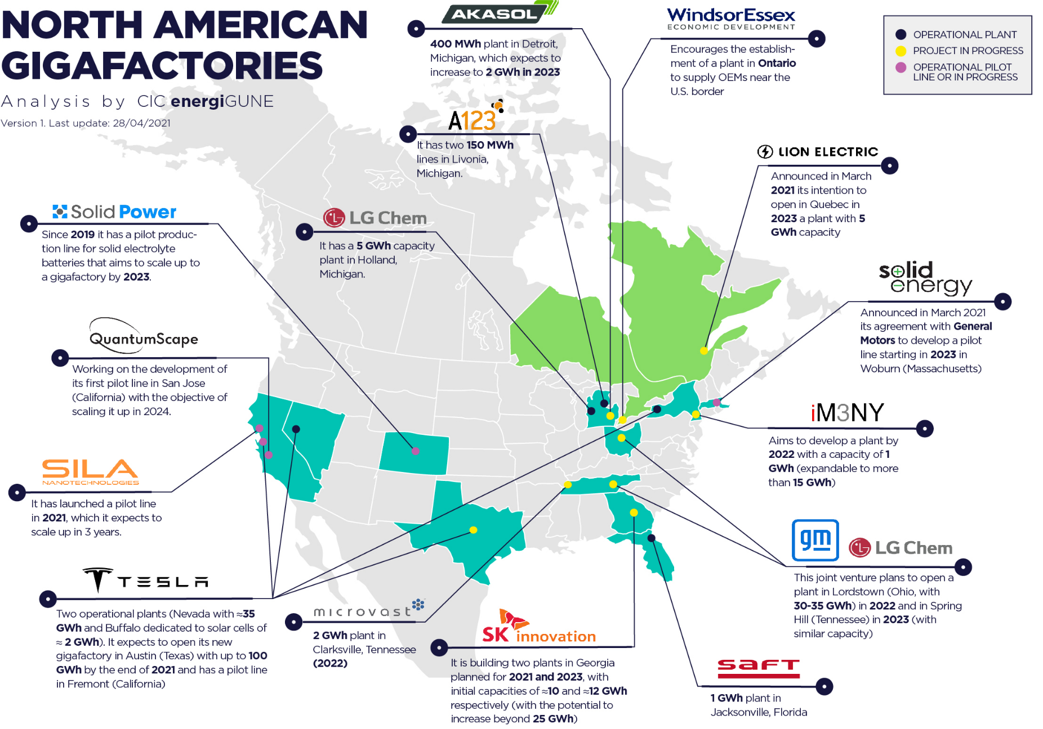
Portfolio in Strategic Locations
5 world class projects in proximity to end users - reducing transportation costs
Each has the potential to be a world class resource of 1 – 5 million tons Lithium Carbonate
Equivalent to 19M – 95M EV batteries
Renewable energy across most projects
Automotive companies are accelerating EV production and focused on securing supply chains

Slide 9
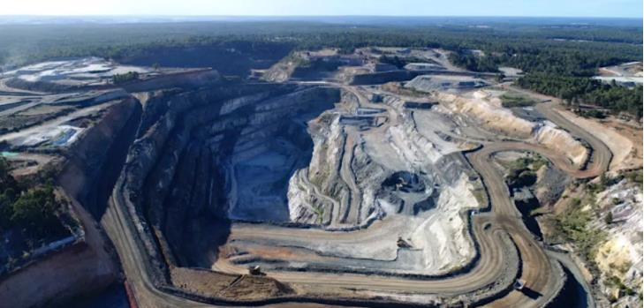
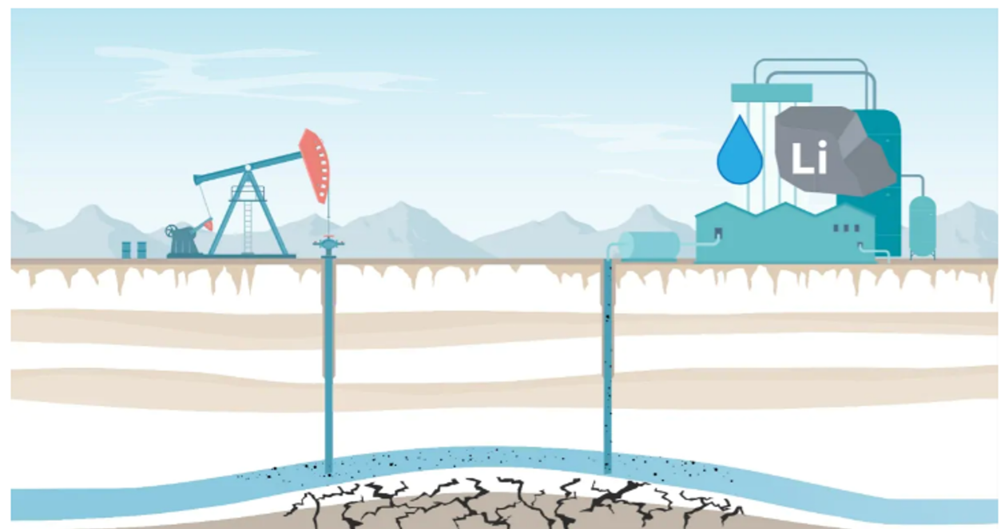
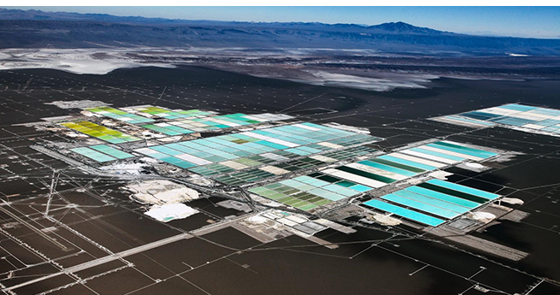
Not All Lithium Mining is Created Equal
Direct Lithium Extraction
Open Pit Mine and Salt Lake Bed Lithium Extraction
Targeting subsurface Lithium brines, comparable to onshore oil with, limited surface disruption for production wells and surface facilities.
Vs
Lithium extraction from open cast mines or salt lake beds is environmentally damaging, capital intensive & often takes years for approval
Processing facilities extract Lithium from the brine stream, the waste is reinjected maintaining reservoir pressure.
Modular approach reduces project cost risk, unlocks early production and sales
Geo40 - Leading Extraction partner identified with MOU in progress

Slide 10
Folsom Point Energy - Valuation Growth Potential
Illustrative Value across Development Milestones Including Required Capex. Considers Only One of the Five Prospects
Corporate Assets:
Capex Required:
Extensive well data
First mover advantage on world class asset
Team expertise
50k acres
43-101 Reserve report
750Kt Li₂CO₃ Recoverable Reserves
200k acres
PFS and Pilot begin
2.25Mt Li₂CO₃ Reserves
160Ktpa production
3.3Mt Li₂CO₃ Recoverable Reserves
$10M
$30-60M
$200M-$400M
[June 2022]
[February 2023]
[November 2023]
[November 2024]
Comparison Companies | M. Cap ($M)⁽¹⁾
Bradda Head Lithium | 72
Cleantech Lithium | 31
Balkan Mining & Minerals | 12
Comparison Companies | M. Cap ($M)⁽¹⁾
Lithium Americas | 3,722
Lake Resources | 2,002
Standard Lithium | 1,136
Comparison Companies | M. Cap ($M)⁽¹⁾
Albemarle | 24,270
Pilbara Minerals | 6,288
Allkem | 6,170
Cap IQ date as of 21/04/2022

Slide 11
Helium
The High
Tech Gas

Slide 12
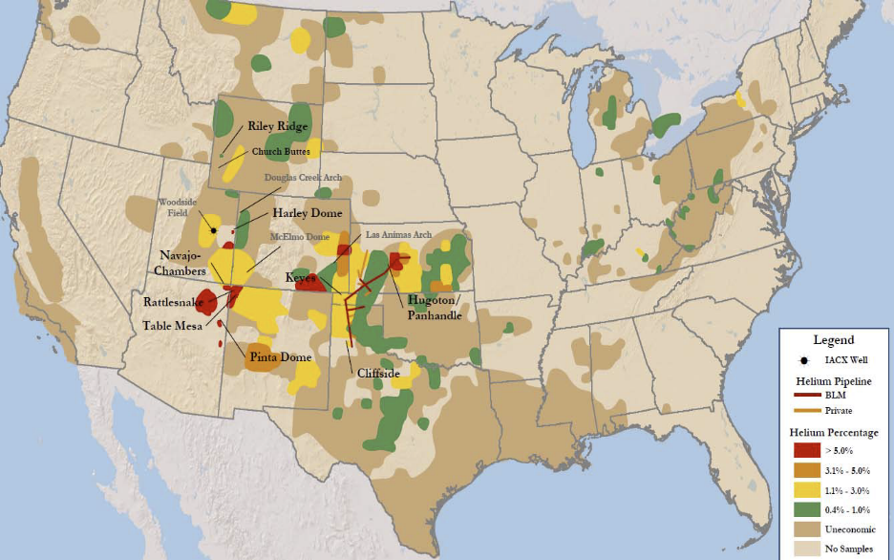
Investment Overview
2CP has identified two significant helium opportunities in historic Helium producing regions in the central USA; the company is moving to consolidate a large land position and establish a world class resource
As a required strategic resource for high-tech manufacturing (semiconductors), healthcare machinery, and space operations, helium supply is a key focus for governments’ goals to future proof their economies. Demand profiles for helium indicate that there will be substantial supply shortages through the 2020s and potentially long-term
The helium opportunities identified by 2CP are a) strategically located in the USA, b) close to specialized helium infrastructure and c) low-cost extraction prospects
The total project size has identified c. 800,000 acres containing areas with stacked reservoirs and zones between 0.9% and 2.2% helium content
Upper Zone
Lower Zone
Potential 200k acres
Potential size
  603 BCF (unrisked)
  198 BCF (risked)
  1.79 BCF (helium risked @ 0.9%)
Pressure >500psi
1,300-4,500’ depth
Potential 800k acres
Potential size
  1,271 BCF (unrisked)
  330 BCF (risked)
  4.95 BCF (helium risked @ 1.5%)
Pressure >1000psi
4,500-5,500’ depth
Upper zone overlays lower zone

Slide 13
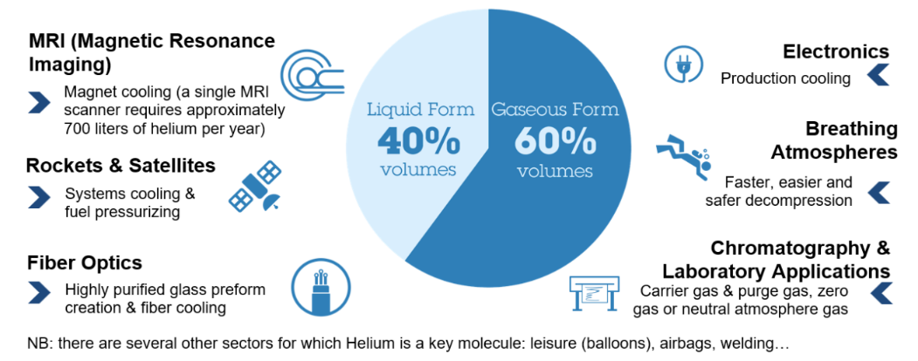
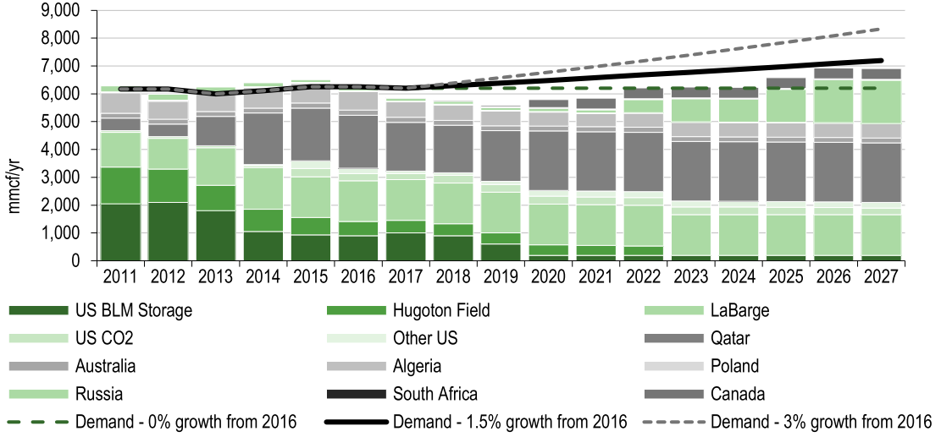
Why Helium?
Helium Uses – Critical High-Tech Applications ⁽¹⁾
Key Market Trends
Liquid helium’s extremely low boiling point makes it fundamental for many technical processes
Helium is used as an inert gas for cryogenic, heat transfer, shielding, leak detection, analytical and lifting applications
Growing applications in in space, quantum computing, semi-conductor, electronics, nuclear fusion, healthcare
Structural supply deficit, emergence of “Helium Shortage 4.0”¹
Production is highly concentrated, with ongoing disruption and maintenance issues at key plants impacting supply
On the critical material lists of the USA, EU, China and other major economies
Geopolitical tensions and potential sanctions against Russian producers disrupting the market
Helium Uses ⁽²⁾
Helium Market Supply and Demand ⁽³⁾
Magnetic Resonance Imaging
Magnet cooling a single MRI scanner requires approximately 700 litres of helium per year
Breathing Atmospheres
Faster, easier, and safe decompression
Rockets & Satellites
Systems cooling and fuel pressurising
Electronics
Production cooling
Fibre Optics
Highly purified glass preform creation and fibre cooling
Chromatography and Laboratory Applications
Carrier gas and purge gas, zero gas or neutral atmosphere gas
1) Gas World, February 2022
2) Air Liquide
3) JR Campbell & Associates report for BLM Office of Minerals Evaluation and Edison Investment Research, various

Slide 14
Natural Gas
The Transition Fuel

Slide 15
Summary of Investment Opportunity
2CP Resources Ltd is a private company with a unique Gas + Secondary Oil opportunity in North America
Project Summary
  2CP has identified a ready to produce oil & gas project in Texas with a potential Lithium Brine resource
  Global shortage of Traditional Energy Supplies – Lack of Investment in the US due to political considerations
  Contains a significant gas discovery plus two drilled and completed oil discoveries in world class source rock
  Project identified from previous ownership, 3D seismic, exploration, well testing and offset data.
  $70+ Million spent previously and over $2.0 Billion by offset operator
Required Funding
  Initial investment of $xx
    secures oil and gas discovery well leases (2,000 acres), funds production testing, infrastructure installation and restores production at all three wells
    secures a 15k - 20k acre land position surrounding the discoveries, and will be funded by either cash flows from operations, reserve-based lending or new equity
  Second Investment $xx - Development plans include 54+ wells, at c.$500M development cost, estimated working capital requirement of $50-75M
Payback Period
  Operations from the gas and two oil wells projected to generate unlevered cash flows of >$25M over the first-five years of operations enabling strong CFADS from day one
  Establishing production and reserves supports larger RBL structure for full field development, CFADS supported by early cash flow
15

Slide 16
Investment Staging
Initial Investment:
Secures 2,000 acres, covering both the gas and oil discoveries
Gas discovery:
  13,300’ vertical x 5,500’ treated lateral
  Tested at 8,500 mmcf/d (still dewatering)
Oil discoveries:
  Well 1: 8,670’ vertical x 4,300’ treated lateral, produced at 424 bbl/d with stabilized production at 100+ bbl/day
  Well 2: 8,590 vertical x 6,800 lateral, produced at 160 bbl/d with stabilized production at 80 bbl/day
Restores production from the gas and oil wells
  Infrastructure at site and to gathering network
  Remove plug
  Production testing
  Places well on stream, targeting 4,500 mmcf/d
Secures additional 17,400 acres surrounding the discoveries
Second Investment:
54+ drilling locations identified from historic 3D seismic
  717Bcfe risked gas reserves expected
  IRR 88.50%
  Working capital to drill first 8-10 new gas wells
  Power and pipelines options available
Decision on further oil wells taken once production profile from two discovery wells is understood.
Further working capital up to $100M may be required depending on market conditions and the drilling program
Gas Reservoir Properties
300’ - 400’ thick pay zone
8 - 12% porosity
0.6 psi/ft pressure gradient
23% water saturation
Oil Reservoir Properties
200’ - 400’ Thick Pay Zone
8 - 15% porosity
0.52 psi/ft pressure gradient
70% water saturation

Slide 17
Initial Investment - Project Strategy and Key Highlights
Initial Investment - Use of Proceeds ($)
Gas Production over Life of Gas Well 1
 | Phase I |  | Phase II | Phase III
 | Gas | Oil | Oil | Land
Lease Expansion - Acres |  |  |  | 17,400
Lease $ per acre |  |  |  | 500
Lease Costs | 193,962 | 128,000 |  | 8,700,000
Permit, Bond & Surface Agreement | 106,000 |  | 15,000
Re-enter and bring online Gas well | 187,750 |  | 447,200
Facilities | 350,000 |  | 350,000
Flow Testing + Pipe Line | 250,000 |  | 250,000
Evaporation Pit |  | 100,000 | 250,000
Management, Legal, G&A | 100,000 | 50,000 | 175,000 | 650,000
Contingency (10%) | 118,771 | 27,800
Total |  | 1,612,000 | 1,635,920 | 10,985,920
Project Total |  |  |  | 14,234,123
Oil Production over Life of Oil Well 1 & 2
Project Cash Flows over Life of Gas and Oil Wells⁽¹⁾
1) Gas price of US$6 / mbtu and an oil price of US$85 / bbl

Slide 18
Our Roadmap
Renewable Energy Storage

Slide 19

Storage is the key to a Green Power Grid
Intermittent renewable energy added to the grid requires the equivalent addition of Fossil fuel generation capacity for stability
Efficient , Large-Scale Storage eliminates the need for this redundant generation capacity
Current Battery technology
  Protects the stability of a power grid that is running close to capacity
  Can’t move large amounts of energy from times of surplus to times of scarcity.
Large Scale, Efficient, Long Duration Energy Storage is Essential
Our goal is to take surplus wind or solar energy and store it in a depleted gas formation
We have a relationship with a technology partner developing the economic model
We have identified a suitable underground formation adjacent to excess wind energy

Slide 20
Thank You
2CP Resources:
Bacchus Capital Advisers:
Aaron Cameron
Position: CEO
Phone: +44 (0) 747 504 6339
Email: cameron@2cpresources.com
Aaron Close
Position: Adviser
Phone: +1 (214) 908 6384
Email: close@2cpresources.com
Richard Allan
Position: Managing Director & COO
Phone: +44 (0) 785 785 7287
Email: richard.allan@bacchuscapital.com
Shea O’Callaghan
Position: Director
Phone: +44 (0) 771 554 8610
Email: shea.ocallaghan@bacchuscapital.com
2CP Resources Ltd, Craigmuir Chambers, P.O. Box 71, Road Town, Tortola VG1110, British Virgin Islands

