Slide 1

SI PHARMA
PTE LTD
One-Stop Direct-to-Market Food &
Pharmaceutical Product Manufacturing

Slide 2
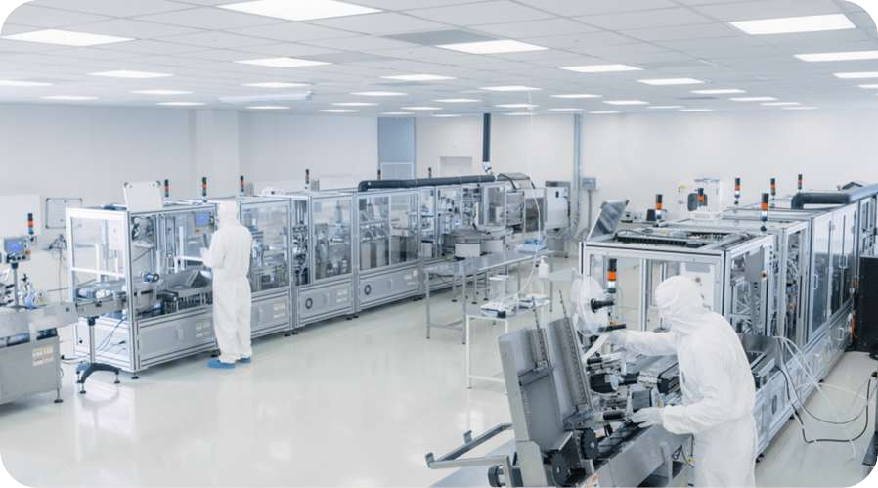


ABOUT US
SI Pharma Pte Ltd is a Singapore-based OEM & ODM manufacturer specialising in the active development and production of food products and pharmaceuticals. Our manufacturing processes are performed in full compliance with industry standards for safety and quality, with products ranging from powder, sachet, softgel and gummies—technology processes we have developed extensively to deliver high-quality products.
With extensive production capabilities in Malaysia, we are positioned to capitalise on our financial, global business, and production resources to deliver world-class food & pharmaceutical technology solutions.
Supported by a strong R&D, SI Pharma is focused on developing new or improved products, combining comprehensive safety and long-term health studies and product stability testing under a range of realistic environmental conditions.
Led by a dedicated team with years of experience in the industry supported by the essential production resources to deliver one-stop solutions—from product conceptualisation, formulation, packaging design, product registration and legal compliance, and logistics/delivery to deliver ready products direct to market under the brand name of our customers.
As an ISO, GMP, HACCP, and Halal certified manufacturer, SI Pharma is capable of scaling up production while ensuring food safety standards and legal compliance for the benefit of customers and the businesses that serve them.
&
SI PHARMA PTE LTD
01

Slide 3


ABOUT US
VISION
Harnessing nature’s gifts to serve the community with exceptional products, service quality, and commitment to bettering lives.
MISSION
To play an active role in improving lives.
For the end-users: We are all about bringing safe and quality products that truly benefit the end-users.
For the farmers: We are dedicated to supporting the livelihood of our farmers through ethical and sustainable practices, while providing access to the resources they need to grow and thrive.
For the community: We are committed to giving back to society through charitable giving and volunteering for meaningful causes to uplift the well-being of the community as a whole.
SI PHARMA PTE LTD
02

Slide 4



OUR SERVICES
RESEARCH & DEVELOPMENT
Innovation, insights, and entirely novel solutions represent the hallmarks of progress to create products that better serve our customers and business partners.
At SI Pharma, we are committed to strong R&D to formulate new products and improve their safety, stability, and cost-effectiveness with a specific food ingredient, supplement, or pharmaceutical product. Our R&D undergoes a number of rigorous processes, including long-term health studies, scientific chemical analysis, and manufacturing process design.
SI PHARMA PTE LTD
03

Slide 5








































OEM/ODM MANUFACTURING
SI Pharma offers comprehensive OEM/ODM manufacturing services following our extensive R&D process. From product formulation, manufacturing process development, and branding and marketing planning, SI Pharma is ready to help customers take their plans from conceptualisation to market-ready products. We can also adapt & customise our OEM/ODM process to formulations provided by customers after evaluating its safety, stability and business viability.
Step-by-Step Manufacturing Process
01
03
05
07
Laboratory testing, technology evaluation, stability verification
Manufacturing
Product Packaging & Quality Control
Delivery
Product Development (qualitative & quantitative)
Production Preparation (raw materials purchases & packaging)
Registration & Export Documentation
Logistics & Supply Chain
02
04
06
08
Product Processing
We provide product processing services to prepare a range of finished and partially finished products with no minimum order quantity: Liquid to powder processing, additive manufacturing & processing (e.g. collagen, additives, stabilisers), etc.
SI PHARMA PTE LTD
04

Slide 6





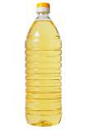
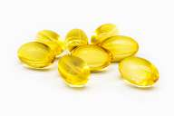


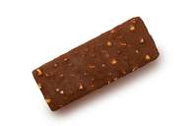


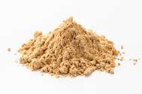



PRODUCT PROCESSING
SI Pharma manufactures products in a range of types based on the end-product:
Bulk Filling Of Oil
We provide oil filling services for edible oil products of various viscosity from bulk to bottle. Our fillers can handle plastic, glass and metal containers, with volume ranging from 10ML to 1L.
Softgel
Hermetically-sealed, stable, and providing full bioavailability, softgels are ideal for encapsulating liquid foods & pharmaceuticals safely and reliably. Our softgel products are formulated to provide the best absorption rates & protection for specific foods and pharmaceuticals, including vitamin supplements, honey, oils, beauty line skincare, and more.
Chocolate Processing
Chocolate panning is a popular method used to coat confectionery or nuts with a layer of chocolate. More commonly known as “chocolate coating”, SI Pharma provides panning services for various types of bite-sized confections panned in nuts, dried fruits, cereals and candies. Our low minimum runs make an affordable option for customers requiring low-volume, high-mix products.
Plant-based Vegetarian Softgels
At SI Pharma, we specialise in plant-based vegetarian softgels developed at our R&D laboratories to provide customers with non-animal alternatives. Made using proprietary technologies, our vegetarian softgels comprise mainly of starches derived from tapiocas grown on our organic farms in Johor Bahru, Malaysia, to replace the conventional bovine (beef) protein. In addition to addressing the specific challenges of enhancing the bioavailability presented by different product fill, our vegetarian softgels offer several other advantages over gelatine-based products :
Powder
We provide bulk powder processing with measured solubility, uniform particle size, free-flowing powder, and taste.Our powder products are ideal for all common types of storage, including bags, bottles, jars, and canisters.
Low Hygroscopic properties (moisture resistance/non-absorbing).
Ethical alternative to animal-based products (can be packed with animal-based product fills, such as fish oil).
Highly stable - fill products are less likely to migrate to the capsule shell or react with the shell material.
Gummy
We produce a wide range of gummy products using a precise starch and
non-starch moulding process that are combinable with various additives such as vitamins, collagen, calcium, and melatonin. From chewable vitamins, jelly candy, and calcium-enriched snacks, our R&D is constantly working to add new and improved gummy product types to our lineup.
Equipped with advanced automated production facilities, SI Pharma has the capacity to produce
500,000 softgels per week, with our newer facilities capable of producing 1,000,000
softgels per week.
SI PHARMA PTE LTD
05

Slide 7
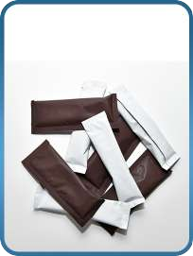
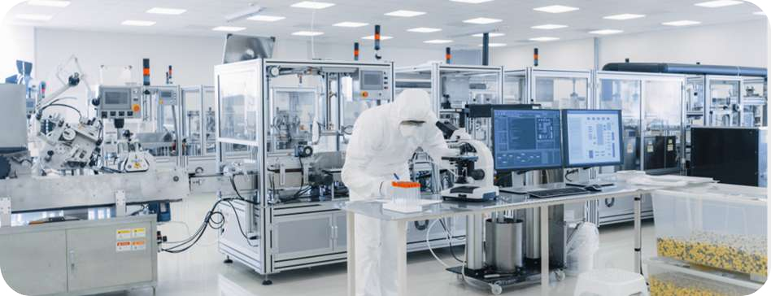



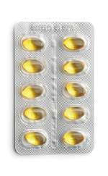
PRODUCT PACKING
Sachet Filling
Holding precisely measured doses, sachets are ideal for holding liquid and powder fills. Sachets are also affordable, eco-friendly, customisable, and excellent at preserving contents.
At SI Pharma, our automated machines ensure high consistency and reproducibility to meet the strictest standards of quality and safety.
Blister Pack
We provide blister packaging service to keep capsules and tablets safely protected from dirt, moisture and external environmental influences. Our blisters come in multiple formats, including thermo-form, cold-form and heat-sealed blisters, with pockets made from PVC/PVDC and lidding seals made of foil for opening convenience.Both compact and easy to carry, our blister packs are ideal for pharmaceutical tablets, capsures or lozenges requiring unit-dose packaging.
Machinery Supply
We supply a wide range of product processing and packaging machines to help enterprising businesses venture into food tech and pharmaceutical manufacturing. From consultation, modification, maintenance and after-sale, SI Pharma is well equipped with extensive know-how to support.
List Of Machines
Preparation tanks Transfer Tanks Jacketed Tanks Encapsulation Machine
Bottle Labeling Machine
Auto counting and packing machine Sachet Packing Machine
SI PHARMA PTE LTD
06

Slide 8
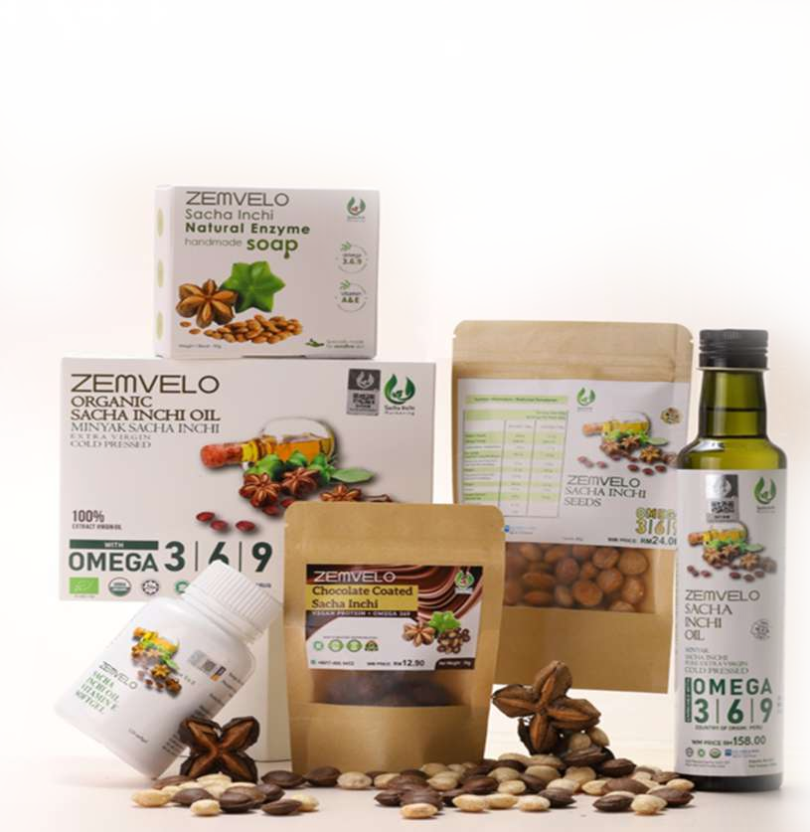








PRODUCT SHOWCASE
We produce a wide range of high-quality pharmaceuticals and supplements for various brands. Below is a selection of SI Pharma’s finished products under the ZEMVELOⓇ brand:
ZEMVELOⓇ is a range of Sacha Inchi Oil products available in softgel, liquid sachet, bottle, chocolate and seed form. Made using state-of-the-art manufacturing and supported by active R&D that identifies the functional components of Sacha Inchi oil and precisely extracts, improves and preserves its contents, we are proud of our ZEMVELOⓇ Sacha Inchi products which capture the essence of the Amazonian fruit in all its goodness.
CERTIFICATIONS
SI Pharma is capable of scaling up production while ensuring food safety standards and legal compliance for the benefit of customers and the businesses that serve them. We maintain full compliance with international standards of quality and safety with certifications in:
ISO I HACCP I GMP I Halal
SI PHARMA PTE LTD
07

Slide 9


WHY CHOOSE US?
Own Plantations
SI Pharma owns and manages its own plantation in Johor Bahru, Malaysia, ensuring a steady supply of quality raw materials to maintain consistent high volume production.
Fair Trade Practice With Farmers
SI Pharma operates on a fair trade practice with the farmers we work with and guarantees to purchase their harvests at agreed prices. In addition, farmers are free to sell their produce elsewhere for their benefit, with SI Pharma willing to purchase any surpluses.
No MOQ
We accept business from anyone regardless of the size of their orders for many of our products. This gives small companies greater access to our services to grow their business and overcome the challenges small businesses face at this critical stage in their development.
SI PHARMA PTE LTD
08

Slide 10


































SACHA INCHI OIL PRODUCT
Heart Health
Immune System Health
Powerful
Anti-Cancer Activity
Skin Moisturising (Emollient)
Antioxidant &
Anti-Inflammatory Activity
Brain Function
Detoxification (e.g. cleanses heavy metals)
Healthy Cell & Tissue Growth
SI PHARMA PTE LTD
09

Slide 11



SI PHARMA PTE LTD
enquiry@si-pharma.com

