Slide 2
Company Background
Established in 2019
Subsidiary of Prabh Dayal Om Parkash Infrastructure Ltd & Purshotam Profiles Pvt. Ltd.
Prabh Dayal Om Parkash Infrastructure Ltd
  3 Decades of experience in plastic
  A leading supplier in North India for Water Storage Tanks, Road Safety equipment and Solid Waste Management products
Purshotam Profiles Pvt. Ltd.
  Leading supplier of module mounting structures in India with an annual supply of more than 5GW.

Slide 3

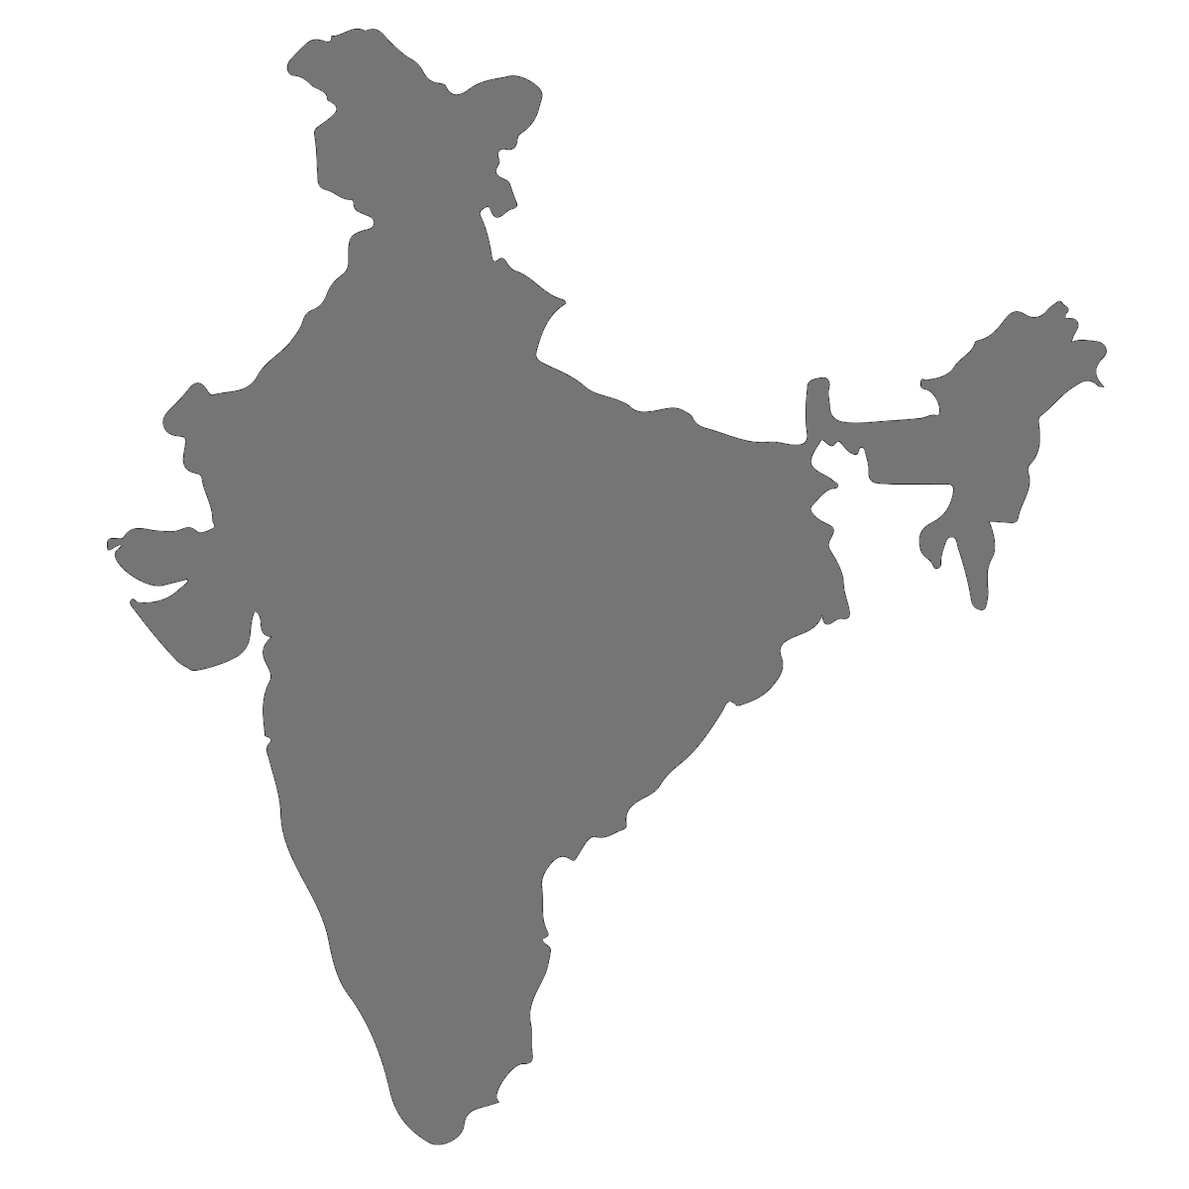
Manufacturing Facilities
Sonipat, Haryana
Sanand, Ahmedabad
Ramagundam,
Telengana

Slide 4
Production Capacity
10 Blow Moulding machines
3 Injection Moulding machines
25Mw DC production capacity per month
7 additional Contract manufacturing plants tie-up

Slide 5
Market Share
Largest manufacturer of Floats in India
Market share of more than 70% in the Indian Market

Slide 6
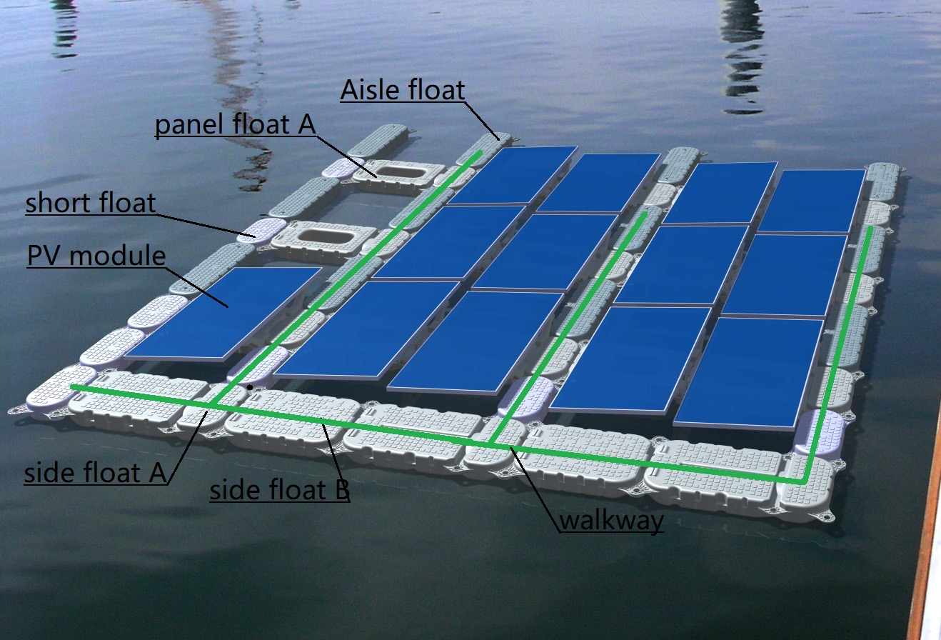
TYPICAL FLOAT ASSEMBLY

Slide 7
Technical Details
Tilt Angle: 5*/8*/10*
Module: 330Wp-550Wp
Configuration: 2 row or 4 row
Wind Speed: 200km/hr
Water Depth: Project can be designed for any depth
Current Production Capacity: 25MW/month

Slide 8




Material Partners
Polymers
Additives

Slide 9
In House Testing Facilities
ASTM D4329 & ISO4892-3: QUV UV Exposure Test
ASTM D1238: Melt Flow Index
ASTM D638: Tensile Modulus
ASTM D790: Flexural Modulus
ASTM D1603: Carbon Black Content Test
ASTM D1505: Density
BIS 10146: Migration Test
ASTM D1693 : Environmental Stress Cracking Resistance

Slide 10
Projects
Project | Capacity (DC) | Status
NTPC/BHEL Ramagundam | 118MW | Commissioned June 2022
NTPC/BHEL Simhadri | 21.5MW | Commissioned May 2021
NTPC/BHEL Kayamkulam | 21MW | Commissioned March 2022
NTPC/L&T Auraiya | 28.3MW | Supply Ongoing
NTPC/Vikram Solar Khawas | 34MW | Supply Ongoing. 90% Complete. 25% commissioned.
Avaada Power | 2MW | Commissioned January 2022
Dalmia Cement | 3.5MW | Supply Complete

Slide 11
Services
Designing
Site Survey & Analysis
Floater Supply
Installation Supervision
Mooring and Anchoring Designing
Installation of Mooring & Anchoring

Slide 12
Mooring & Anchoring Capabilities
Floatex has an in-house technical team for designing of mooring and anchoring
All mooring and anchoring design is vetted by third party. Current third party verification is done by Indian Registrar of Shipping (IRS)
Experience with the following mooring systems:
  Anchor Plate
  Piling
  Deadweight

Slide 13
MOORING ANALYSIS

Slide 14
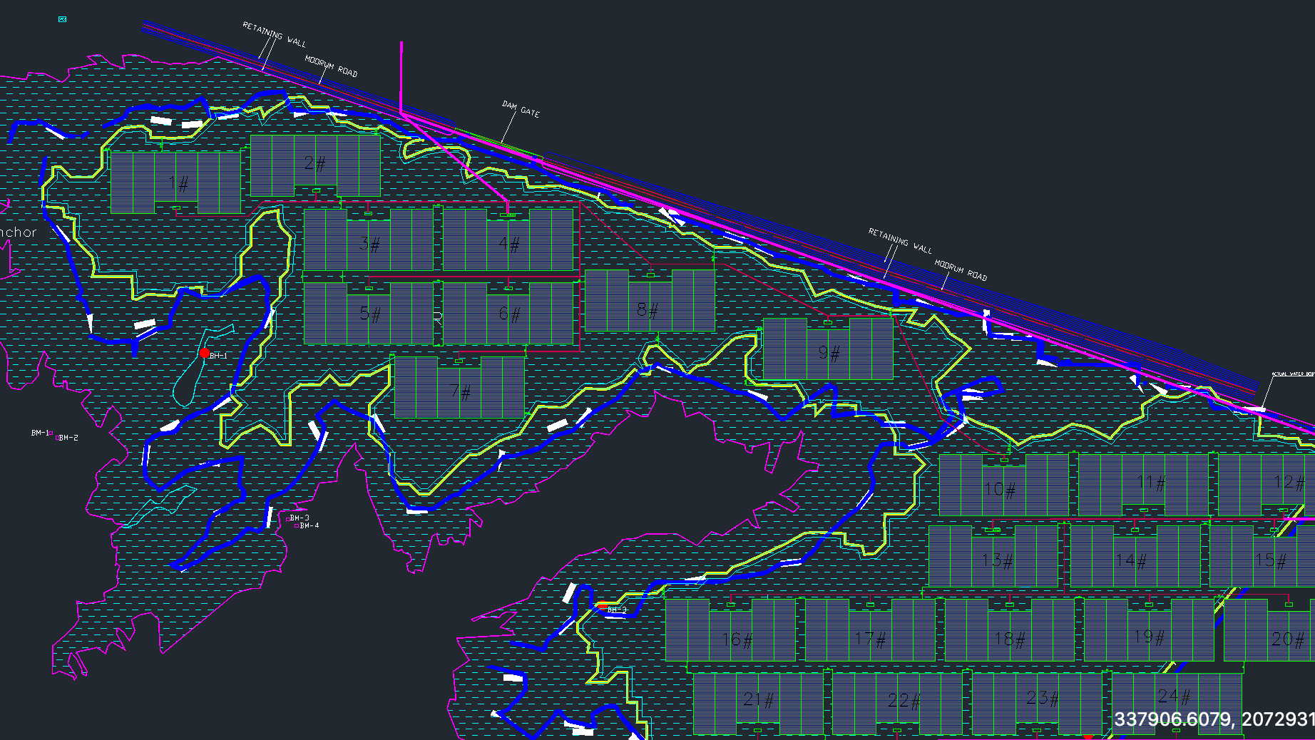

Slide 15
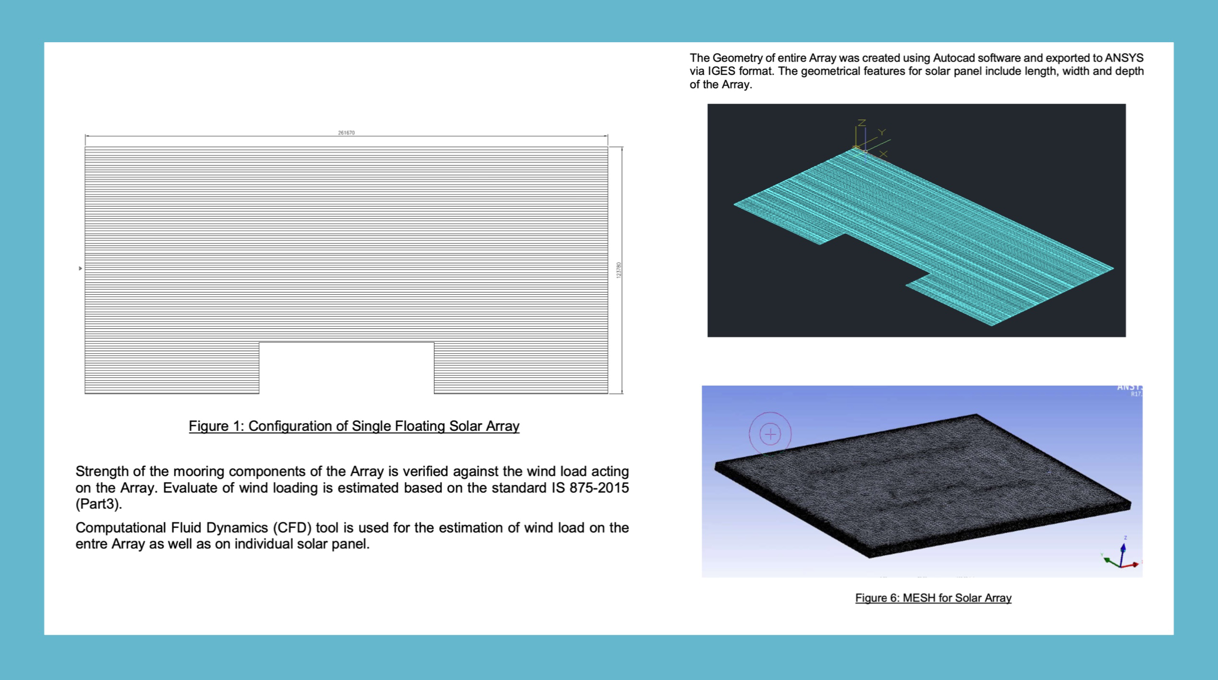
Meshing

Slide 16
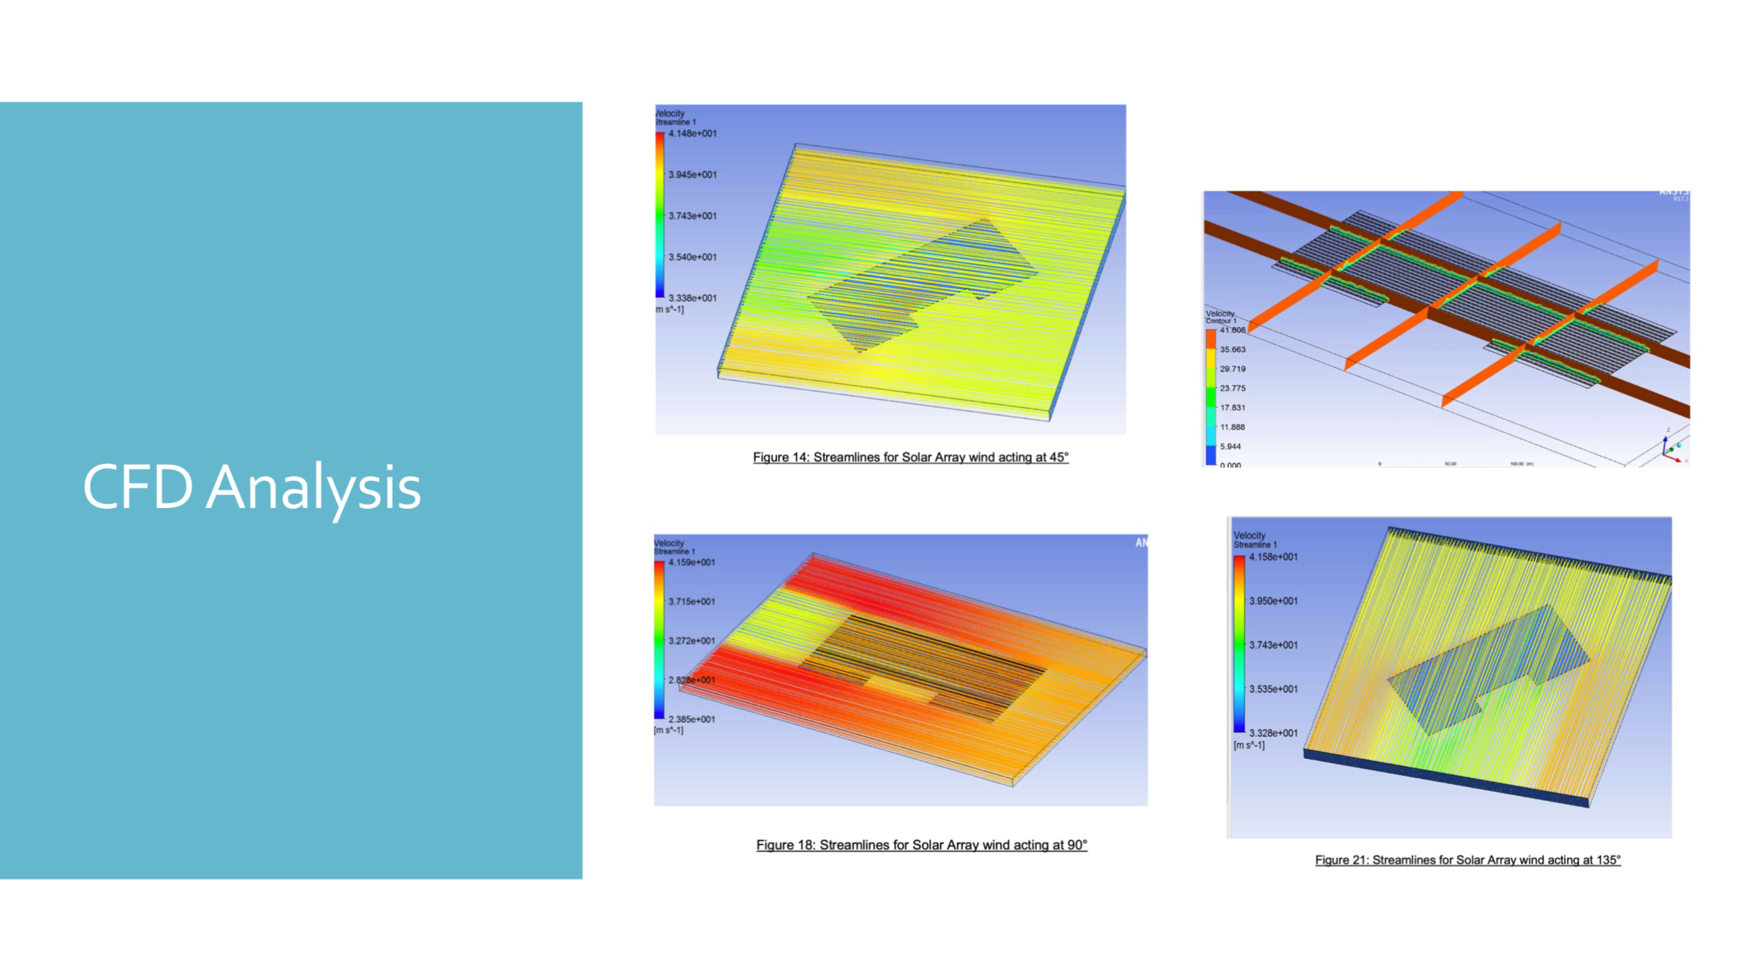

Slide 17
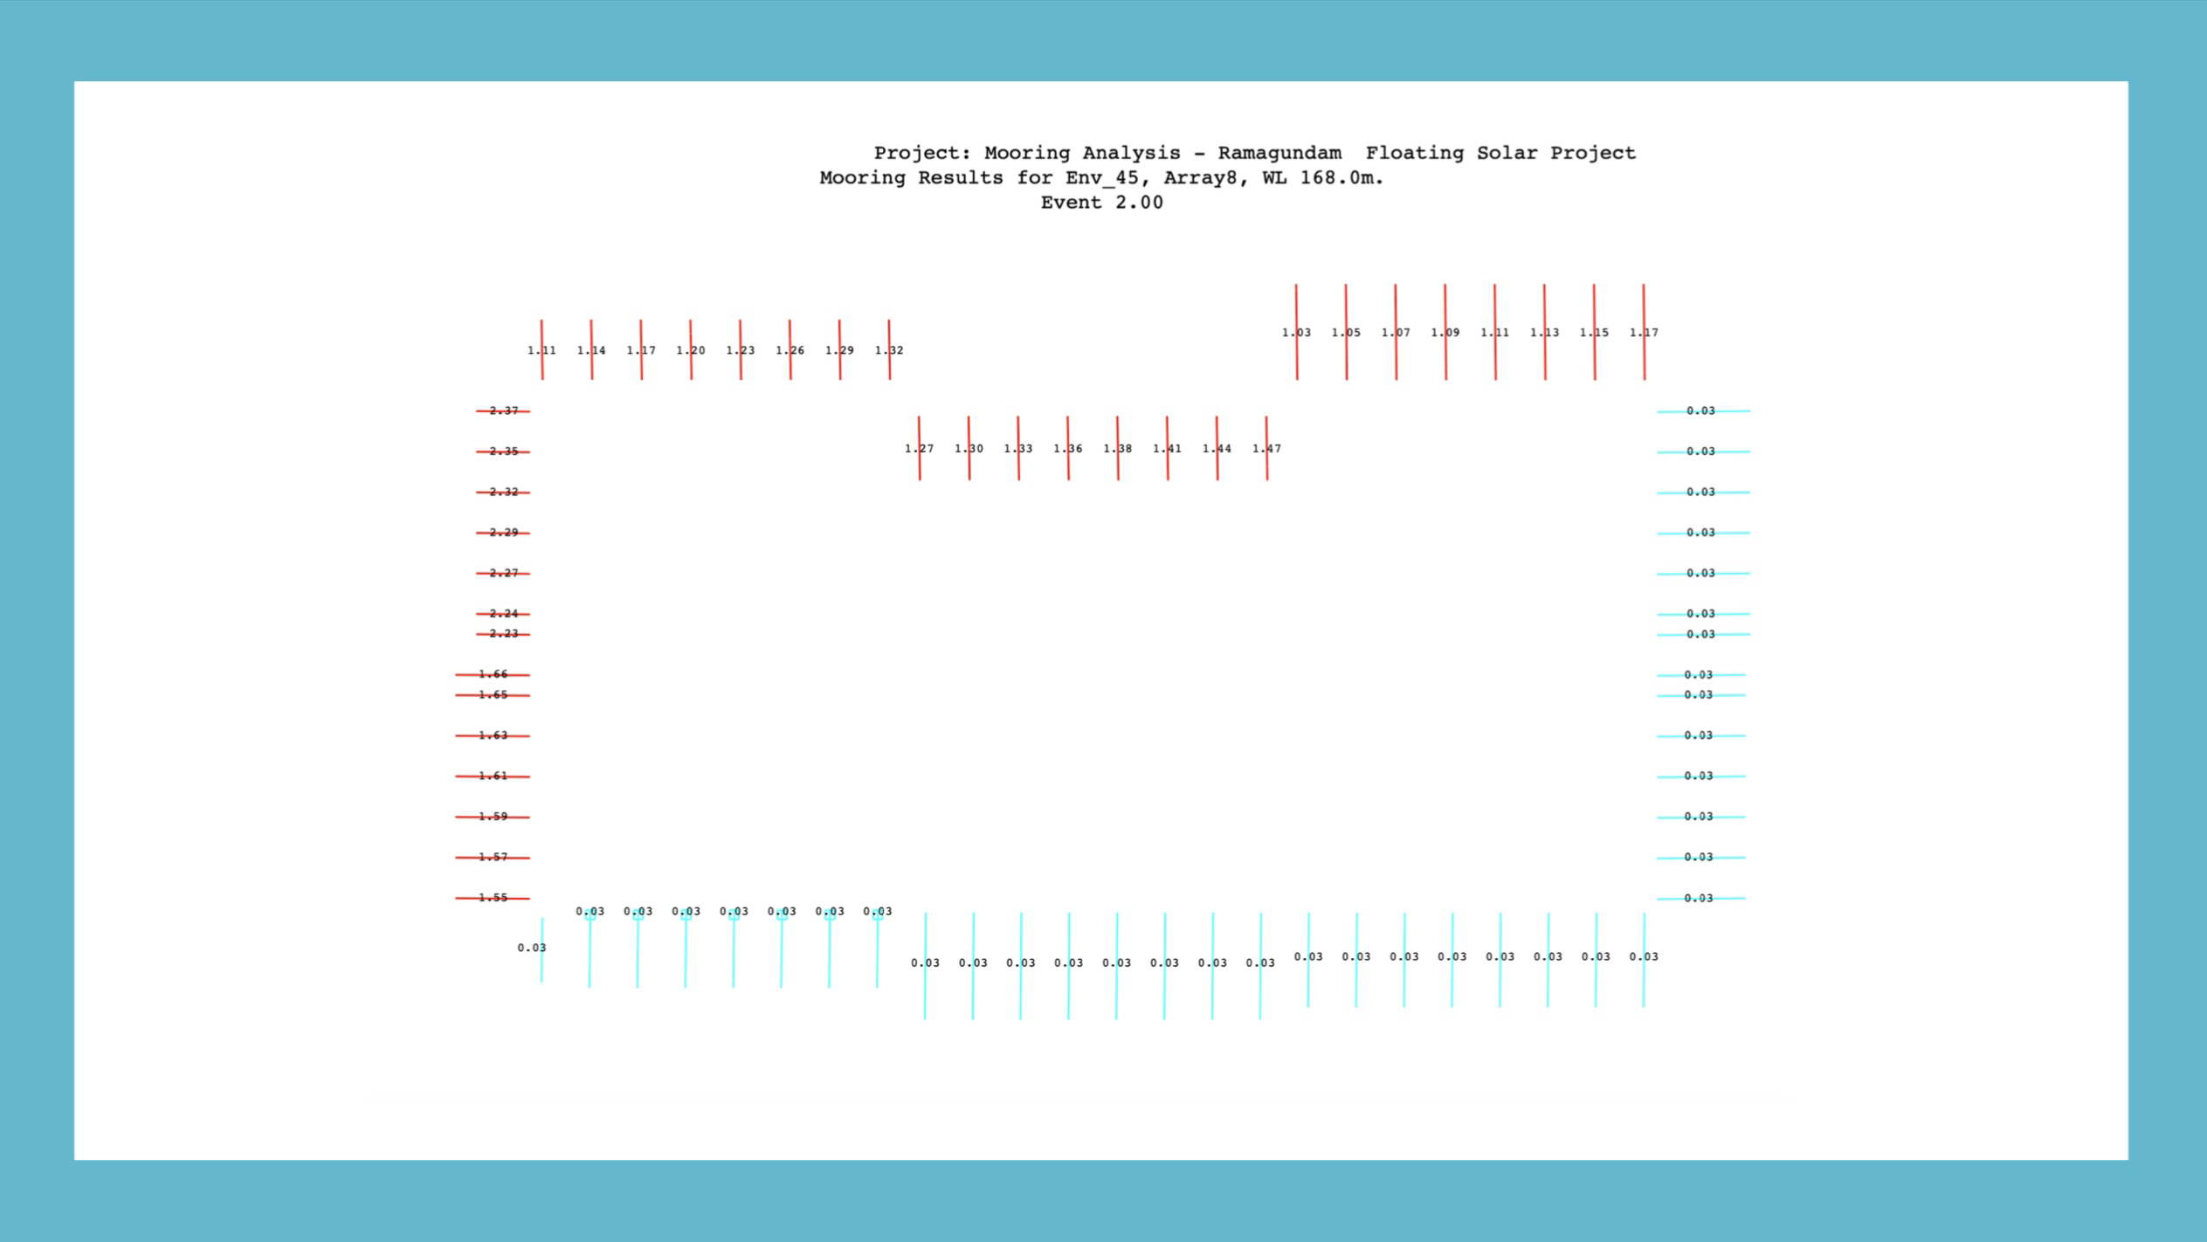

Slide 18

NTPC Ramangundam Project Images

Slide 19
INSTALLATION

Slide 20
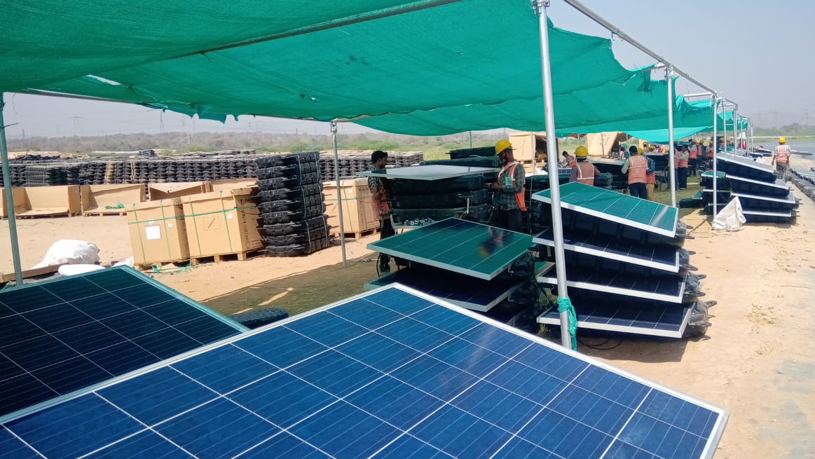
Launching Site

Slide 21
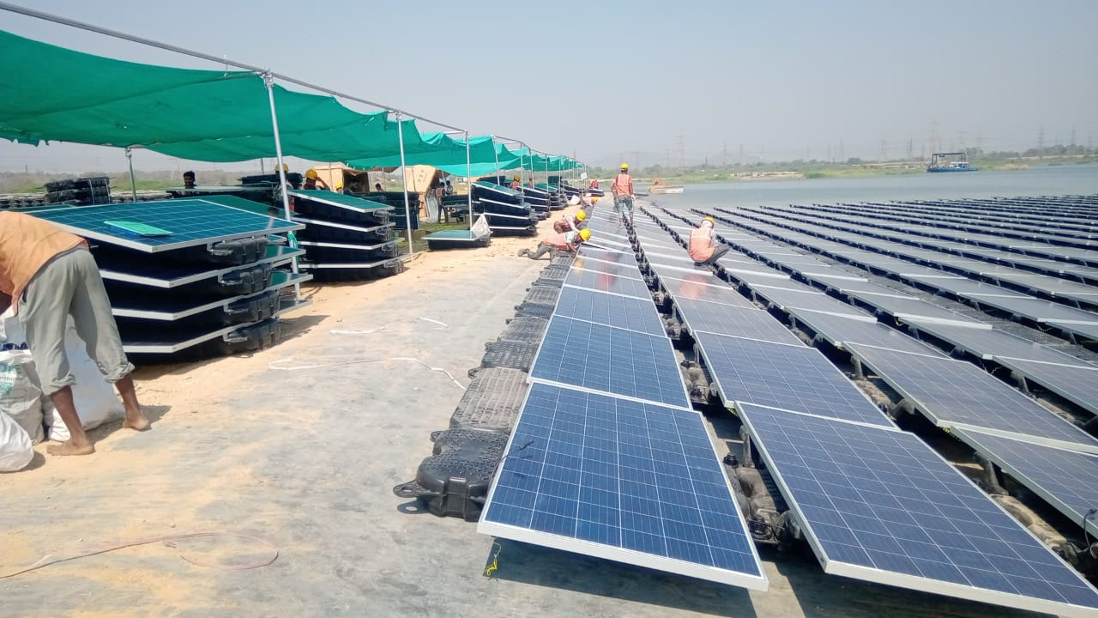

Slide 22
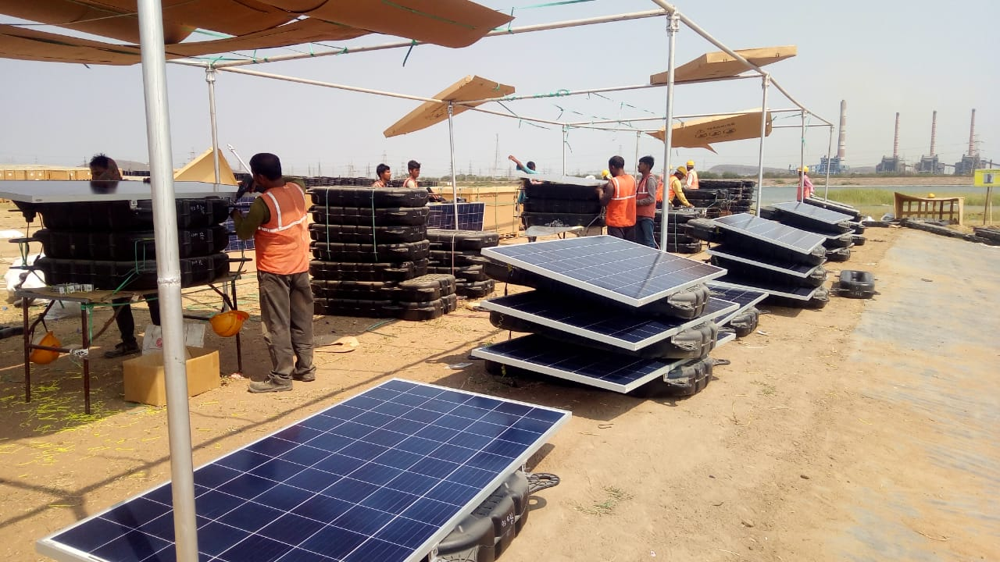

Slide 23
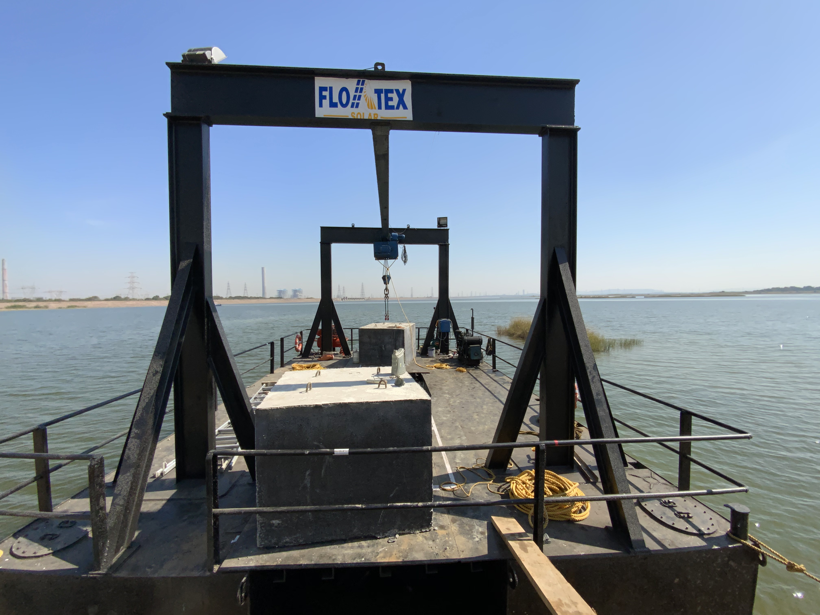
MOORING & CIVIL WORK

Slide 24
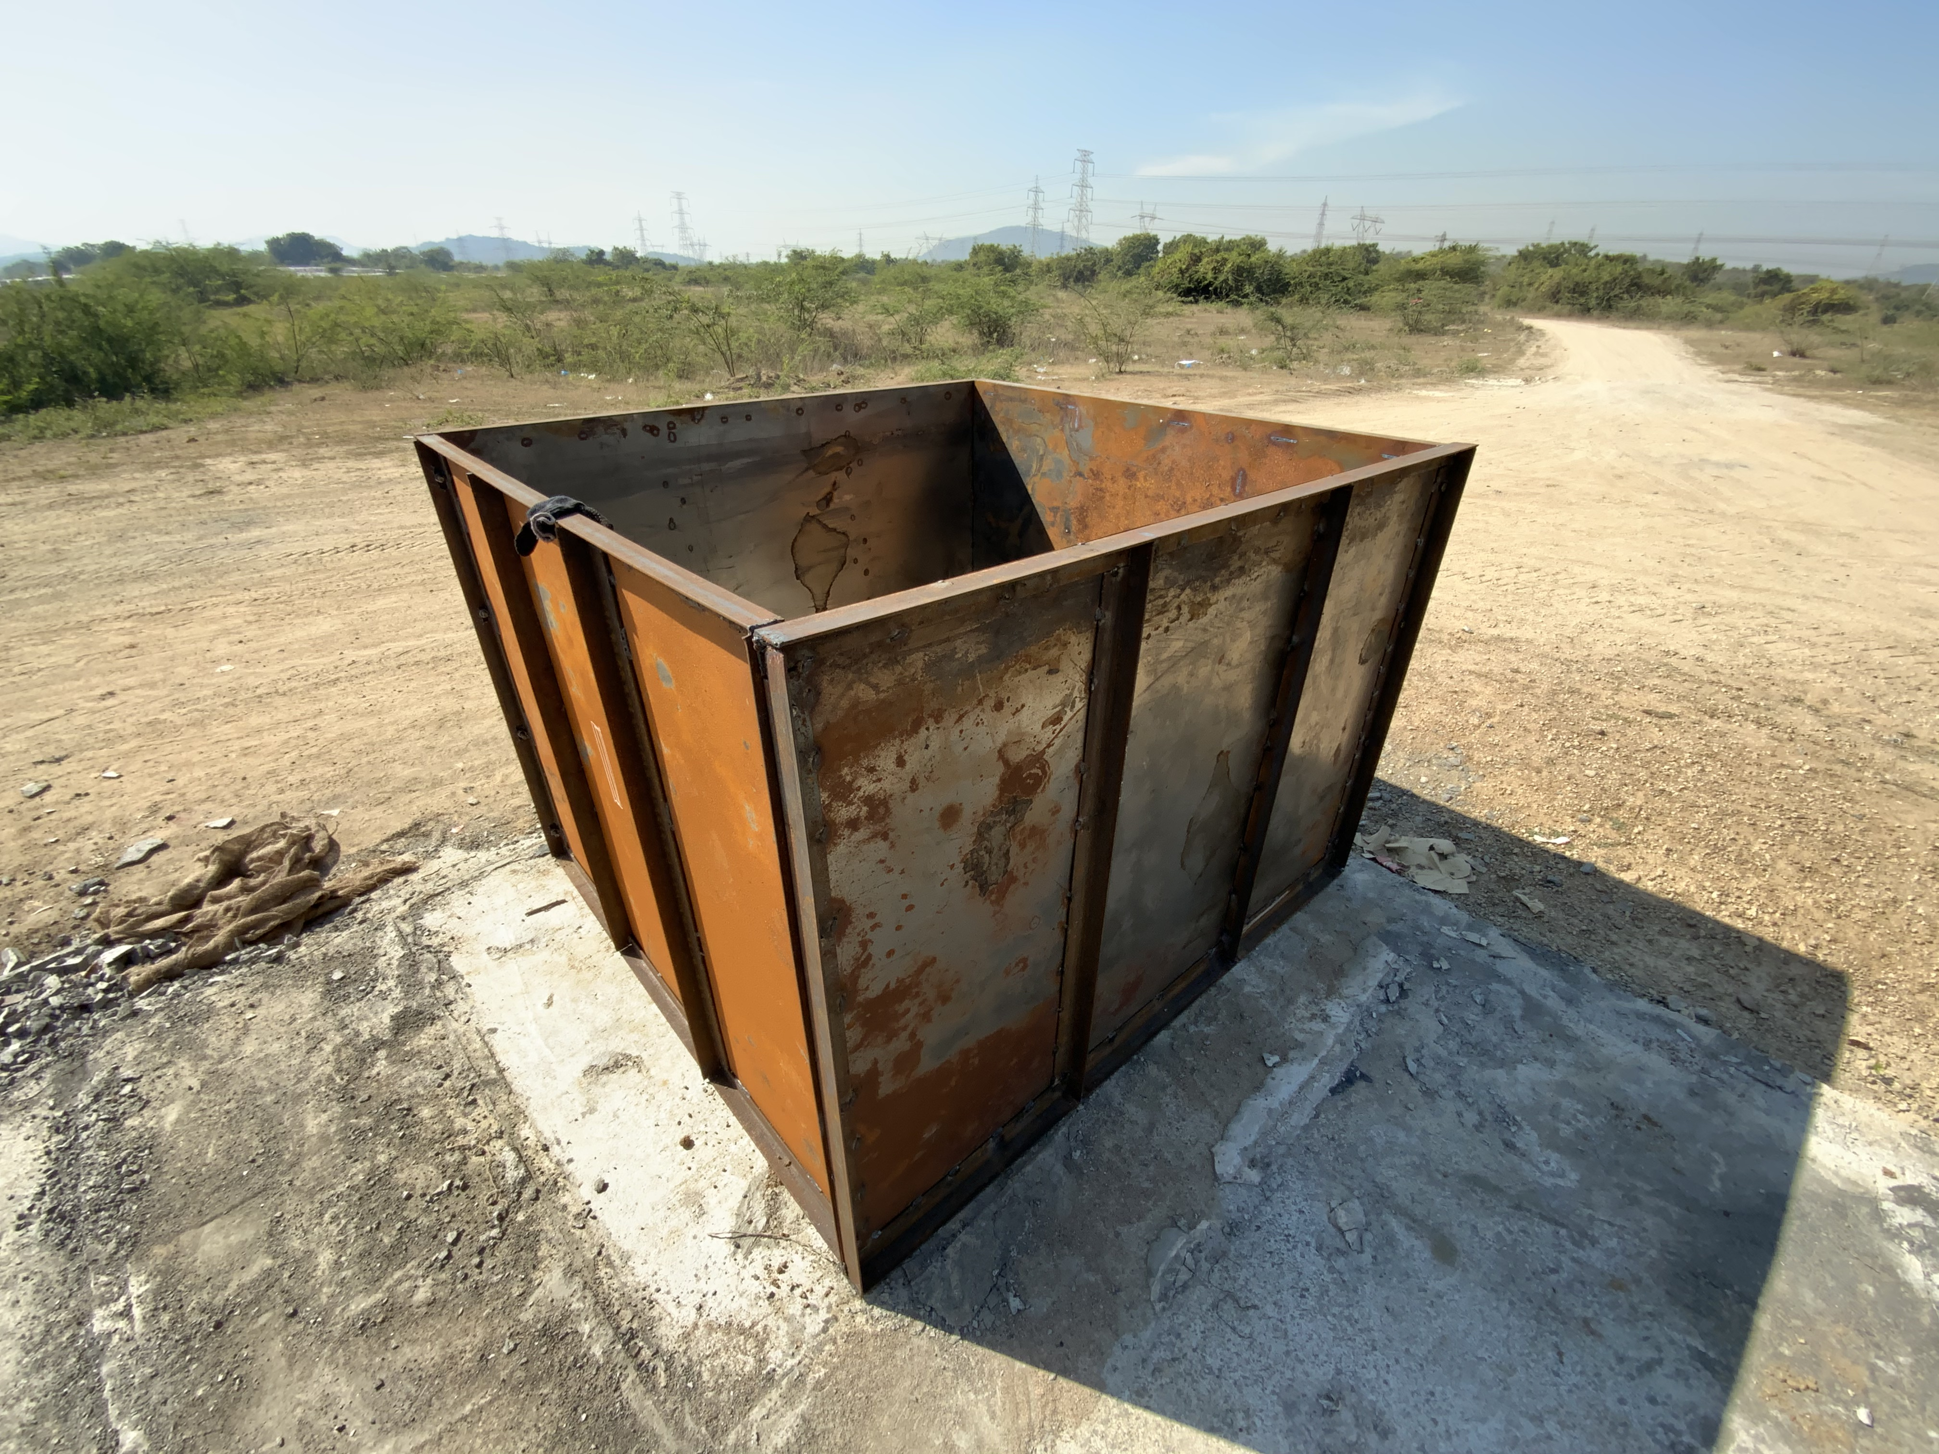
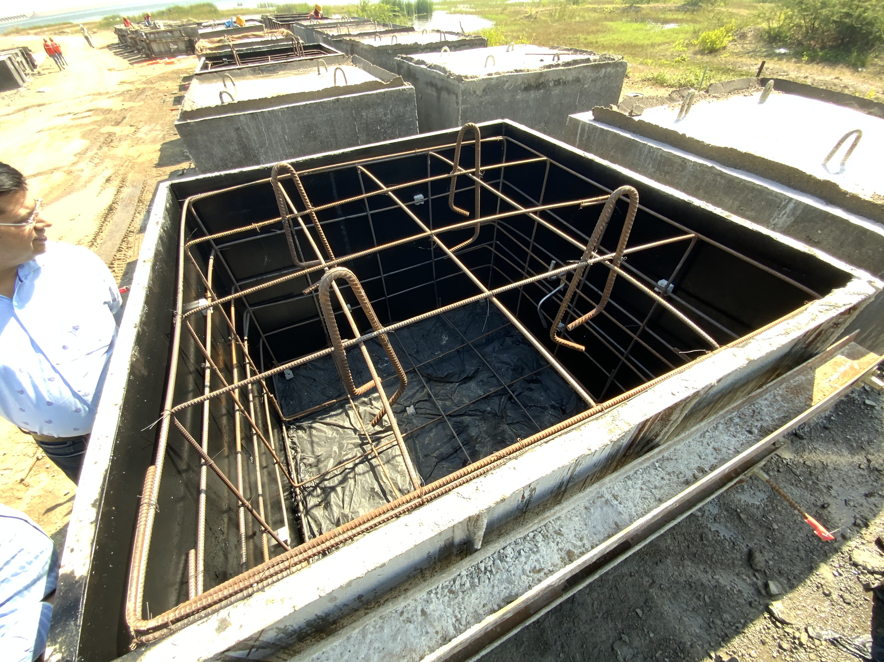
CONCRETE BLOCKS

Slide 25
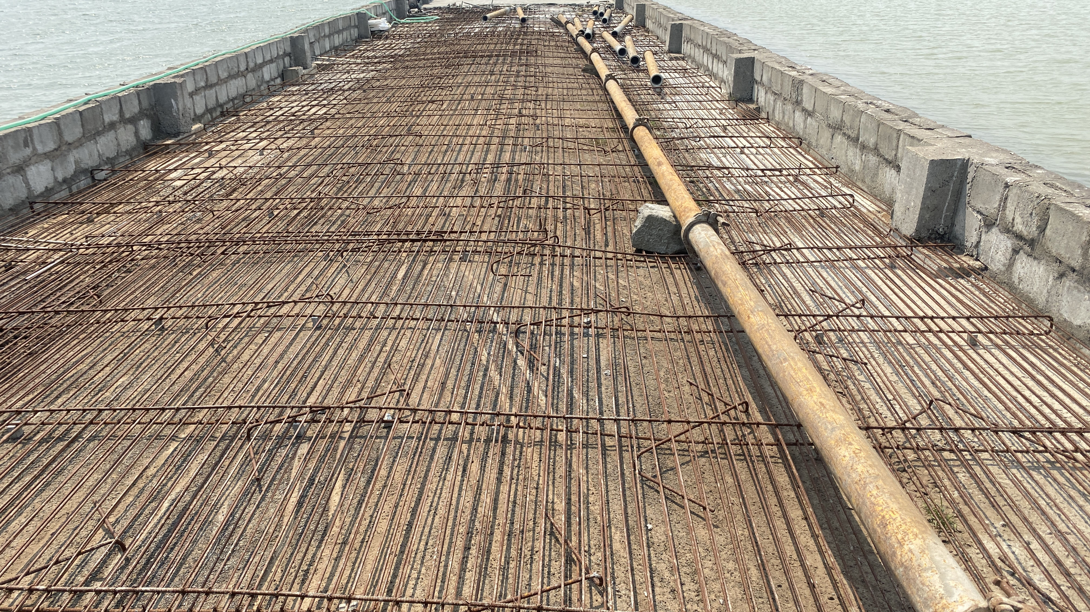

Slide 26
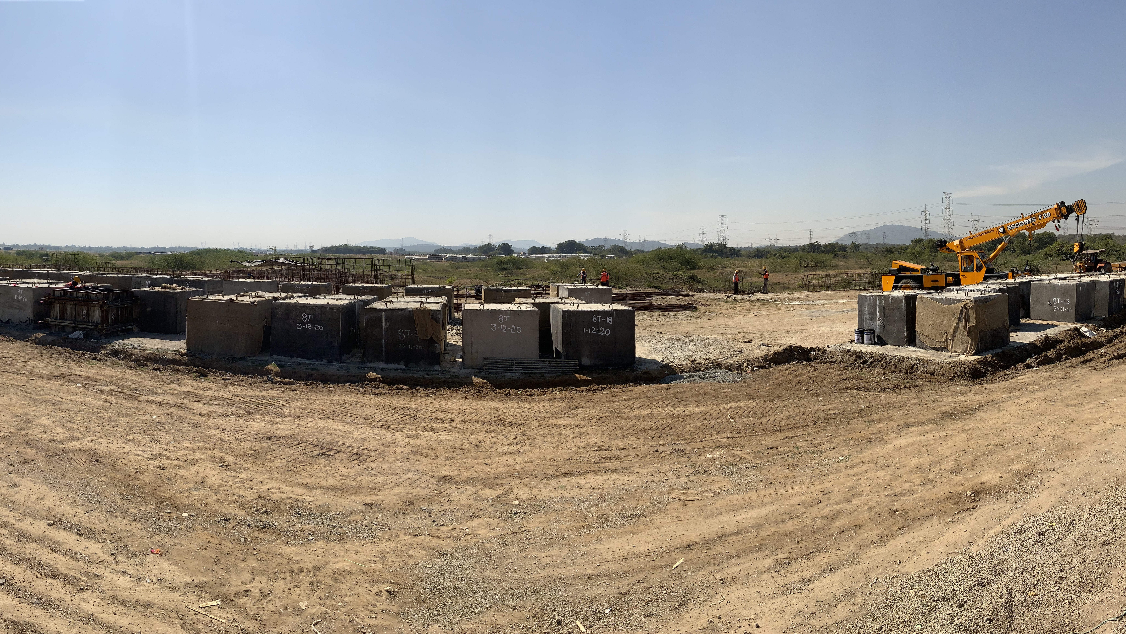

Slide 27
SIMHADRI
PROJECT IMAGES

Slide 28
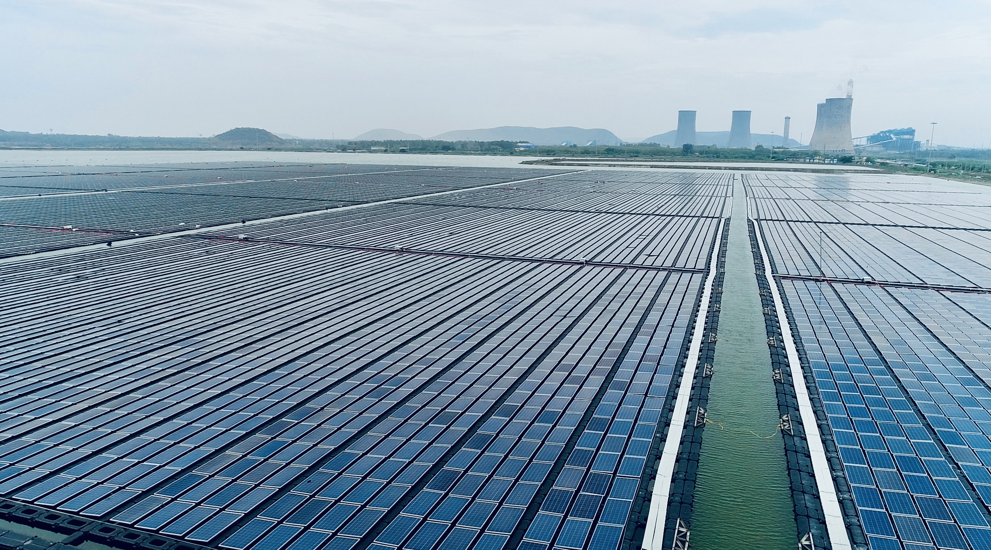
21MW NTPC SIMHADRI

Slide 29
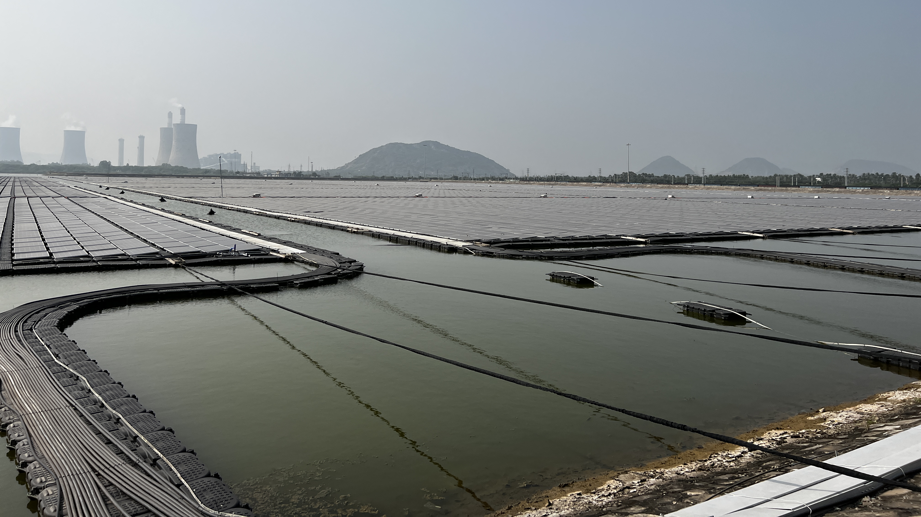

Slide 30
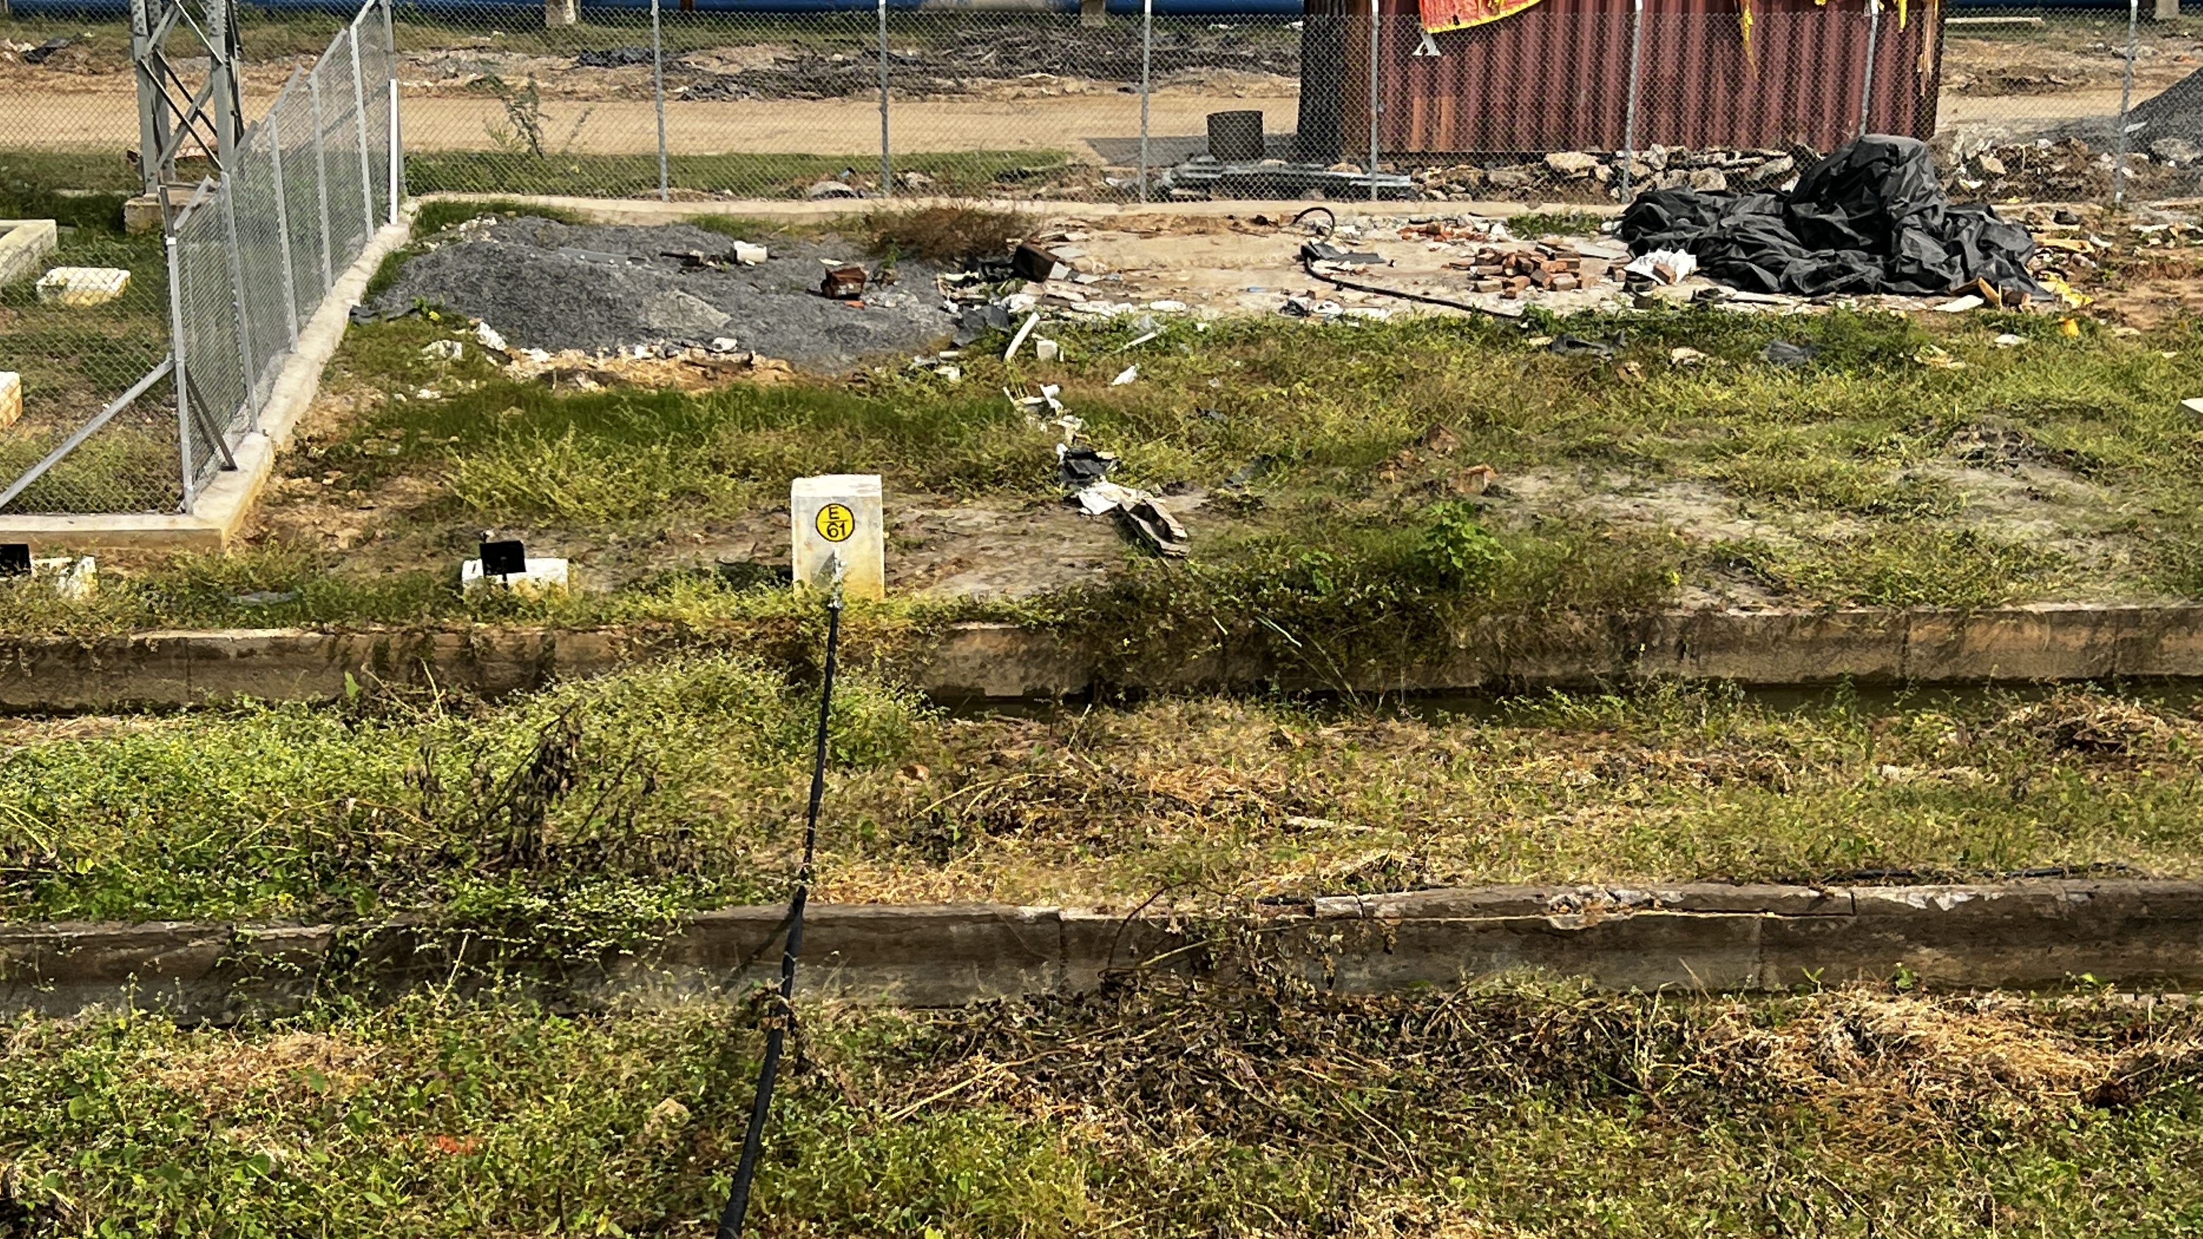

Slide 31
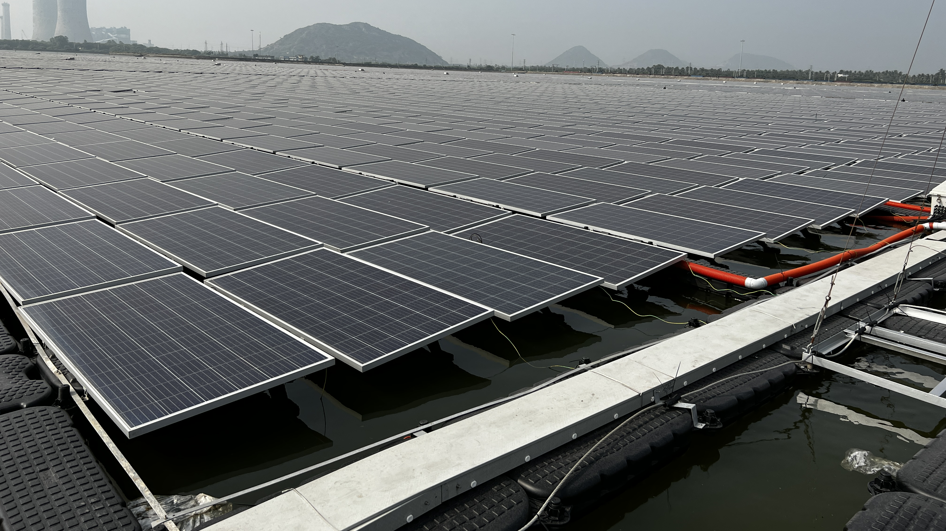

Slide 32
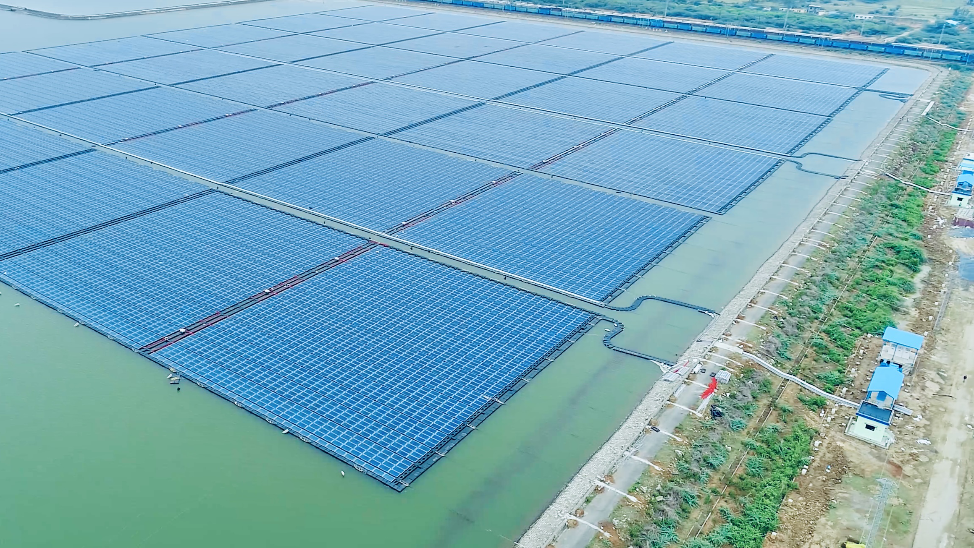
21MW NTPC SIMHADRI

Slide 33
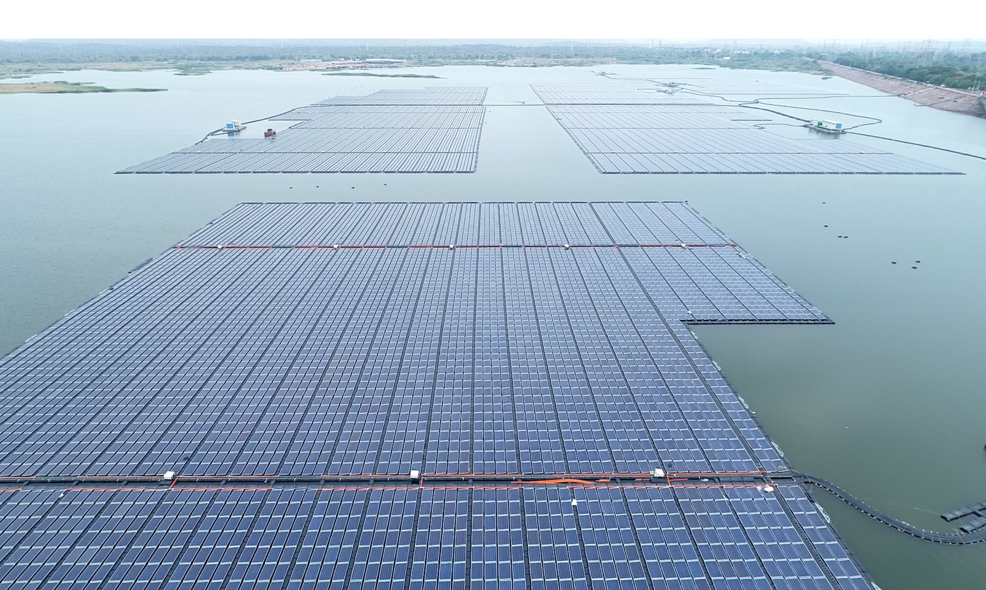
118MW NTPC RAMAGUNDAM

Slide 34
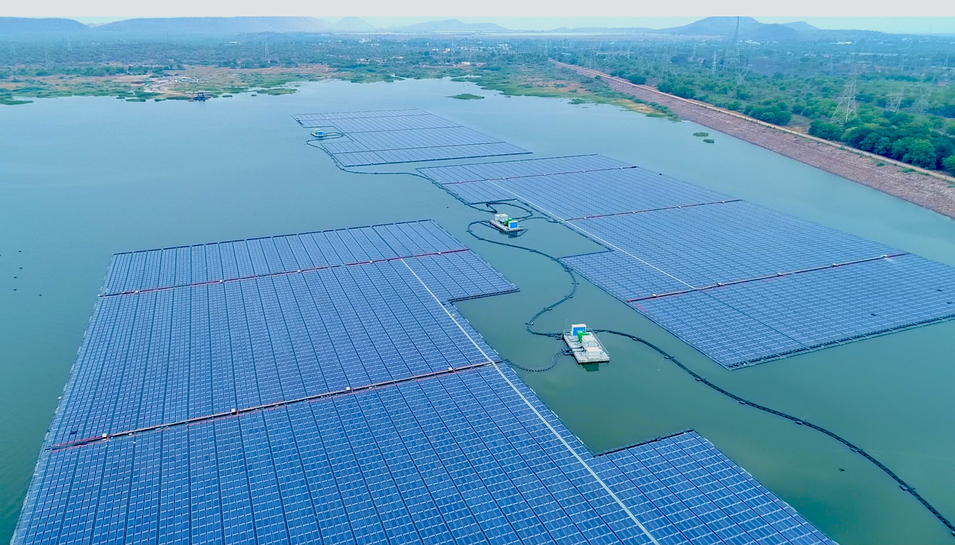
118MW NTPC RAMAGUNDAM

Slide 35
THANK YOU

