Slide 1


LTC ESG
Board Update
July 26, 2022

Slide 2
Agenda
LTC ESG Update
ISS Updates
Disclosures to Adopt
SASB | UN SDG Alignment
General Roadmap

Slide 3
LTC Update
Action | Note | Detail
Property assessments in progress |  | HMG, ALG, BKD, Juniper (approx. 26% of our portfolio)
Greening Leases |  | Amended and New (3 to date)
Portfolio Climate Risk Assessment | VERY important to ISS | In process
Started Purchasing Carbon Offsets | Important to ISS | Quarterly Basis: Travel and office space
Contracted consultants for Reporting and Data Collection | Data collection and reporting is VERY important to ISS | - Measurabl
Adding ESG underwriting enhancements | Important for disclosures and SASB | Researching peers and best practices
Created / Updated Disclosures per ISS | New ISS rep = extremely helpful | - Goal is to have board adopt by August 1st and upload to our website, then report in to ISS
Operator Survey– receiving feedback |  | Slog
Conducting internal ESG Meetings |  | Ongoing
Initiated ESG Report | See example in Appendix | Target date - November

Slide 4
LTC ESG UPDATES
Consultant Update & Budget - Estimates
Role / Purpose | Company | Status
General Consultant | - Centaur Building Solutions | $5,000 monthly (contract is flexible)
Property Evaluations to identify ESG benefits and cost savings | Greenleaf Lumenant Constant outreach and discussion with others | $50,000
Narrative / ESG Sustainability Report | - Financial Profiles | $40,000
Data Collection and Reporting (energy, water, waste) | Measurabl | $50,000 (test then scale)
Portfolio Climate Risk Assessment | Climate Check | $30,000 (test then scale)
ISS | Consulting Assist drafting Disclosures | $30,000

Slide 5
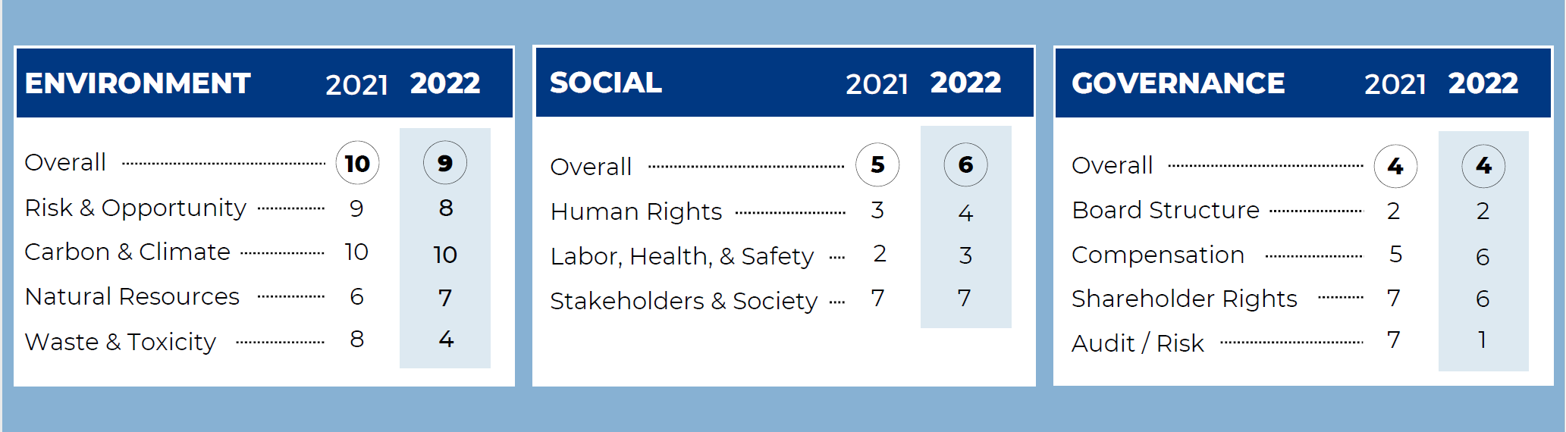
LTC ISS Scores – December 2021 vs. July 2022

Slide 6
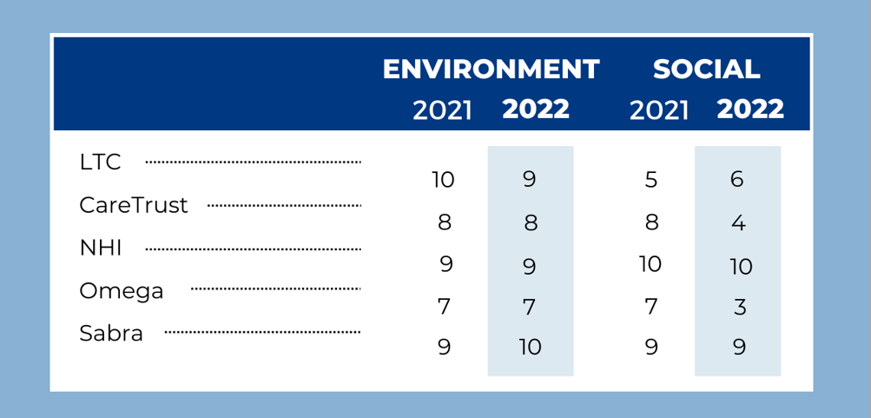
Peer Comparison – Dec. 2021 vs. July 2022

Slide 7
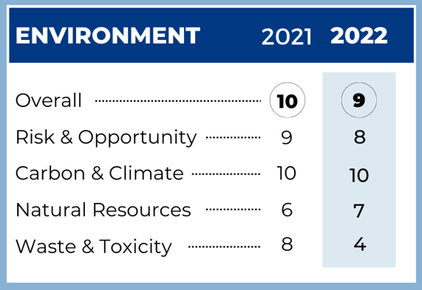
How to improve | Timing
- Climate Risk Disclosure – created, ready for Board adoption | August
- Update Environmental Sustainability Commitment and rename as Environmental Policy - updated, ready for Board adoption | August
- Report HQ Climate Risk - included in Environmental Sustainability Policy | August
- Benchmark operator energy, water and waste (start with a % of portfolio) | November

Slide 8
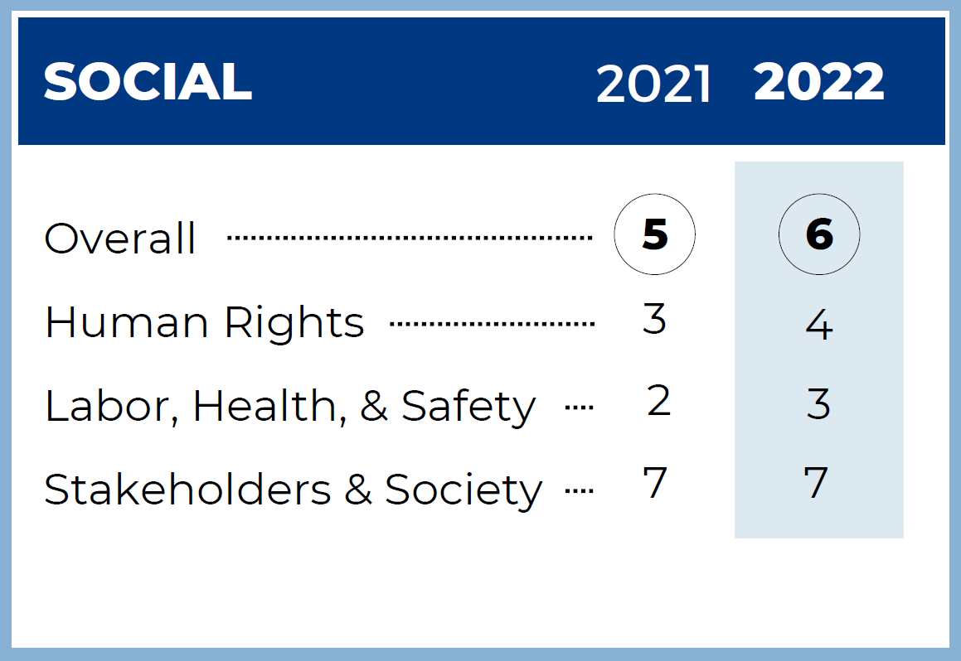
How to Improve | Timing
Create Labor Rights Policy per ISS areas of focus where applicable – created, ready for Board adoption | August
Create Vendor Code of Conduct per ISS areas of focus where applicable- created, ready for Board adoption | August
Update Human Capital Management Guidelines and rename as Human Rights Policy and enhance per ISS - created, ready for Board adoption | August

Slide 9
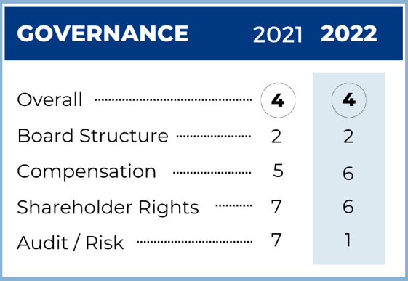
How to Improve | Timing
Work with ISS for recommendations where they are willing to disclose without charging us extra | November

Slide 10
New / Updated Disclosures
(available in Diligent)
Disclosures to be adopted with goal to enhance ISS Scores
  Human Capital Management / Human Rights Policy (updated)
  Environmental Policy (updated)
  Labor Rights Policy (new)
  Vendor Code of Conduct (new)
  Climate Risk Disclosure (new)
Please review and vote via Diligent by August 1st

Slide 11
The ESG Committee collaborated with an LTC internal cross-functional team to review feasibility of the SASB framework topics and UN Sustainability Development Goals (SDGs) and developed a roadmap for adoption.
For 2022, the ESG Committee recommends that the Board approves for LTC [to reference] the following select SASB framework topics and [to align]/[commit] to the following select UN SDGs.
These are just the first step – we’ll be looking to add more over time
See Appendix for a detailed overview of both frameworks

Slide 12
Proposed SASB for 2022
Topic | Accounting Metric | Next Steps
Energy Management | Description of how building energy management considerations are integrated into property investment analysis and operational strategy | Enhance underwriting requirements. Define the “considerations.” Evaluate existing infrastructure and develop sustainable solutions. Evaluate opportunities – boils down to numbers and capex needs (energy savings).
Management of Tenant Sustainability Impacts | Discussion of approach to measuring, incentivizing, and improving sustainability impacts of tenants | Contract consultants to evaluate properties and recommend sustainable value solutions; offer attractive financing rates for ESG-specific projects
Climate Change Adaption | Description of climate change risk exposure analysis, degree of systematic portfolio exposure, and strategies for mitigating risks Area of properties located in 100-year flood zones, by property subsector | Run ClimateCheck reports and share results with operators.

Slide 13



Proposed UNSDGs for 2022
The buildings in our portfolio provide safe environments for the elderly and frail to easily access healthcare, good nutrition, socialization and wellness activities.
Diverse workforce and board composition. Our Board has committed to and adopted Board Diversity Guidelines for recruiting to reach more diverse candidates.
LTC offers employees quality work environments including corporate headquarters, regional offices or enabling working from home. Additionally, we consult with employment lawyers to ensure we are paying at-or-above market competitive wages.

Slide 14
ESG General Roadmap
TASK | TIMING
Board to adopt selected SASB [goals] and UNSDG [alignment] | July 26 meeting
Document Approval: Human Capital Management / Human Rights Policy (updated) Environmental Commitment (updated) Labor Rights Guidelines (new) Vendor Code of Conduct (new) Climate Risk Disclosure (new) | August 1st
Post Disclosures and update ISS | Early August
Select a few portfolios to start benchmarking energy, water, waste | August / September
Run ClimateCheck Report on select portfolios | August
Present Operator Survey Results | October meeting
Begin TCFD Disclosures discussion | October meeting
Publish ESG Report | November

Slide 15


Thank You

Slide 16
Appendix
Emissions Explained – Very clear and simple definitions of Scope 1, 2 and 3
ClimateCheck Snapshot
ClimateCheck Report for HQ
Disclosures for Approval
Omega ESG Report for reference

Slide 17
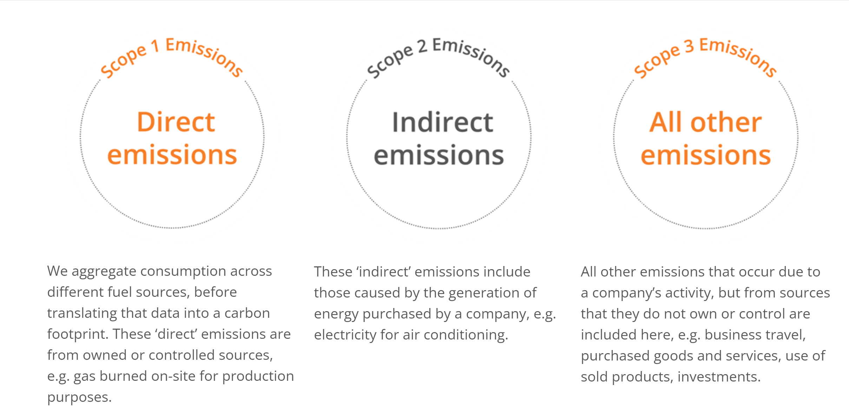
Emissions Explained
Source: Apex Group – ESG Consulting Firm

Slide 18
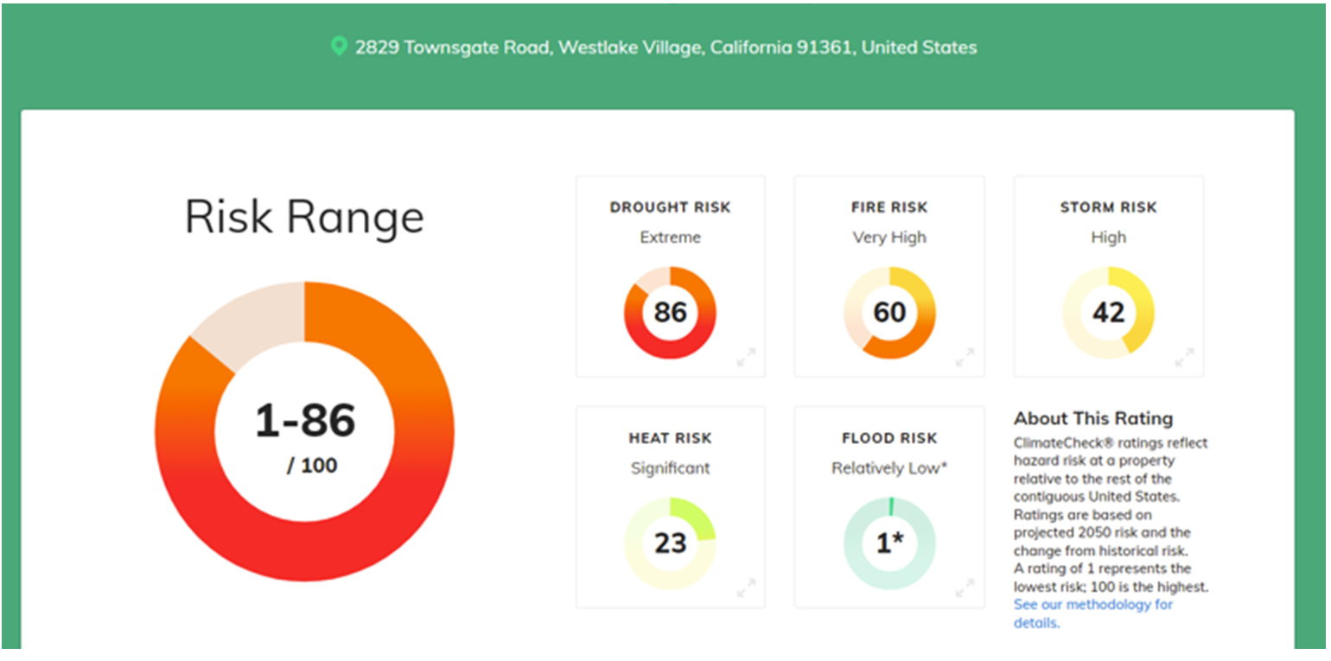
Snapshot of HQ Climate Risk

