Slide 1

online payment security
to eliminate cart abandonment
© Cyberbeat Pte. Ltd.
Confidential

Slide 2
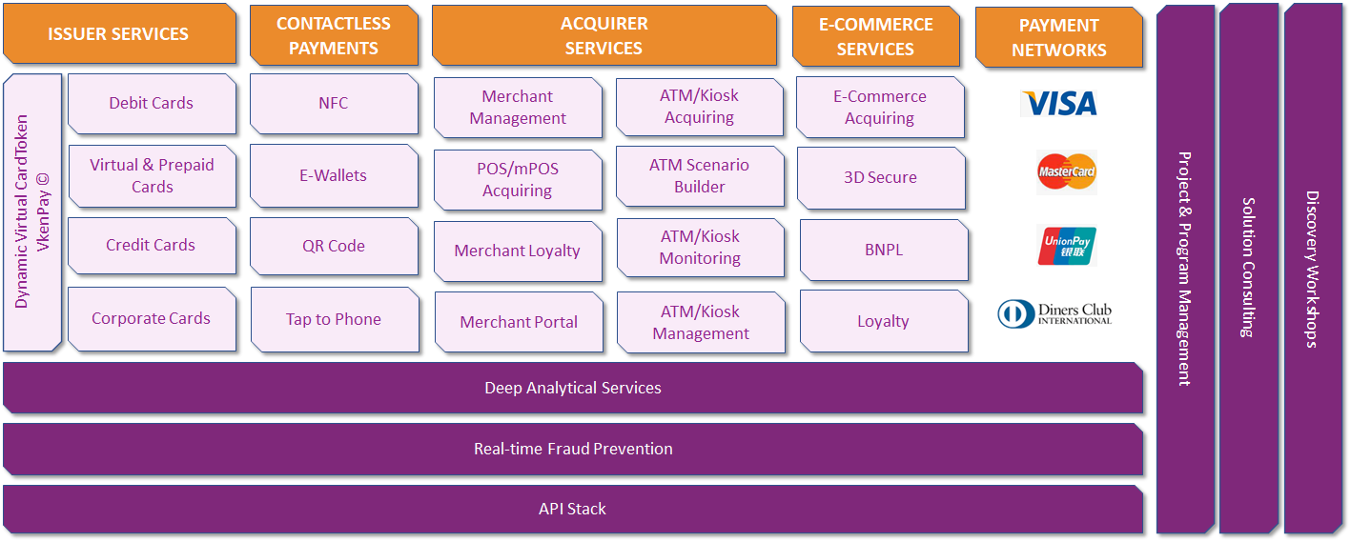
Business Solutions & Client Verticals
Target Client Verticals
Financial Institutions
Issuers
Acquirers
Banks
FinTechs
Airlines
Hotels
Merchant Aggregators
Large Retailers
SMEs
BUSINESS SOLUTIONS
Digital Payment Processing, Fraud Prevention/detection, Corporate Cards, Keyless Entry, Loyalty Monetization,
Single ID Management, Travel Cards, Fleet & Fuel Cards, OTP/2FA
Passwordless Login, Enhanced Identity Verification
Confidential - ©Cyberbeat Pte. Ltd.

Slide 3












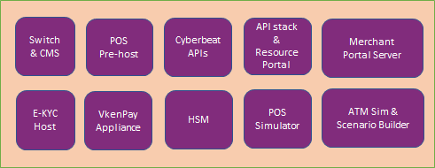








Cyberbeat Payment Ecosystem
Acquirers
Cyberbeat Client Institutions
Merchant
Institution 1
POS
POS
ATM
ATM
VPN
CBS
Merchant
Payment network
Other host
Institution 2
POS
Card present & Card not present
ATM
VPN
CBS
Online
Internet
Merchant
Offline
Other hosts
Institution Merchant
Confidential - ©Cyberbeat Pte. Ltd.

