Slide 1

Design Brief
We would like to create a new logo for our new brand SureFire. Here is some background information to help you formulate the design concepts;
This is our current website; https://www.cncplasmacutters.com.au/
Our product range is CNC cutting equipment
We want our new logo to appear;
  Minimalistic
  Masculine
  Bold
  Not require a separate “icon” the name is the brand and the logo
The new logo should suit our current colour scheme (white on blue) – examples;
continued…

Slide 2


Design Brief
This are some examples of other brands in the industry;
We would like some sort of unique & subtle design element to be incorporated into our logo (like the triangle in the Swift Cut example above)
The following slides show our colour scheme and design usage guide – the new logo will need to tie into these. We would prefer for the logo to be one colour only; white.

Slide 3
Usage Guide
Primary Secondary
Colours
The SureFire brand colours should be applied in accordance with the listed codes to ensure a consistent brand representation.
FOR WEB, DIGITAL, SCREEN USE:
RGB or HEX
NB: these colours will always be more vibrant than printed colours due to pixels brightness in comparison to printed inks on paper.
FOR PRINT USE:
PMS or CMYK
NB: Colours on screen appear different to print. PMS colours must be viewed from an official Pantone colour book.
Blue
RGB:
R-26 G-59 B-142
CMYK:
C-100 M-88 Y-0 K-10
PMS:
2746C
HEX:
#1A3B8E
Highlight Orange
RGB:
R-253 G-127 B-27
CMYK:
C-0 M-60 Y-100 K-0
Dark Grey
RGB:
R-85 G-85 B-85
CMYK:
C-64 M-56 Y-55 K-31
Light Grey
RGB:
R-217 G-217 B-217
Blue RAL
RGB:
R-0 G-56 B-123
CMYK:
C-100 M-90 Y-0 K-10
RAL:
5002 (“Ultramarine Blue”)
Next closest = 5005 (“Signal Blue”)
powdercoat colour
Delux:
98419990 (“Space Blue”)

Slide 4
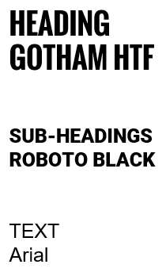
Usage Guide
Typography
Designers should use;
Oswald, Roboto & Arial for collateral and digital where final art can be produced.
Arial should be used in situations where final art cannot be produced, and artwork or applications require non-designers to create content such as:
• Emails
• Email signatures
• Forms
• Letters
• Correspondence material
• PowerPoint Presentations
• And more
Note: this list of typography may be expanded upon creation of new digital content such as a website.
For non-design situations;
HEADING
ARIAL BLACK
SUB-HEADINGS
ARIAL NOVA (BOLD)
Text
Arial
Weldclass Fonts

Slide 5


Style Guide
is 30% of
Design elements
Headings and sub-headings to have design elements as indicated
=
=
Example;

Slide 6
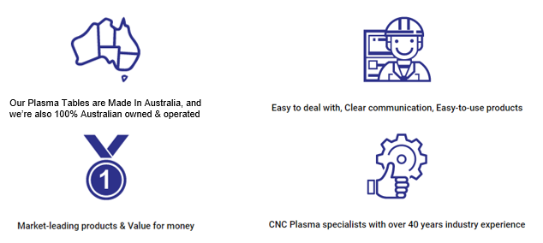
Style Guide
Icon Treatments
Icon usage
Icons should be used as a supporting element to the creative, and not detract from the content & core messaging, always “lead with content.”

Slide 7
Style Guide
Design elements
Other creative design elements can be used for various applications as needed, e.g.
Promotions
Diagrams
Etc.
$300
OFF!
$300
OFF!

