Slide 1
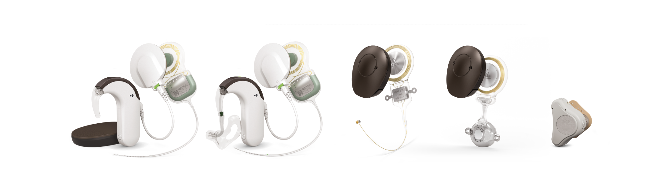

The Hearing Implant Company
Company Presentation MED-EL
Dr. Ingeborg Hochmair

Slide 2

Our Mission
We want to overcome hearing loss
as a barrier to communication and quality of life

Slide 3



We effectively yet gently restore hearing by offering a comprehensive set of intact-skin hearing implant solutions.
We thus provide best benefit to individuals with a hearing loss,
today, tomorrow, worldwide.
We aim to restore other body functions through similar devices
and concepts.
Our Mission

Slide 4
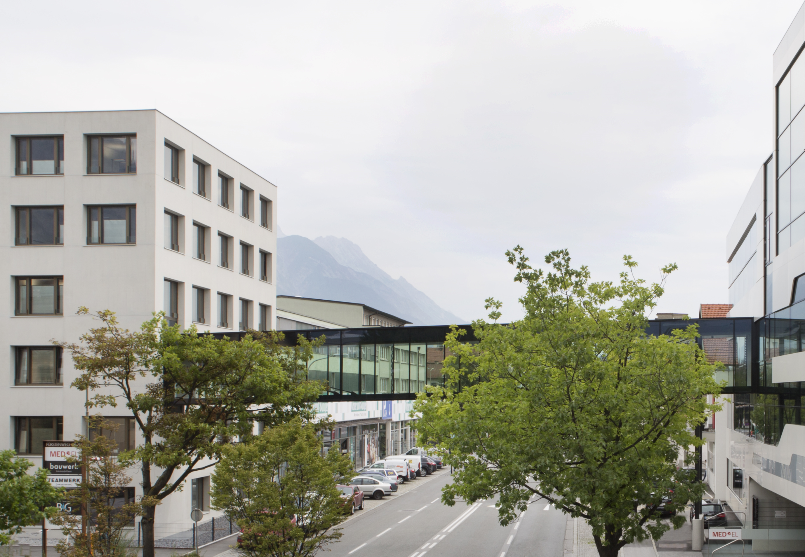
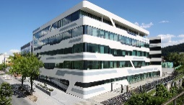
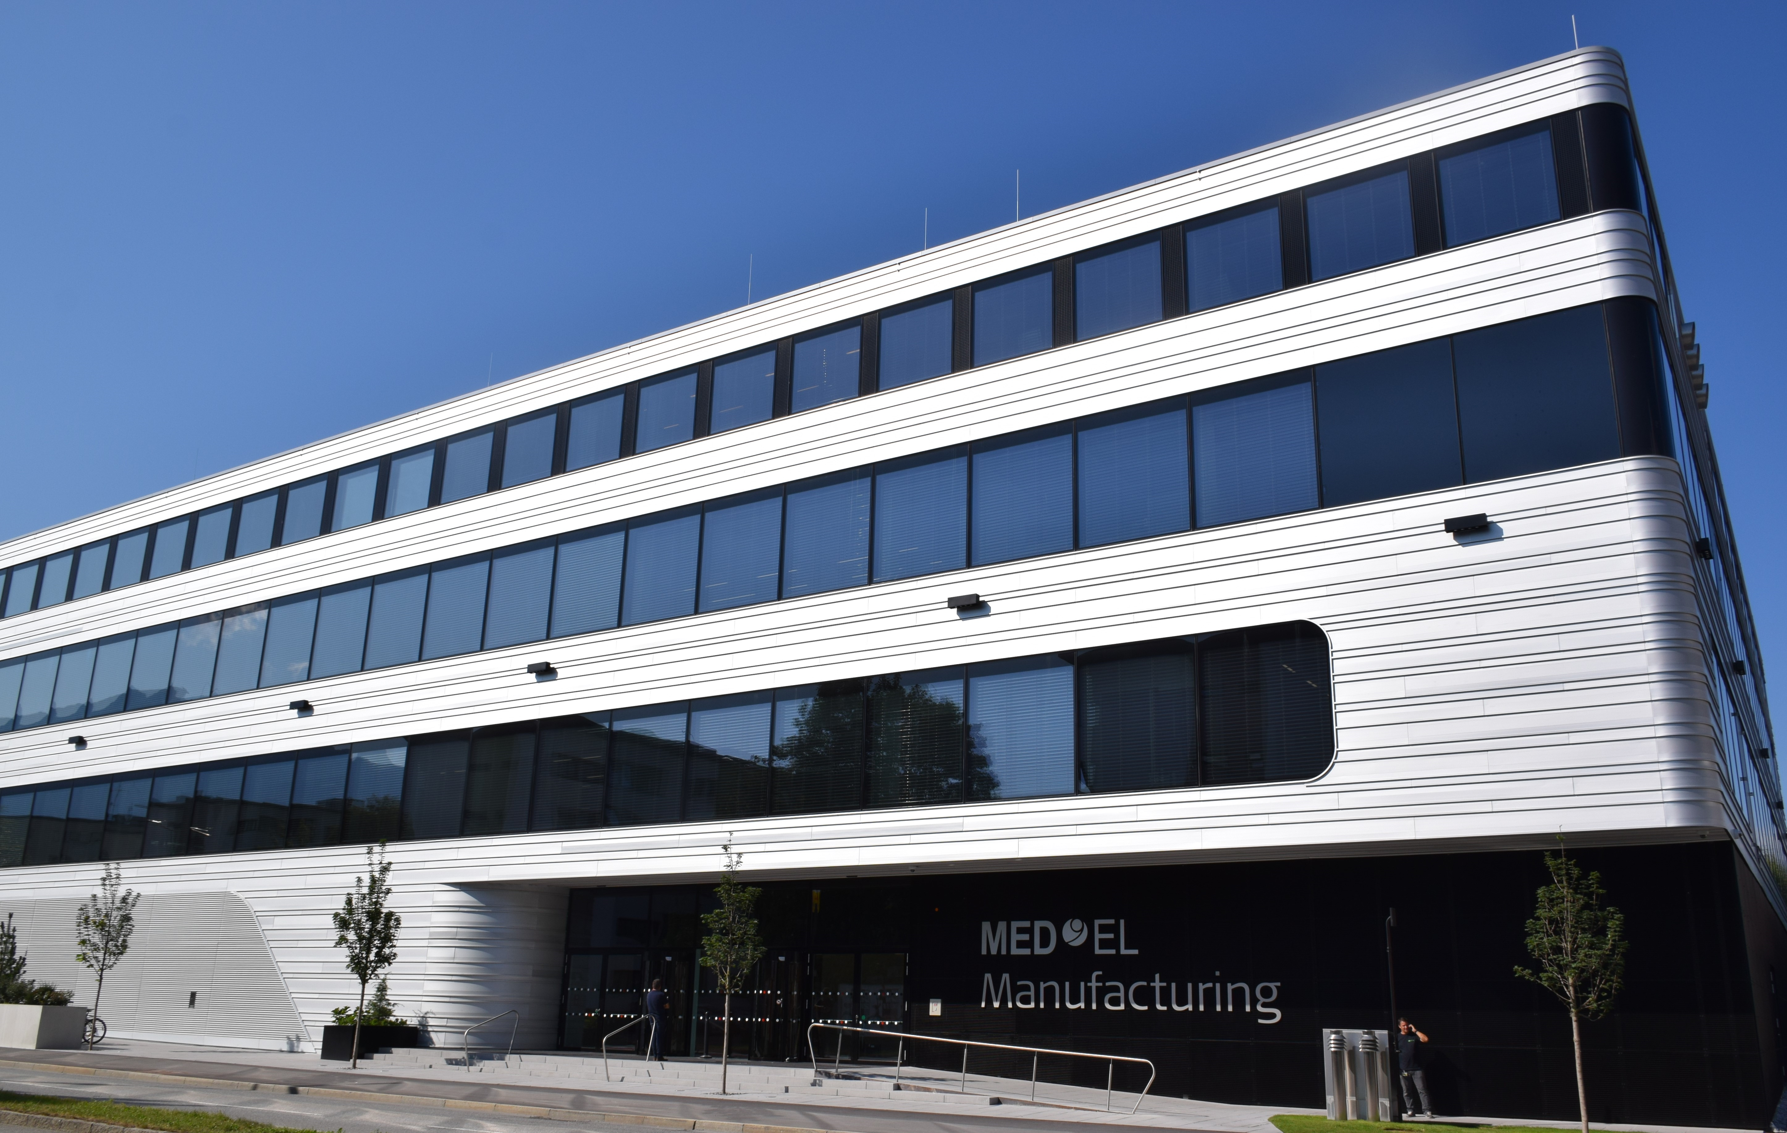


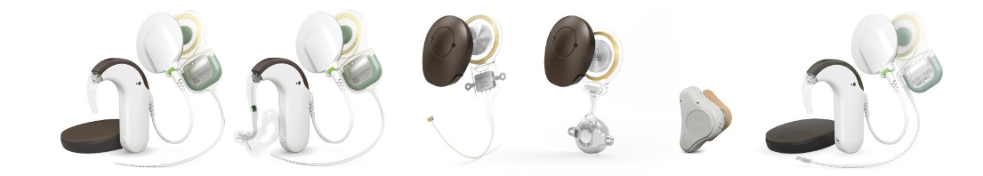
MED-EL worldwide
Implantations in
134 countries
& >4370 clinics
From before
1990-1999
2000–2009
2010 until now
Companies &
subsidiaries
>2300 MED-EL Team Members worldwide, > 1400 in HQ
Status December 2021

Slide 5
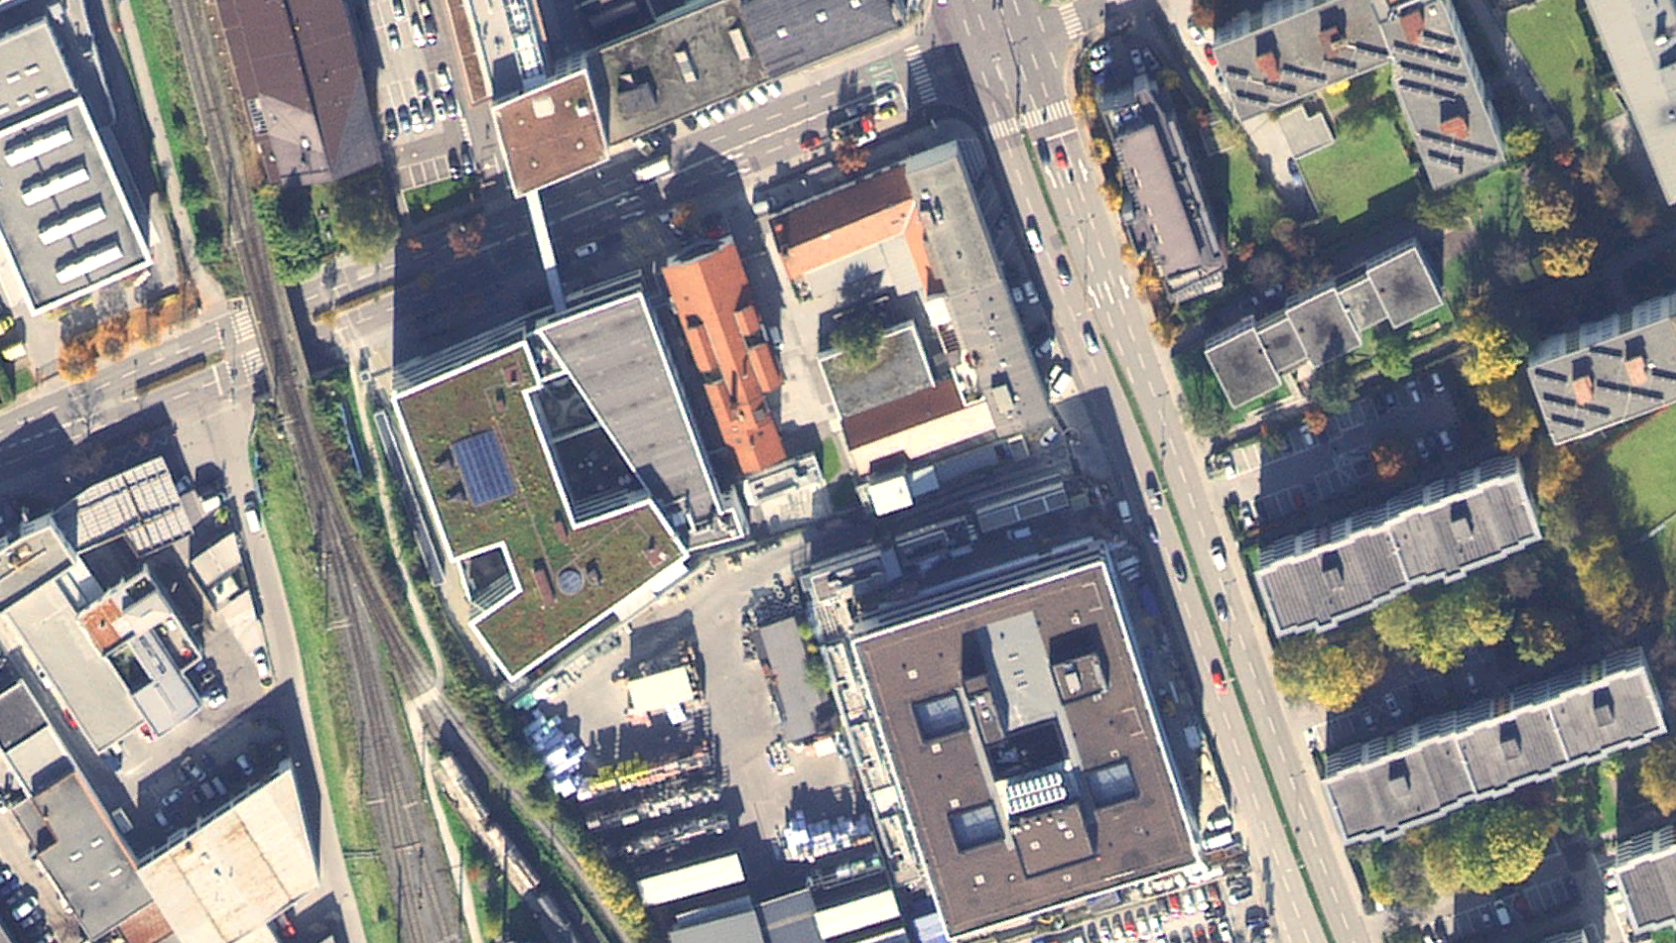
N
I
O
G
A
B
D
C
Central MED-EL Campus
P
Innsbruck

Slide 6
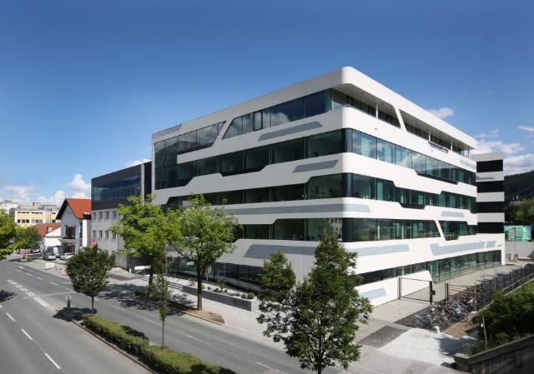
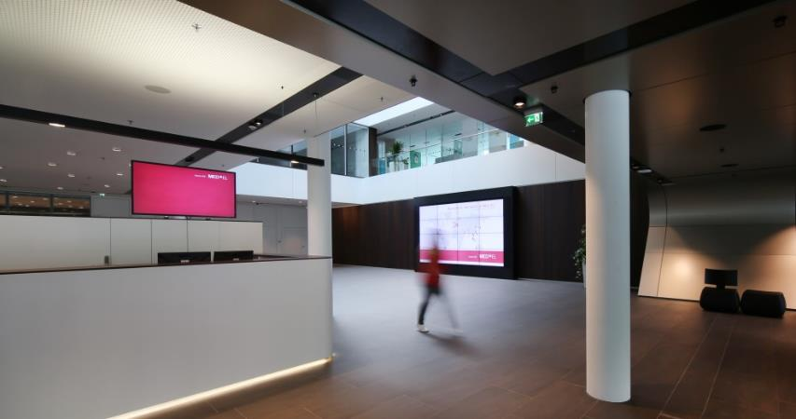
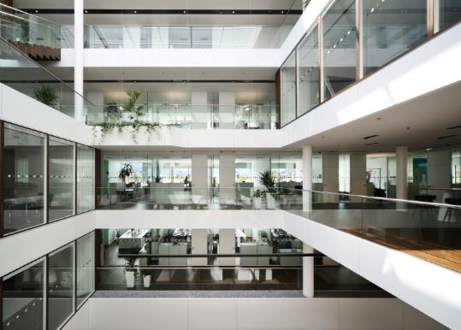
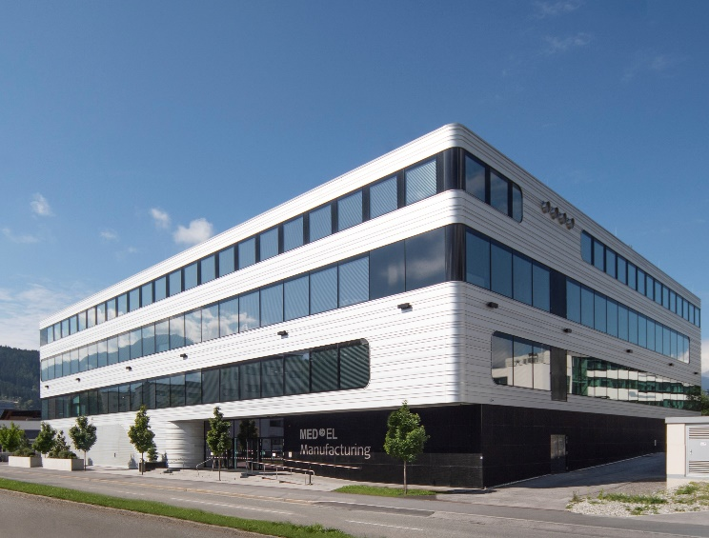
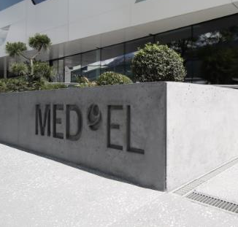
R&D Building
NEW Production building

Slide 7
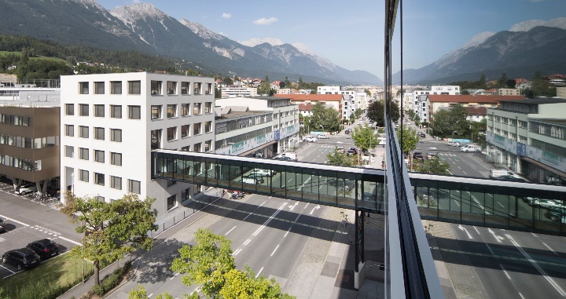
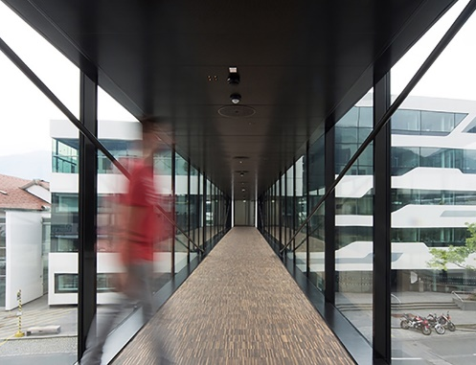
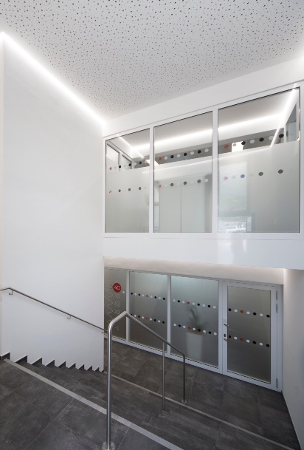
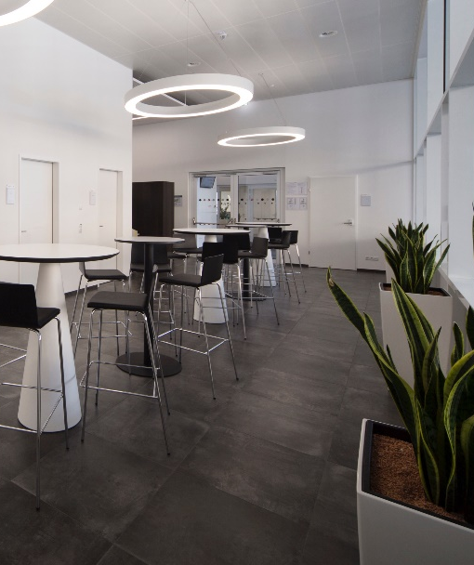
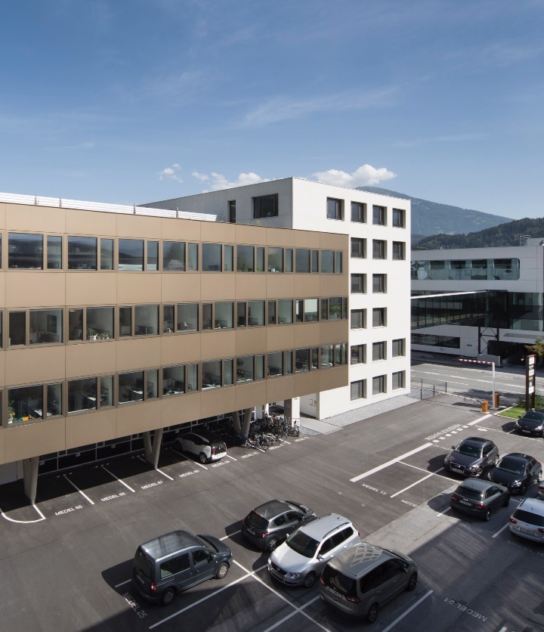
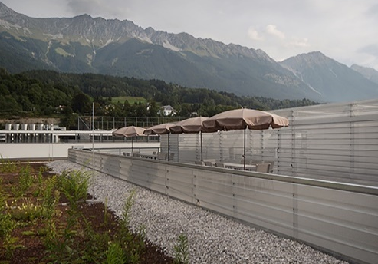
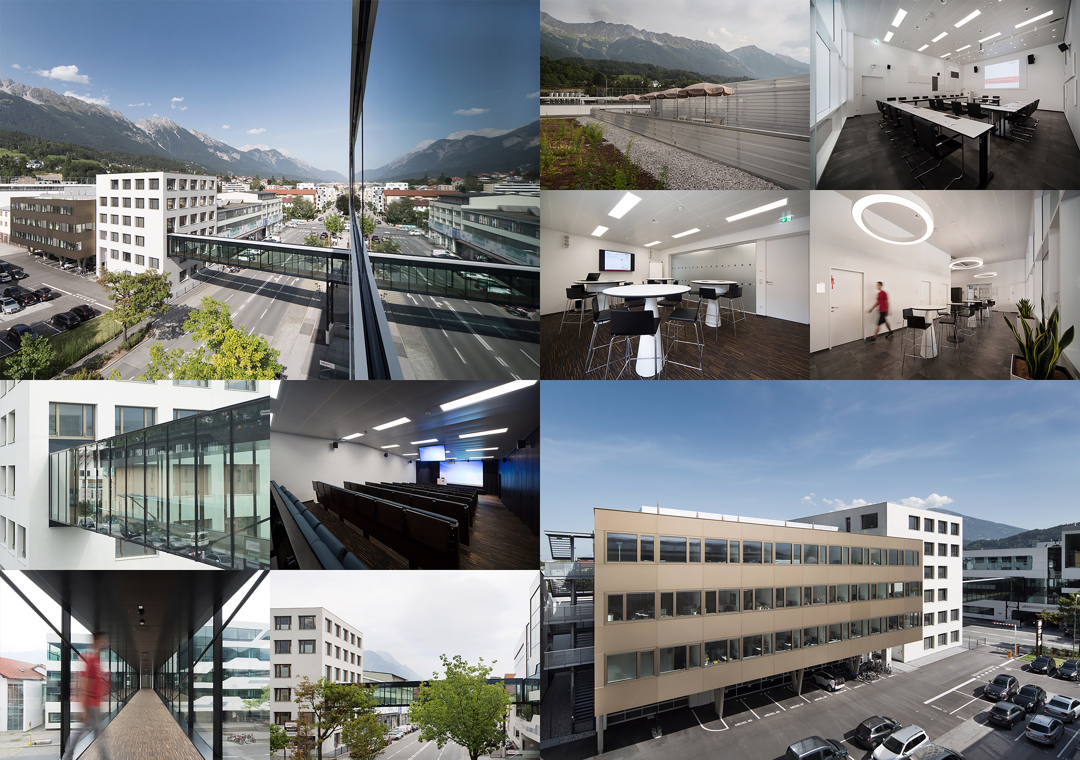
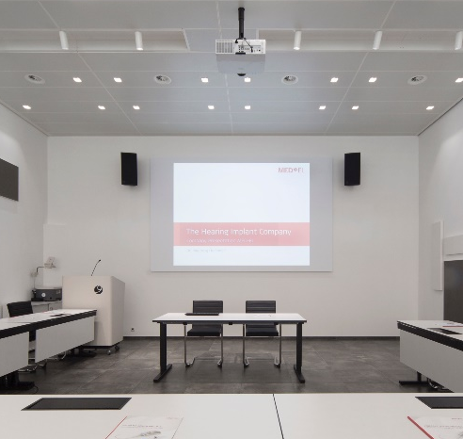

Slide 8
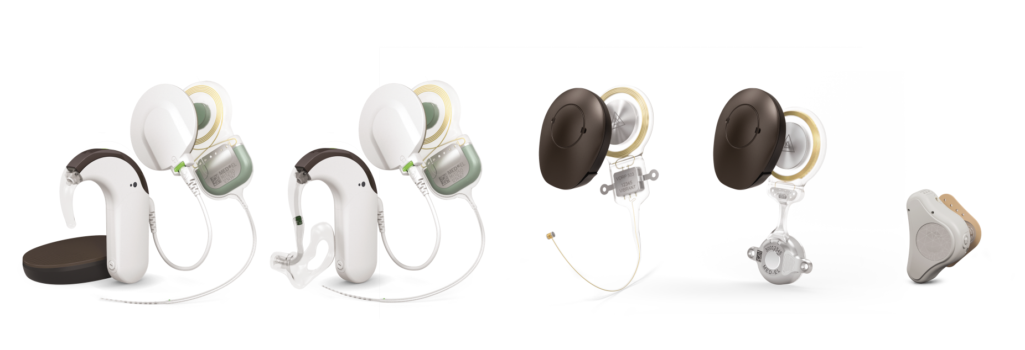
MED-EL Hearing Systems
For a wide range of indications & ages
MED-EL Hearing Systems

Slide 9
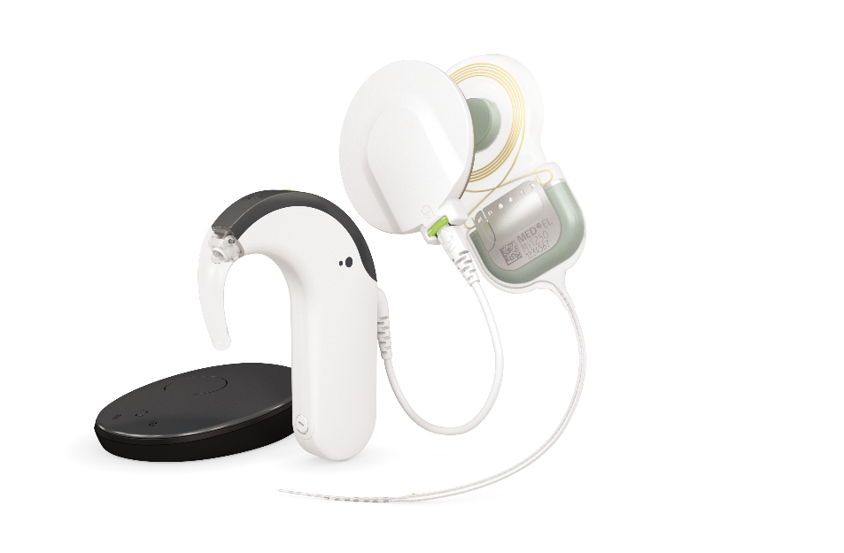
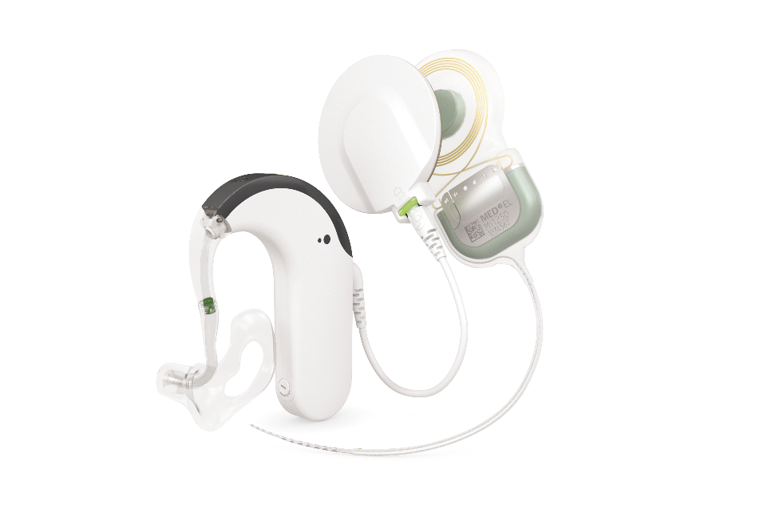
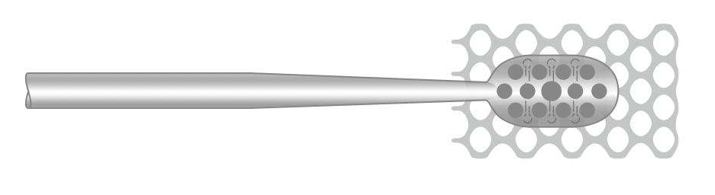
MED-EL Hearing Systems based on electrical stimulation
ABI
SYNCHRONY
Cochlear Implant System
SYNCHRONY EAS
Hearing Implant System
SYNCHRONY ABI
Hearing Implant System
MED-EL Hearing Systems

Slide 10
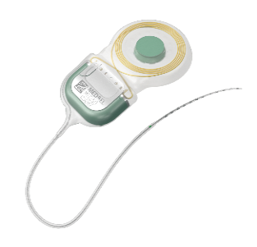
The New SYNCHRONY
Cochlear Implant System
SYNCHRONY 2 Cochlear Implant

Slide 11
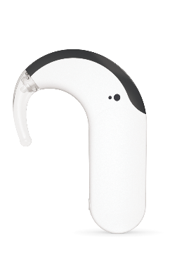

The New SYNCHRONY
Cochlear Implant System
SYNCHRONY 2 Cochlear Implant
SONNET 2 Audio Processor

Slide 12
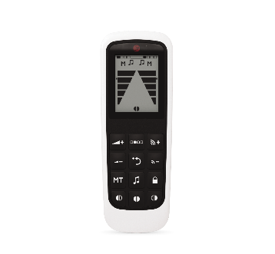

The New SYNCHRONY
Cochlear Implant System
SYNCHRONY 2 Cochlear Implant
SONNET 2 Audio Processor
FineTuner Echo

Slide 13
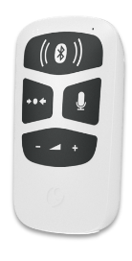

The New SYNCHRONY
Cochlear Implant System
SYNCHRONY 2 Cochlear Implant
SONNET 2 Audio Processor
FineTuner Echo
AudioLink

Slide 14
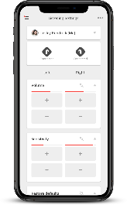

The New SYNCHRONY
Cochlear Implant System
SYNCHRONY 2 Cochlear Implant
SONNET 2 Audio Processor
FineTuner Echo
AudioLink
AudioKey App

Slide 15
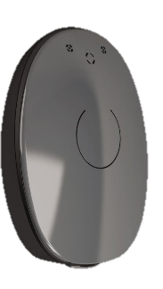

The New SYNCHRONY
Cochlear Implant System
SYNCHRONY 2 Cochlear Implant
SONNET 2 Audio Processor
FineTuner Echo
AudioLink
AudioKey App
RONDO 2 Audio Processor

Slide 16
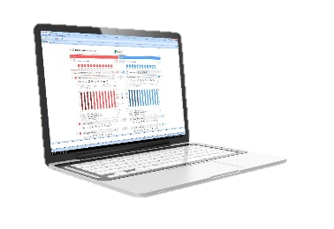
The New SYNCHRONY
Cochlear Implant System
SYNCHRONY 2 Cochlear Implant
SONNET 2 Audio Processor
FineTuner Echo
AudioLink
AudioKey App
RONDO 2 Audio Processor
MAESTRO 8 System Software

Slide 17
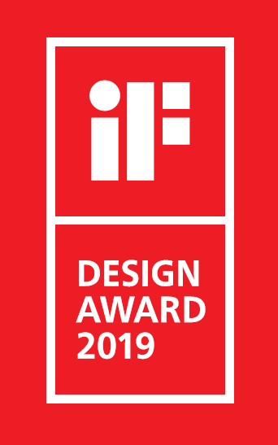
The New SYNCHRONY
Cochlear Implant System
SYNCHRONY 2 Cochlear Implant
SONNET 2 Audio Processor
FineTuner Echo
AudioLink
AudioKey App
RONDO 2 Audio Processor
MAESTRO 8 System Software

Slide 18
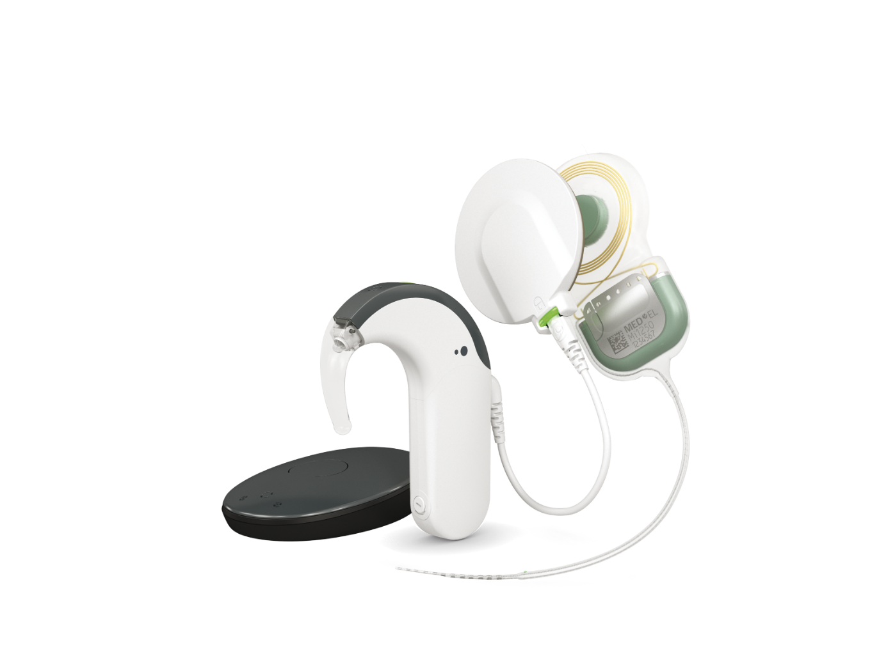
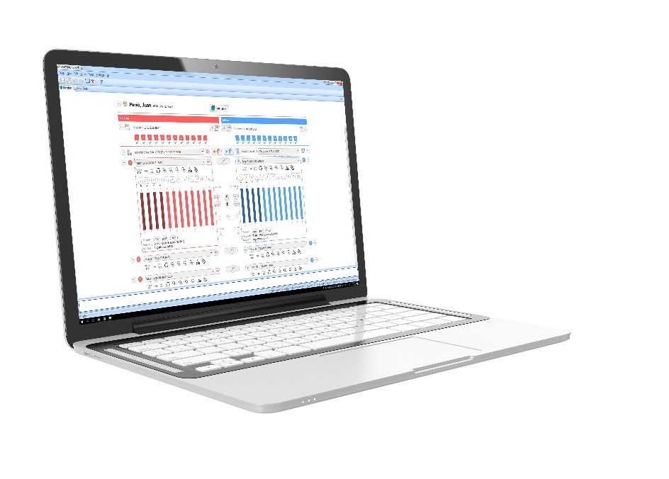
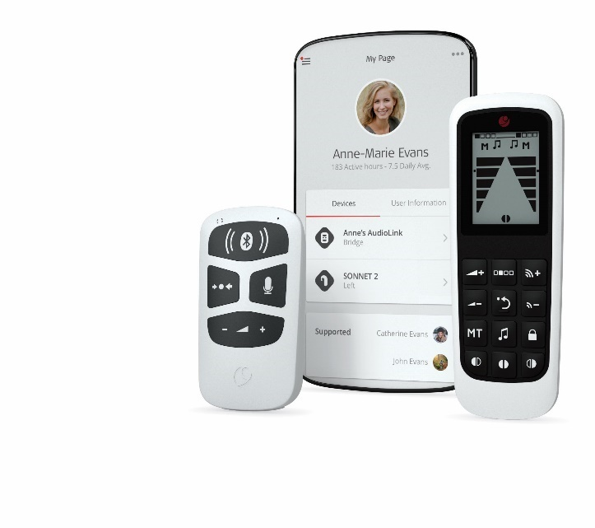
The new SYNCHRONY System approved in Europe in July 2019

Slide 19
SYNCHRONY Electrode Arrays
Designed for atraumatic implantation
FLEXSOFT
FORM24
FLEX28
FORM19
FLEX26
STANDARD
FLEX24
MEDIUM
FLEX20
COMPRESSED
ABI
SYNCHRONY Electrode Arrays
Notes:
FLEX series – Extension of FLEX portfolio with our new FLEX 20 electrode array
FORM series
CLASSIC series
and ABI (MRI is limited to 1.5T)

Slide 20
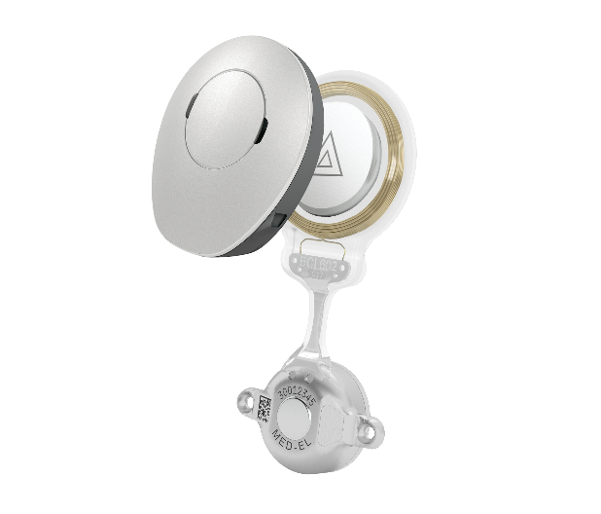
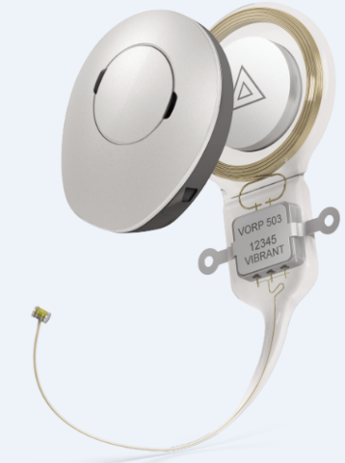
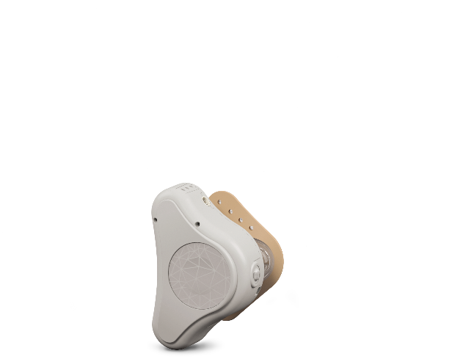
MED-EL Hearing Systems based on vibratory stimulation
BONEBRIDGE
Bone Conduction
Implant System
VIBRANT SOUNDBRIDGE
Middle Ear
Implant System
ADHEAR
Bone Conduction
Hearing System
MED-EL Hearing Systems

Slide 21
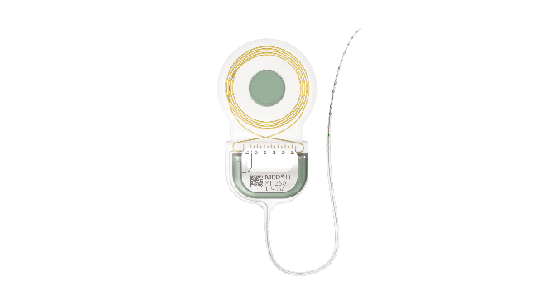
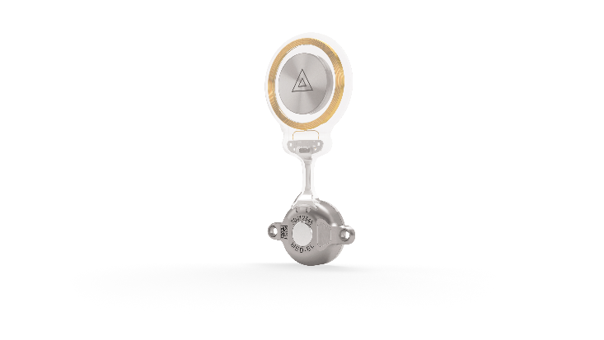
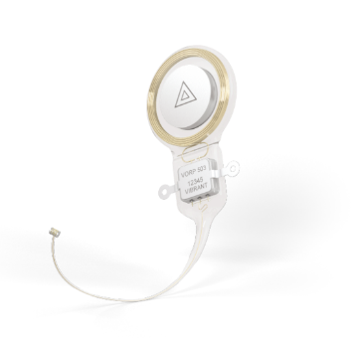
A Lifelong Commitment
> 25 years of legacy support
The newest audio processors are
compatible with all prior implants
SYNCHRONY 2
SYNCHRONY
CONCERTO
C40+
PULSAR
SONATA
BCI 602
C40
VORP 503
BCI 601
1994
VORP 502
MED-EL Hearing Systems

Slide 22
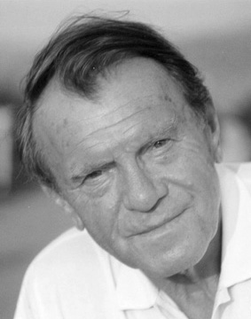
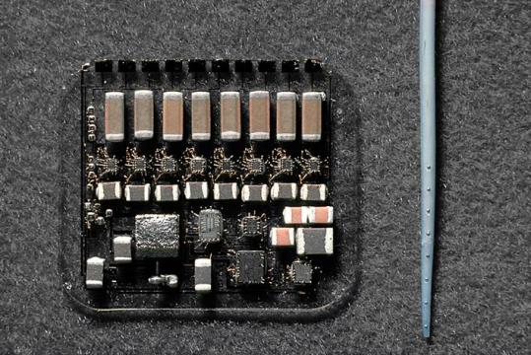
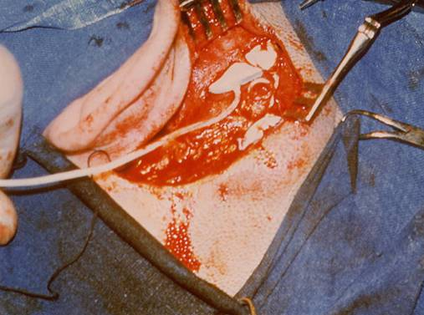
Implantation of the First
Micro-Electronic Multichannel CI
December 16, 1977
Prof. Dr. Kurt Burian, Vienna
The Hearing Implant Company

Slide 23
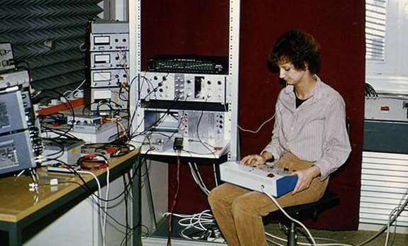
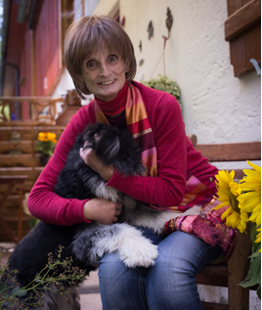
Patient Conny in the
Psychophysics Lab in 1979
Conny has been enjoying open set audio only speech perception from a portable processor since March 6, 1980, for now 39 years
The Hearing Implant Company

Slide 24
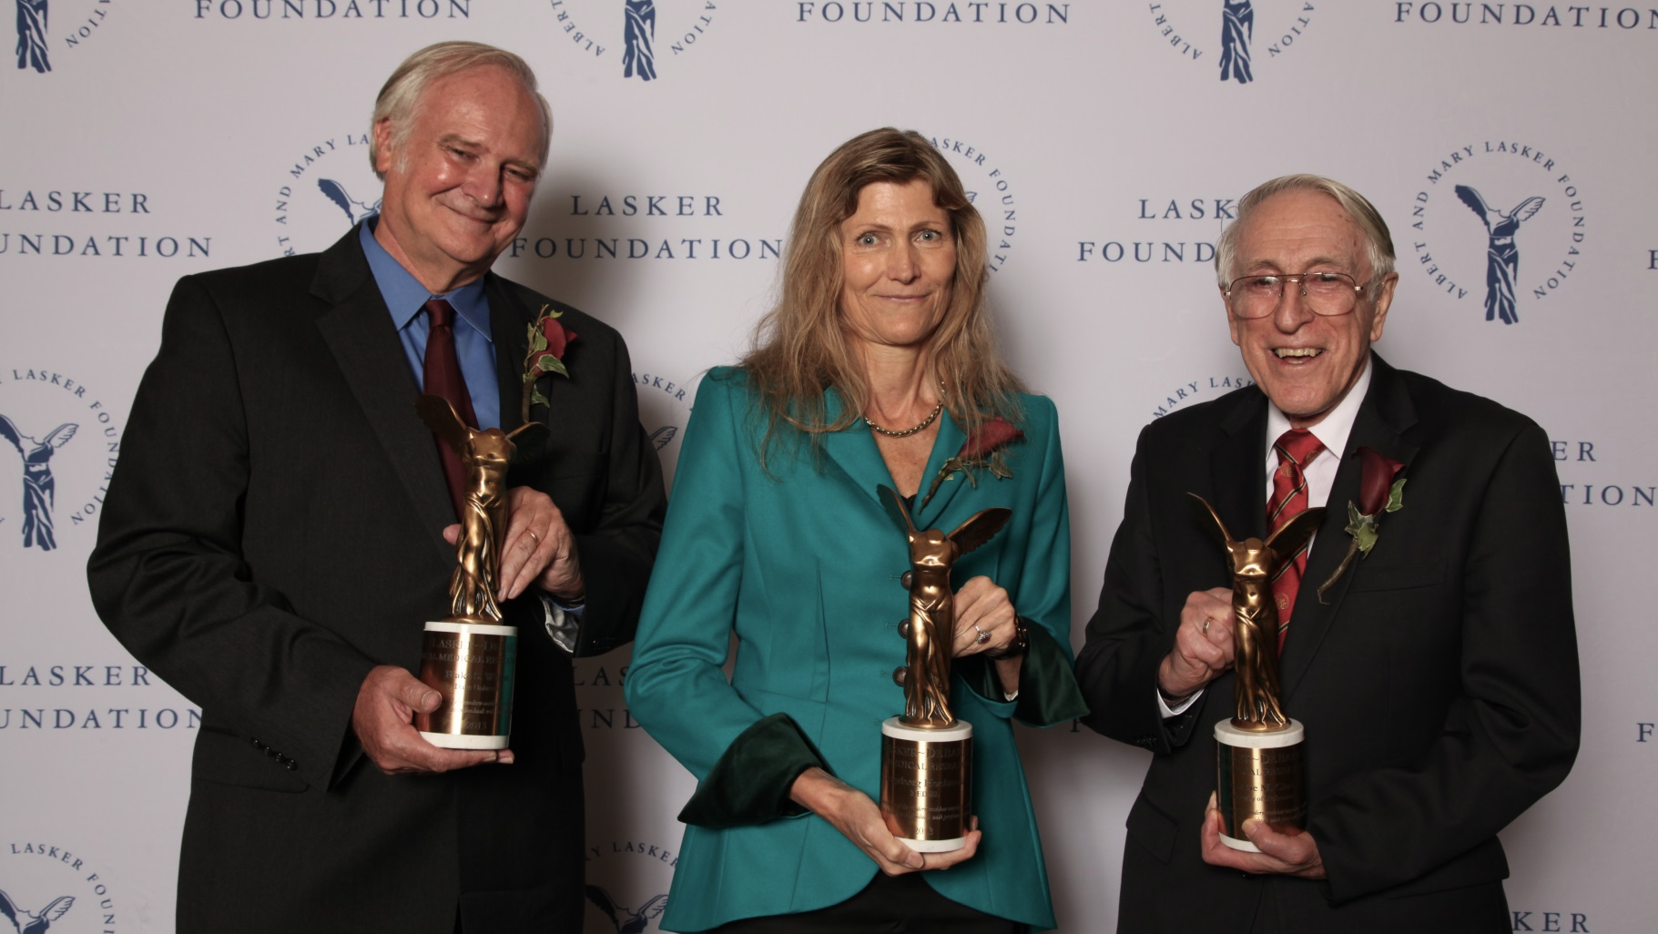
Lasker Award

