Slide 1

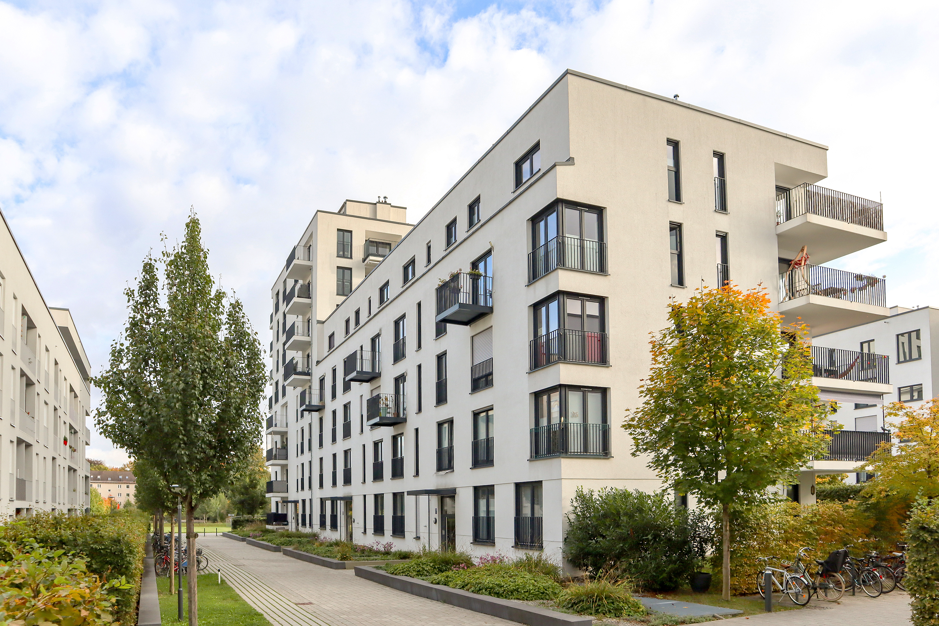
Providing innovative housing solutions nationwide.

Slide 2
Who We Are
The BLVD Group develops and invests nationally in quality real estate projects across multiple business lines. We approach business through an entrepreneurial lens, cultivating a team who acts entrepreneurially and rewards team members commensurate with their contributions. This approach drives us to produce outsized returns.
While what we do determines our day-to-day, it’s what we believe that makes us The BLVD Group.
We believe in being action oriented. Results are achieved by compressing the distance between good ideas and great execution.
We believe in authenticity. It doesn’t take a suit and tie to solve big problems. Work hard and be yourself.
We believe in big goals. In order to achieve uncommon results, our goals must push us out of our comfort zone, beyond what we think is possible.
We believe we can do well while doing good. We give back to our communities and aim to have a lasting social impact.
We believe work and fun are not mutually exclusive. When done right, hard work can be a lot of fun.
We believe in a thoughtful approach. We utilize our experience and a considered approach to make swift, reasoned and forward-thinking decisions.
www.theblvdgrp.com

Slide 3



Our Business Lines
BLVD Capital is The BLVD Group’s market rate investment vehicle founded on the basis of value investing philosophies, focusing on distressed, opportunistic, value-add and niche market real estate assets. Within these classes, BLVD typically targets underperforming properties that often require significant renovations and hands-on management to realize the assets’ full potential.
BLVD constantly assesses market conditions and end-user demand in order to identify short- and long-term inefficiencies and arbitrage opportunities. Subsequent to identifying broader market opportunity, BLVD applies a methodical approach to set the stage for realizing superior returns.
In the context of a deepening affordability crisis, The BLVD Group entered affordable housing in 2013 with the establishment of BLVD Communities, a developer, owner, and operator focused on providing affordable housing nationwide.
Through property-based Section 8 subsidies, Low Income Housing Tax Credits, and additional programs, BLVD aims to preserve and expand long term housing affordability for low-income households. BLVD and its principals have a proven track record in the industry for safeguarding and growing the number of affordable units throughout the country.
BLVD Impact Housing was founded to address the housing problem for middle income earners – moderate-income individuals that cannot afford to reside in the communities in which they work.
Drawing upon the company’s affordable and market-rate housing expertise, BLVD Impact Housing creates quality, income restricted housing units. The essential housing properties serve middle-income residents who earn incomes in excess of traditional affordable housing restrictions and yet cannot afford market rate housing without becoming rent burdened. The company undertakes these projects through strategic public-private partnerships with government agencies and financial institutions.
www.theblvdgrp.com

Slide 4
Company History
Possibly include a single slide that shows the full company timeline, ahead of the detailed timeline. This slide would touch focus only on formation of business lines, portfolio size, etc, and would not include any fluff
2010
2011
2012
2013
2014
2015
2016
2017
2018
2019
2020
2021
2022
www.theblvdgrp.com

Slide 5
Company History
What do you get when you combine a principal, an unpaid intern, and 5,000 square feet of borrowed office space? The beginning of BLVD
In 2010, we found the Company based on value investing principals in the depths of the Great Financial Crisis with a focus on value-add, distressed and opportunistic investments. We leverage our significant experience and track record in the value-add institutional real estate investment space, starting small and building an investment firm from the ground up. It may not be the easiest path to choose, but we do what’s right and not what’s easy.
Start with what you know
Finding a hidden gem, polishing it, and presenting it to the world can be a lot of fun. We know how to do it and enjoy doing it, so we decide to dive into the value-add apartment business. We find the worn out properties in great neighborhoods and we find the underutilized properties in the next hot neighborhoods. The key to success is to see things for what they can be, and not just what they are, then to innovate through reimaging, reorganizing and reworking.
2010
2011
2012
2013
2014
2015
2016
2017
2018
2019
2020
2021
2022
www.theblvdgrp.com

Slide 6
Company History
Who wouldn’t want to buy $1.00 for 70 cents?
Armed with a man at the court house steps with an earpod in one ear and millions of dollars of cashiers checks in his back pocket, we embark on a daily ritual of bidding on apartment building foreclosures. Through the White Cottage Fund, a discretionary investment fund we raise to bid on foreclosed, distressed apartments, we successfully invest in this space over a four year period. With no traditional diligence available for the properties, and just seconds to bid, it can be a nerve wracking experience, but we never lose money on any of the acquisitions, and actually earn quite an attractive return. If this isn’t a crash course in making swift, reasoned, and forward thinking decisions, we don’t know what is.
2010
2011
2012
2013
2014
2015
2016
2017
2018
2019
2020
2021
2022
www.theblvdgrp.com

Slide 7
Company History
Eureka!
After a nail biting 22 months of money going out the door during the Company’s initial existence, we successfully complete our first disposition of an investment which (thankfully) brings some profit back into the bank account. With a sale price 55% above our purchase, we’re off to a good start. And better yet, our investment thesis is validated.
Doing well while doing good.
After rigorous analysis we dip our toe in the affordable housing waters because of perceived opportunity. While the initial opportunity is just a sliver of the vast affordable housing landscape we uncover in the years to come, the affordable housing industry becomes more of a mission rather than just a mere opportunity. We create a new segment of the business, BLVD Communities, to focus on fulfilling affordable housing needs across the country. This would not be possible without our pursuit of lifelong learning, allowing us to marry our existing multifamily experience with a new asset class.
2010
2011
2012
2013
2014
2015
2016
2017
2018
2019
2020
2021
2022
www.theblvdgrp.com

Slide 8
Company History
The Naked City
Just off the glittering Las Vegas strip we find what we believe to be an attractive affordable housing opportunity. But once we complete our diligence, we realize that the property has too many physical needs to be a viable long term investment. Rather than walking away, we decide to dive deeper into the affordable housing world by utilizing the Low Income Housing Tax Credit to complete a redevelopment of the 201 unit property located in a neighborhood known as The Naked City for its history as a home to many of Las Vegas’ showgirls in the 50’s and 60’s. This redevelopment not only enhances the lives of the property’s residents, but contributes to lifting the entire neighborhood. This is the first of many projects BLVD Communities undertakes to redevelop affordable housing across the country.
Ladies and gentlemen, start your engines.
While the debate still rages in the office as to who actually won the inaugural BLVD go karting race, one thing is certain: we all walk away that day with big smiles on our faces. We work hard and have fun, otherwise, what’s the point?
2010
2011
2012
2013
2014
2015
2016
2017
2018
2019
2020
2021
2022
www.theblvdgrp.com

Slide 9
Company History
46.., 47…, 48…., 49….., 50!
Never are we met with such a range of emotions for a company activity: excitement, nervousness, dread. The BLVD health challenge is a 60 day competition that tests our willpower, establishes beneficial habits, and leaves us feeling a better version of ourselves. We gain points by simply eating right and working out, all while having a trainer cheering us along or giving us a nudge. Our single biggest competitor is ourself. To be successful, we must approach each day with intention, just like we approach our business. A testament to the spirit of the team, the competition is neck and neck until the very end.
Solving for the missing middle
How can we have thriving cities when the people who work and play there cannot afford to live there? Spoiler alert: we can’t. Expensive, high-end housing pencils to build. Affordable housing for low income renters, although scarce, can pencil to build through government funded programs. But what about middle income renters who make the cities run? They are left with dilapidated, old housing stock, or spending hours a day fighting traffic to get to and from work. Harnessing the collective and collaborative power of a public/private team, BLVD Impact Housing is born to address this crucial need, providing high quality housing to the teachers, nurses, and numerous professionals who are the life blood of our cities.
2010
2011
2012
2013
2014
2015
2016
2017
2018
2019
2020
2021
2022
www.theblvdgrp.com

Slide 10
Company History
Don’t step in the kitchen
What company retreat is complete without a bit of work, a lot of laughs, and little competition? The competitive juices are in full swing at the first BLVD pickleball tournament. The open courtside bar soothes the sting of defeat, but regardless of where we each rank in the standings, there is a lot of talk of pickleball becoming the new favorite BLVD pastime.
Movin’ on up
The growth and success of a company does not happen overnight, nor does it just happen. It takes a team of dedicated, intelligent, results oriented individuals to deliver exceptional results. When a member of the team consistently delivers results, we reward those results. In this case, we name our first Partner.
2010
2011
2012
2013
2014
2015
2016
2017
2018
2019
2020
2021
2022
www.theblvdgrp.com

Slide 11






Where Are We Now
Apartment Units Acquired
Senior Management Team Acquisition Experience
Current Assets Under Management
7,500 +
Over $4 billion
$1+ billion
Number of Residents Served
Renovations Performed
IRR of Realized Investments – BLVD Communities
13,000+
$60mm+
34.87%
www.theblvdgrp.com

Slide 12
Our Nationwide Portfolio
www.theblvdgrp.com

Slide 13
What Does Tomorrow Look Like?
We will be a market leader. We will pursue growth and innovation to achieve industry beating returns and exponentially expand our portfolio through new and existing business lines.
We will positively impact those we touch. We have a responsibility to create opportunity for our residents and our employees. Investing in the success of both parties, particularly by empowering individuals, will help us enact the social impact that is sorely needed.
We will have a positive impact on those we touch. We will positively impact all stakeholders in our business ( residents, employees, communities and investors) by…adhering to a high standards in terms of both our fiduciary and social obligations.
We will have a positive and lasting effect on residents/communities/etc by doing what’s right not what’s easy
We will reduce our footprint. We recognize that the construction industry has a significant carbon footprint. Through our perpetual desire to innovate through reimagining, reorganized and reworking, we will find further solutions to substantially reduce the carbon footprint of our communities.
We will utilize our expertise to its fullest. The multifamily industry has been one of the highest performing asset classes, and is poised to remain such. We will outperform the already favorable market by applying all of our experience to mitigate risk and enhance upside.
www.theblvdgrp.com

Slide 14
Our Core Values
We do what’s right, not what’s easy
We lead by example
We harness the collective and collaborative power or the team
We empower individuals
We make swift, reasoned and forward-thinking decisions
We pursue lifelong learning
We reward results
We approach each day with intention
We innovate through reimagining, reorganizing and reworking
We think and act like owners
We work hard and have fun
www.theblvdgrp.com

