Slide 1
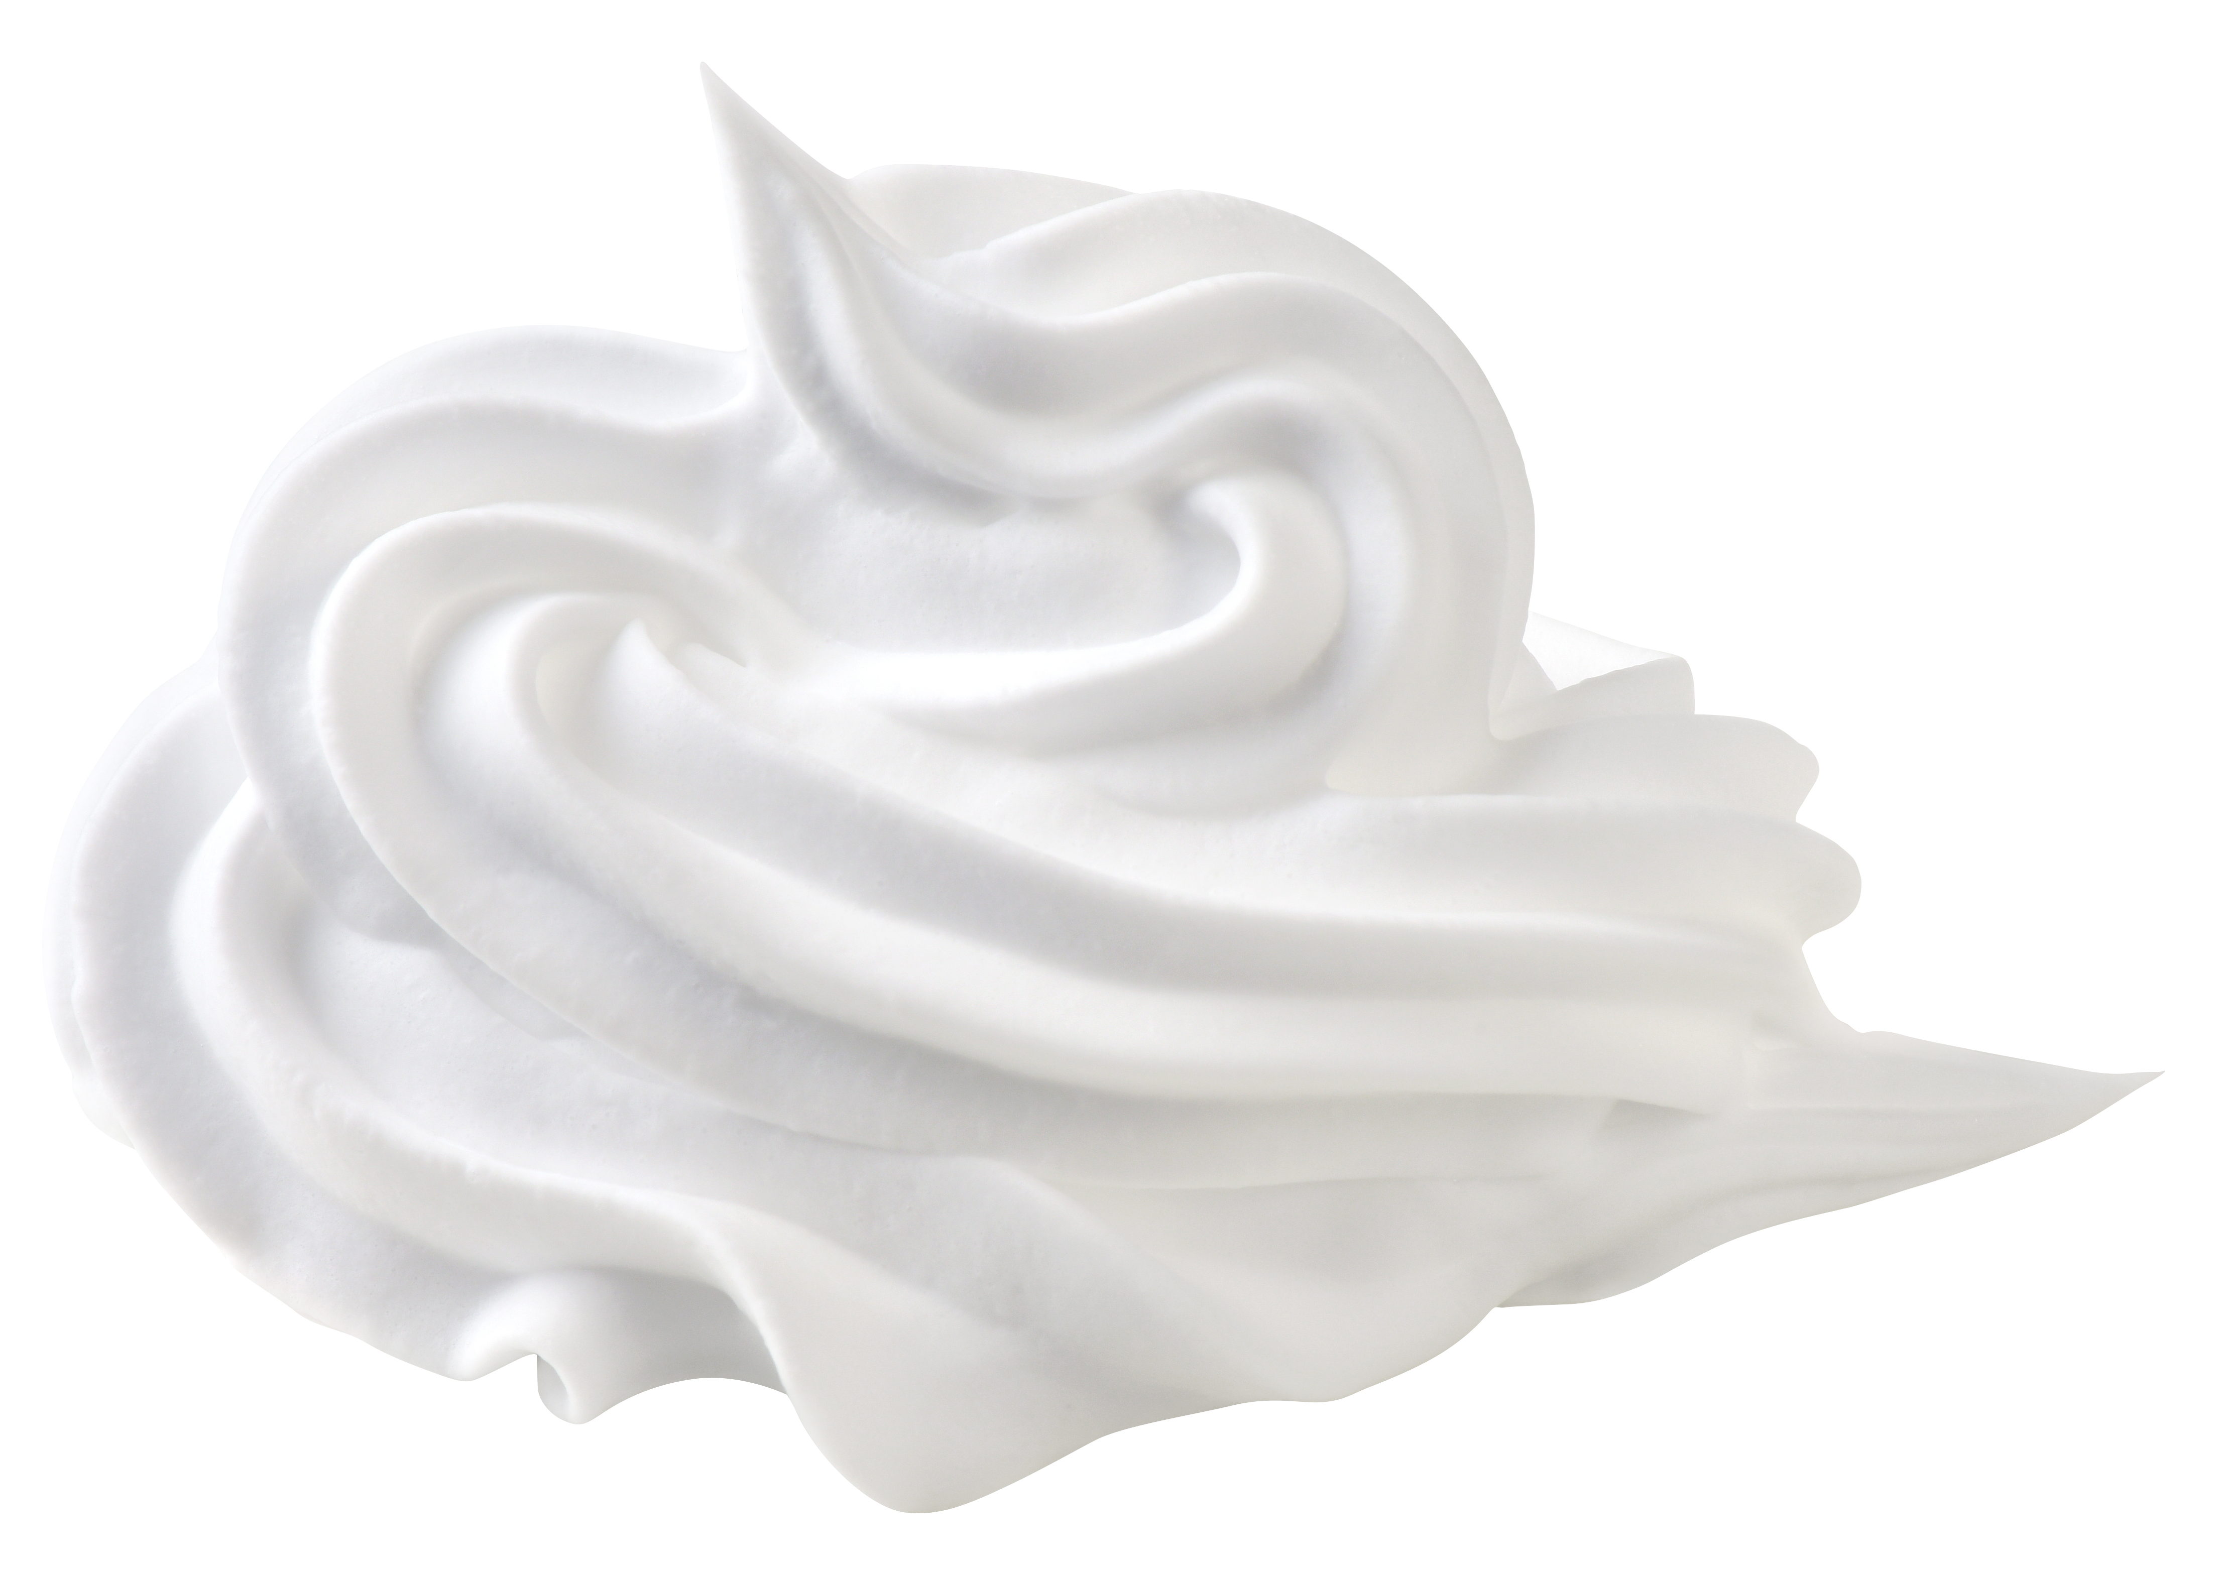
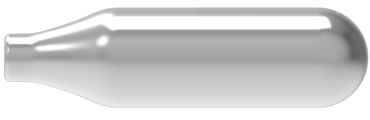
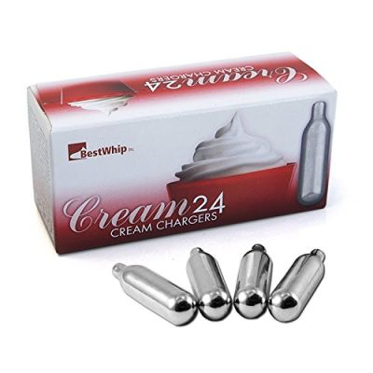
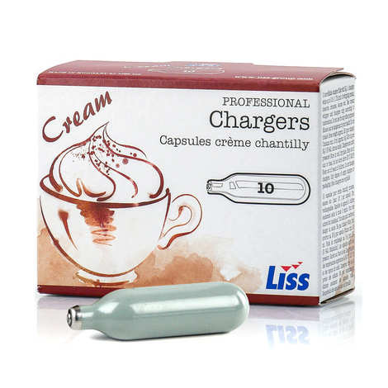
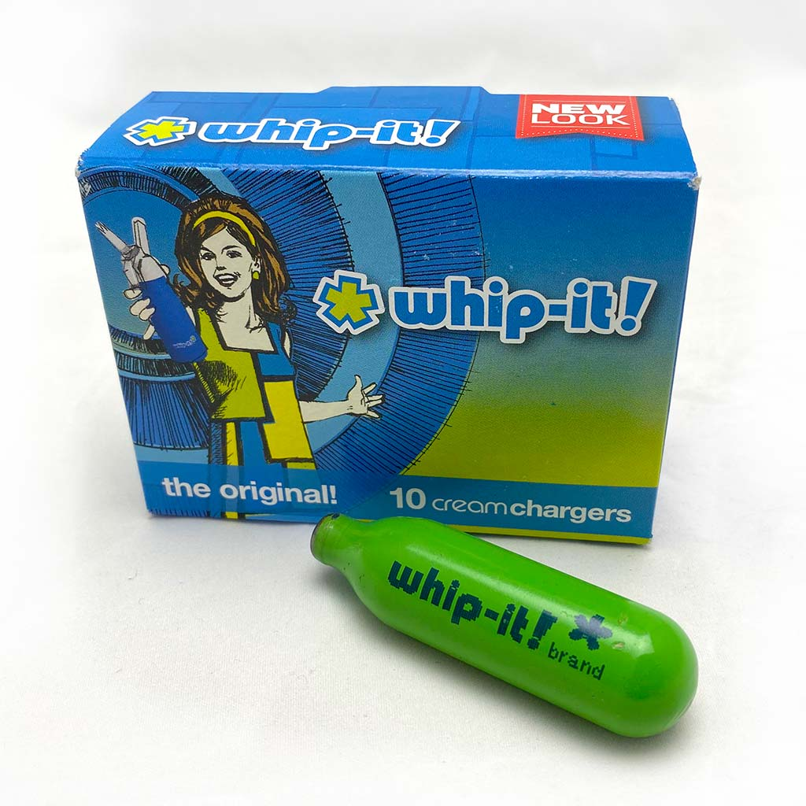
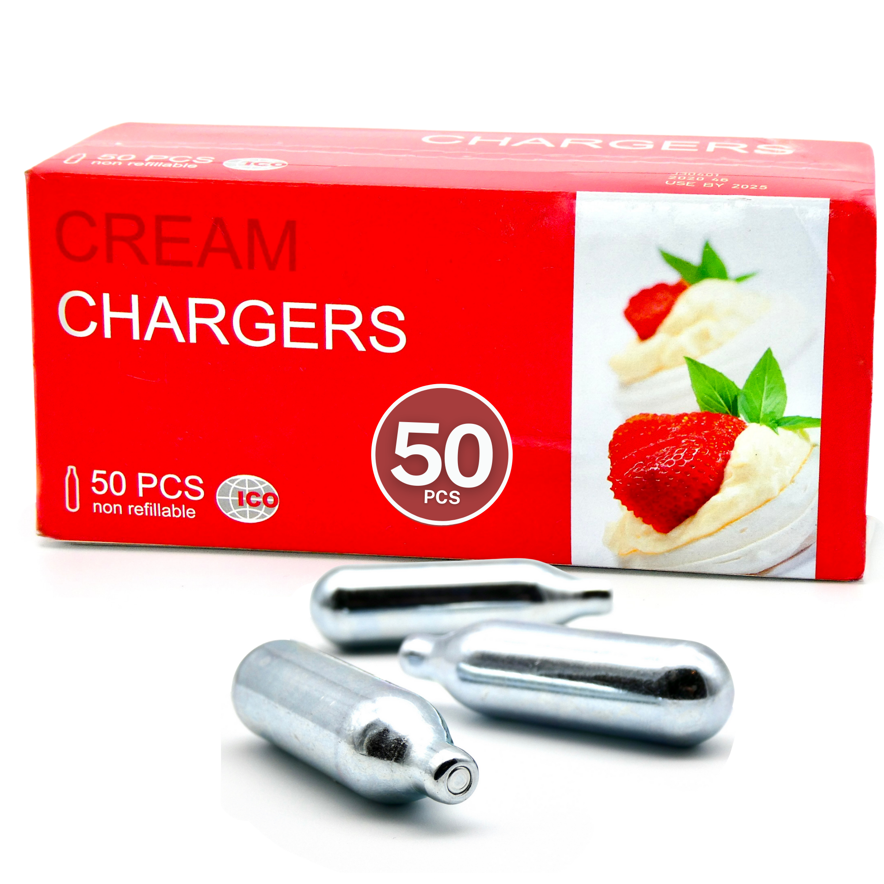
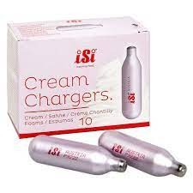
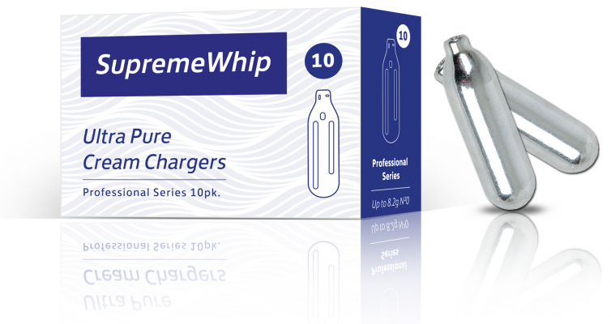
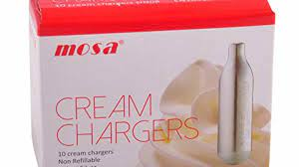
N₂O Alu-Whip Brand Logo Project
For more details, please refer to https://en.wikipedia.org/wiki/Nitrous_oxide
Most of 8gr N2O cartridge is made from steel, we are a manufacturer who can product from Aluminum.
Brand Name : ALU-WHIP (Alu-Whip)
Logo should contain : Brand Name. Emphasize ours made from Aluminum instead of steel.
Font and Color : No limitation
Product Image
Competitors (Steel) Brand and Logo for Reference

Slide 2
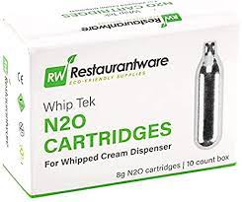
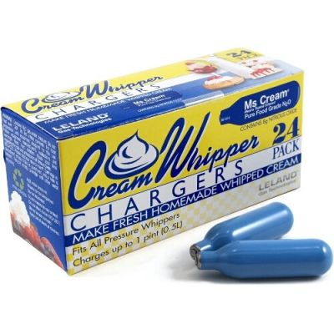
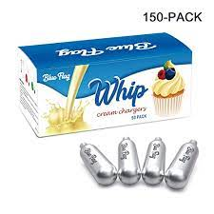
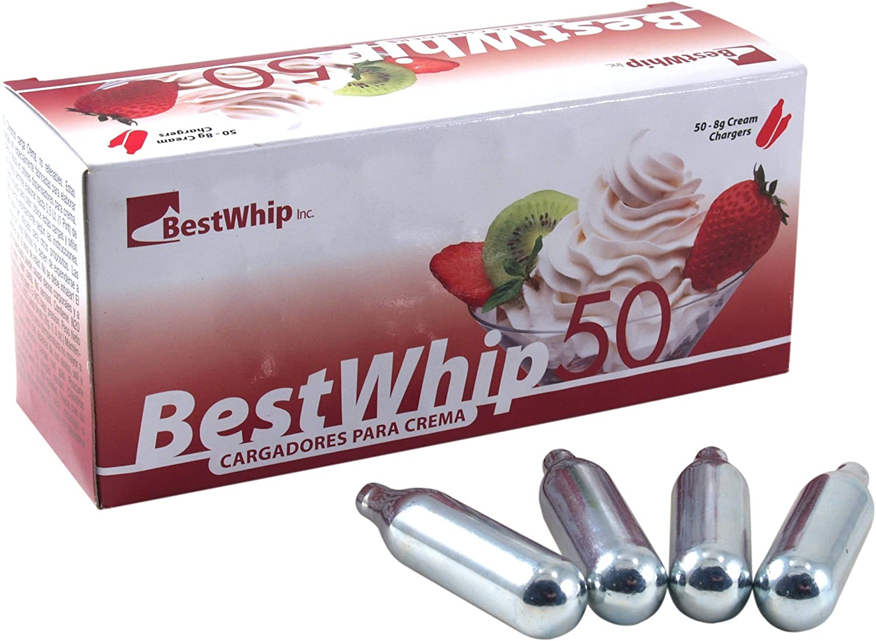
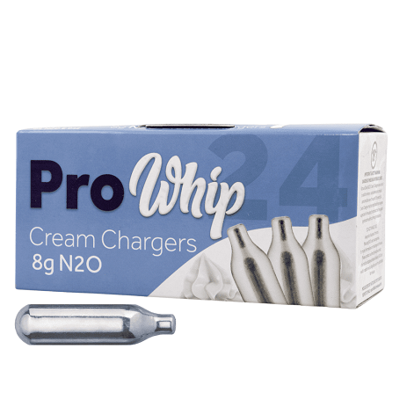
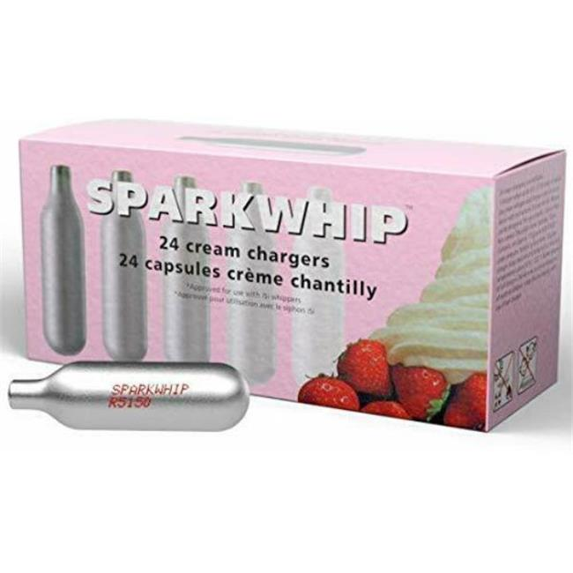
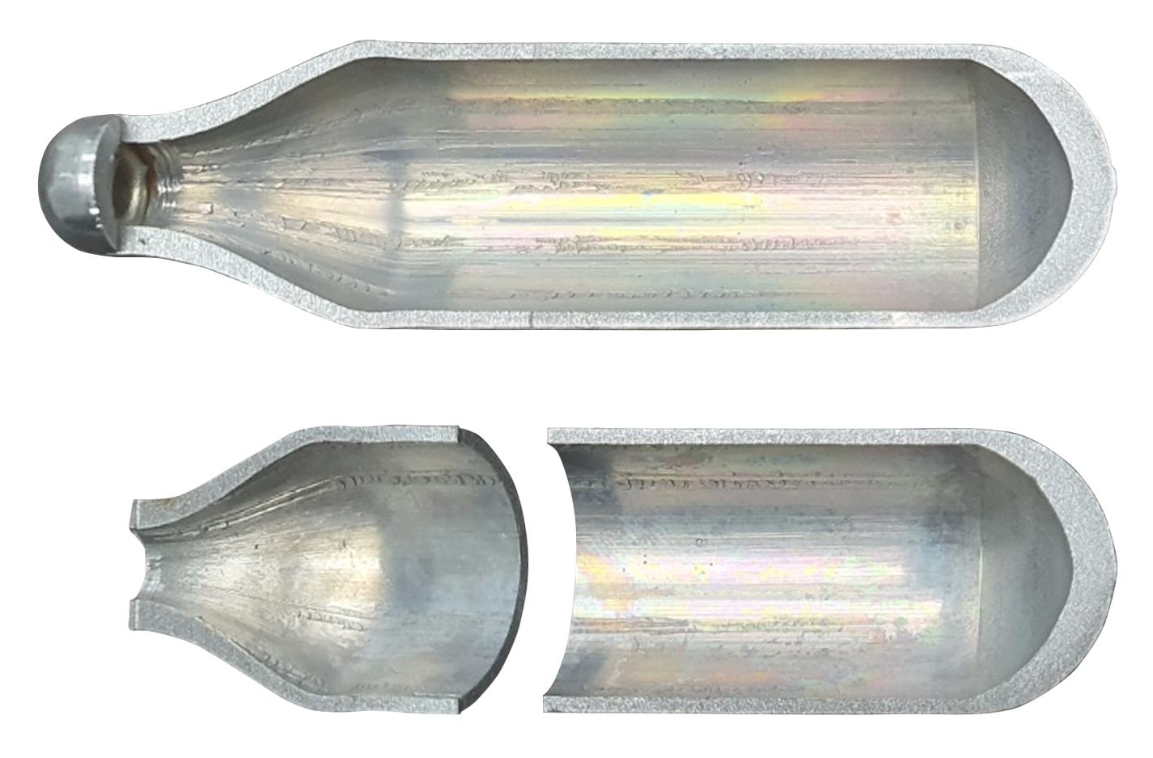
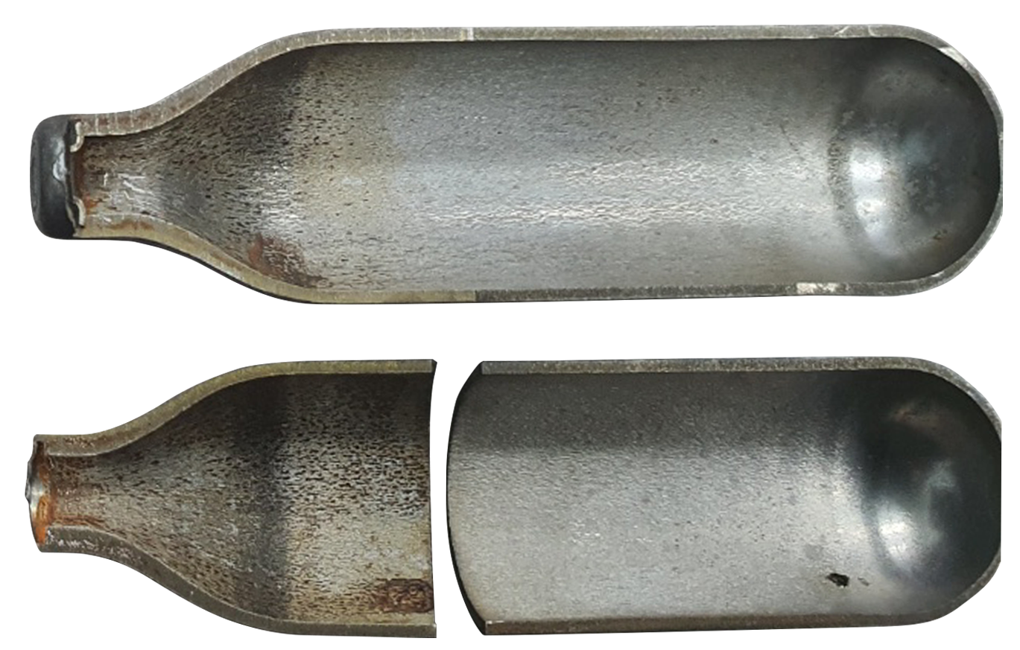
Comparison Aluminum vs Steel Cartridge
Aluminum - Al
Steel - Fe
▪ Impact Extrusion
▪ No internal coating
▪ No chance contaminated
▪ Natural glossy
▪ Simple process
▪ Light weight – 18gr
▪ Drawn & Welding
▪ Internal coating
▪ Possible contamination
▪ Outside painting
▪ Complicated process
▪ Heavy weight – 29gr

