Slide 1
Instructions:
Company main colors to use →
Goal: to appear innovative, technological and data driven​
Present two new concepts:
UOC – a corporate control center to coordinate the operations of each company plant as a single entity
AOM - plant operators are central and we want to augment their capability to take the best production decisions using AI tools
Specific details on slide goal can be found on notes

Slide 2
Unified Operation Center and Augmented Operation Management
Notes:
Presentation title

Slide 3
Notes:
Scope: how digitalization evolved in last years from being technology focused to user and value focused – images can be used

Slide 4
Main challenged companies face today:
Sustainability
Flexibility → availability of assets, experience (SMEs), decisions
Workforce demographic → experience, decisions
Corporate wide visibility and coordination
Supply Chain visibility and coordination
Notes:
SME = Subject Mattter Expert

Slide 5




Train
Inform
Skill
PEOPLE
Augment
Connect
Unify
Coordinate
Notes:
Show how people are central in every company activity

Slide 6


Competence
WORKFORCE TURNOVER → MISSING EXPERIENCE
Knowledge
Experience
t
Notes:
Experience growth can be only linear with time while knowledge can be accelerated. Workforce turnover creates lack of experience in companies

Slide 7
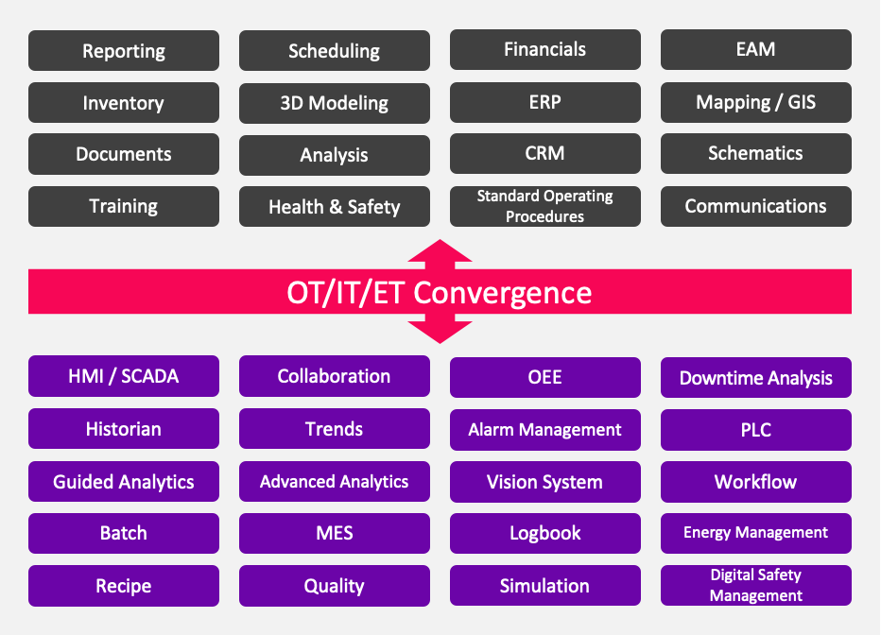
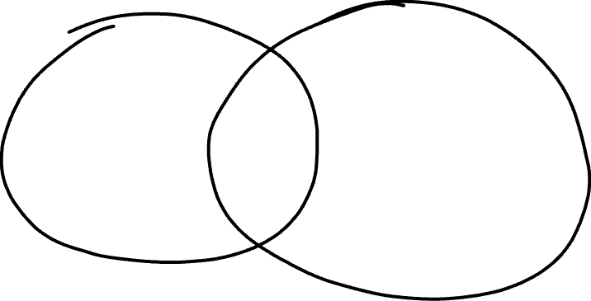

IT/OT convergence → IT/OT fusion
IT Data and info
OT Data and info
VALUE
Notes:
Show that the creation of value is in merging info coming from IT (information technology) and OT (operation technology – plant process (es. production, packaging, …)) systems. In the picture, some examples of IT (gray squares) and OT (purple squares) application

Slide 8
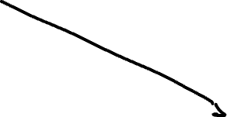
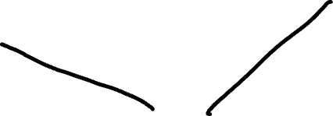

2 main streams
Augment corporate visibility
Augment people
AUGMENTED OPERATIONS MANAGEMENT
Notes:
Introduction to AOM (Augmented operations mangement) concept
Infos can help both people and the corporate in taking decisions

Slide 9






AOM
HISTORY
SUGGESTIONS
SUGGESTIONS
MES/MOM
DATA/DECISIONS
DATA
Notes:
Flows represented here, are information flows related to applications installed
AOM can be represented as an AI (Artificial intelligence) entity – MES/MOM (Manufacturing Execution System/Manufacturing Operations Management) are specific industrial applications

Slide 10



IT DATA LAKE
PRESENTATION
IT
APPLICATION
Information level
BUSINESS
AUGMENTED OPERATIONS MANAGEMENT
UNIFIED OPERATIONS CONTROL
Coordination/Action level
CORPORATE
SUPPLY CHAIN
Operations level
PLANT
MES/MOM
MES/MOM
MES/MOM
MAINTENANCE
IOT
Notes:
Introduction of UOC (unified operations control) concept and architecture
Flows represented here, are information flows related to applications running at the plant/corporate or business level
The business level (IT data lake, application and presentation) can be represented as cloud apps
AOM (augmented operations management) can be represented as an AI (Artificial intelligence) entity
UOC (unified operations control) can be represented as a system representing process info and dashboards
MES/MOM (Manufacturing Execution System/Manufacturing Operations Management) are specific industrial applications

Slide 11




IT
Information level
PRESENTATION
BUSINESS
Coordination/Action level
AUGMENTED OPERATIONS MANAGEMENT
UNIFIED OPERATIONS CONTROL
CORPORATE
Operations level
SUPPLY CHAIN
PLANT
MES/MOM
MES/MOM
MES/MOM
MAINTENANCE
IOT
Notes:
As the previous one.
Goal of this slide is to show that AOM and UOC can be implemented also without data lakes of apps running in cloud.
The presentation layer stays because UOC (unified operations control) has the ability to publish dashboards in cloud.

Slide 12
Right person right tool
Cloud and BIs: Business → informative
AOM and UOC: Operations → informative/executive
Notes:
Cloud and BIs (business intelligence) systems are dedicated to business → only informative
AOM (augmented operations management) and UOC (unified operations control) are dedicated to operations → both to inform and to operate directly

Slide 13
USE CASES UOC
Notes:
New section: next slided will be about UOC (unified operations control) use cases

Slide 14
Linked KPIs
Global
Regional
Plant/facility/operations
Equipment
→ Operations manager can take decisions with a corporate vision and dispatch them to plants. Any decision become instantly action
Notes:
Format: tile (first row) and content
Images can be used
Sildes from 14 to 18 can be merged in one or more slides

Slide 15
Cross functional collaboration
→ Data and information of different departments are correlated and generate an holistic view to take decision in close loop
Notes:
Format: tile (first row) and content
Images can be used
Sildes from 14 to 18 can be merged in one or more slides

Slide 16
Supply chain coordination
→ Data coming from different plants/systems are correlated to optimize supply chain decisions with a multi plant approach. Internal supply chain managed as a whole
Notes:
Format: tile (first row) and content
Images can be used
Sildes from 14 to 18 can be merged in one or more slides

Slide 17
Production optimization
→ Production optimized at a corporate level and not only at a plant level. Decisions taken at the corporate operations control level
Notes:
Format: tile (first row) and content
Images can be used
Sildes from 14 to 18 can be merged in one or more slides

Slide 18
Knowledge capturing and nurturing
→ Knowledge of users collected at corporate level and made available to any user with no geography, time or language limitation. Reduced onboarding, increased efficiency, better engagement
Notes:
Format: tile (first row) and content
Images can be used
Sildes from 14 to 18 can be merged in one or more slides

Slide 19
USE CASES AOM
Notes:
New section: next slided will be about UOC (unified operations control) use cases

Slide 20
Production optimization
→ Based on historical production results and conditions best production scheduling/dispatching/setup is proposed
Notes:
Format: tile (first row) and content
Images can be used
Sildes from 19 to 24 can be merged in one or more slides

Slide 21
Line setup
→ Based on historical data and environmental data best setup is proposed for product/line/format/…
Notes:
Format: tile (first row) and content
Images can be used
Sildes from 19 to 24 can be merged in one or more slides

Slide 22
Production performance
→ Analysis of production, line and environment status to suggest best actions to keep production performance in target
Notes:
Format: tile (first row) and content
Images can be used
Sildes from 19 to 24 can be merged in one or more slides

Slide 23
Production forecast
→ Analysis of production, line and environment status to forecast production volumes or completion
Notes:
Format: tile (first row) and content
Images can be used
Sildes from 19 to 24 can be merged in one or more slides

Slide 24
Internal logistic optimization
→ Analysis of production, line and environment status to optimize internal material movements (raw material to the line, WMS missions, …)
Notes:
Format: tile (first row) and content
Images can be used
Sildes from 19 to 24 can be merged in one or more slides

Slide 25
CORPORATE OPTIMIZATION
UOC
AOM
Notes:
Conclusion: merging UOC (unified operations control) and AOM (augmented operations management) helps create optimization at the corporate level

