Slide 1
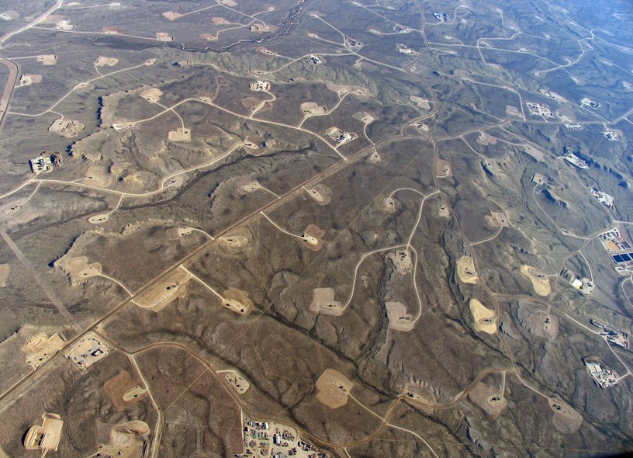

Consolidating profitable conventional West Texas Oil & Gas wells into a high return investment fund

Slide 2


The Industry Today
Typical “Major” O&G Companies have thousands of horizontal wells and thousands of vertical wells. They want to focus on horizontal.
Strong economic motivation to divest Vertical wells on good terms to trusted operators like Lodestone/BCP.

Slide 3
The Opportunity
Internal template page example

Slide 4
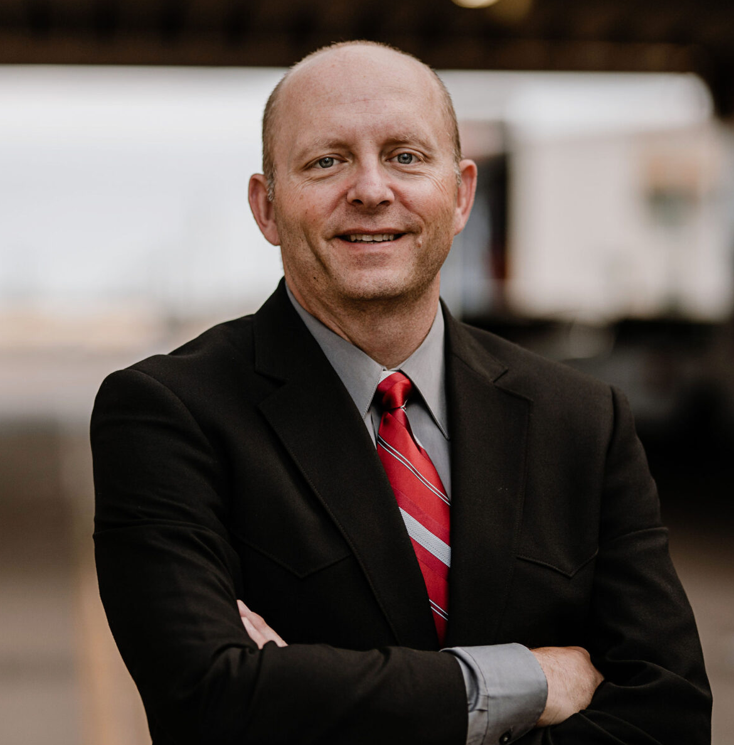
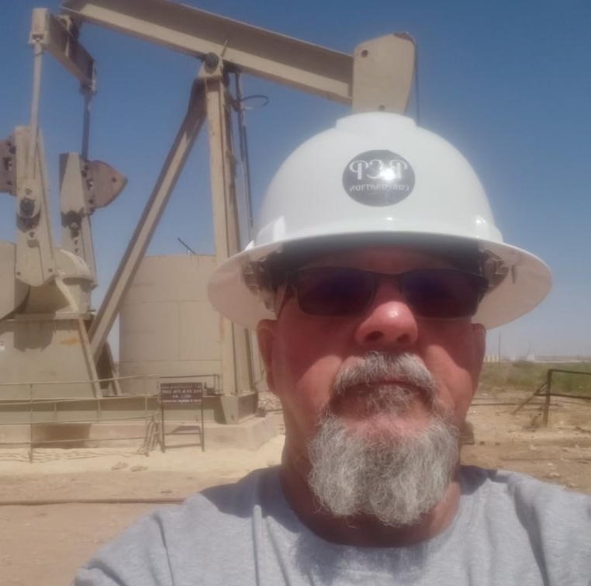





Team
Advisors
Russell Smith, P.E.
Over 18 years experience in Permian Basin oil and gas operations including engineering, field, and executive leadership roles.
Jerry Watkins, Reserves Analysis and Property Evaluation. Registered Petroleum Engineer with 30+ years experience and significant background in the Permian Basin.
Barry Portman
Managing Partner + CEO BCP Resources
Numerous oilfield operations leadership positions including VP & GM for Pioneer where he was responsible for 1000+ horizontal wells and 6000+ vertical wells
Gary Covert
Managing Partner, Lodestone
Extensive P&L and management experience, including positions at JX Nippon Mining & Metals, a Global 50 electronic materials company.
Bruce Hoover
Operations Manager
Over 40 years of experience in oilfield operations, drilling, and equipment maintenance. Bruce manages our daily field operations and production efforts.

Slide 5
Disclaimer
Nothing contained in these documents and materials is meant to be, and shall not be considered, a security offering, an offer to invest, or a solicitation of funds for any purpose. All information contained in these materials and documents, including, but not limited to, numbers, dollar amounts, rates of return, oil production, projections, etc. are included in such materials and documents purely for informational and discussion purposes only, and are strictly conjecture. The success of this proposed business idea or venture is not guaranteed in any way, and any investment in such business idea or venture carries the risk of significant or complete loss of investment.

