Slide 1


LTC ESG
Committee Meeting
May 25, 2022

Slide 2
Agenda
UPDATES!
  LTC ESG in Action
  SEC Climate Disclosure Update and NAREIT Response
  ISS Score
ISS Focus Areas for Board Diversity
Discussion on LTC Adopting Board Diversity Guidelines
  Diversity Definition Discussion
  Proposed Board Diversity Guidelines for Adoption
Next steps

Slide 3
LTC ESG in Action
Action | Detail
Surveys Deployed | Employee Engagement (complete) Company-wide ESG initiative (expect comments mid-June) Operator ESG Overview (expect results end of June)
Property Assessments in progress | HMG (13 properties reviewed. Greenleaf proposal submitted proposal being reviewed by Asset management) ALG (ongoing –good relationship with the vendor Lumenant) Juniper Colorado Properties (in discussions)
Messaging / Content Updates | Wendy highlighted ESG initiatives on earnings call Updated website, supplemental, investor presentation, proxy Ongoing refinement of narrative and disclosures per SEC Counsel, ISS, EY
Investigating WELL certification process – healthy buildings | - Preliminary stages
Identifying portfolio partners (via vendors) who are already integrating ESG and environmental and wellness initiatives | - Preliminary stages
Greening leases | Brookdale’s updated lease provides incentives for sustainability projects There are ongoing discussions regarding the intention of installing LED lighting throughout the portfolio

Slide 4
LTC ESG in Action – Consultant / Vendor Update
Role / Purpose | Company | Status
General Consultant | - Centaur Building Solutions | Hired – Ramping up; extension to team ($3,000 / month)
Property Evaluations to identify ESG benefits and cost savings | Greenleaf Lumenant Constant outreach and discussion with others | Greenleaf has assessed HMG portfolio and provided a bid. Asset management is reviewing. Lumenant works extensively with ALG – has implemented some ESG measures LTC has financed
Narrative / ESG Sustainability Report | - Financial Profiles | Negotiating contract
Data Collection and Reporting (energy, water, waste) | Diligent (frontrunner) Measurabl Goby | In negotiations – final determination by June 1
Portfolio Climate Risk Assessment | Climate Check Risk Footprint Researching others | None are perfect. They will include everything except one random variable (ie earthquake). The idea is to benchmark the entire portfolio then integrate reports into underwriting moving forward.

Slide 5
SEC Climate Disclosure Update and NAREIT Response
On May 9, the SEC extended the comment period for the Climate Disclosure Proposal for 30 days until June 17.
NAREIT Response Letter - Key Takeaway: Disclosure of Scopes 1 and 2 greenhouse gas (GHG) emissions should be mandatory; but Scope 3 GHG disclosures should be voluntary: REITs should only be required to report GHG emissions arising from operations they directly control, and tenants should be responsible for reporting GHG emissions arising from their own business operations.
Because of the importance of this initiative to the REIT industry and the high level of member interest, Nareit is moving forward expeditiously in developing its response. Follow this link for Nareit’s detailed DRAFT letter, also attached for your convenience.

Slide 6
ISS Ratings
Updated 2022 proxy will set roadmap for disclosures and messaging
ISS has us in a blackout period until May 25th – meaning no discussions
Mandi scheduled call with ISS for May 26th to discuss enhancing disclosures and messaging
Stay tuned! We will have a detailed report ready for July’s meeting

Slide 7
ISS Focus Areas for Board Diversity
How many women are on the board
What is the percentage of women on the board
How many women serve in leadership on the board
How many women are executive officers at the company as of the last annual meeting
What is the standard deviation of director age
Does the board exhibit ethnic diversity

Slide 8
Discussion on LTC Adopting Board Diversity Guidelines
LTC’s Current Proxy Statement
  The Nominating and Corporate Governance Committee does not have a specific policy with regard to the consideration of diversity in identifying director nominees. As part of its periodic review of the composition of the Board, the Nominating and Corporate Governance Committee considers whether the composition of the Board reflects the appropriate balance of independence, sound judgment, business specialization, technical skills, diversity, and other desired qualities. The Nominating and Corporate Governance Committee does not have formal objective criteria for determining the amount of diversity needed or present on the Board. Instead, the Nominating and Corporate Governance Committee seeks to have a board of directors with a diversity of background and experience.

Slide 9
Discussion on LTC Adopting Board Diversity Guidelines
Board Diversity Guideline Peer Example: Welltower
The Nominating/Corporate Governance Committee recommends to the Board, if necessary, measures to be taken so that the Board reflects the appropriate balance of knowledge, experience, skills and diversity. The Nominating/Corporate Governance Committee considers diversity in terms of (i) professional experience, including experience in Welltower’s primary business segments and in areas of possible future expansion, (ii) educational background and (iii) age, race, gender, sexual orientation, geography, ethnicity and national origin. This process is designed to ensure that the Board includes members with diverse backgrounds, skills and experience, including appropriate financial and other expertise relevant to Welltower’s business.
See additional examples from various companies included in the appendix
ESG committee recommends the board adopt Board Diversity Guidelines after full discussion

Slide 10
Diversity Definition Discussion
Diversity can be generally described to cover underrepresented groups (e.g. gender or ethnicity). This is the approach LTC’s SEC counsel used in preparing his proposed Diversity Rider language.
Diversity can be specifically defined to cover particular underrepresented groups. This is the approach that California and Nasdaq have used in their standards. See the NASDAQ and CA [State] definitions on the next slide.
Diversity can also be more broadly summarized to cover backgrounds, knowledge expertise etc. This is the approach that LTC currently describes in its proxy statement regarding director nominees.
Discuss LTC’s intentions and goals of adoption Board Diversity Guidelines

Slide 11
Diversity Definition Discussion
NASDAQ Definition | California Definition
Self identifies as a woman Self-identifies as an underrepresented minority (defined below) or as LGBTQ+ (defined below) African American or Black Alaskan Native or Native American Asian Hispanic or Latinx Native Hawaiian or Pacific Islander Two or more races or ethnicities Lesbian, gay, bisexual, transgender or a member of the queer community | SB 826 ("Women on Boards") and AB 979 ("Underrepresented Communities on Boards") Both laws have been found by California judges to be improper government mandates Female Underrepresented community an individual who self-identifies as Black, African American, Hispanic, Latino, Asian, Pacific Islander, Native American, Native Hawaiian, or Alaska Native, or who self-identifies as gay, lesbian, bisexual, or transgender.

Slide 12
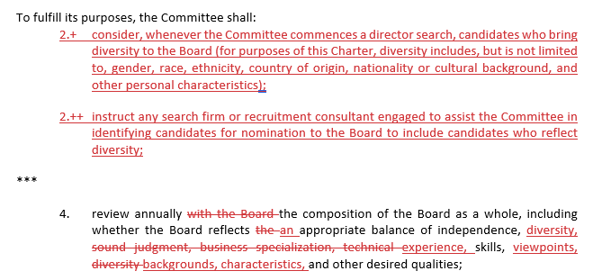
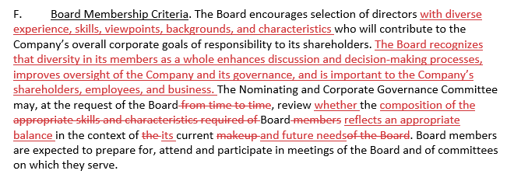
Proposed Board Diversity Guidelines for Adoption
Proposed amended Corporate Governance Guidelines and Nominating & Corporate Governance Committee Charter to include diversity. Full versions of the documents can be found in the appendix.
NOMINATING & CORPORATE GOVERNANCE COMMITTEE CHARTER
CORPORATE GOVERNANCE GUIDELINES

Slide 13
ESG Committee Next Steps
TASK | DEADLINE
Update ISS per Proxy assessment and ISS consultation | Early June
Internal working committee finalize SASB/UNSDG feasibility & timeline and make recommendations for ESG Committee review | Mid June
ESG Committee to review and finalize and recommend selected SASB [goals] and UNSDG [alignment] to the board | Early July – provide materials in ample time to digest before July 26 meeting
Board to adopt selected SASB [goals] and UNSDG [alignment] | July 26 meeting
Document Approval: Human Capital Management Guidelines (updated) Environmental Commitment (updated) Labor Rights Guidelines (new) Vendor Code of Conduct (new) | July 26 meeting
Board to approve adoption of diversity definition (if not approved in May meeting) | July 26 meeting
Disclose Operator Survey results as available | July 26 meeting
Begin TCFD Disclosures discussion | October meeting
Publish ESG Report | Nov. 1

Slide 14
Appendix
Nareit comment letter regarding SEC Climate Disclosure Proposal
Examples of Diverse Candidate Search Language
Amendment to Corporate Governance Guidelines
Amendment to Nomination & Corporate Governance Committee Charter

