Slide 1
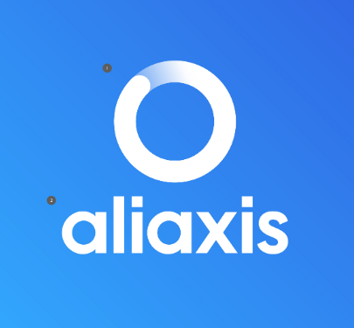
Aliaxis Next - Logo – Crowdsource Design Challenge Creative brief for Logo Design
Aliaxis NEXT a brand-new commercial division of Aliaxis
Logo should connect to Aliaxis Next Values & Activities
Key general topic: Water & Water management
Driver: creating global societal impact
Image: entrepreneurial; dynamic and passionate; impact; water; sustainability; compassion; digital; disruptive; “emotional connection to the message”; innovation;
Sustainability Development Goal 6 “Clean water and sanitation for all”
Additional background: Aliaxis Next comprises of 4 business areas:
Access to water
Re-use of water
Resilient water infrastructure
Water for food
Should ideally have visual reference to “Mothership” logo – Aliaxis Logo
(1) The ‘flow’ symbol: The ‘flow’ symbol acts as a shorthand for the essence of Aliaxis brand ‘we make life flow’. The 10:30 position of the gradient ensures a sense of acceleration and momentum, in turn positioning Aliaxis as a forward-thinking progressive business.
(2) The wordmark: The lowercase letters communicate openness and humility. They also help to reinforce and connect the wordmark to the ‘ﬂow’ symbol conveying a sense of balance and symmetry. The spacing, weight and upright nature of letters evokes strength, solidity and authority.
Note: Aliaxis Wordmark is not mandatory in connection to Aliaxis NEXT
Aliaxis Mothership Logo

