Slide 1

Fraud Digital Identity Factory
- Brief Logo -

Slide 2
WHO WE ARE?
Losam is a marketing agency specializing in the creation and animation of communities.
Losam created a community in partnership with Adobe, a think tank dedicated to anti-fraud director in the bank and insurance sectors.
This new Losam community corresponds to:
-1 founding committee composed of 8/10 leaders which will define the themes of the different meetings
3 meetings a year (3 breakfasts)

Slide 3
WHO IS ?
« LexisNexis Risk Solutions is the global leader in providing critical information that helps governments and businesses in all sectors assess, predict and manage risk. We are part of the LexisNexis Risk Solutions Group, a portfolio of brands spanning various industries and providing clients with innovative technologies, information-based analytics, decision-making tools and data services. »
Their scope:
Give your company the means to succeed
Innovation and expertise
Commitment to data accountability

Slide 4
TARGET & POSITIONING
We create this community to promote LexisNexis Risk Solutions solution, to integrate it into company’s strategies, to network with high-level decision-makers inside companies
Target of the Lab:
Director of Anti-Fraud; Director of Payments; Director of Electronic Security
Positioning:
-High-end, we address a target of corporate decision makers
-Professional, we address corporate companies exclusively
-The club is confidential and is focused on sharing the best practices about design and creation through innovation

Slide 5
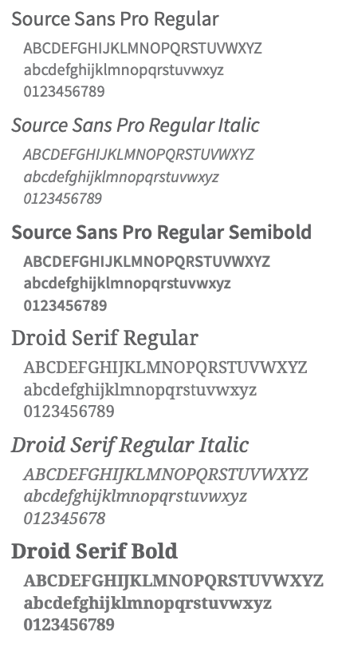
BRAND GUIDELINES - fonts

Slide 6
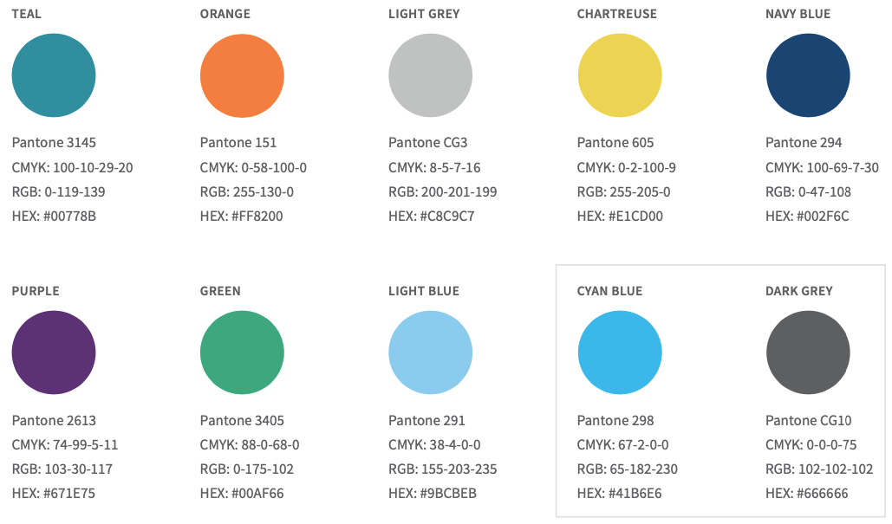
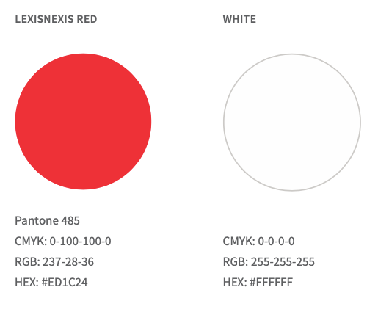
BRAND GUIDELINES - colors

Slide 7
BRIEF
What? A logo
Sector? Bank and Insurance Sectors
Logo text : Fraud Digital Identity Factory
Elegant
Funny
Traditionnal
Personnel
Feminine
Colourful
Low end
Bold
Serious
Modern
Professional
Masculine
Black and White
Top of the line

