Slide 1




LGBTQIA+ For Example Only An Introduction
Presented by:
Patsy Parrish
Dallas Diversity 24/7, LLC
Notes:
Title and graphics should be consistgent with Compass Conference theme Use this a guide only and my logo

Slide 2



Agenda
Lofw64 logo
TBD

Slide 3


Capability Statement
Our company helps organizations become a more supportive and engaging place to work by understanding the perceptual, institutional, and psychological processes that impact the ways people interact with each other. Starting with a look at employee engagement, then identifying interventions surrounding unconscious bias and specific diversity and inclusion strategies. We help anyone committed to going beyond mere compliance to building a genuinely aware and inclusive work culture.
We offer human resource development, leadership development training and consulting, in-person, virtual, or hybrid, training designed to help clients navigate the broad spectrum of diversity categories. All Workshops are designed to enhance understanding of diversity and inclusion; improve their ability to interact with respect, dignity, and fairness; and increase the effectiveness of their communications.

Slide 4
Executive Summary

Slide 5
TBD

Slide 6
TBD

Slide 7
TBD

Slide 8


CORE COMPETENCIES
Diversity, Equity & Inclusion
Human Resource Management
Human Capital Management
Compliance & Community Relations Programs Management
Continuous Process Improvement & Business Strategies
Strategic Business Development
Leadership Development
Public Administration
Business Consulting and Executive Coaching
Diversity Spend Tracking & Reporting
Economic Inclusion
Online & Onsite Training
Talent Management
Superior Communication

Slide 9

DIFFERENTIATOR
Over two decades of experience in varied sectors and industries working with senior leadership teams:
Capability to scale up to meet any size and scope project to help clients achieve results through an extensive associate network of industry experts
Customized, comprehensive professional and leadership development solutions
Unique approach to organizational culture assessment and transformation
Local, domestic, and international delivery experience for over (15) diverse industries
Leverage core principles and Best Agile practice methodologies to propel organization and workforce transformation.

Slide 10
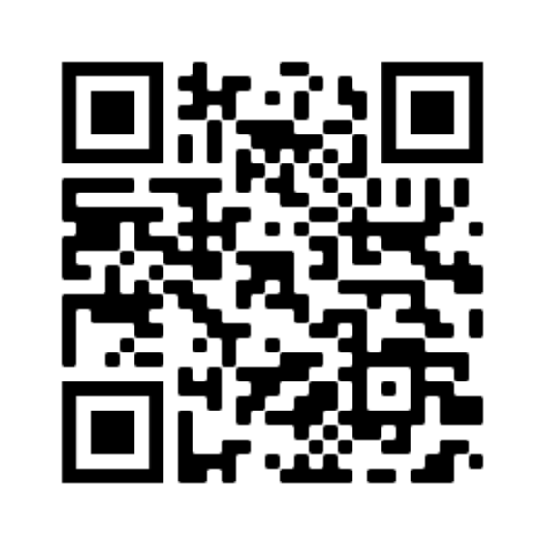


COMPANY INFORMATION
Company name: Parrish Business LLC,
dba Dallas Diversity 24/7
Company address: 1408 N. Riverfront Blvd
#309 Dallas, Texas 75207
Founded: 2014
Corporation Type: LLC
SAM: Registered
DUNS: 0 7 9834366
CAGE Code: 7X N91
Point of Contact: Patsy Parrish, MBA
Email: pat@dallasdiversity247.com
Website: www.dallasdiversity247.com
Phone: 469-456-7813

Slide 11


NAICS CODES
541611 Administrative Management and
General Management Consulting Services
541330 Engineering Services
541612 Human Resources Consulting Services
541613 Marketing Consulting Services
611430 Professional and Management Development Training
541618 Other Management Consulting Services

Slide 12

Certifications

Slide 13
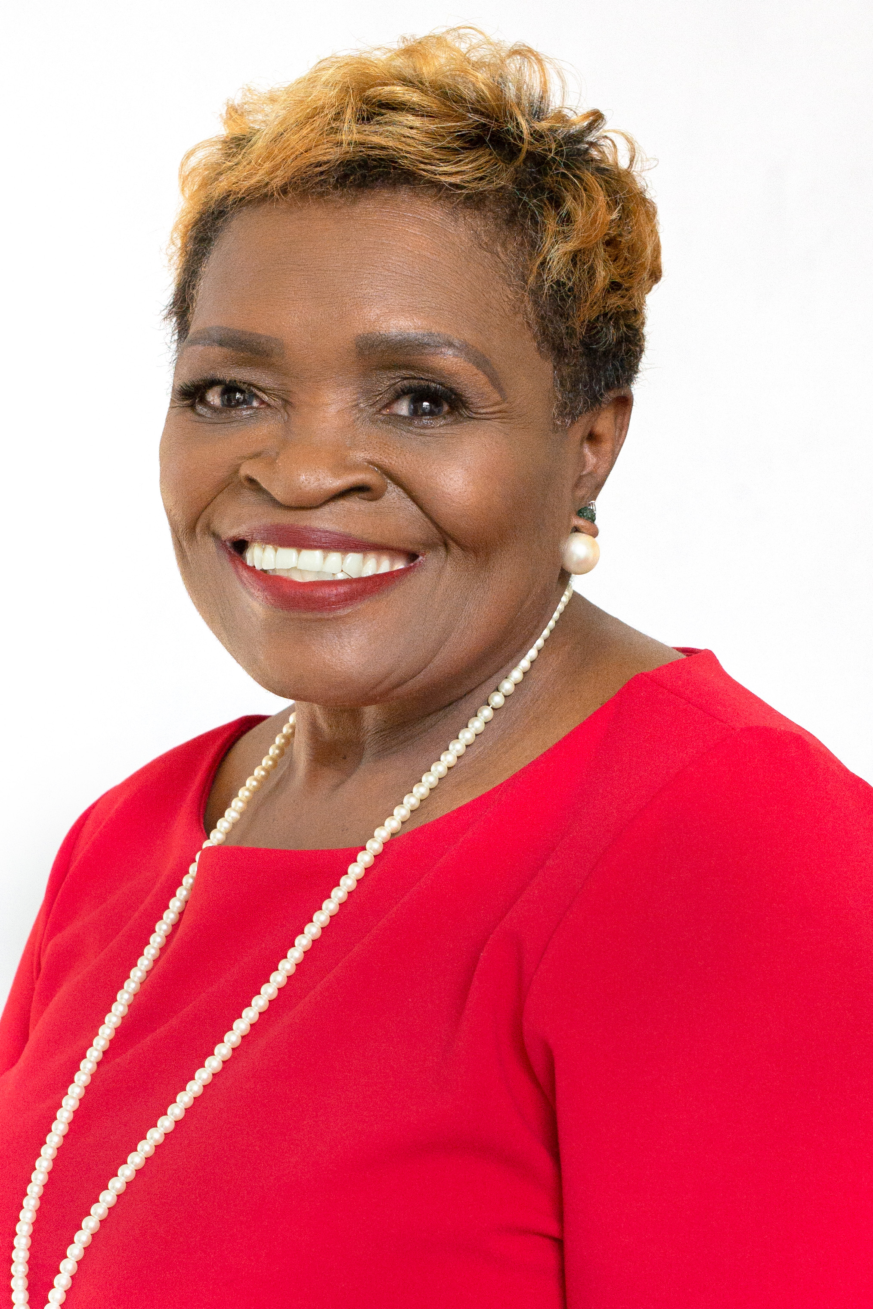
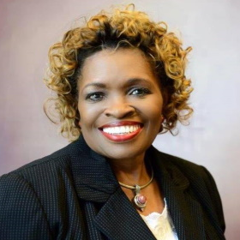




Meet Your Coach…
Patsy Parrish, MBA, HRM
Global Trainer, Coach and Mentor
Management Consultant and Community Advisor
Human Capital Management Innovator
Equity Advisor and Advocate
Use photo in red
(214) 293.2392
pat@dallasdiversity247.com
www.dallasdiversity247.com
1408 N Riverfront Blvd Ste 309 Dallas, Texas 75207

Slide 14
Thank You

