Slide 1
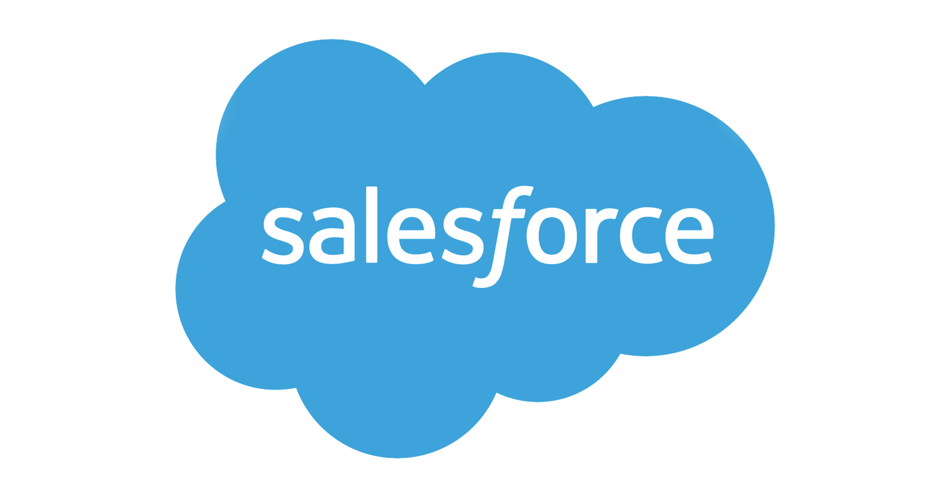
Brief Logo
CMO Lab’

Slide 2
Who we are
Losam Agency is a marketing agency specializing in the creation and animation of communities.
Losam Agency created CMO Lab’ for the company Salesforce, a think tank dedicated to the personalization of the customer experience.
What is CMO Lab’ ?
5 meetings a year (1 “founder” dinner + 4 dinner meetings)
1 founding committee composed of 6/8 leaders which will define the themes of the different meetings

Slide 3
Who is
Salesforce
Salesforce is a software publisher founded in 1999.
The #1 CRM tool for small, medium and large companies
Salesforce offers 5 solutions for different purposes : Sales Cloud, Service Cloud, Marketing Cloud, Salesforce Platform, Commerce Cloud.
Pioneer in the world of cloud computing and SaaS, Salesforce maintains its technological lead
An all-in-one marketing solution, the goal is to optimize all stages of the conversion funnel with clients
The company is about bringing companies and customers together.
More informations can be found here :
https://www.salesforce.com/

Slide 4
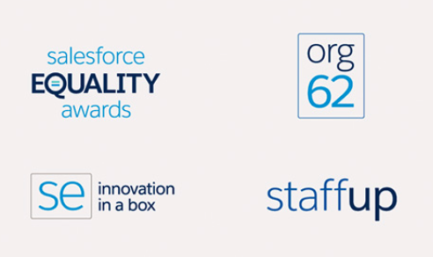
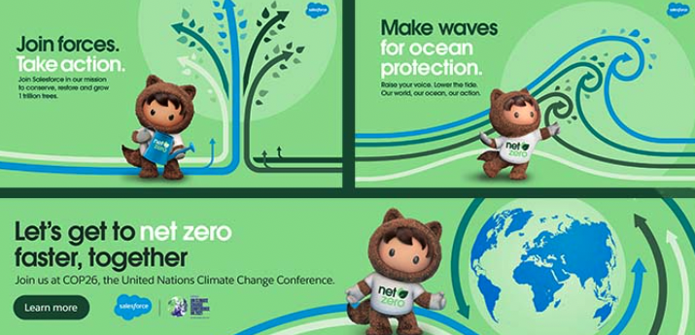


Salesforce - Brand Guidelines
Wording :
Font :
The official Salesforce corporate font is Salesforce Sans OR Avant Garde.
If they are not available, use Calibri.
Salesforce Sans
With four weights — plus italics — you've got options. In general, light weights (Thin and Light) are preferred for headlines, hero statements, and body copy. Heavier weights (Regular and Bold) are used mainly in subheads and calls to action.
Avant Garde

Slide 5




Salesforce - Brand Guidelines
Colours :
The iconic Salesforce Blue is the star of the corporate color palette, which draws inspiration from day and night skies. It's also a subtle nod to the pioneering spirit in cloud computing.
These rainbow colours can also be used to represent products in small touches.
R13 G157 B218
Web #0d9dda
C85 M19 Y0 K0
Pantone 299

Slide 6

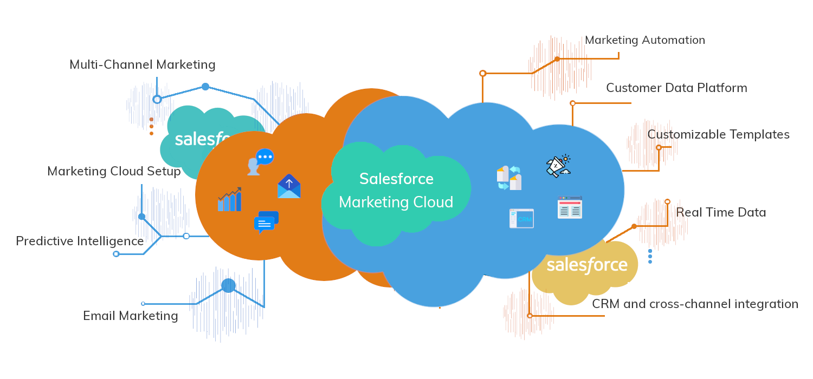

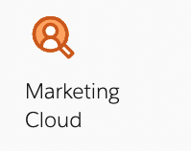
Salesforce - Brand Guidelines
Visual Identity :
Illustration shows the whimsical and fun side of the company and culture. It helps set the brand apart, broadens brand awareness, and creates friendly and positive feelings about Salesforce.

Slide 7
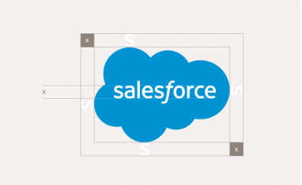
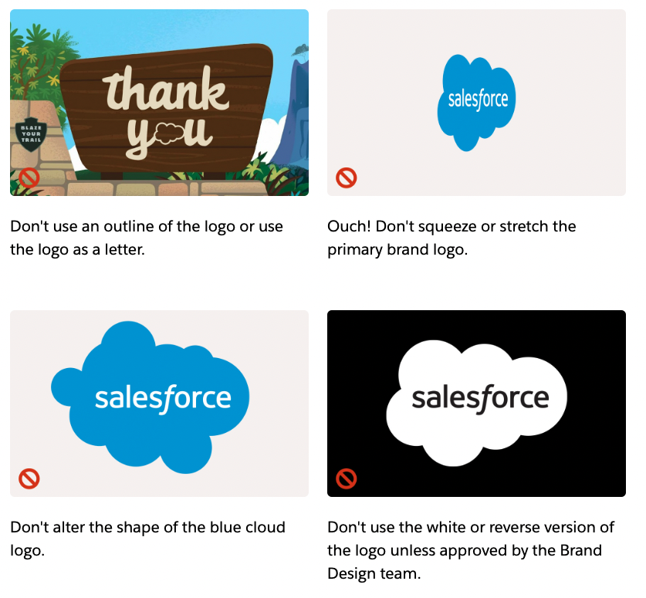
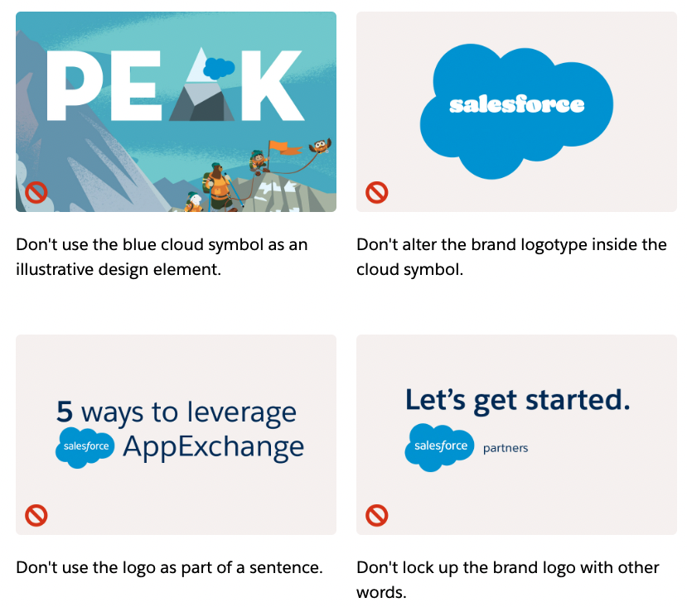


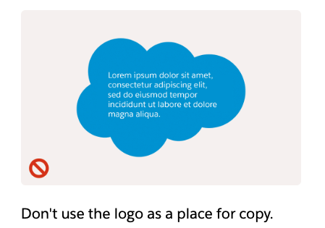
Salesforce - Brand Guidelines
Signets :
Don’t :

Slide 8
CMO Lab’
Target :
Chief Marketing Officers
Group VP Marketing
Marketing Directors
Leaders of CAC 40 / SBF 250, Next Forty, Start-ups (french unicorns)
Leaders who are interested in the best digitized growth strategies, through the essential lever of personalizing the customer experience.
Positioning :
High-end but playful, we address a target of high level leaders in marketing
Improving innovation, community, experience - the theme of the think tank
Innovative skills, fun, creativity, trust, we address companies exclusively

Slide 9
Brief
What: Creating a logo
Sector: Software editor about customer experience
Logo text: CMO Lab’
Elégant
Amusant
Traditionnel
Personnel
Féminin
Coloré
Bas de gamme
Audacieux
Sérieux
Moderne
Professionnel
Masculin
Noir et Blanc
Haut de Gamme
v
v
v
v
v

Slide 10



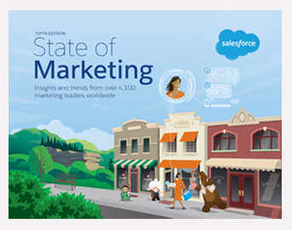
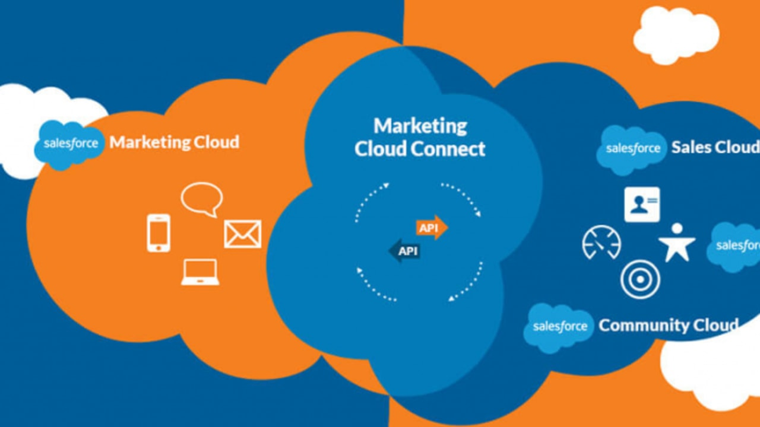

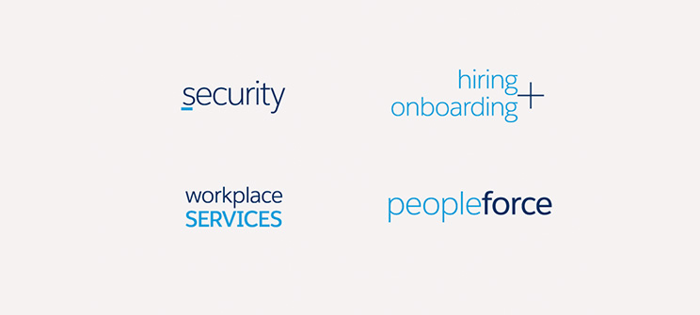
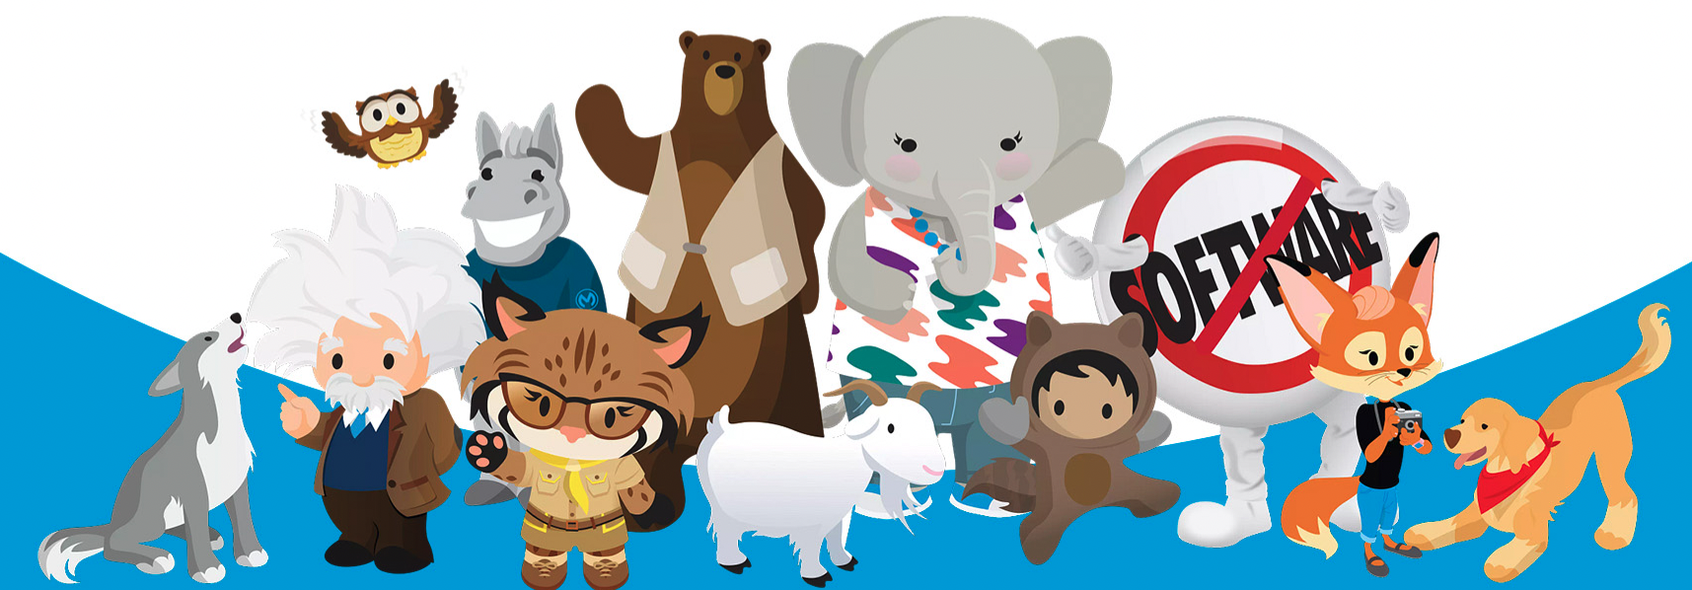
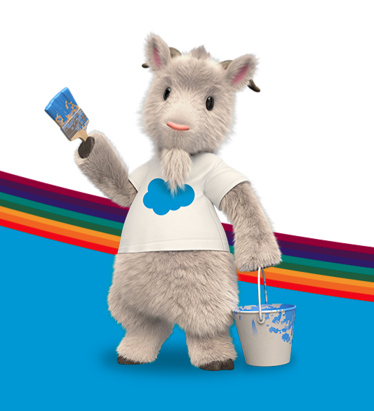
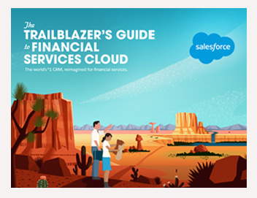
DNA of Salesforce
Keep the DNA of the client Salesforce

Slide 11




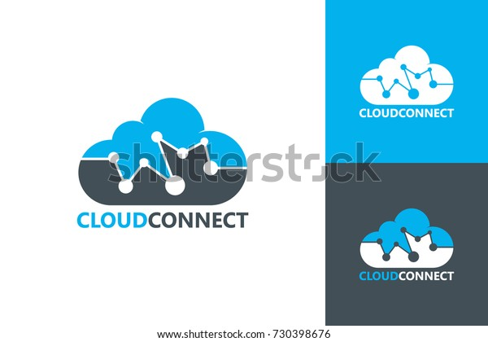

Inspiration #1
Salesforce Blue
Serious
Creative
Suggests innovation and skills
Cloud computing and technology

Slide 12

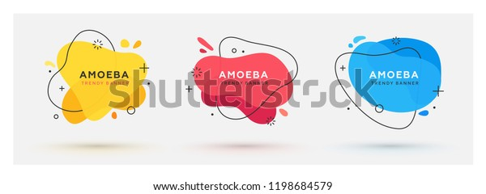
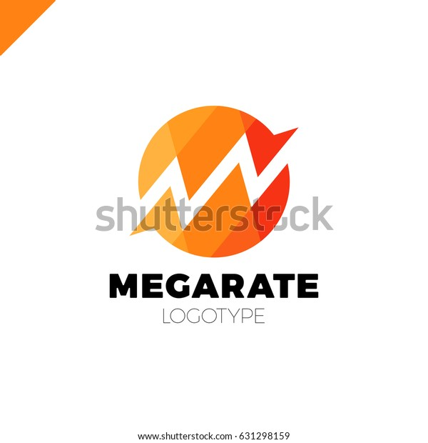
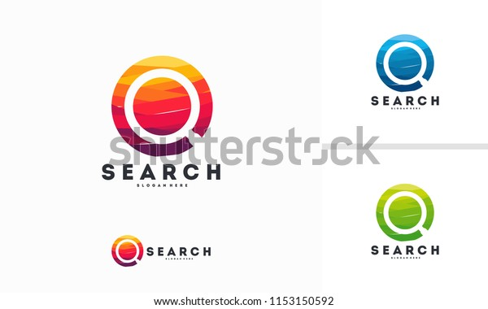





Inspiration #2
Colorful and playful
Notion of community
Magnifying glass to suggest the Salesforce’s tool « Marketing Cloud »
Without any black/ black lines

