Slide 1

The way forward

Slide 2
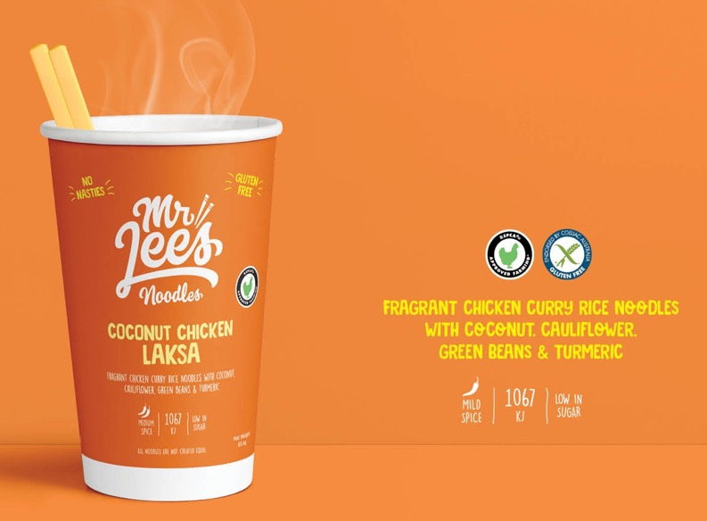
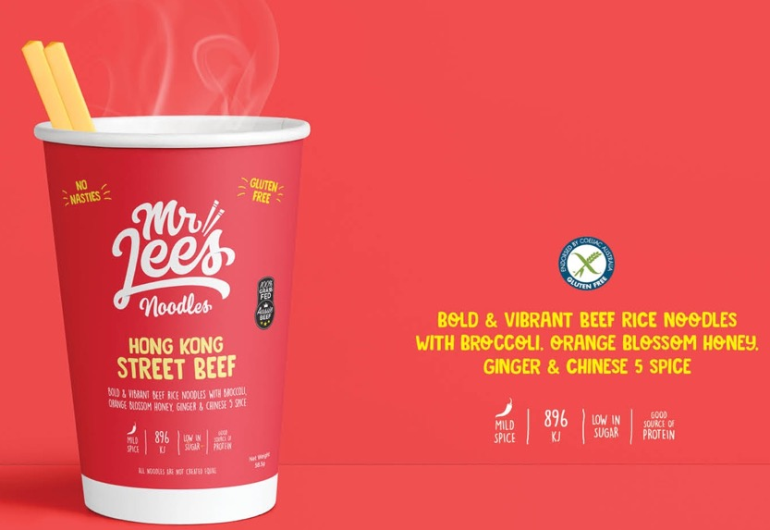
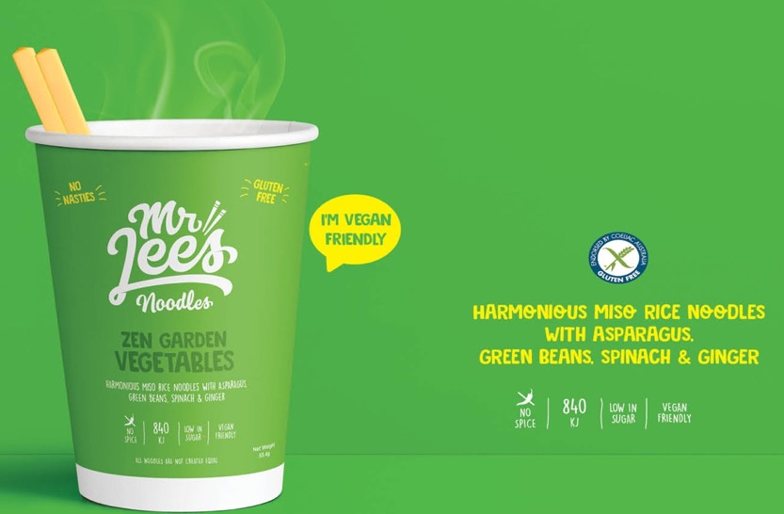
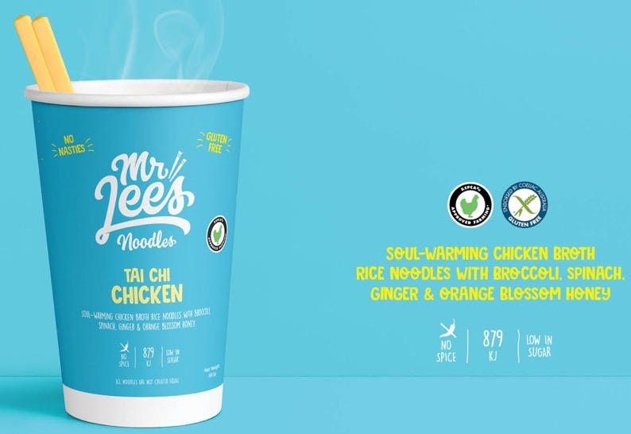
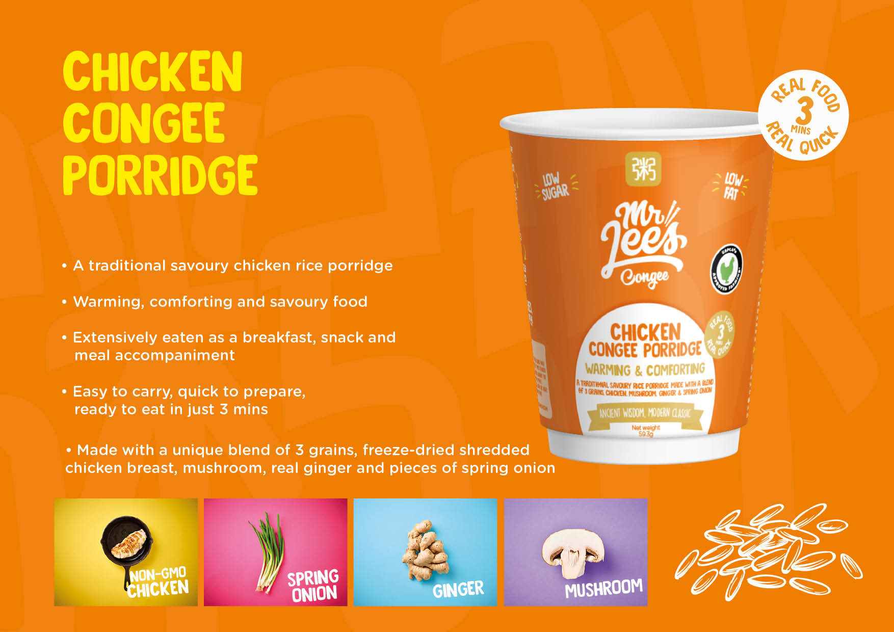
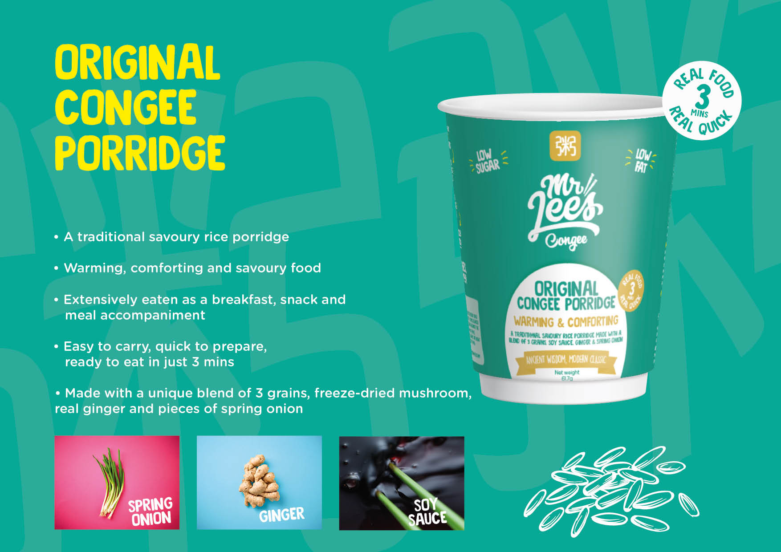
What we do…..
Our premium range
$4rrp

Slide 3
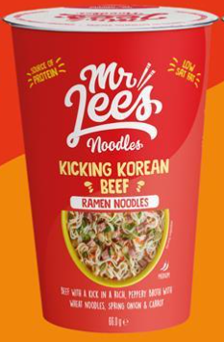
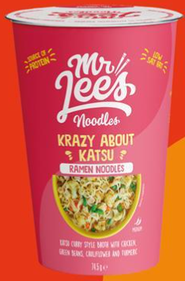
What is next
‘No Nasties’ Ramen collection
Totally Tonkatsu
Spicy Chicken
Kicking Korean Beef
Malay Jungle Curry
$3rrp

Slide 4
And Finally for 2022 – Mr Lees Simply soup
Simple soups aimed as entry level to attract customers to better for you products – Noodles + seasoning
Warming Chicken soup
Asian beef soup
Chicken Laksa soup
Vibrant Miso soup
$2rrp

