Slide 1
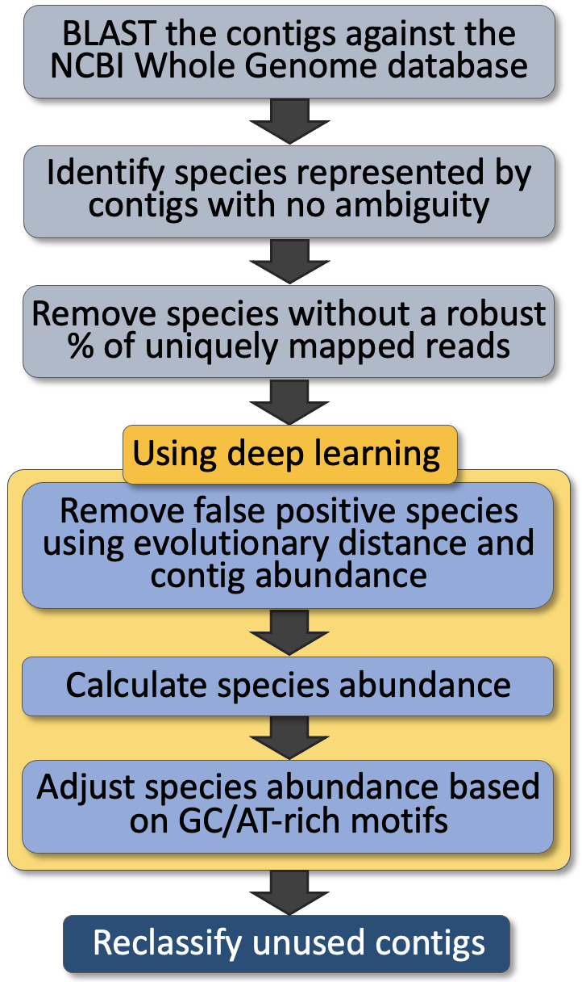
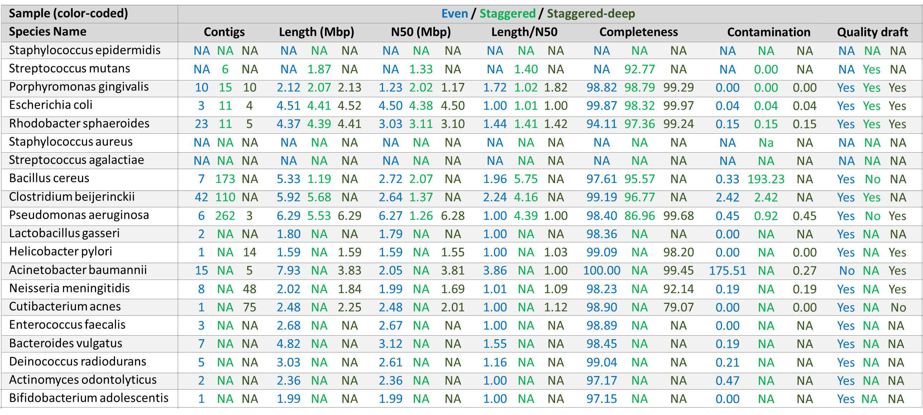
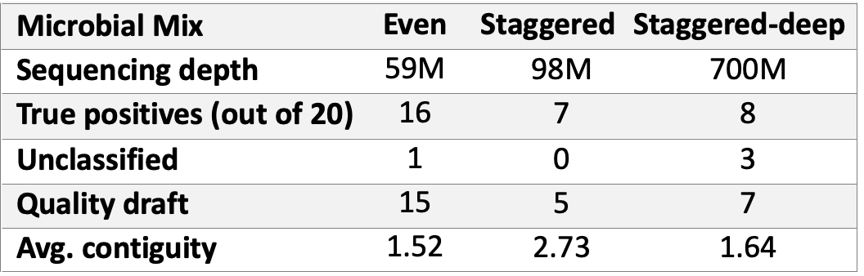
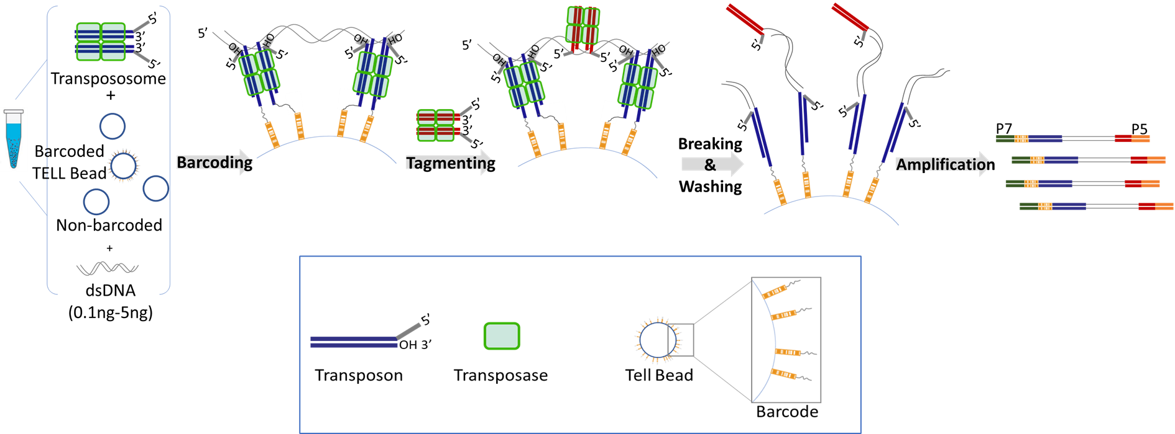
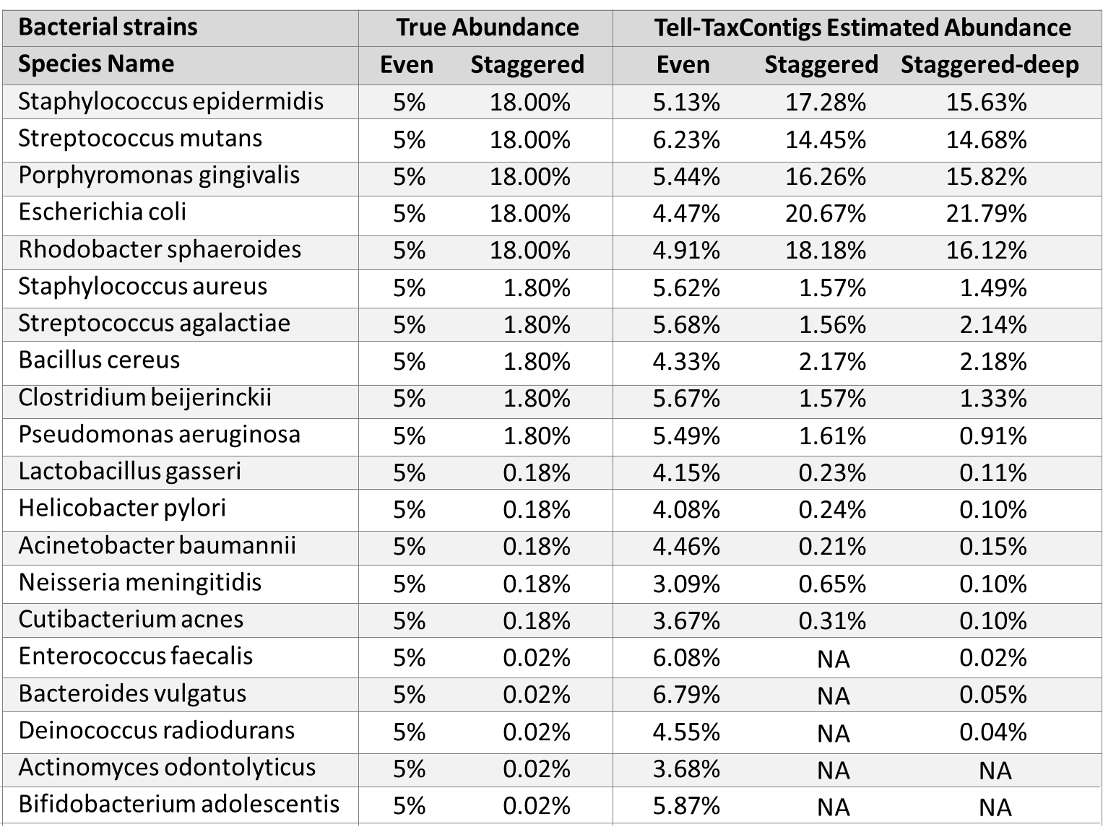
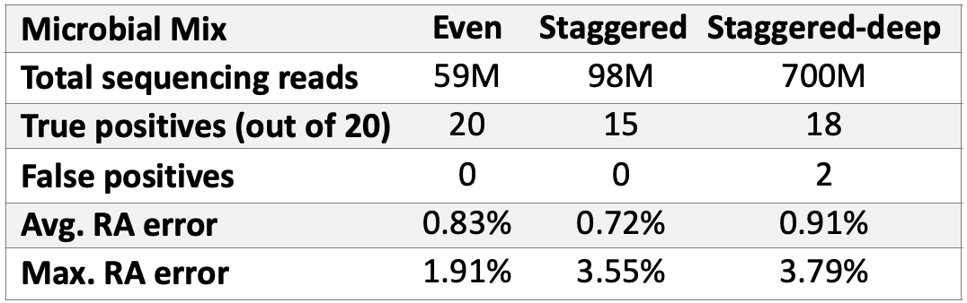
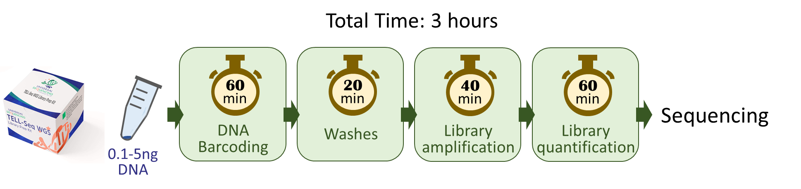

Tell-TaxContigs: Microbial Metagenome Assembly, Taxonomy, and Abundance Estimation Using UST TELL-seq Long-range Information
Colin Heberling¹, Long Pham², Sree Krishna Chanumolu⁴, Hasan H. Otu³, Yu Xia², Peter Chang², Andrew Anfora², Ivan Garcia-Bassets², Tom Chen², Yong Wang¹
¹ Universal Sequencing Technology, Canton, MA (USA); ² Universal Sequencing Technology, Carlsbad, CA (USA); ³ OTUFY, Lincoln, NE (USA); ⁴ GeneFront, San Jose, CA (USA)
Abstract. Deconvolving diversity of a metagenome is critical for understanding the role of a given microbial community in human health and disease, small molecule biosynthesis, and other complex ecosystems where more reductive analysis proves to be elusive. Metagenomic assembly is one common method for characterizing a metagenome, especially for identifying novel gene content or novel organisms. However, analyzing sequencing data from microbial mixtures with a high dynamic range of relative abundance of strains, close relatedness, and repetitive genomic content amongst members can vastly complicate the genome assembly process of individual microorganisms and strains. Furthermore, efficient assembly requires high fidelity sequencing reads to avoid ambiguities. We previously developed a method that captures long-range molecular origin information from kilobase-long genomic fragments by a process of DNA barcoding that we called transposase enzyme-linked long read sequencing (TELL-seq) developed by Universal Sequencing Technologies (UST)¹. TELL-seq barcoded fragments can be sequenced with instruments that process short reads (i.e., high-fidelity sequencing). Here, we show that integration of TELL-seq data with a computational pipeline that combines de novo genome assembly (Tell-Link) with taxonomic classification and abundance estimation (Tell-TaxContigs) provides highly accurate metagenomic analyses. We show how the application of Tell-Link and Tell-TaxContigs on sequencing data generated from commercially available microbial mixture standards results in genome assemblies with contiguities larger than 1Mbp (N50), and highly accurate classification and relative abundance estimation for organisms at 0.18% or greater relative abundance, respectively. Therefore, Tell-Link, in combination with genome binning software (e.g. metabat2²) provides highly contiguous and high-fidelity genome assemblies of abundant organisms in a metagenomic sample. Tell-TaxContigs classifies contigs and unassembled reads with BLASTn and using a deep learning approach resolves ambiguities, rules out false positive classifications, and accurately estimates relative abundances of classified species. This approach has an average margin of error of lower than 1% in enumerating relative abundance for the microbial mixture standards tested.
Tell-TaxContigs Overview
1. Metagenomic Assembly & Genome Binning
Detailed metagenomic assembly and genome binning results
Metagenomic assembly summary
Notes on metagenomic assembly:
Contiguity is defined as assembly length divided by N50 score.
Quality draft denotes medium quality draft assembly according to Bowers et al. (2017)³ minimum information of MAGs.
Conclusions. UST TELL-seq allows for long-range information to be integrated into short-read sequencing projects. This offers several advantages to standard whole metagenome shotgun sequencing projects. We have shown that de novo assembly of TELL-seq barcoded Illumina reads results in highly contiguous, high fidelity binned genome assemblies with N50 scores in the Mbp range. Achieving this level of contiguity and fidelity normally requires the hybridization of high-fidelity short reads with error-prone long-read technologies, ideally from the same DNA extraction⁴. Using UST TELL-seq is a simpler process that can achieve similar results, with only a single sequencing source. As a result, the highly contiguous and accurate contigs generated with TELL-seq can be used for various metagenomics downstream analysis steps, such as taxonomic classification and relative abundance estimation, with relatively low margins of error, as we have demonstrated with Tell-TaxContigs. Tell-TaxContigs will be released publicly later this year.
How Does UST TELL-seq Work?
2. Taxonomic Classification & Abundance Estimation
Transposase Enzyme Linked Long-Read Sequencing
Detailed classification results
Classification summary
TELL Bead
TELL Bead
TELL Bead
TELL-seq Library Workflow is Simple & Scalable
References
1. Chen, Z et al. 2020. Genome Research 30: 898-909.
2. Dongwan et al. 2019. PeerJ, 7:e7359
3. Bowers et al. 2017. Nat. Biotechnol. 35:725–731
4. Wick et al. 2017. PLoS Comput Biol 13(6): e1005595.

