Slide 1




CoMax Capitol New Logo Launch
Overview
CoMax Properties, the parent company, is a real estate investment firm located on Long Island N.Y. We are direct home buyers that buy houses in any situation or condition including damaged homes, inherited homes, foreclosure avoidance, relocating, or downsizing. We rehab the homes and then put them on the market for sale. CoMax Properties is now launching a new division called CoMax Capitol. This new division will focus on investing in multifamily properties like apartment complexes and buildings
Design Direction
We are looking for a design that is in line with our main logo but for CoMax Capitol we would like to add in a graphic of a multiple type buildings and add in the colors of Navy and Steel Gray

Slide 2


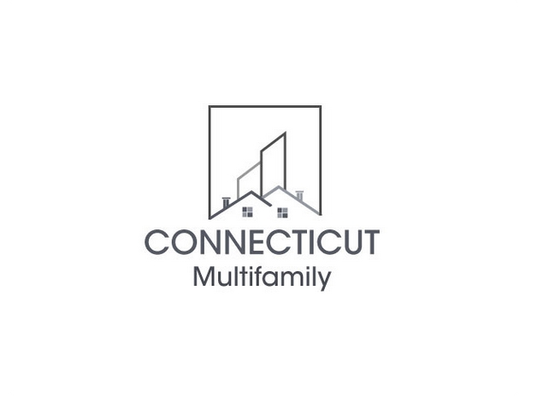

CoMax Capitol New Logo Launch
CoMax Properties Main Logo:
Other company logos we like:

Slide 3
CoMax Capitol New Logo Launch
Where will the Logo live
Website
Other websites (BBB etc)
Direct Mail
Business Letterhead
Email footer
Merchandise
Need versions for SOCIAL MEDIA
Instagram :
  Profile Pic (circle)
Facebook
  Cover Pic
  Profile Pic
Linkedin :
  Profile Pic (circle)
  Banner
Twitter
  Banner Pic
  Profile Pic (circle)
YouTube

