Slide 1
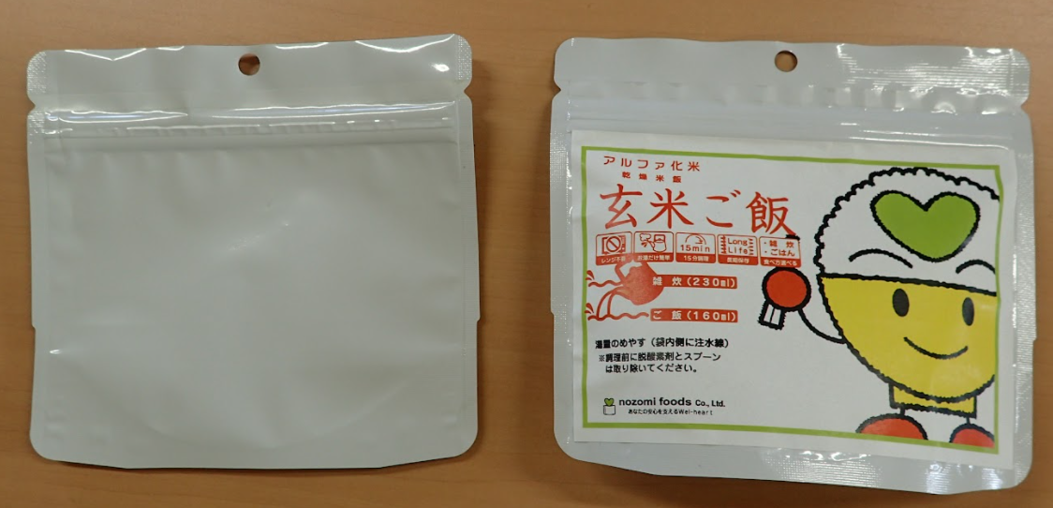

Slide 2
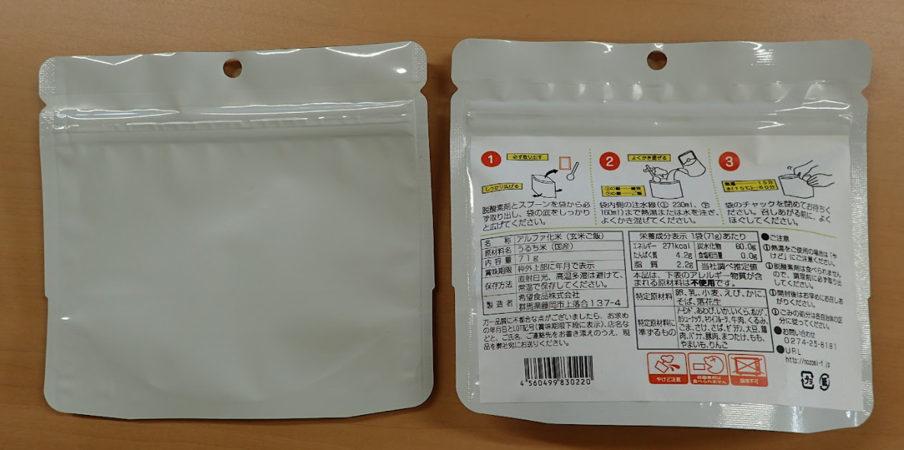

Slide 3
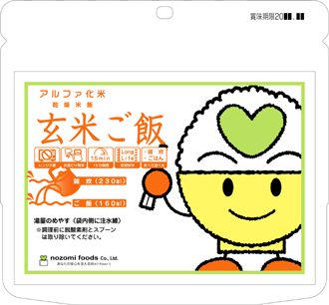
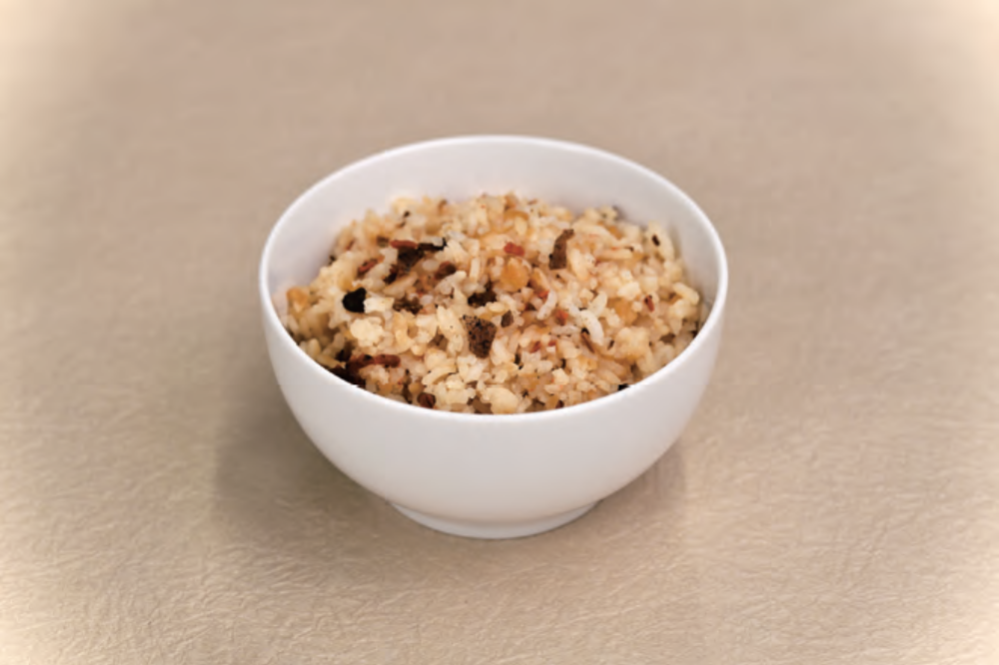

https://kamui.co/
Made in Japan
First product: Mixed Rice
Label size: 105 mm x148 mm
Our brand: KAMUI

