Slide 1


Shield with stalactite and crossed hammers – rough idea
STALACTITE FITNESS
Consistency creates
Lasting results

Slide 2
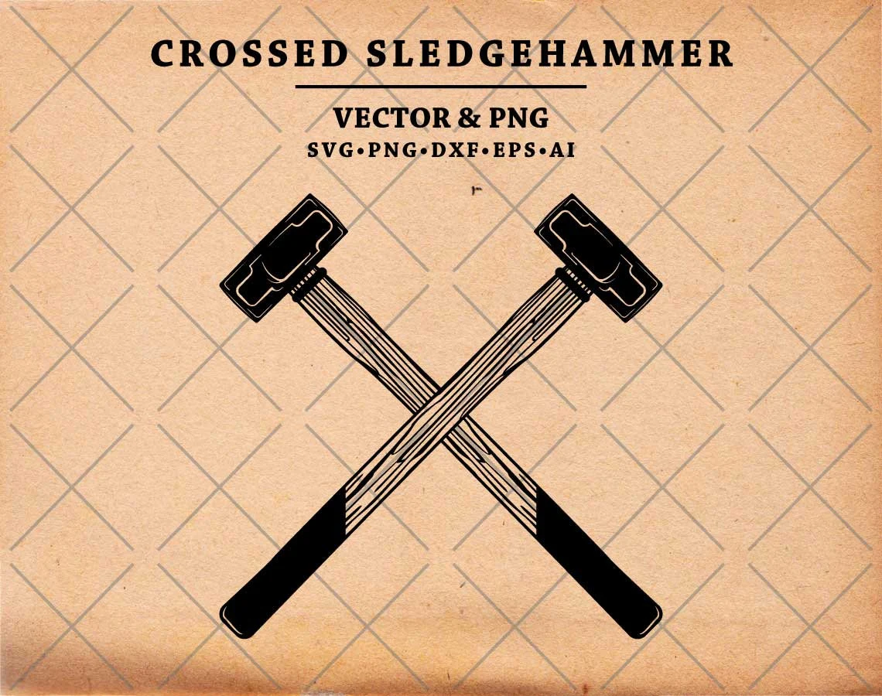


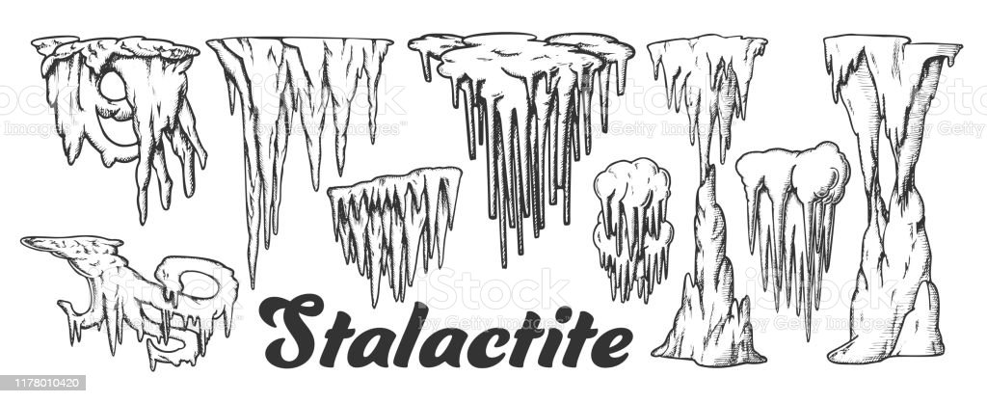
Potential themes:
Stalactite/stalagmite
Crossed hammers
Crossed arrows
Shield background
Military/industrial feel
Weathered look
Simple design

