Slide 1

KMG/Freddy’s Announcements

Slide 2
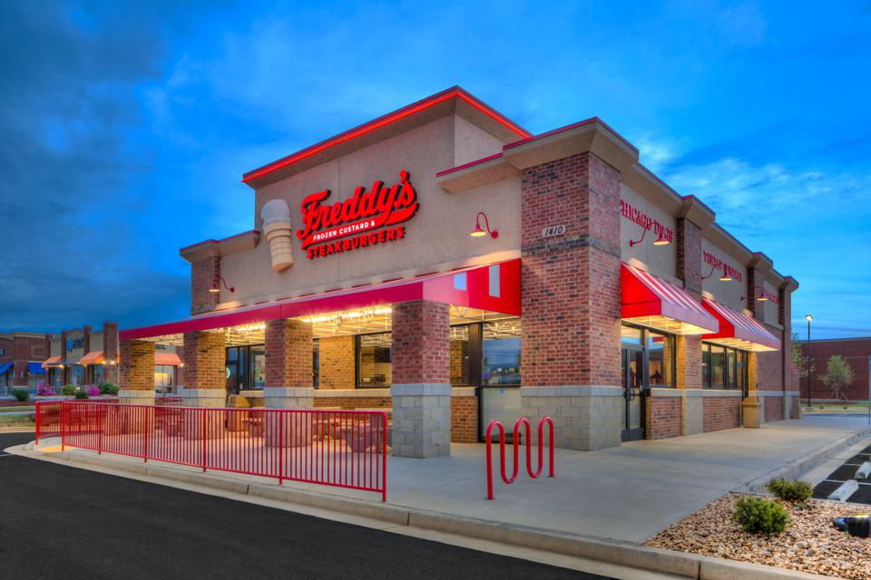
Upcoming Brink Conversions
  Stetson Hills: 3/13/22
  Garden of the Gods: 3/14/22
  Interquest: 3/15/22
  Orange Park: 3/15/22
  Academy: 3/16/22
Fish LTO starts 2/23/22
  Video Due: 2/21/22

Slide 3
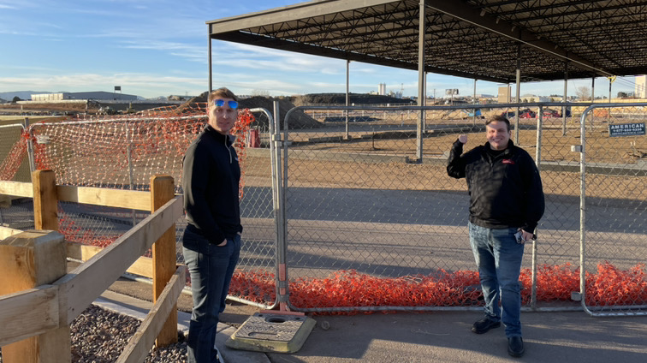
Construction/ NRO Updates
Collecting Bids from Construction Teams

Slide 4



Slide 5
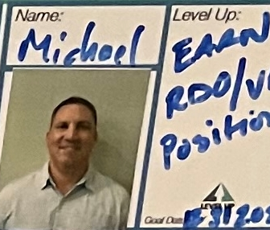
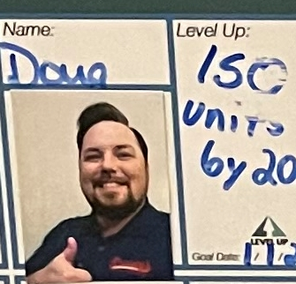
Highlighted Level Up
Michael Pasquale:
Joined KMG in 2019 as the ADO of FL. Strives to grow the FL DMA and increase store count to elevate into the next position.
Doug Tuder:
Joined KMG in 2020 as the COO. Strives to grow KMG into a major powerhouse within Freddy’s.

Slide 6
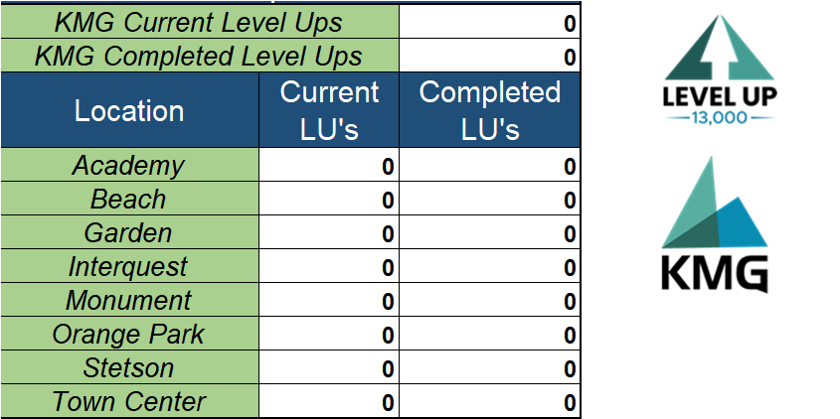
Level Up Counter

Slide 7
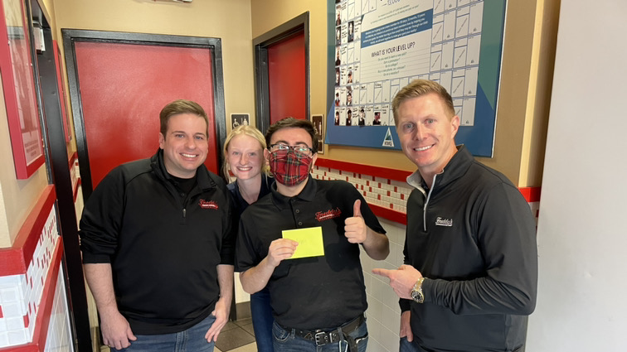
Level Up Achievements
Angelo Notte “Angel” has successfully completed Barber School

Slide 8
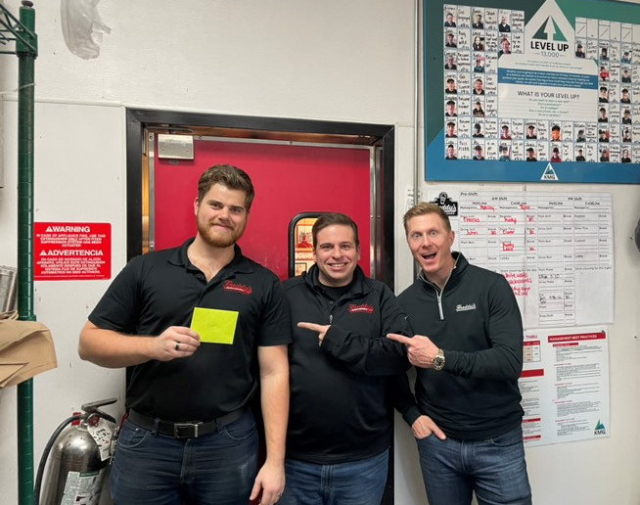
Unique Level Up’s
KMG Family Rivalry:
Ryan “RJ” Wish has thrown the gauntlet down and is out to beat fellow Shift Specialist Dillon Wish at the Grill!

Slide 9
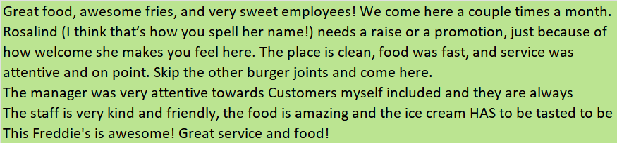
Positive Guest Comments
Monument

Slide 10
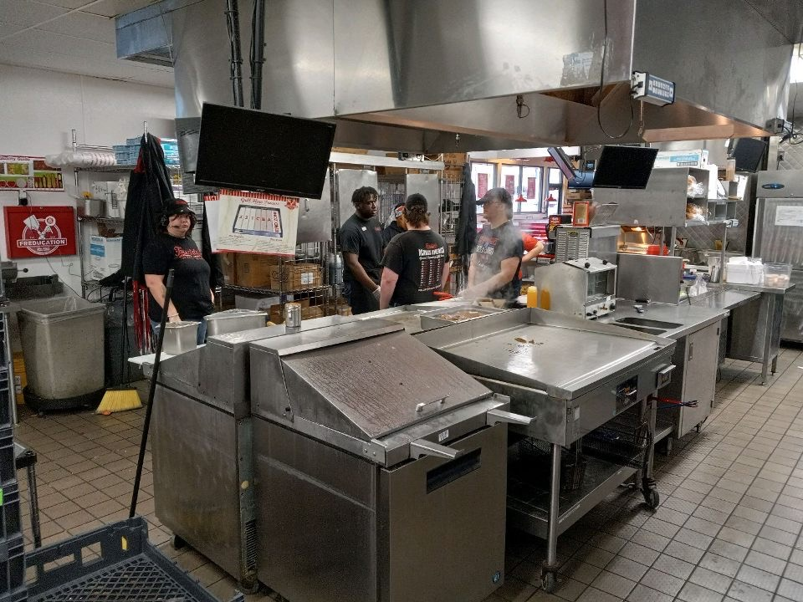
Team Member Highlights
Day 2 of Shift Specialist training, and Gino is leading the days Pre-Shift Meeting

Slide 11
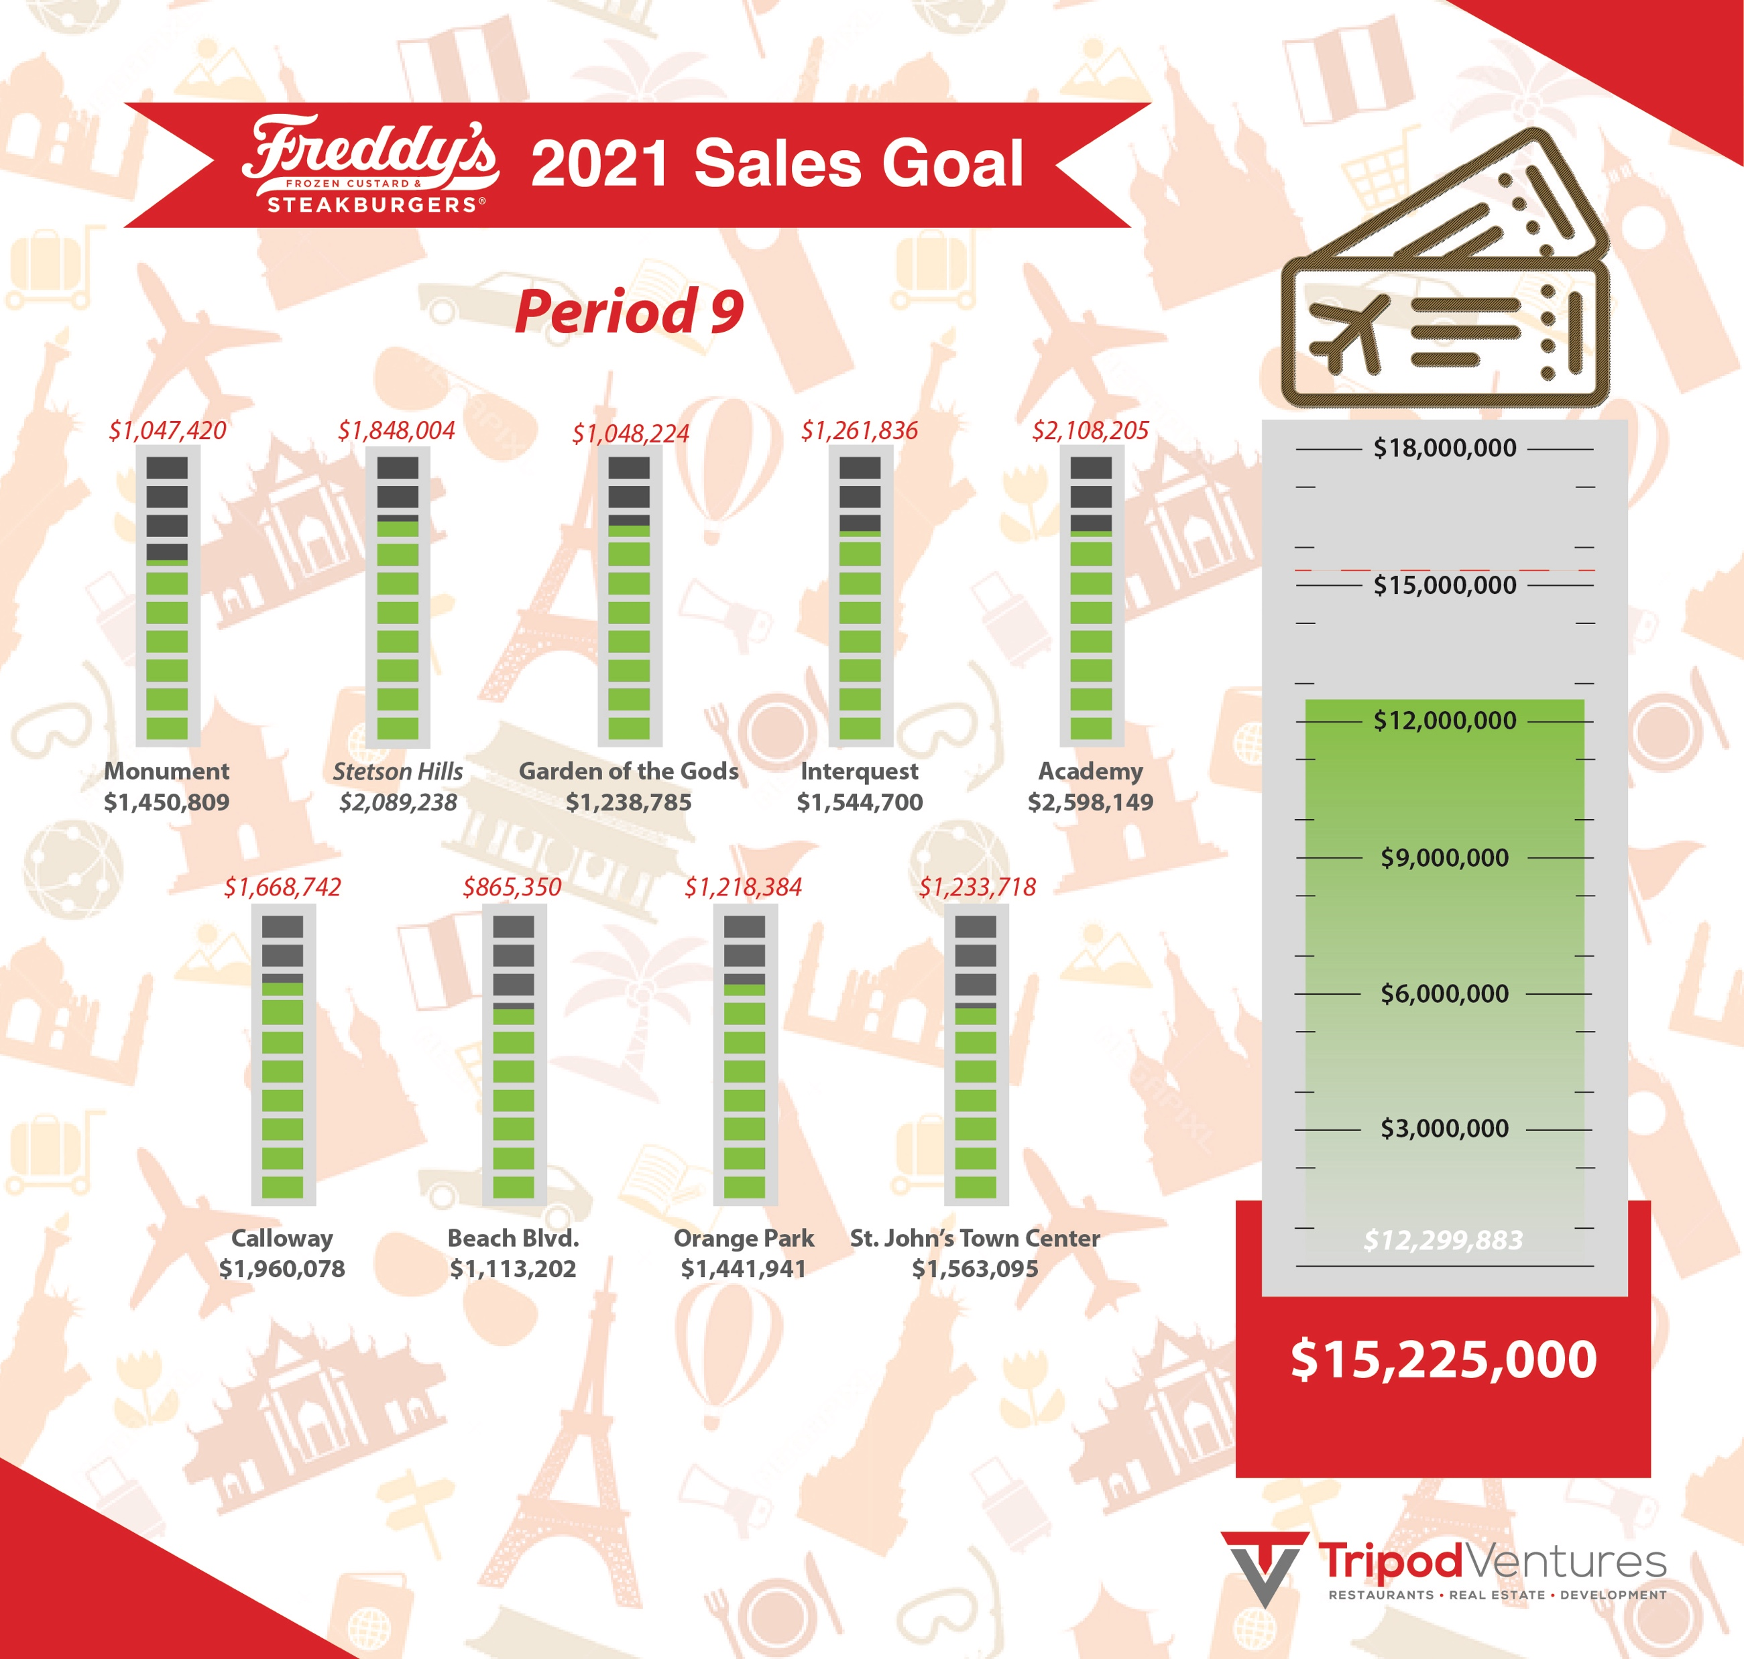
Global Goal Update

Slide 12
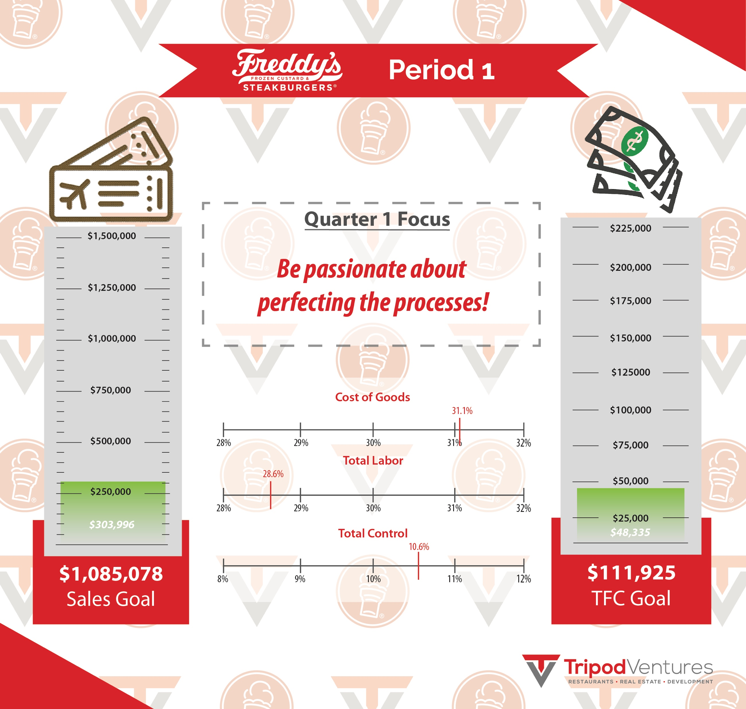
Global Goal Update

Slide 13
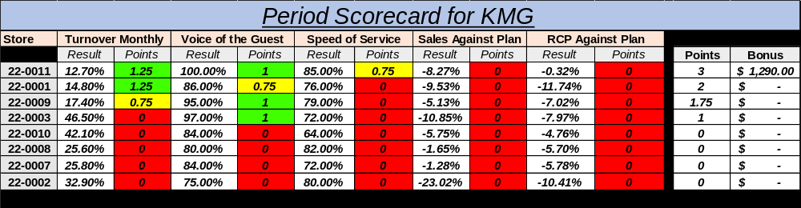
KMG Scorecard

Slide 14

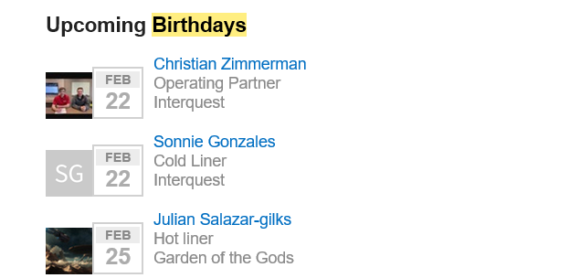
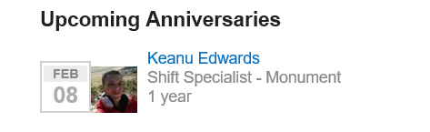
Birthday’s & Anniversaries

Slide 15
Welcoming our new Team Members
Name | Location | Job Title | Hire Date
Lillie, Deon’dre | Academy | Hot liner | 02/14/2022
Maese, Jaylyn | Academy | Cold Liner | 01/28/2022
Leija, Donevyn | Beach Blvd | Cold Liner | 02/15/2022
Nadal, Luis | Beach Blvd | Hot liner | 02/08/2022
Wyss, Amy | Beach Blvd | Cold Liner | 01/28/2022
Jones, Tiffany | Garden of the Gods | Cold Liner | 02/07/2022
Jackson, Jodi | Garden of the Gods | Hot liner | 01/31/2022
DeMarchi, Nathaniel | Interquest | Hot liner | 01/29/2022
Ortiz, Franco | Monument | Hot liner | 02/15/2022
Jackson, deion | Monument | Hot liner | 02/04/2022
Flowers, Mira | Monument | Cold Liner | 02/04/2022
Belknap, Joey | Monument | Hot liner | 01/27/2022
Hutchinson, Z | Orange Park | Hot liner | 02/16/2022
Bridges, Davashia | Orange Park | Cold Liner | 02/06/2022
Ives, Samuel | Orange Park | Hot liner | 02/06/2022
Curry, Paige | St. Johns Town Center | Cold Liner | 02/15/2022
Scott, Tanesha | St. Johns Town Center | Hot liner | 02/13/2022
Lloyd, Corey | St. Johns Town Center | Hot liner | 02/06/2022
Schmahl, Elexas | St. Johns Town Center | Cold Liner | 02/05/2022
Wiggins, Z | St. Johns Town Center | Cold Liner | 02/04/2022
Williams, Krissy | St. Johns Town Center | Cold Liner | 02/04/2022
Carpenter, Dawson | St. Johns Town Center | Cold Liner | 02/03/2022
Curry, Paige | St. Johns Town Center | Cold Liner | 02/01/2022
Mckie, kaylee | St. Johns Town Center | Cold Liner | 01/31/2022
Gandy, Anaiyah | Stetson Hills | Hot liner | 02/03/2022
Paccassi, Matthew | Stetson Hills | Cold Liner | 01/27/2022

Slide 16
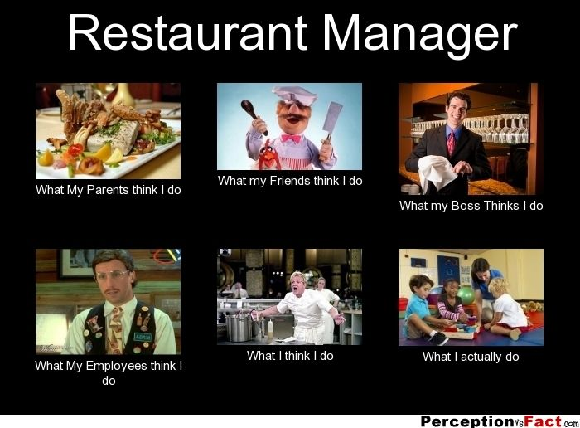
Quote or Meme of the Week

Slide 17

Wounded Warriors
Just an example when needed

Slide 18

Local Store Marketing
Custard Cookie Drop offs for Graduating Seniors of 2022

Slide 19

Voice of the Guest
Restaurant | VOTG Rating | Total Reviews | Negative Reviews | Tickets per review
GRAND TOTAL | 92% | 235 | 23% | 271
CO Springs - Interquest (CO) | 77% | 11 | 27% | 646
CO Springs - Stetson (CO) | 77% | 25 | 36% | 368
CO Springs - Garden of the Gods (CO) | 88% | 14 | 21% | 375
Orange Park (FL) | 89% | 23 | 22% | 355
Jacksonville - Town Center Pkwy (FL) | 89% | 30 | 23% | 311
Jacksonville - Beach Blvd (FL) | 92% | 14 | 14% | 423
Monument (CO) | 97% | 48 | 31% | 151
CO Springs (Fountain) - Venetucci & S Academy (CO) | 100% | 70 | 16% | 164

Slide 20

Team Member of the Period

Slide 21
Team Member of the Period
Athena Collins
Academy
They are an extremely adept team member and they’ve been a gigantic help with covering shifts and helping train up new members of our team

Slide 22

Quarterly Focus
Flawless 4 Wall Execution
Local Store Marketing
Whattaburger Opening in CO
Fish & Mint Oreo Concrete/Cookie
PPA’s
Updated PBR process

Slide 23
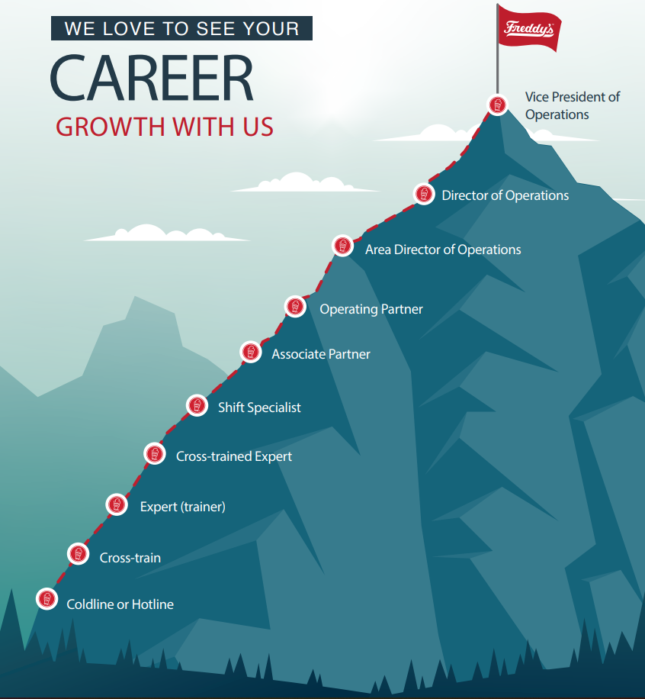
Year to Date Promotions
Christian Zimmerman
Operating Partner
Jadyn Laffler
Operating Partner
Hadleigh Hamilton
Operating Partner
Angelo Notte
Shift Specialist
Tyler Reifschneider
Associate Partner
Olivia Peters
Associate Partner

