Slide 1
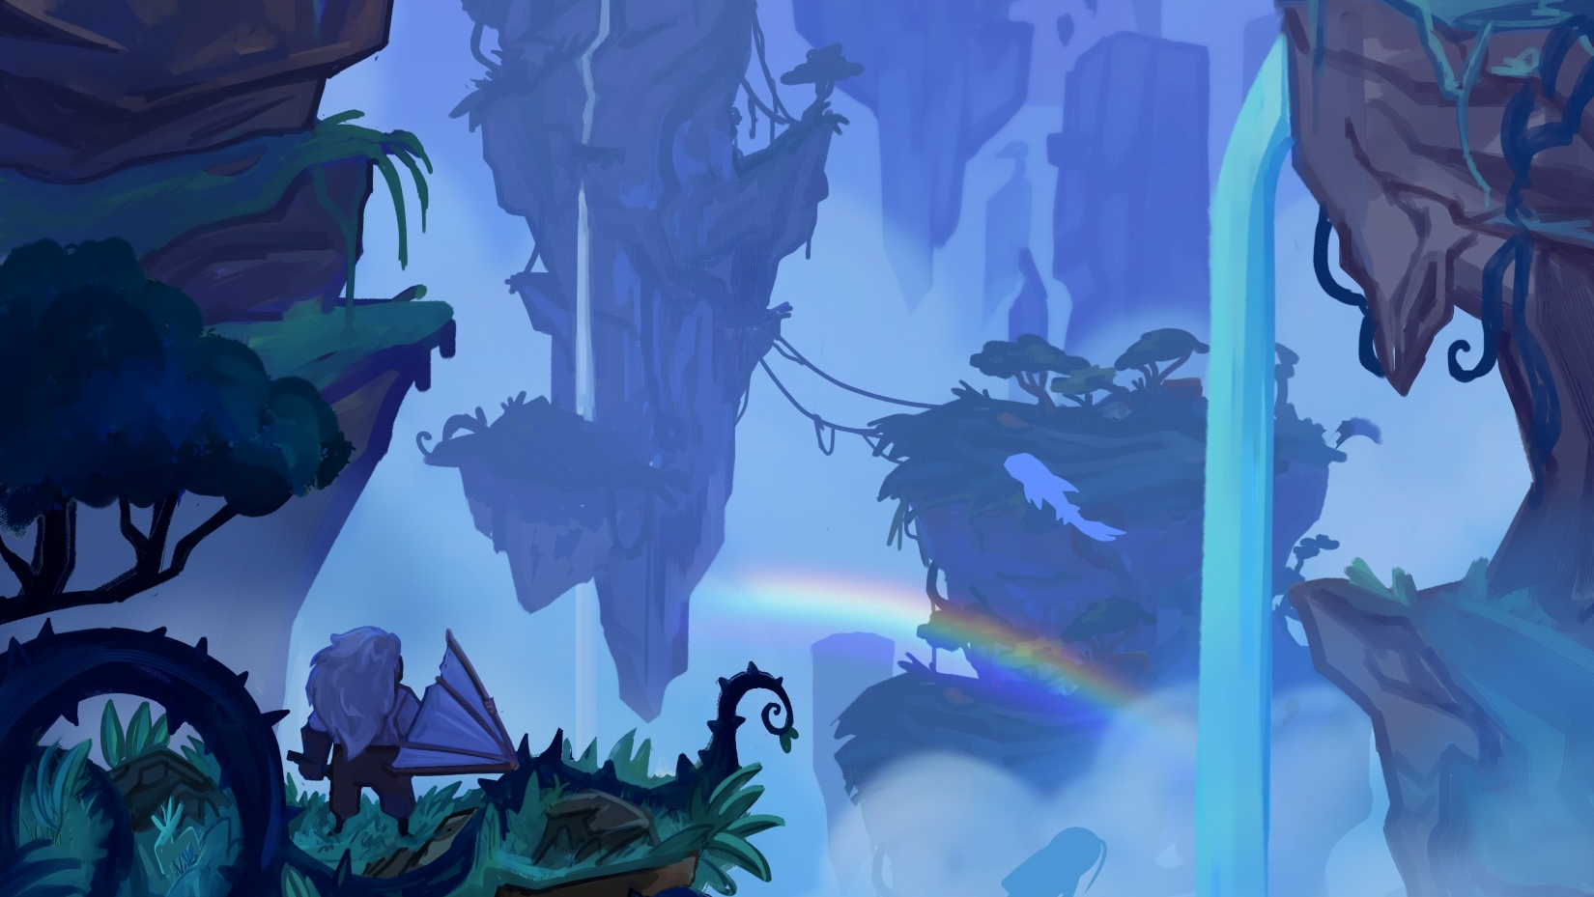
Skylost
Charlie Anderson
Notes:
[POST LINK]
Hello, my name is Charlie Anderson, I am a CSGD master’s student, and may I present: Skylost.

Slide 2
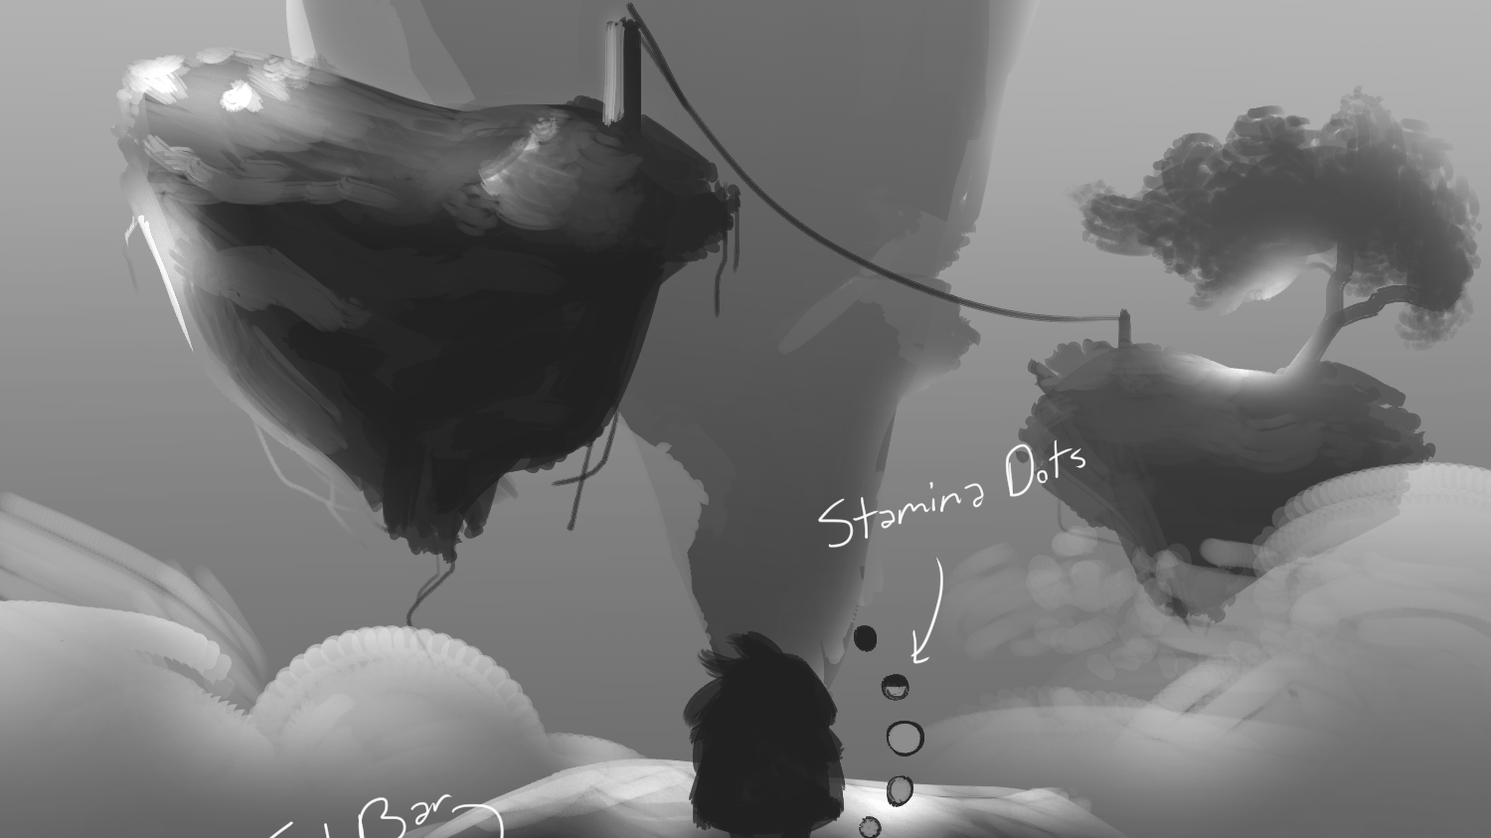
What is Skylost?
Notes:
You, a determined craftsman, open your eyes after crashing your glider into the first island of the Endless Spire, a place off the edge of the map where few ever venture and from where fewer return. You gaze up, seeing the floating islands climb endlessly upward in a vertical sky world, cloaked in thick fog and home to monstrous creatures. But you came here searching for someone, your loved one, who went missing in these parts some months ago. You’ve heard rumors of their expedition team, comprised of the top craftsmen from your village, had something terrible happen to them, and it’s up to you to find uncover what happened. You will gather resources to craft the tools you need, from gliders that fly from island to island to flutes that lull the giant cliff spiders to sleep, to ascend the Spire and uncover the truth of the expedition and the dark secrets of the Spire itself.

Slide 3
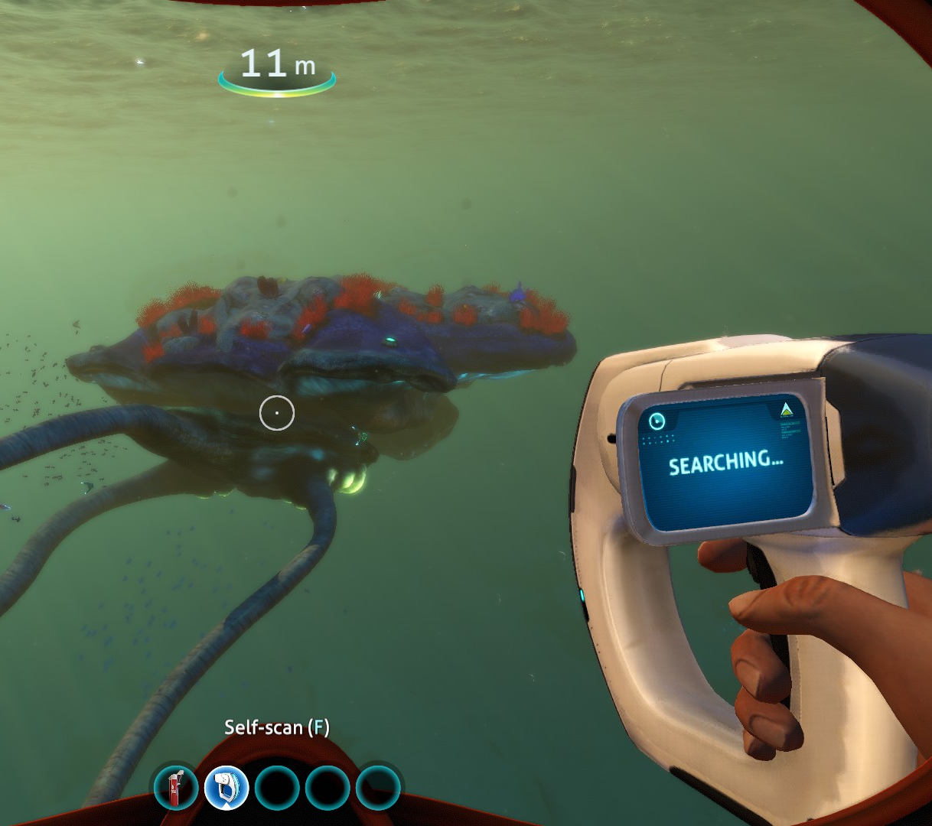
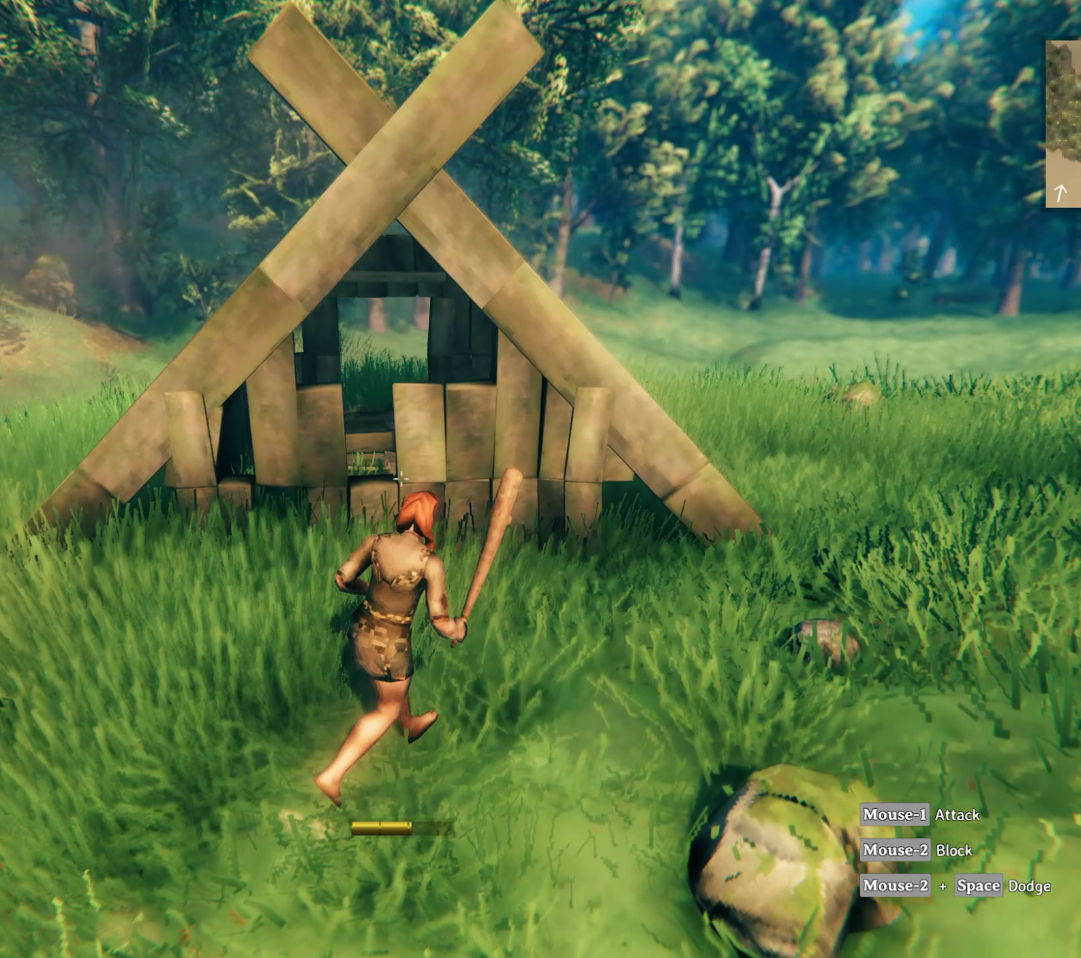
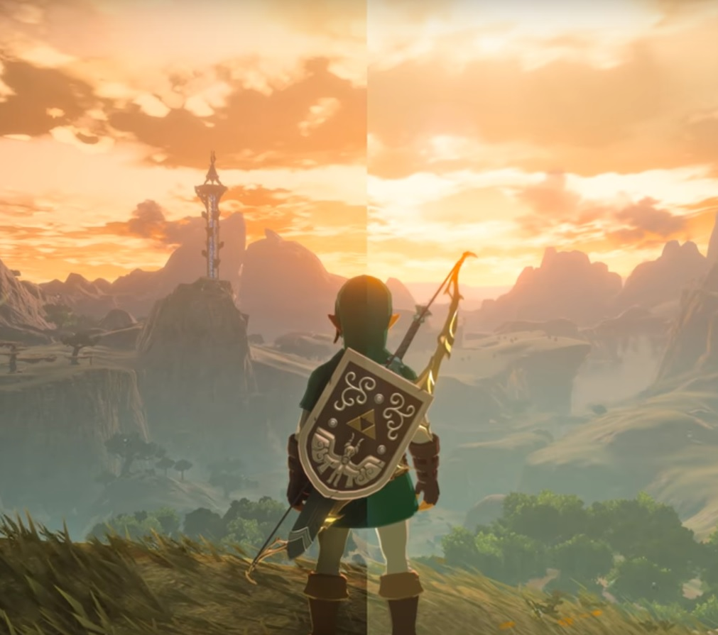
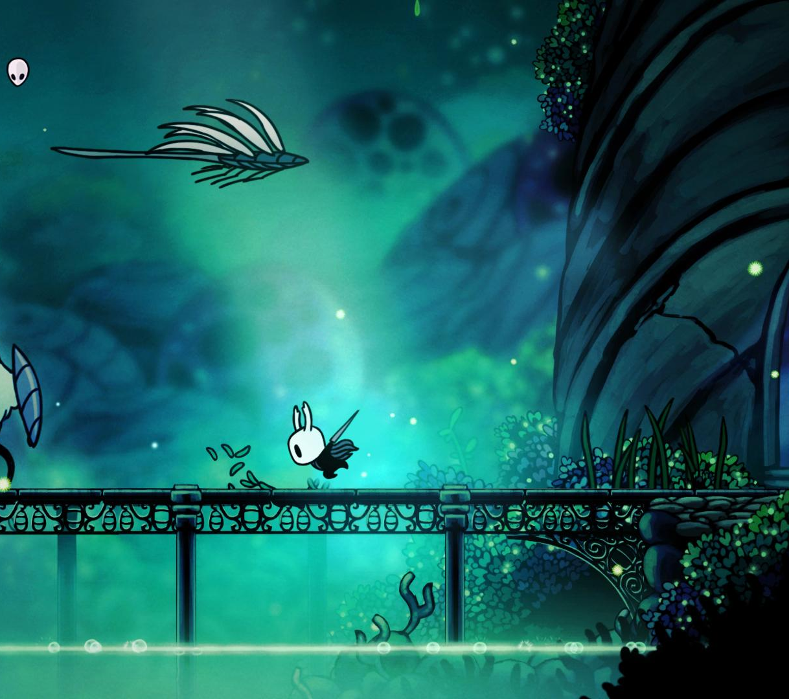
Goals
Experience
Feel like a rugged adventurer
Dangerous and dynamic world, unknown
Player planning
Design
1) Vertical World
2) Crafting
3) Driven by systems
Notes:
Here are some of the games that inspired this project:
This experience will be fostered through an emphasis on a vertical world.
Discovery
Adventure
Fun traversal
Variability in player stories. Crazy stuff that seems to only happen to you!

Slide 4
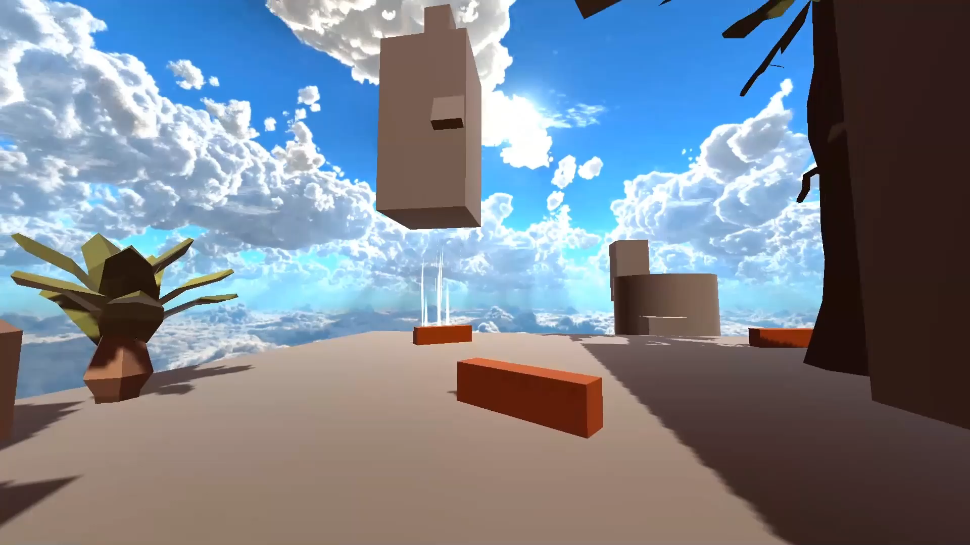
Demo!
Notes:
Let’s see what this might look like in practice.
As you can see we have awoken in a sky world.
On the right you can see our crafting menu and inventory.
We know we want to build a glider to fly around, so we are going to collect wood and leaves do to so.
Now that I’ve made my glider, I’m going to look around at my environment
I notice some feathers over by that dangerous Bugaboo. I also see that I need feathers to upgrade my glider. So, I head over to get them.
Uh oh, looks like he really didn’t like that.
Time to make a new plan. I can stun the Bugaboo with a makeshift Stun Bomb with resources around the environment.
Let me head down and collect the smelly fruit, grab these crackling crystals. And now I have my stun bomb.
Time to head back up and face the Bugaboo.
Now I can use my little bombs to stun him, grab the feather, and make my escape.
Finally, I can craft my glider upgrade.
And I’m on my way to the next area.

Slide 5
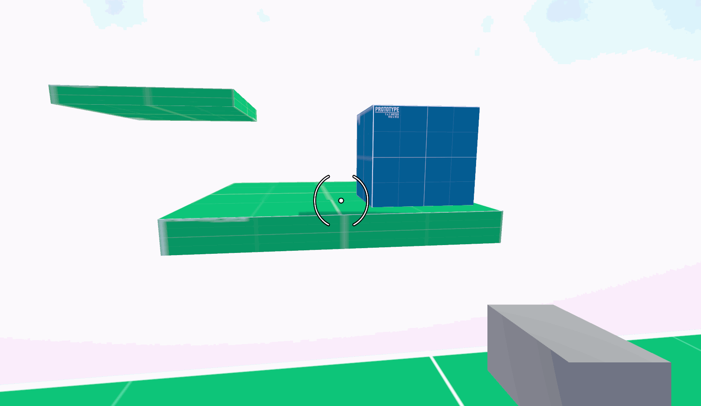
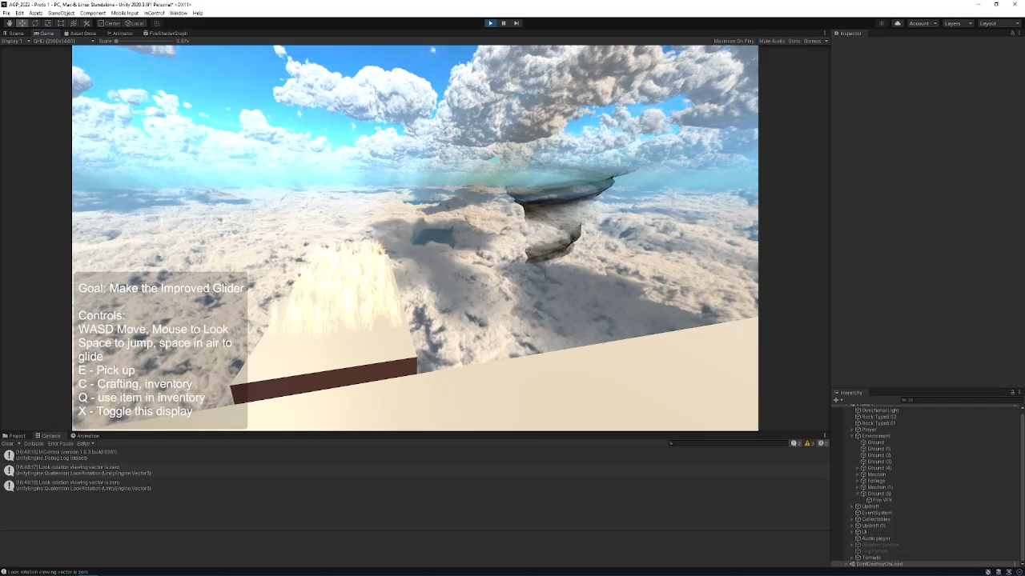
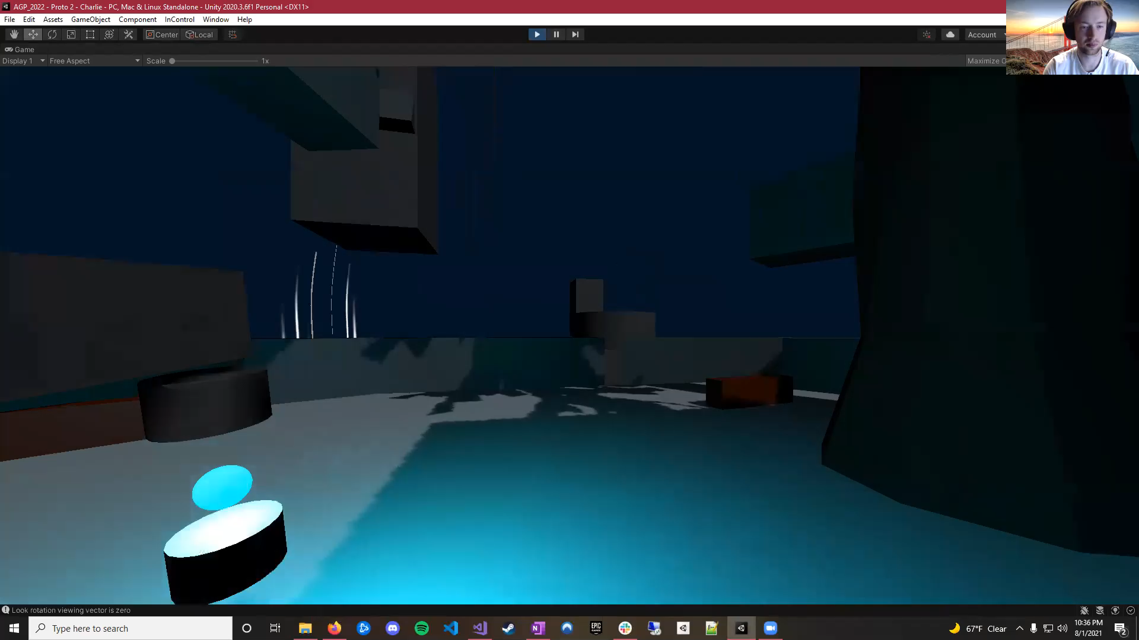
This summer
…and tons of concepting!
Narrative Design
Audio sketches
Concept art
Gameplay Designs
Notes:
Rope
Weather, fog
AI
Not to mention audio, narrative, and much further reaching designs. I’m very proud of my team for all the incredible work they’ve put in this summer!

Slide 6
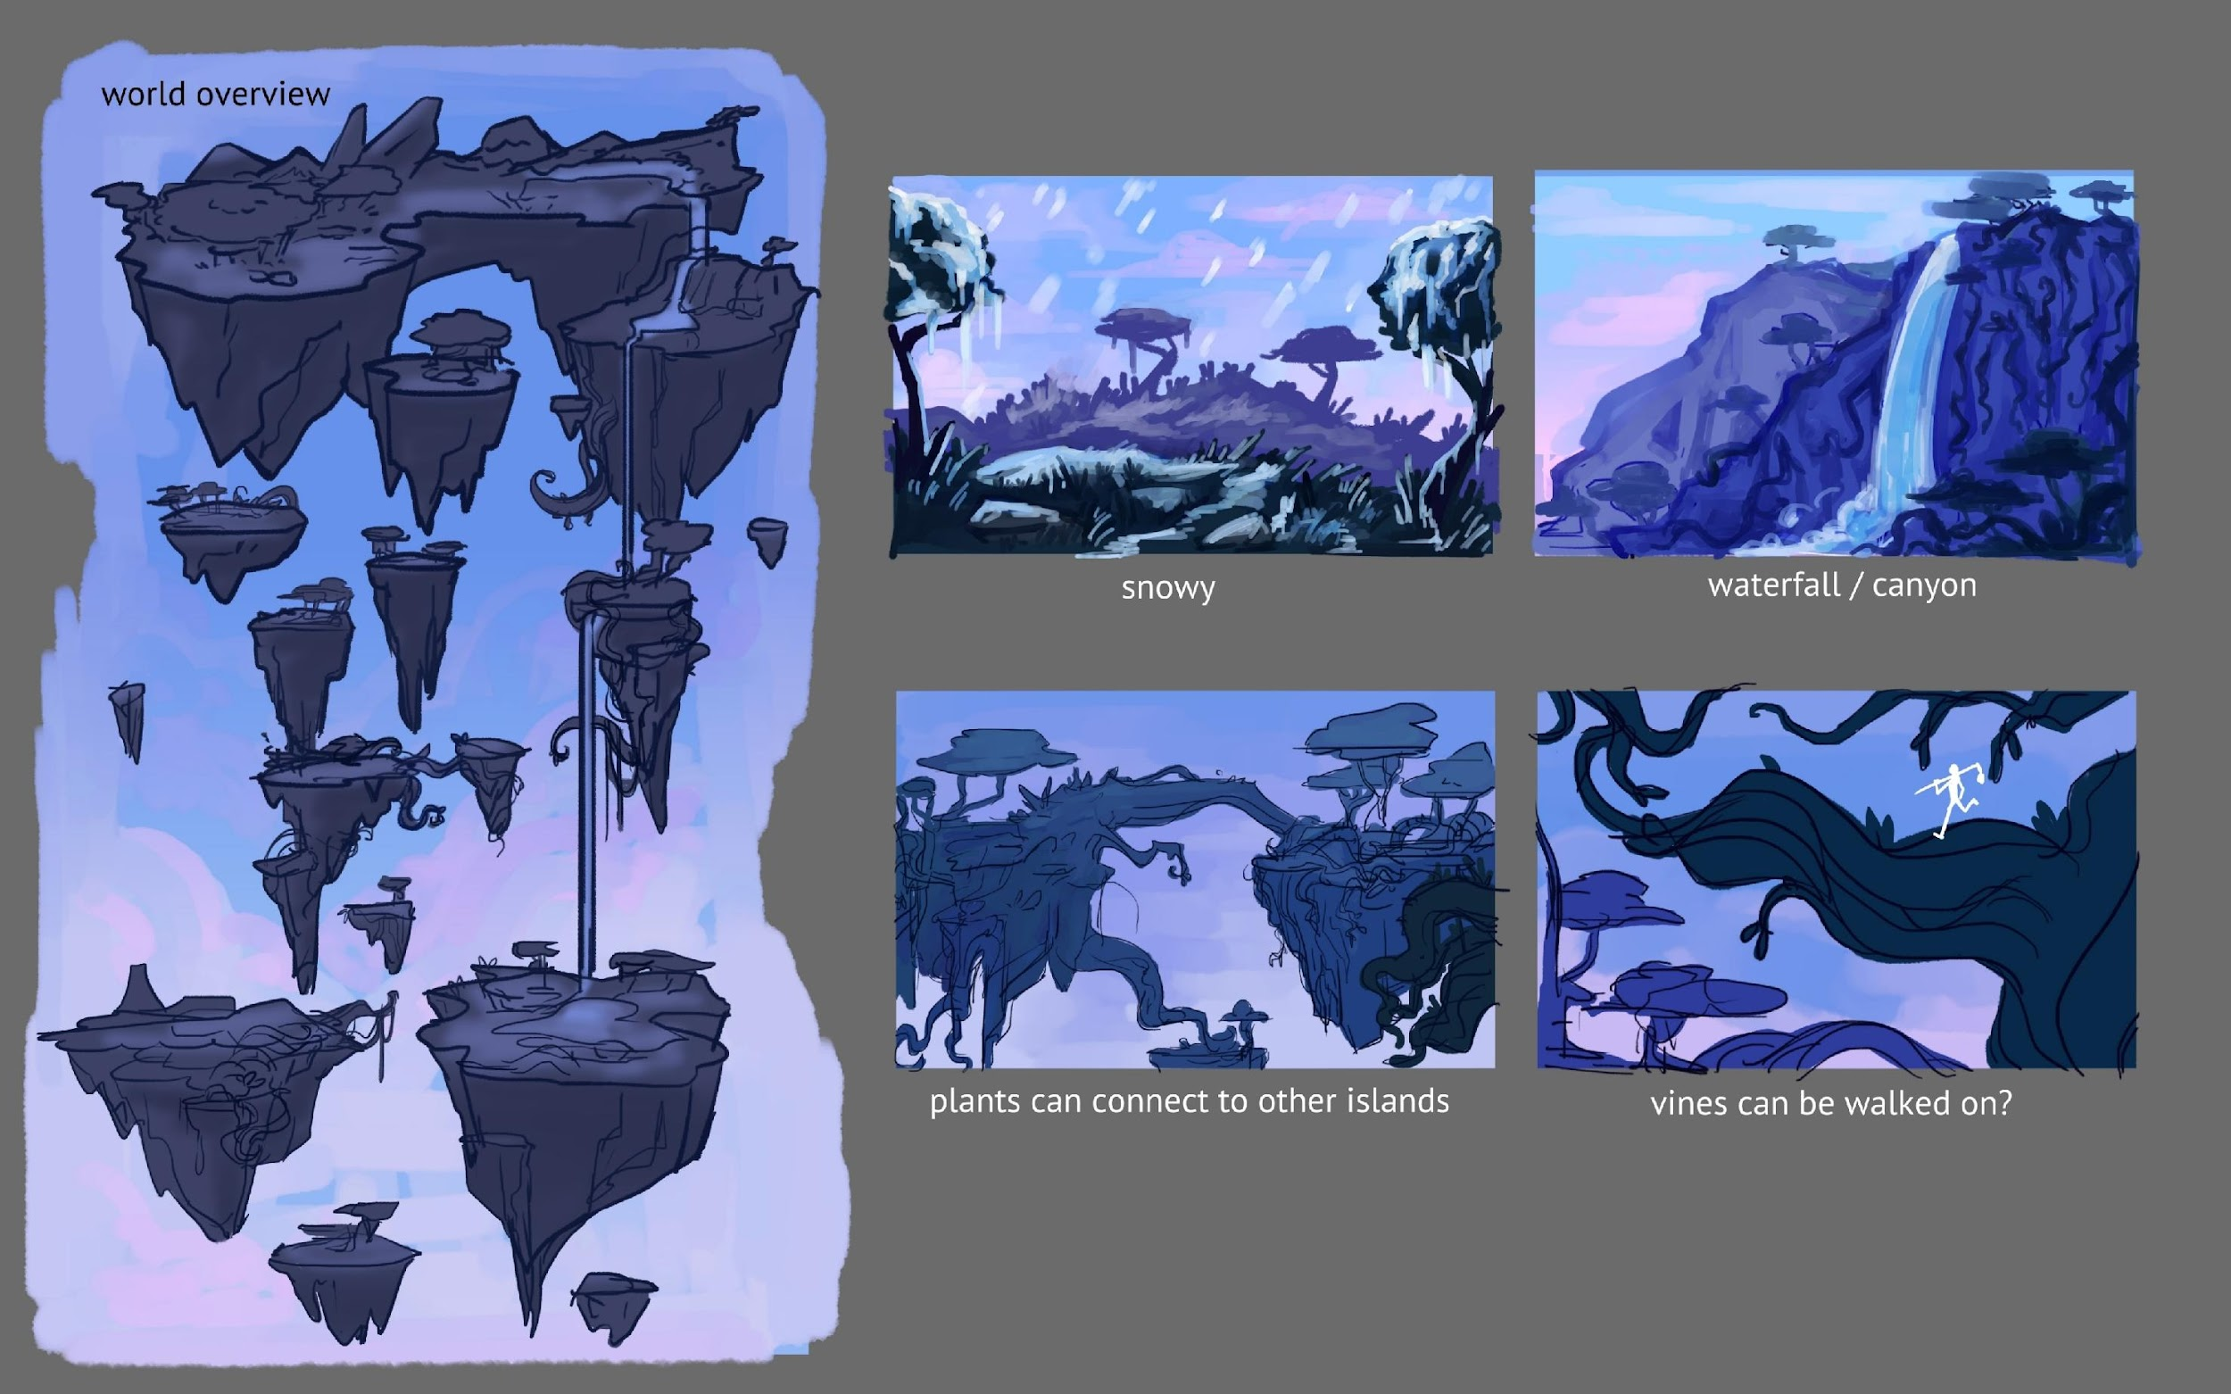
A note about Team Culture
This is really important to us. We’re looking for people who:
1) Are highly self motivated and professional
2) Hold their work to high standards
3) Love the problem, not the solution
4) Are nice

Slide 7
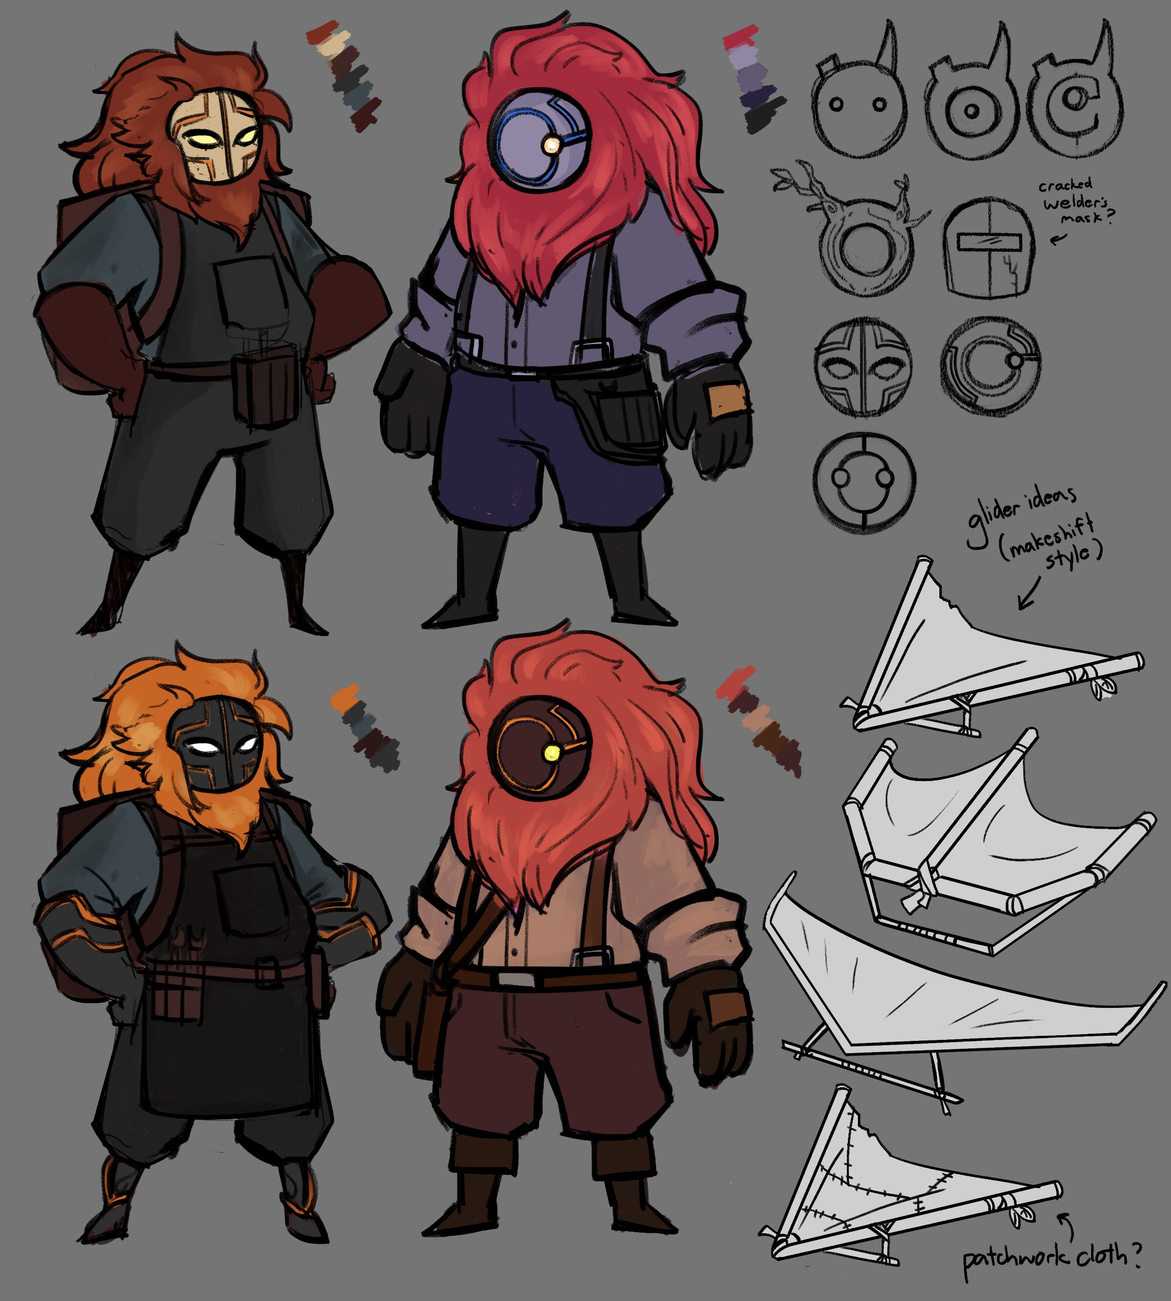
Positions we need:
3D Artists
Environment – Fantastical, Sky world
Character Artist (particularly large beastial creatures)
  Riggers, modellers, animators
Notes:
We need artists!

Slide 8
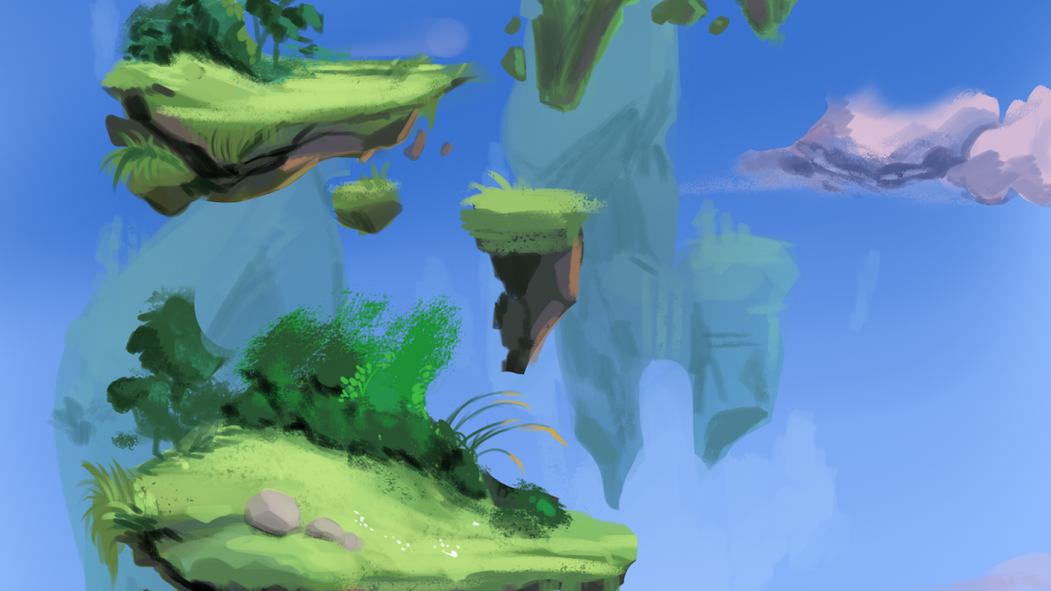
Skylost
Thank you for your time!
EMAIL US AT Roccowu@usc.edu
Let’s talk!
https://bit.ly/2WulDja
Notes:
Thank you so much for listening, I’m Charlie Anderson, and this was Skylost.

