Slide 1
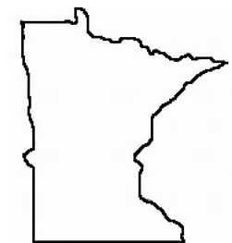

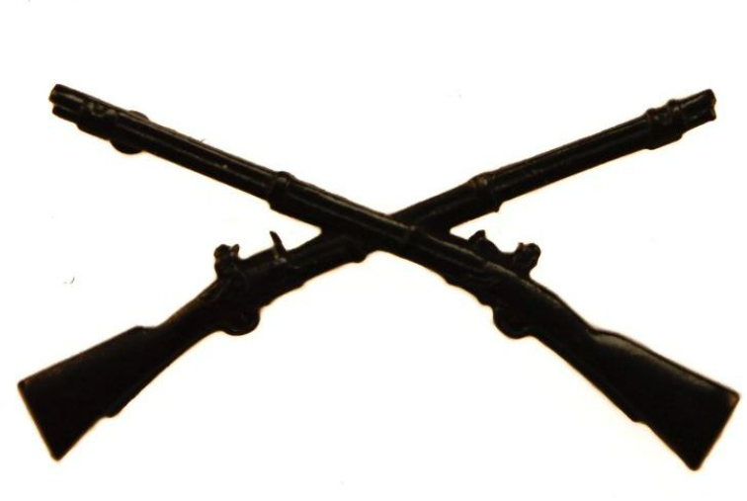
Solid infantry blue fill between
Rings. Black Text inside ring in circular format. “ MIDWEST CREATIONS” across the top. “CUSTOM FURNITURE AND DÉCOR” across the bottom. All font to match the ‘M’
I would like the ‘M’ and the ‘W’ to have
The leg of ‘M’ centered in ‘W’ and left
Arm of ‘W’ centered and tucked in ‘M’
“Veteran Owned & Operated” Arched up and around crossed rifles.
JOHN 15:13

