Slide 1
Customer Development
Mom’s test - how to talk to customers

Slide 2
Agenda
Mom’s test:
What is the problem?
How to talk to customers ?
How to ask questions?
Who to talk to?

Slide 3
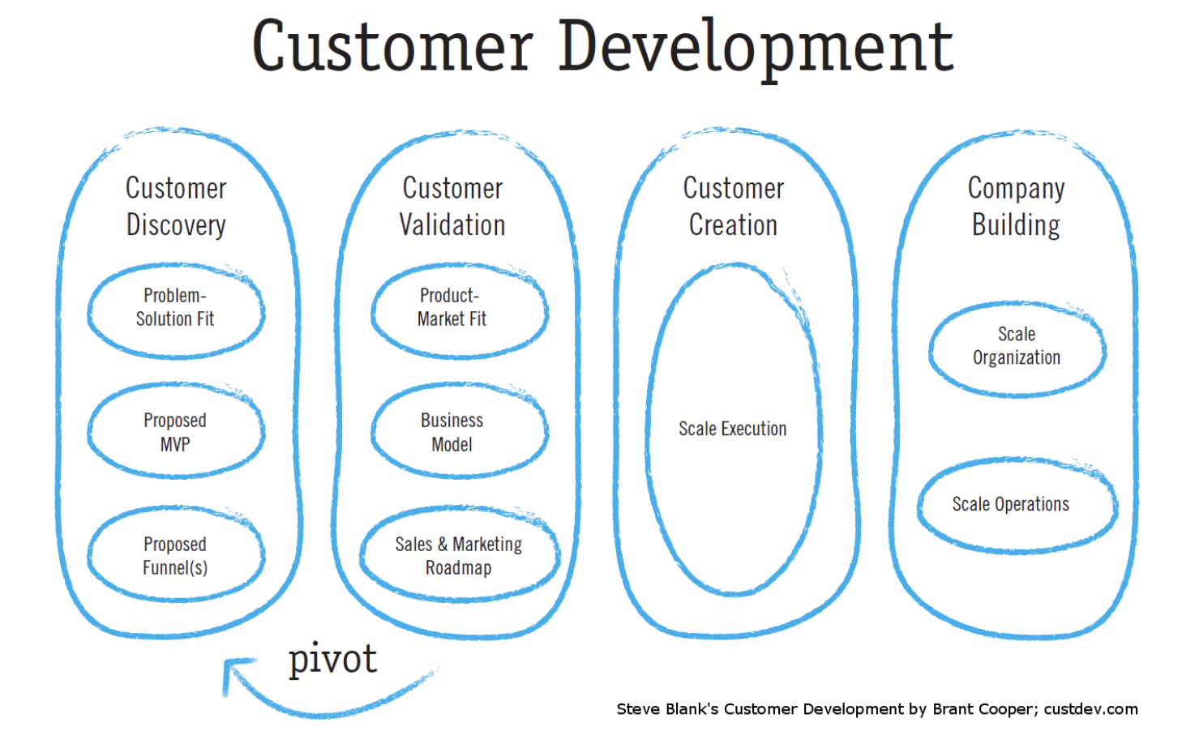
Notes:
How you talk to customers is part a broader framework called customer development.
Iterative process of refining your idea and product to find product market fit. Product market fit when product satisfies a strong market demand. Product market fit is not when only your family and friends love your product, it’s identifying a unique need that has not been met yet in the market that multiple people of companies have
There are 4 stages and today we will only focus on Customer discovery which is finding a on the first part of finding a problem - solution fit. Once you have identified a need you can build an MVP, have a build a customer funnel. Customer validation is when you have a product - market fit - when your product is being bought by multiple people and you start to have a business miodel, that process needs to be refined over and over until you find product market fit.
Danial and i along with other cofounders went through all these iterations.
Ex - B2C -

Slide 4

People try to be nice
Therefore they lie in your face
without realizing it
Bad data it worse than no data
E.g. “I’ll definitely buy that”
THE PROBLEM
Notes:
https://timesofindia.indiatimes.com/life-style/health-fitness/de-stress/are-you-a-nice-person-you-are-more-likely-to-suffer-from-this-mental-illness/photostory/67538606.cms
Ill talk about how to avoid this mistake and how to have insightful conversation where you atune to truth and not to things that say to you because they are being nice.
This is fundamental without this skill you will work really hard but it wont go anywhere, because you are working on a set of false belief and data set.
So let’ learn how to talk to customers

Slide 5
Mom’s test - What people say
You: Mom, I have a business idea. Do you have 5 mins?
Mom: Of course, dear
…
You: You like your Ipad and use it a lot?
Mom: Sure it’s great.
…
You: Would you buy a cookbook app?
Mom: I love cookbooks, sounds nice. Does it come with vegan recipes? Or something special for Xmas?
…
Notes:
Many of you, i’m sure might have gone through this conversation with your parents and friends.
This is such a good idea - i need to do this - the reality is completely different. What people say vs what they think is different.

Slide 6
Mom’s test - What people think
You: Mom, I have a business idea. Do you have 5 mins?
Mom: Of course, dear
I’m proud of you and I don’t want to hurt your feelings
You: You life your Ipad and use it a lot?
Mom: Sure it’s great.
I use it to check email on the sofa
You: Would you buy a cookbook app?
Mom: I love cookbooks, sounds nice. Does it come with vegan recipes? Or something special for Xmas?
Well, I have plenty of cookbooks. I don’t need a computer in my kitchen - It might get dirty! But hey, if my kid made it, I’ll try it. App? I never bought an app. Don’t you need to enter your credit card for that? Let me try to change the subject.
Notes:
As you can see - people will always try to be nice - this is the social code of relationship, very rarely people will let it as it is. It’s critical you learn how to ask the questions in was that they still feel they are nice to you but gives our the truth behind their true behaviours. This a skill that everybody can learn - it’s critical for founders to learn to have these conversation to uncover the truth.

Slide 7
Mom’s test - How to do it right
You:
Mom, when have you last time used the ipad?
For what?
Have you ever used it in the kitchen?
Have you ever bought an app? Which? Why? For how much?
Do you use your cookbooks
Is there anything you dislike about them?
What was the last cookbook you bought? When? Why?
Notes:
If we rewind the conversation - shape the way you ask the questions to get to the truth faster
You don’t make assumptions like we did before - you like your ipad? We use past behaviour to validate assumptions. - just the other day, i was in the living.
For what? - get a general idea what of a user general behaviour on the ipad and how it is is useful for. i used to check my email
Have you used in the kitchen → trying to get a bit closer to the topic you are looking to investigate -again don’t make assumption - look for past behaviour - no i haven’t dont want to ket it dirty – mm that’s an interesting relevantion
Have you ever bought an app? Which? Why? For how much? - you learn a critical piece of information —-no i haven’t bought an app, i dont like to enter my credit card on these platforms they are not safe. This is an area where this business can Fail
Do you use your cookbook? – trying to figure out if there is frequency in cookbook usage —> no i dont only if i want to learn something new like how to cook shrimps, i typically cook the same thing, i have know so many already. - indicator frequency is not high – not good news for thei demographic- you need to target a different type of persona. - occasional I used for last christmas - i was trying to make a special dish like a green papaya salad.
They give a lot of recipes that i already know. But i like more specialized cookbook on a specific new cuisines, thai -
3 years i was in thailand and bough a local recipe thai cuisine.
You can learn so much about your demographic and the topic by:
not biasing the conversation with assumptions
looking for past behaviour
try to validate certain assumption you are making.

Slide 8
General rule of thumb
Understand the problem/goal
Learn about alternatives/ workaround
Identify the obstacles
High frequency of usage
It is urgent/painful enough
Is it worth it/ will people pay (social currency, time, money)

Slide 9
What to ask? Important questions
Good
Imagine your company failed. Why did it fail? → Questions
Imagine your company is huge success why? → Questions
Ask those questions
“ you should be terrified of at least one of the questions you’re asking in every conversation”
Bad
Deep inside, you are afraid your idea might be bad
So you ask bogus questions
Notes:
How to i know which questions to start of ?
Image failure & success and the reasons behind
Those are the important questions you need to answer
Example of failure -
Student adoption
App content
Empty wall
Student don’t use the app - it doesn't matter if the admin will put content on it
Point of failure - app content -
By doing interviews with partners - there are 20 ways to promote things to students but we learned only 3-5 strategies gave expotential results compared to the effort and there were cenrtai time that we needed to put all our efforts to onboard the students - if we missed the window it will be harder.
We learned that when students leader tell students to download the app and add them as friend - students would do it and would drive 80% adoption - the same action would have been different than if a staff member asked. These are nuances and details that you got to pay attention if you want your company to success.
ExEmpty wall
Nobody whats to post on a empathy wall - staff would put these boring messages that would scare students away from it… we hired someone to post on that app – that wasn’t effective. .. we asked again student leader to post - that worked -
You can make a point a failure - your greater asset - if you solve the problem effectively.

Slide 10
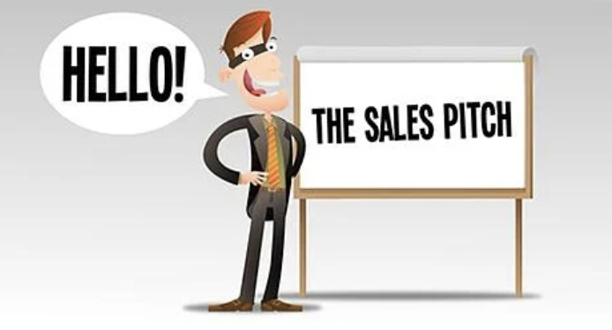
! Mistakes to avoid
STOP PITCHING YOUR PRODUCT
“Let me show you our product…”
You stopped learning once you get into pitch mode and failed the mom’s test.
There is a time for it, not when you are doing discovery customer calls
Notes:
https://www.thealternativeboard.com/blog/top-6-sales-pitch-mistakes-your-team-cant-afford-to-make
You came the conversation about you and not about their needs. Just dont do it.
You all done this mistake - try to catch yourself and correct your conversation and focus back on the customer

Slide 11
What to ask? Get into specifics
Good
Their life
Specifics in the past
How do you solve x now?
Why did you try to solve it?
What are the implications
Talk to me through the last time that happened.
Talk me through your workflow.
What else have you tried?
Where do your funds come from?
Who else should i talk to? → expand the target group
Is there anything else I should have asked? → expand knowledge
Bad
Your idea
Generics, Opinions
Would you….
Bad Data
Generics: “I always/never..”
Future : “ I would/ will..”
Hypothetical:“ I might/could..”
Notes:
Once you identified the questions that can related to your failure/success and stopped pitching - you need to get really curious about their life … you will get better with time to learn to open them open, you need to learn to build a connection.
Implication - what is the impact on you & team ( time, cost, productivity )
Last time - past behaviour is a very good way to identify behaviour patterns
Workflow - understand the entire process and see if they are opportunities of improvements or not
What else - understand the alternatives, are they effective enough - do customers show frustrations from them?
Funds - understand the buying process, who the decision makers are, are there legal limits, is it an individual / team decision
Ideas - “Do you think it’s a good idea?” - Opinions are worthless.
“Would you buy a product which did X?” - Anything involving the future is an over-optimistic lie
“How much would you pay for X?” - People will lie to you if they think it’s what you want to hear.

Slide 12
More good questions
Example of Good Questions
“Talk me through the last time that happened.”
“Talk me through your workflow.”
“What else have you tried?”
“How are you dealing with it now?”
“Where does the money come from?”
“Does-this-problem-matter” questions:
“How seriously do you take your blog?”
“Do you make money from it?”
“Have you tried making more money from it?”
“How much time do you spend on it each week?”
“Do you have any major aspirations for your blog?”
“Which tools and services do you use for it?”
“What are you already doing to improve this?”
“What are the 3 big things you’re trying to fix or improve right now?”

Slide 13

!Mistakes to avoid
EMPTY COMPLIMENTS
Don't get flattered, it won’t help your startup
Those are warning signal during a conversation. Direct the conversation away from you and back to the customer
“ I love this!”, “ You are such a young bright student”, “ this is a really good idea”
Notes:
People try to build a relationship with you dont want o hurt your feelings - they will flatter you …
Maybe people will say this is amazing but they will not buy the product - I can’t recount how many meetings i was in when

Slide 14

!Things to get excited about
Watch for EMOTIONAL REACTION
“I see this frustrate you, tell me more? Yes i see.. what else? “
When someone get excited or share something that frustrate them -
DIG in, something is there!
Questions to dig into emotional signals:
“Tell me more about that.”
“That seems to really bug you — I bet there’s a story here.”
“What makes it so awful?”
“Why haven’t you been able to fix this already?”
“You seem pretty excited about that — it’s a big deal?”
“Why so happy?”
“Go on.”
Notes:
https://tinybuddha.com/blog/how-to-stop-being-a-slave-to-your-emotions/
When you see someone get super excited about something - you can see how they speech pattern increase, they become highly animated all of the sudden - bring back the question - let me more about the past, and get into specifics.
Encourage them to tell you
Neutral is not good!!

Slide 15
How to frame the conversation? Casual
Good
Keep it casual
Ideal: one one-meeting about the 3 best questions
Instead of asking: Do you have a time for a meeting with me? Ask simply your 3 questions, casually during a conversation. Pick one and add it in your email outreach.
Takes maybe 5-15 mins
Bad
Customer development advises to have 3 meetings:
1) the first about the customer and their problem
2) the second about your solution
3) the third to sell a product
That takes a lot of time
Notes:
Always have your 3 questions in mind

Slide 16
Commitments & Advancements
Time commitment
Clear next meeting with known goals
Sitting down to give feedback on wireframes
Using a trial themselves for a non-trivial period
Reputation risk ( Social currency)
Intro to peers or team
Intro to a decision maker ( Boss,Spouse,lawyer)
Giving a public testimonial or case study
Money
Letter of intent ( non -legal but gentle agreement to purchase once ready)
Pre-order
Deposit
Notes:
These are the commitments that you need to get excited not the compliments . track those
Advacement - you can move the customer to the next step in your

Slide 17
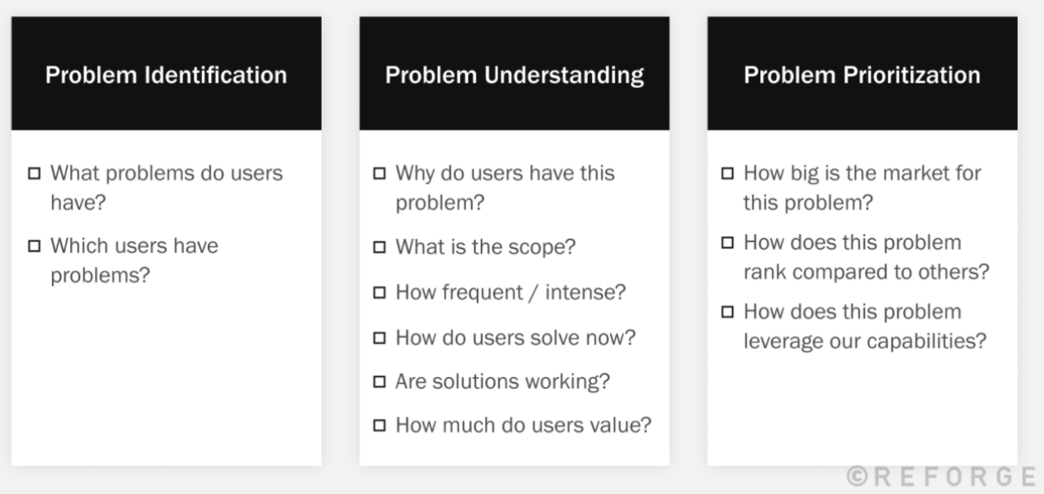
Discovery phase evidence
If you know the answers of these questions, move to MVP solution design

Slide 18
How to find customers

Slide 19
Step 1: Identify customer segment & attributes
How do your customers look like?
Pick 2-3 different customer segments and initiate conversations
You will start hearing the same thing after 4-5 interviews, if you are hearing new things after 10+ interview your segment is too broad.
If you can’t find them, you’ll never advertise or sell to them
B2B ( Business to Business) | B2C ( business to consumers)
Company size Industry Role/ title | Demographics: age, gender, profession, income layer, interests, single/family, etc.)

Slide 20
Step 1: Finding Initial Conversation
Cold Calls/emails- 2 out of 100 will talk to you
Serendipity - there are often cool people already around you
Find a good excuse:
I do my PhD on…. Can i ask you some questions
I’m a student in …
Immerse yourself in where they are
Social media platforms
Organize meetups
Landing pages
Industry blogging
Get clever :)
“The goal of cold conversation is to stop having them”

Slide 21
Step 2: Creating warm intros Initial Conversation
6 degree of separations - “you can find anything you need if you ask for it a couple of times”
Industry advisors
Colleges ( Hint, hint)
Professors
Try to avoid a “real meeting”, if possible ( keep it casual)
Vision : what we aim for, broadly
Framing : why we meet you, what we expect
Weakness : why we need you
Pedestal: a compliment
Ask: try to get more commitments

Slide 22
Customer conversation & your team
Prepping - Together with your team
Choose the right 3 scary questions ( if the answer is on google, google it!)
Due diligence on X/ linkedin about your conversation partner
Write down your assumptions about a person to validate them later
Decide on what commitment you want
Doing -
Who should who up
Those who make decisions ( at least to some meetings)
1-2 persons : 1) talking 2) note-taking & fixing conversations
How to write it down:
Note: Emotions, problems, goals, workarounds, obstacles, ideas/feature request, budget/buying process, follow up -task, reference person/companies
Maybe use 1 card for one information item
Team debrief
Review notes, update written assumptions, update 3 questions
How can you improve to learn better next time

Slide 23
Homework
Pick 3 scary questions
Identify 3 learning goals and 2-3 questions for each
Identify 2 audience segments and its attributes
Find & outreach & Do your first 3 conversations ( 10-15 mins interviews)
Debrief with your team on the learning and set new learning goals

Slide 24
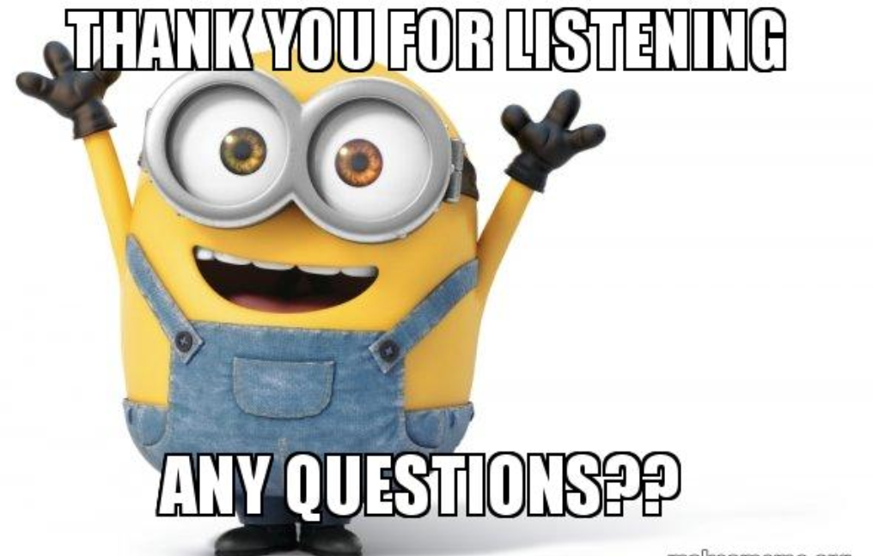
Alice Dinu
Co-Founder Ready Education
alicedinu@gmail.com

