Slide 1
Customer Development
Mom’s test - how to talk to customers

Slide 2
Agenda
Mom’s test:
What is the problem?
How to talk to customers ?
How to ask questions?
Who to talk to?

Slide 3
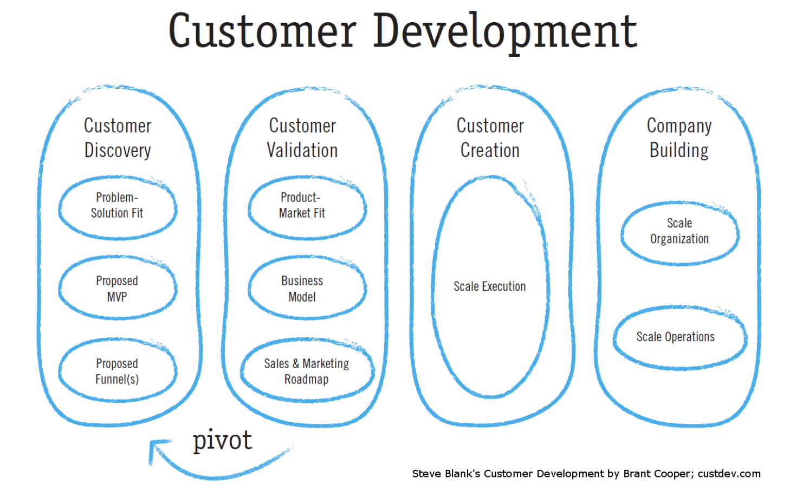

Slide 4

People try to be nice
Therefore they lie in your face
without realizing it
Bad data it worse than no data
E.g. “I’ll definitely buy that”
THE PROBLEM
Notes:
https://timesofindia.indiatimes.com/life-style/health-fitness/de-stress/are-you-a-nice-person-you-are-more-likely-to-suffer-from-this-mental-illness/photostory/67538606.cms

Slide 5
Mom’s test - What people say
You: Mom, I have a business idea. Do you have 5 mins?
Mom: Of course, dear
…
You: You life your Ipad and use it a lot?
Mom: Sure it’s great.
…
You: Would you buy a cookbook app?
Mom: I love cookbooks, sounds nice. Does it come with vegan recipes? Or something special for Xmas?
…

Slide 6
Mom’s test - What people think
You: Mom, I have a business idea. Do you have 5 mins?
Mom: Of course, dear
I’m proud of you and I don’t want to hurt your feelings
You: You life your Ipad and use it a lot?
Mom: Sure it’s great.
I use it to check email on the sofa
You: Would you buy a cookbook app?
Mom: I love cookbooks, sounds nice. Does it come with vegan recipes? Or something special for Xmas?
Well, I have plenty of cookbooks. I don’t need a computer in my kitchen - It might get dirty! But hey, if my kid made it, I’ll try it. App? I never bought an app. Don’t you need to enter your credit card for that? Let me try to change the subject.

Slide 7
Mom’s test - How to do it right
You:
Mom, when have you last time used the ipad?
For what?
Have you ever used it in the kitchen?
Have you ever bought an app? Which? Why? For how much?
Do you use your cookbooks
Is there anything you dislike about them?
What was the last cookbook you bought? When? Why?

Slide 8
General rule of thumb to watch for
High frequency of usage
It is urgent/painful enough
Is it worth it/ will people pay
Notes:
( social currency, money)

Slide 9
What to ask? Important questions
Good
Imagine your company failed. Why did it fail? → Questions
Imagine your company is huge success why? → Questions
Ask those questions
“ you should be terrified of at least one of the questions you’re asking in every conversation”
Bad
Deep inside, you are afraid your idea might be bad
So you ask bogus questions
Notes:
Example of failure -
Student adoption
App content
Empty wall
Student don’t use the app - it doesn't matter if the admin will put content on it
Point of failure - app content -

Slide 10
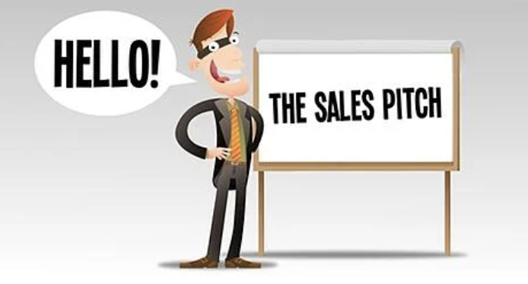
! Mistakes to avoid
STOP PITCHING YOUR PRODUCT
“Let me show you our product…”
You are stop learning once you get into pitch mode and failed the mom’s test.
There is a time for it, but not when you are doing discovery customer calls
Notes:
https://www.thealternativeboard.com/blog/top-6-sales-pitch-mistakes-your-team-cant-afford-to-make

Slide 11
What to ask? Get into specifics
Good
Their life
Specifics in the past
How do you solve x now?
Why do you bother?
What are the implications
Talk to me through the last time that happened.
Talk me through your workflow.
What else have you tried?
Where do your funds come from?
Who else should i talk to? → expand the target group
Is there anything else I should have asked? → expand knowledge
Bad
Your idea
Generics, Opinions
Would you….
Bad Data
Generics: “I always/never..”
Future : “ I would/ will..”
Hypothetical:“ I might could..”

Slide 12

!Mistakes to avoid
EMPTY COMPLIMENTS
Don't get flattered, it won’t help your startup
Those are warning signal during a conversation. Direct the conversation away from you and back to the customer
“ I love this!”, “ You are such a young bright student”, “ this is a really good idea”

Slide 13

!Things to get excited about
Watch for EMOTIONAL REACTION
“I see this frustrate you, tell me more? Yes i see.. what else? “
When someone get excited or share something that frustrate them -
DIG in something is there.
Notes:
https://tinybuddha.com/blog/how-to-stop-being-a-slave-to-your-emotions/

Slide 14
How to frame the conversation? Casual
Good
Keep it casual
Ideal: one one-meeting about the 3 best questions
Instead of asking: Do you have a time for a meeting with me? Ask simply your 3 questions, casually during a conversation. Pick one and add it in your email outreach.
Takes maybe 5-15 mins
Bad
Customer development advises to have 3 meetings:
1) the first about the customer and their problem
2) the second about your solution
3) the third to sell a product
That takes a lot of time
Notes:
Always have your 3 questions in mind

Slide 15
Commitments
Time commitment
Clear next meeting with known goals
Sitting down to give feedback on wireframes
Using a trial themselves for a non-trivial period
Reputation risk ( Social currency)
Intro to peers or team
Intro to a decision maker ( Boss,Spouse,lawyer)
Giving a public testimonial or case study
Money
Letter of intent ( non -legal but gentle agreement to purchase once ready)
Pre-order
Deposit

Slide 16
How to find customers

Slide 17
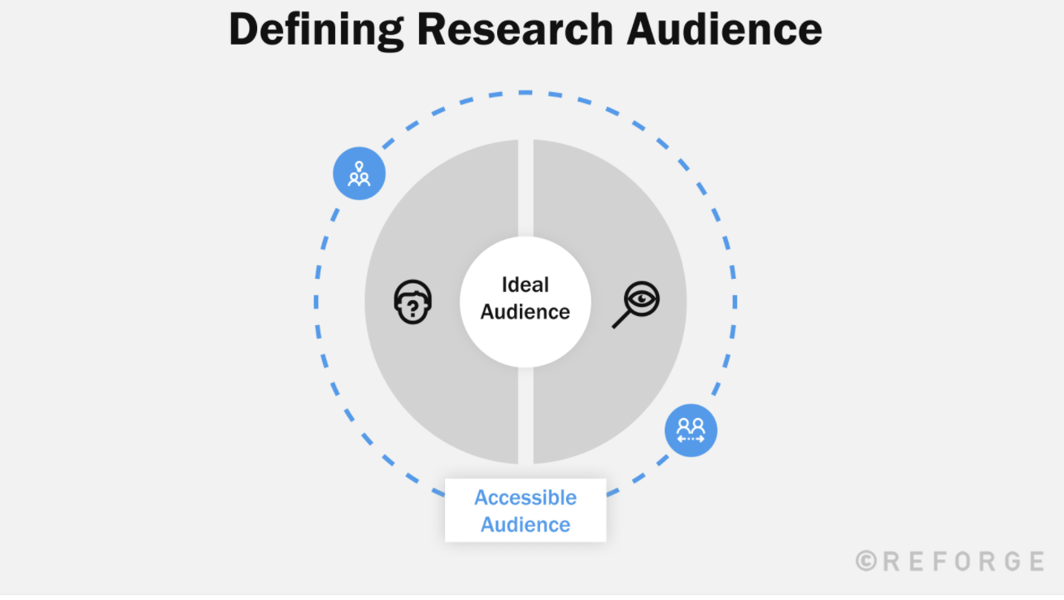
Proxies: people who can speak on how the ideal audience thinks
Describe who they are
Identify the signal/attributes
Analogs: people who look different from ideal audience but could provide similar insights

Slide 18
Step 1: Identify customer segment & attributes
How do your customers look like?
Pick 2-3 different customer segments and initiate conversations
You will start hearing the same thing after 4-5 interviews, if you are hearing new things after 10+ interview your segment is too broad.
If you can’t find them, you’ll never advertise or sell to them
B2B ( Business to Business) | B2C ( business to consumers)
Company size Industry Role/ title | Demographics: age, gender, profession, income layer, interests, single/family, etc.)

Slide 19
Step 1: Finding Initial Conversation
Cold Calls/emails- 2 out of 100 will talk to you
Serendipity - there are often cool people already around you
Find a good excuse:
I do my PhD on…. Can i ask you some questions
I’m a student in …
Immerse yourself in where they are
Social media platforms
Organize meetups :)
Landing pages
Industry blogging
Get clever :)
“The goal of cold conversation is to stop having them”

Slide 20
Step 2: Creating warm intros Initial Conversation
7 degree of separations - “you can find anything you need if you ask for it a couple of times”
Industry advisors
Colleges ( Hint, hint)
Professors
Try to avoid a “real meeting”, if possible ( keep it casual)
Vision : what we aim for, broadly
Framing : why we meet you, what we expect
Weakness : why we need you
Pedestal: a compliment
Ask: try to get more commitments

Slide 21
Customer conversation & your team
Prepping - Together with your team
Choose the right 3 scary questions ( if the answer is on google, google it!)
Due diligence on X/ linkedin about your conversation partner
Write down your assumptions about a person to validate them later
Decide on what commitment you want
Doing -
Who should who up
Those who make decisions ( at least to some meetings)
1-2 persons : 1) talking 2) note-taking & fixing conversations
How to write it down:
Note: Emotions, problems, goals, workarounds, obstacles, ideas/feature request, budget/buying process, follow up -task, reference person/companies
Maybe use 1 card for one information item
Reviewing
Review notes, update written assumptions, update 3 questions
How can you improve to learn better next time

Slide 22
Homework
Pick 3 scary questions
Identify 3 learning goals and 2-3 questions for each
Identify 2 audience segments and its attributes
Find & outreach & Do your first 3 conversations ( 10-15 mins interviews)
Debrief with your team on the learning and set new learning goals

Slide 23
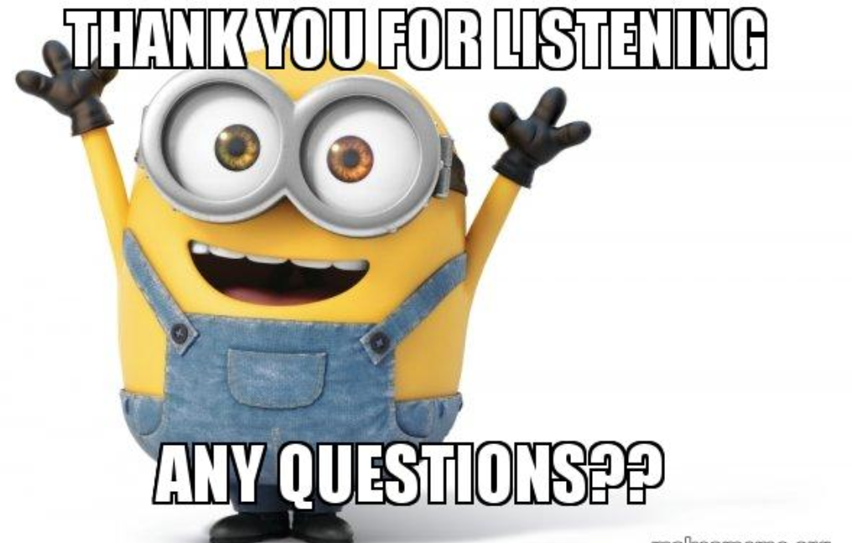
Alice Dinu
Co-Founder Ready Education
alicedinu@gmail.com

