Slide 1

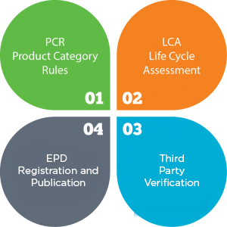
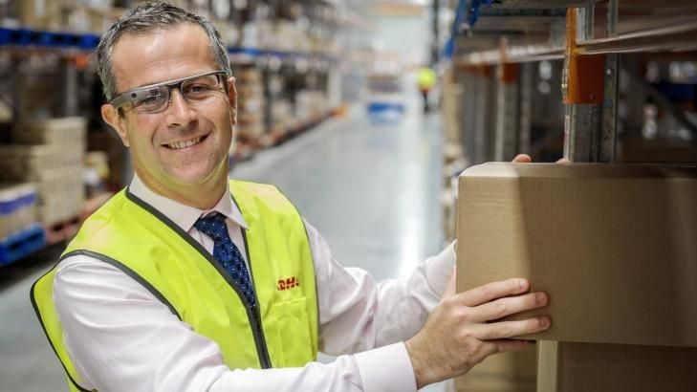
First North American
Product Category Rule (PCR)
For Protective Packaging
Enlisting Stakeholder Participation
“How EPD Can Move the Dialogue Beyond End-of-Life Disposal to Include Environmental Benchmarks for Product Production & Distribution”
Note to Designer: This is not intended to represent what we want the booth design to look like or the colors we want you to use! It is a sketch to show the different message components we need. (We are not licensed to use this photo. Will need to purchase rights, find other photo like this or remove DHL logo on man’s vest.)
Sponsored by EPS Industry Alliance
Managed by Building Transparency

