Slide 1


Canine Diet and Life Span

Slide 2


Slide 3
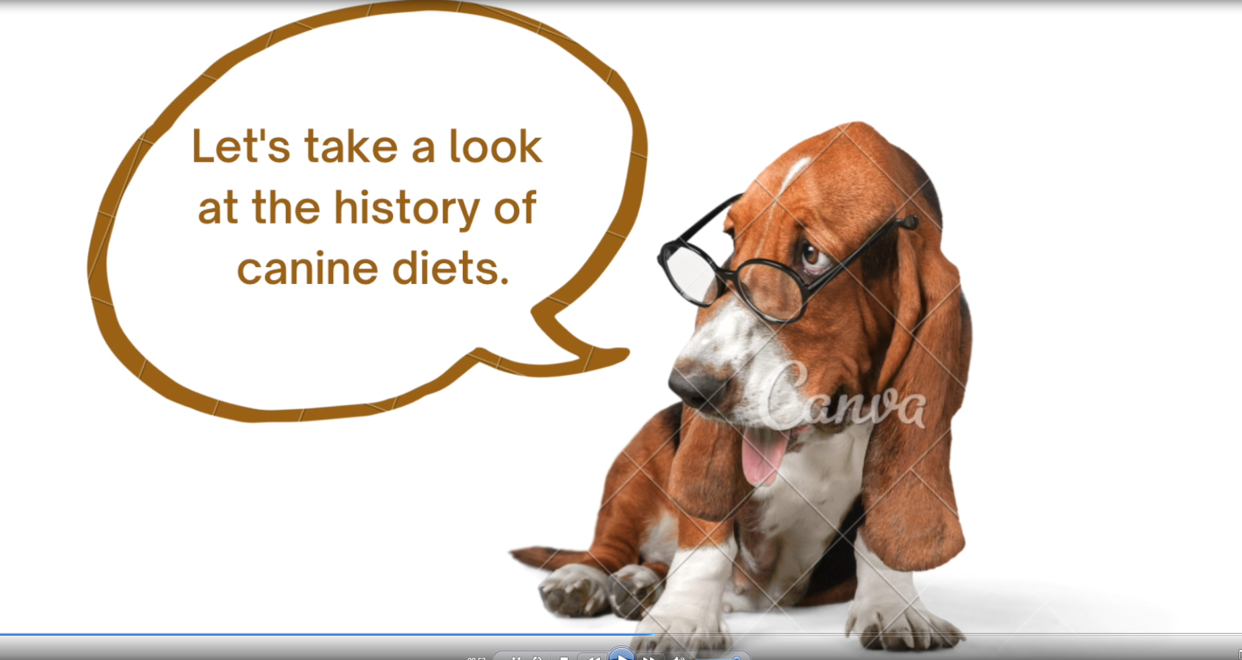

Slide 4
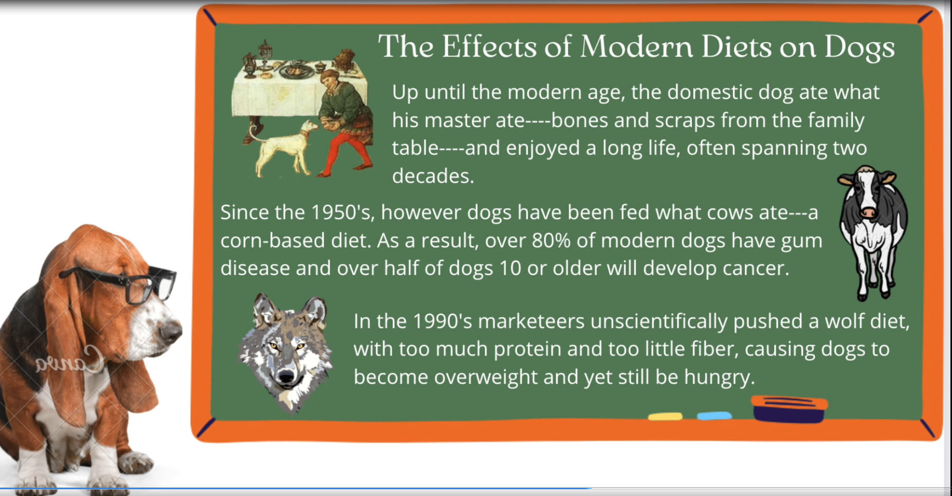

Slide 5


