Slide 1
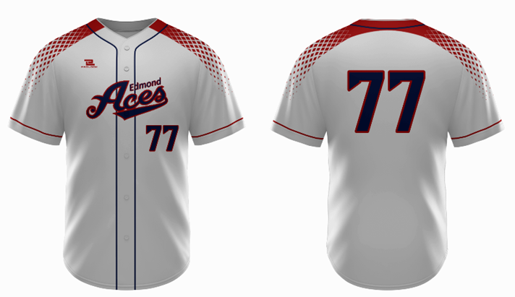
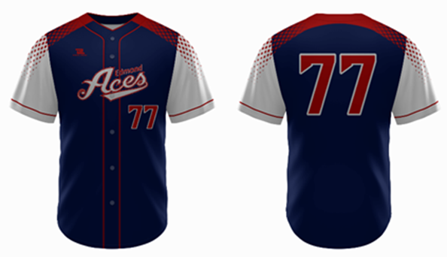

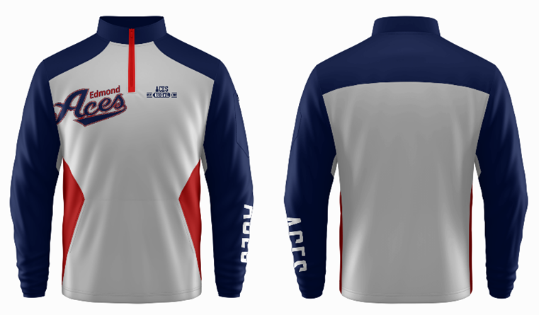

Slide 2

Edmond
THIS SECTION IS FOR GRAPHIC ART PROVIDERS ONLY. UNIFORM PROVIDERS WILL BE PROVIDED ART FOR JERSEYS AND SUCH.
Change red to Navy and Silver to Red
Edmond in same font as Aces, same color
Edmond at same angle as “Aces”
Edmond also outlined in red
Add white diamond to “A”
Change red to silver and silver to red
Edmond in same font as Aces same color
Edmond at same angle as “Aces”
Edmond outlined in red
Add Red diamond to “A”
Edmond
Logo’s needed:
Navy outlined in Red “Aces” 6. Navy and Red no Edmond
Silver outlined in Red “Aces” 7. Silver and Navy no Edmond
White, Just “A” in “Aces” 8. Black outlined Silver w/ Edmond
All black “Aces” 9. Black outlined Silver w/o Edmond
All Silver “Aces”

