Slide 1
IVS Logo Ideas
In Vivo Studies
Vision Statement:
  Nonclinical Expertise + Ethical Mindset = Impactful Data
Shape of logo to complement other functional area logos, which is triangle and circle (slide 16)
Color of logo to complement other functional area logos (and possibly have the option to switch out colors for swag, etc). No ombre effect.
Would like a logo with different versions
  One simple with only IVS and image/symbol
  One with IVS and In Vivo Studies
  One with IVS, In Vivo Studies, and vision statement/key words

Slide 2
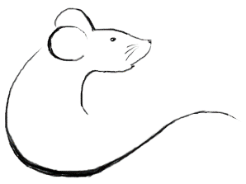
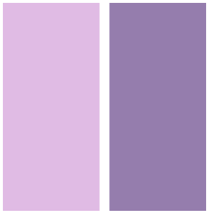
Originally were thinking of using a rectangle shape but with a diamond in the middle so not as boring…
Tried to find colors to complement SO and SAO’s logos, but these are too light…
Impactful Data
Ethical Mindset
IVS
IVS
In Vivo Studies
Nonclinical Expertise
Innovative Capabilities
Nonclinical Expertise + Ethical Mindset = Impactful Data

Slide 3
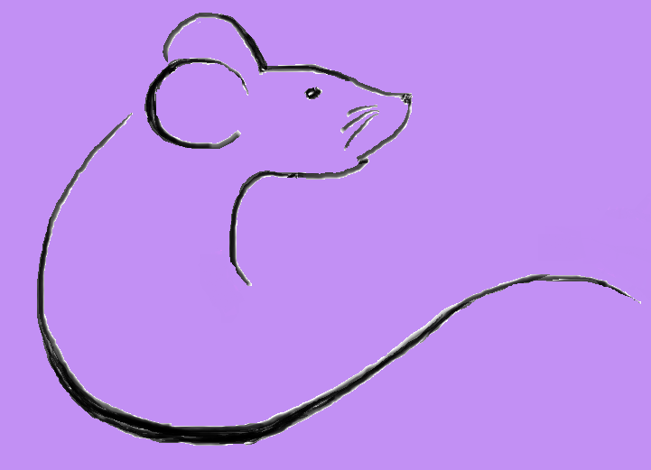

Attempted just a diamond shape with slightly bolder shades of purple
IVS
In Vivo Studies
Nonclinical Expertise + Ethical
Mindset = Impactful Data

Slide 4
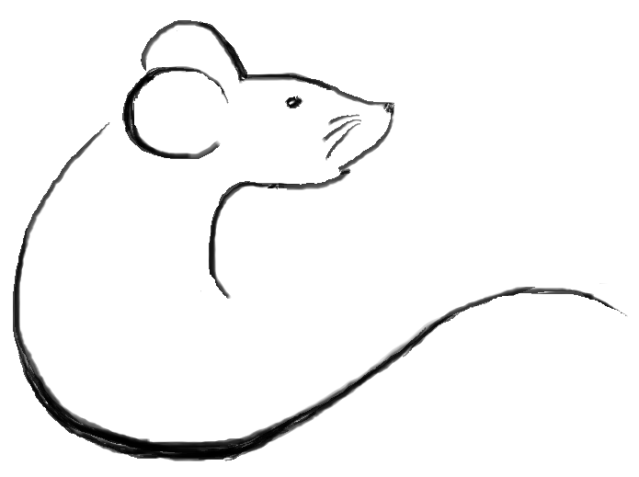
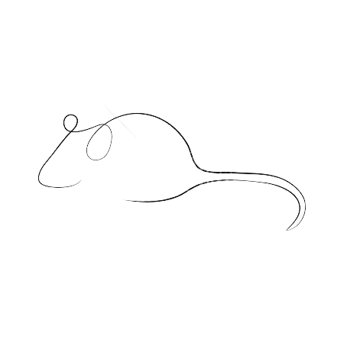
Found this online
I drew this one based off the first image before I figured out how to take most of the watermarks away ;)
I like the idea of this… more impression of a mouse rather than in your face.
Whiskers could maybe be added…

Slide 5


Jaclyn used a free program to create this mockup and I added the mouse profile as an example.
The colors might be too dark/busy tho.

Slide 6

Not as much of a fan of this mouse image and logo overall seems a little plain

Slide 7
With mission statement/key words included
Nonclinical Expertise
Ethical Mindset
Innovative
Impactful Data

Slide 8



Another option but not sure how to fit in the mission statement

Slide 9

Group likes this layout and image but sizing seemed off

Slide 10

Same logo in lighter shade. Not sure it’s strong enough.

Slide 11

The sizing is more uniform here which is better, but shade is still off.

Slide 12
Like this option for incorporating the vision statement. Would maybe like a bolder shade of purple.
Color block on left might be too bright.
Nonclinical Expertise
Ethical Mindset
Impactful Data

Slide 13
Was trying to see what it would look like if the borders were the lines
Nonclinical Expertise
Ethical Mindset
Impactful Data

Slide 14
Sizing is off on this version, but liked the shades of purple (bolder).
Another idea… could the mouse be moved over so the tail makes up the S in IVS? Not sure if that will be too busy looking.
Mouse would need to be smaller to fit in between the letters…
Nonclinical Expertise
Ethical Mindset
Impactful Data

Slide 15

Yellow might be too dilute

Slide 16
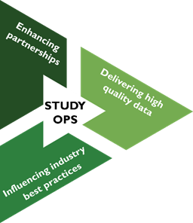

For reference – logos of other functional groups in gNO. Would like IVS logo to complement these if possible.

