Slide 1

Treehill Partners
Beyond Advisory.

Slide 2
Healthcare-Focused Advisor Founded by Former Blackstone Team
15
Senior
Professionals
>$150bn
Transacted
Deal Value
15
CEO Posts
Held
25yrs
Average
Experience
>100
Individual Transactions
>20
C-Suite Positions
Held

Slide 3



























































Deep Complementary Senior Expertise

Slide 4
Deep Complementary Senior Expertise

Slide 5
Unique Approach to Delivering Client Success
Seamless Integration of Disciplines
Successful Transactions
& Corporate Evolutions
Transaction
Strategy
Consolidated Output
Enable and Pursue
==
Management
Notes:
This template was inserted from Power-user, the productivity add-in for PowerPoint, Excel and Word.
Install Power-user to access thousands of templates, icons, maps, diagrams and charts with Power-user.
Visit https://www.powerusersoftwares.com/
©Power-user SAS, terms of license: https://www.powerusersoftwares.com/terms

Slide 6
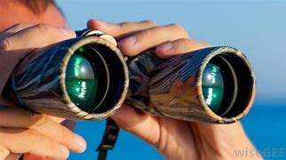
Outsourced Solution Delivery Office for Our Clients – Enhanced Insight
A
B
C
D
Understand Situations
Identify Directions
Inform Decision-Making
Baseline: Flawless Successful Execution Throughout
Notes:
This template was inserted from Power-user, the productivity add-in for PowerPoint, Excel and Word.
Install Power-user to access thousands of templates, icons, maps, diagrams and charts with Power-user.
Visit https://www.powerusersoftwares.com/
©Power-user SAS, terms of license: https://www.powerusersoftwares.com/terms

Slide 7
Outsourced Solution Delivery Office – Areas of Work
Outward Transactions:
Sell · Out-License ·
Partner · Re-Finance
Identify
Strategize
Adjust
Execute
Screen
Approach
Review
Prepare
Transact
Implement
Monitor
Senior Management:
Companies · Businesses ·
Portfolios · Products
Plan
Inward Transactions:
Buy · In-License ·
Partner · Invest
Baseline: Flawless Successful Execution Throughout
Notes:
This template was inserted from Power-user, the productivity add-in for PowerPoint, Excel and Word.
Install Power-user to access thousands of templates, icons, maps, diagrams and charts with Power-user.
Visit https://www.powerusersoftwares.com/
©Power-user SAS, terms of license: https://www.powerusersoftwares.com/terms

Slide 8
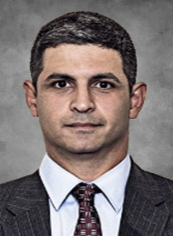
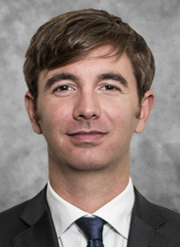
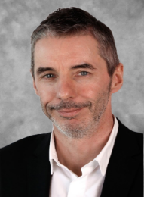
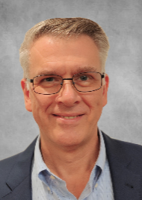
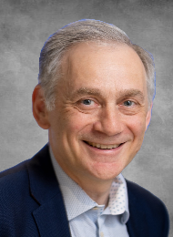













Key Team Members
Mojave Therapeutics
Ali Pashazadeh, MBBS
Founder & Strategic Lead
Senior biotech strategy advisor and negotiator with multidisciplinary strategic mindset.
Led Blackstone’s healthcare advisory globally
Prior roles at Goldman Sachs and UBS
Successful track record across market cycles
Hands-on clinical experience
Trained surgeon, BSc, MBBS, MRCS, MBA
Max Baumann, MHMM
Founder & Execution Lead
Senior biotech transaction advisor with track record
of successful execution
in “usual” and “turn-around” situations.
Buy-side & sell-side transaction origination and execution as well as financings (Blackstone, UBS)
Deep coverage across healthcare segments
Financial and operational restructuring & turn-around
Trained in business and medicinal science
Damian Marron
Head of Biopharma
Successful serial CEO and
board member with track record of successful financing, repositioning and exiting.
Includes a $600m sale to Roche
Formerly Corporate & Business Development leader (NicOx, 3M) and roles across the value chain at Orphan Europe, Rhone-Poulenc-Rorer, Glaxo
Pharmacologist by training
Mark Mayhew, PhD
Portfolio and Strategy
Successful corporate development strategist with track record in
internal & external
business building.
Led the development and implementation of various success strategies across the value chain
Former Head of Corporate Development (Esteve)
Strategy consultant (McKinsey)
Biochemist by training including at Memorial Sloan Kettering
David Kennard, PhD
Industry Relations
Senior corporate development leader
with string of success in
transaction origination and execution.
Led creation of CRUK’s screening & evaluation committee deploying GBP500m p.a.
Corp. & Bus. Dev. leader (Gilead) orchestrating review of countless assets
Biotech C-suite member
Product development positions
Pharmacologist by training
Diverse Senior Team with Deep Combined Domain and Transaction Expertise.

Slide 9



Global Coverage
85%
10%
5%
Revenue Split:
regulated
regulated
7
1+
< 1
[200 to 300[
[300 to 400[
400+
400+
400+
400+
0
400+
400+
Notes:
This template was inserted from Power-user, the productivity add-in for PowerPoint, Excel and Word.
Install Power-user to access thousands of templates, icons, maps, diagrams and charts with Power-user.
Visit https://www.powerusersoftwares.com/
©Power-user SAS, terms of license: https://www.powerusersoftwares.com/terms

