Slide 1

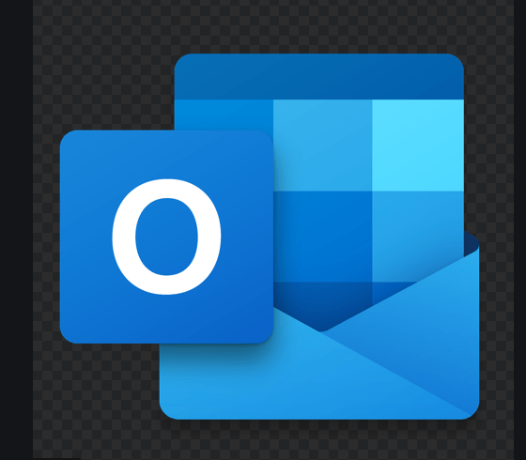




SFFO
SAP FSM
non FSM User
Outlook
FSM Technician

Slide 2





SFFO
SAP FSM
non FSM User
Outlook
Legend:
SAP FSM: SAP Field Service Management
SFFO: SAP FSM For Outlook – Connevtor
FSM Technician: Service technician that uses SAP FSM
Non FSM User: Employee outside the service department
Outlook: Microsoft eMail solution (Cloud an don-premise)
LotusNotes, Gmail as well supported
FSM Technician

