Slide 1
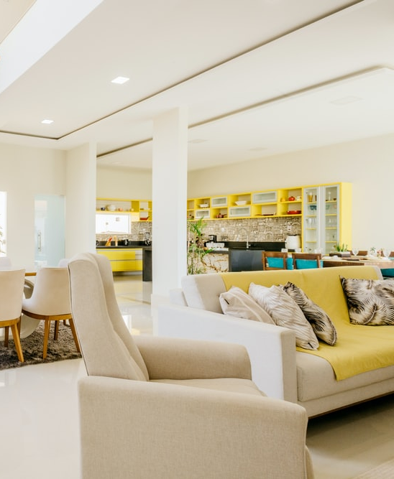
SOLID OI
The first sustainable co-living community
December 2021

Slide 2
How We Will Work, Live & Travel
10 years – NEW WORK/ LEISURE/ LIVING/ TRAVEL HABITS LOOKING FOR WELLBEING & SUSTAINABILITY – NEW TECHOLOGIES – EVER FASTER TELECOM, METAVERSE
Huge market demand and growing for flex-living, wellbeing and sustainable
… We will have 1 BILLION “KNOWMADS” in 2032 seeking to live and work anywhere characterized by shifting attitudes towards wellbeing, flexibility and openness toward

Slide 3
A roaring demand for sustainable, convenient, social, and flexible housing
A value proposition for a whole new way of life
The Solid OI Project design, build, finance and operate flexible, affordable and wellness-minded housing options for the new urban “live, work and travel” lifestyles .
Our aim is to build a global urban living as a service (Laas) community that fits the needs of the fast growing digital, remote and knowledgeable workforce while contributing to build more sustainable cities.
Here’s how we envision that to happen.
TRAVEL
FLEXIBILITY
AFFORDABILITY
WORK
LIVE
WELLNESS
*LIVING AS A SERVICE

Slide 4

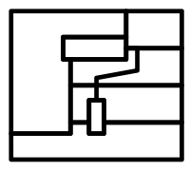





To deliver our value proposition to our customers we guarantee a strong and systematic approach all along our value chain
We source potential investments locating legacy real estate under market value but with high potential to be transformed in low carbon co-living areas.
We reengineer the asset into a high-performance and wellness oriented co-living building fitting all the needs of the new ways of living and working of our community.
We offer through digital platform flexible and private housing options to students, young professionals and digital nomads within great shared areas that fill all their needs.
We operate the co-living facility ensuring a sound experience that cover all the needs of our users and improving their quality of life in the cities.
We continuously improve our facilities to maintain the highest wellness and sustainability standards making sure our community has the highest quality of life and our investments improve their value over time.
We bring together people interested in diversifying their real estate investments and taking a share in our co-living projects.
We continuously bring visibility on investment and help people to manage their investments buying shares in new projects or exchanging them when reaching their expected return.

Slide 5
Our impact / prop / fin tech business model
Sustainable share living solutions for Knowmads with strong values: Flexibility, Affordability, Wellness
We bring investment projects and - - structure SPVs
We upgrade making more sustainable and we highest standard of wellbeing
- increase intrinsic value
We operate places for environmentally conscious KNOWMADS
- revenue generation
SCI, SOCIMI, REIT, CROWDFUNDING (EQUITY FUNDING – INDIVIDUAL INVESTORS & FUNDS), DEBT FUNDING (TRADITIONAL BANKING & CROWD LENDING)
Knowmads
Workationers
Our know-how is the base of professional services selling

Slide 6
We cover the needs for more sustainable, convenient, social, and flexible housing
SUSTAINABILITY: RE-ENGINEERING
Our approach if focused first and foremost on re-engineering apartments to improve their energy efficiency rating. We aim to provide feasible and easy to apply solutions to legacy estate in order to decrease carbon footprint in our cities.
BUILD THEMATIC URBAN COMMUNITIES
Provide an environment to develop urban communities in well situated, affordable, comfortable, functional and nice living areas.
WELLBEING: DESIGN & ARCHITECTURE
Our design must provide a unique design experience with an architecture that optimize each square centimeter of our units. Customer journey must be one of a kind to build the brand and the community. It must also enable to offer the quality at the best price.
1
2
THEMATIC: ONE SIZE DON’T FIT ALL
We provide new living areas refurbished for several types of communities, whether students, digital nomads, seniors, etc. We have a place for you suited to your needs
6
3
AN INVESTMENT PRODUCT
We build micro-pools of investors per living units with a scheme of investment associated to each and managed by the company promote our expansion.
5
4
AFFORDABILITY
With housing prices outpacing wages with more people competing for limited housing stock with need to optimize the size of our units to enable people to live in nice areas at an affordable price.

