Slide 1

COMEX LAB’
Brief logo

Slide 2
Who we are
Losam Agency is a BtoB marketing agency specialized in the creation and animation of CxOs communities.
Losam Agency created “ COMEX Lab’ ” for JICAP, the first think-tank for Mid-Caps dedicated to the sustainable improvement of financial and non-financial performance.
What is “Comex Lab’” ?
1 founding committee composed of 6/8 leaders which will define the themes of the different meetings.
5 meetings a year (1 dinners + 4 breakfasts meeting).

Slide 3
Who is Jicap?
As a consulting firm, the mission of JICAP is to support and improve operational performance by developing and implementing practical and sustainable solutions. Generate both rapid gains and sustainable progress, both financial and operational.
3 values: dialogue, pragmatism, commitment.

Slide 4
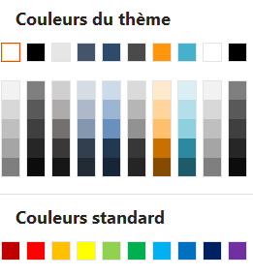
Brand guidelines
Blue Grey Accentuation 1
Orange Accentuation 3
RGB :
R: 47 G: 75 B: 108
HEX : #44546A
Code RGB :
R: 255 G: 150 B: 12
HEX : #FF960C
White Background 1 darker 50%
RGB :
R: 127 G: 127 B: 127
HEX : #7F7F7F

Slide 5
Brand guidelines: Don’t/Do
Don’t use different fonts use Calibri Corps (minimum 12 pt).
Don’t use shadows use either colorful shapes and without any shape.
Don’t use oval shapes use AutoShapes with completely rounded corners instead.
Don’t use a multi-coloured icon or drawing prefer a monochrome version.
Don’t place the text behind the graphics place text next to graphics instead.

Slide 6
Brief logo
What : creating a logo
Sector :
Font : Calibri Corps (minimum 12)
Logo text : COMEX Lab’
Elegant
Fun
Traditional
Personal
Feminine
Colored
Low-end
Audacious
Serious
Modern
Professional
Masculine
White & Black
High-end
v
v
v
v
v

Slide 7




DNA of Jicap
https://jicap-performance.com/

