Slide 1

Brief Logo
Digital Transfo Lab’

Slide 2

Who we are ?
Losam Agency is a BtoB marketing agency specialized in the creation and animation of CxOs communities.
Losam Agency created “Digital Transfo Lab’” for ServiceNow, the first think-tank dedicated to Digital Transformation leaders (from companies > 1Mds€ turnover)
What is “Digital Transfo Lab’ ”?
1 founding committee composed of 6/8 leaders which will define the themes of the different meetings
5 meetings a year (1 dinners + 4 breakfasts meeting)

Slide 3

Who is ServiceNow ?
ServiceNow is the first platform who deliver digital workflows that create great experiences and unlock productivity.

Slide 4

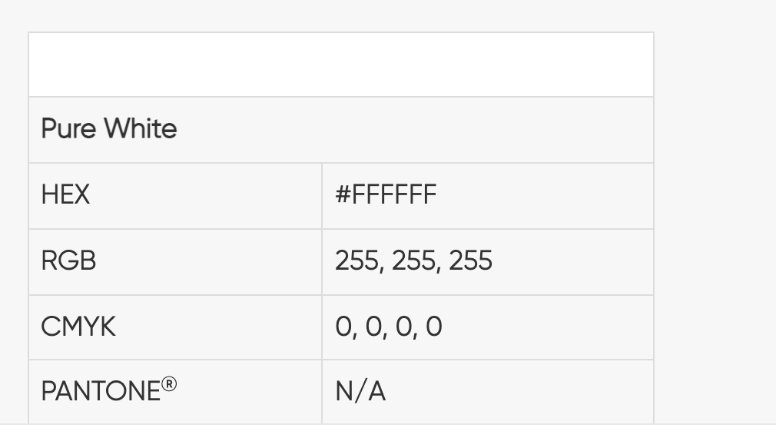
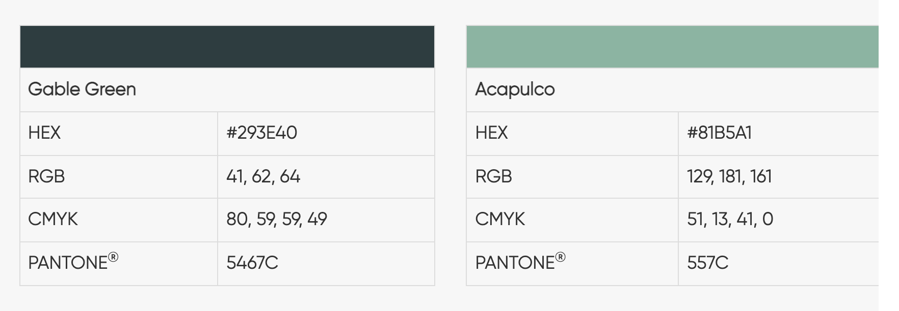
FONTS
Our fonts reflect the tone we use to communicate our brand. They are friendly, open, and clear. The geometric letterforms paired with punchy statements will increase clarity and impact of our messaging.
We use two fonts: Gilroy and Century Gothic. Gilroy requires a license, and we use it for high-end design executions. Century Gothic is a universal font very similar to Gilroy that can be found in any Microsoft Office product (Mac or PC) for use in PowerPoint and other everyday needs.
Primary Font
Gilroy
Internal Font
Century Gothic

Slide 5
Digital Transfo Lab’
Target :
Chief Digital Officer
Head of Digital Transformation
Positioning :
- High-end, we address a target of Head of Digital Transformation decision makers
- The main themes of the Think-Tank : Digital Transformation acceleration best practice’s
We address compagnies > 1Mds€ turnover
Baseline:
« The first think-tank dedicated to the best practices of digital transformation acceleration»

Slide 6
Brief
What : Creating a logo
Sector : Digital
Logo text : Digital Transfo Lab’
Elegant
Fun
Traditional
Personal
Feminine
Colored
Low-end
Audacious
Serious
Modern
Professional
Masculine
White & Black
High-end
v
v
v
v
v

Slide 7
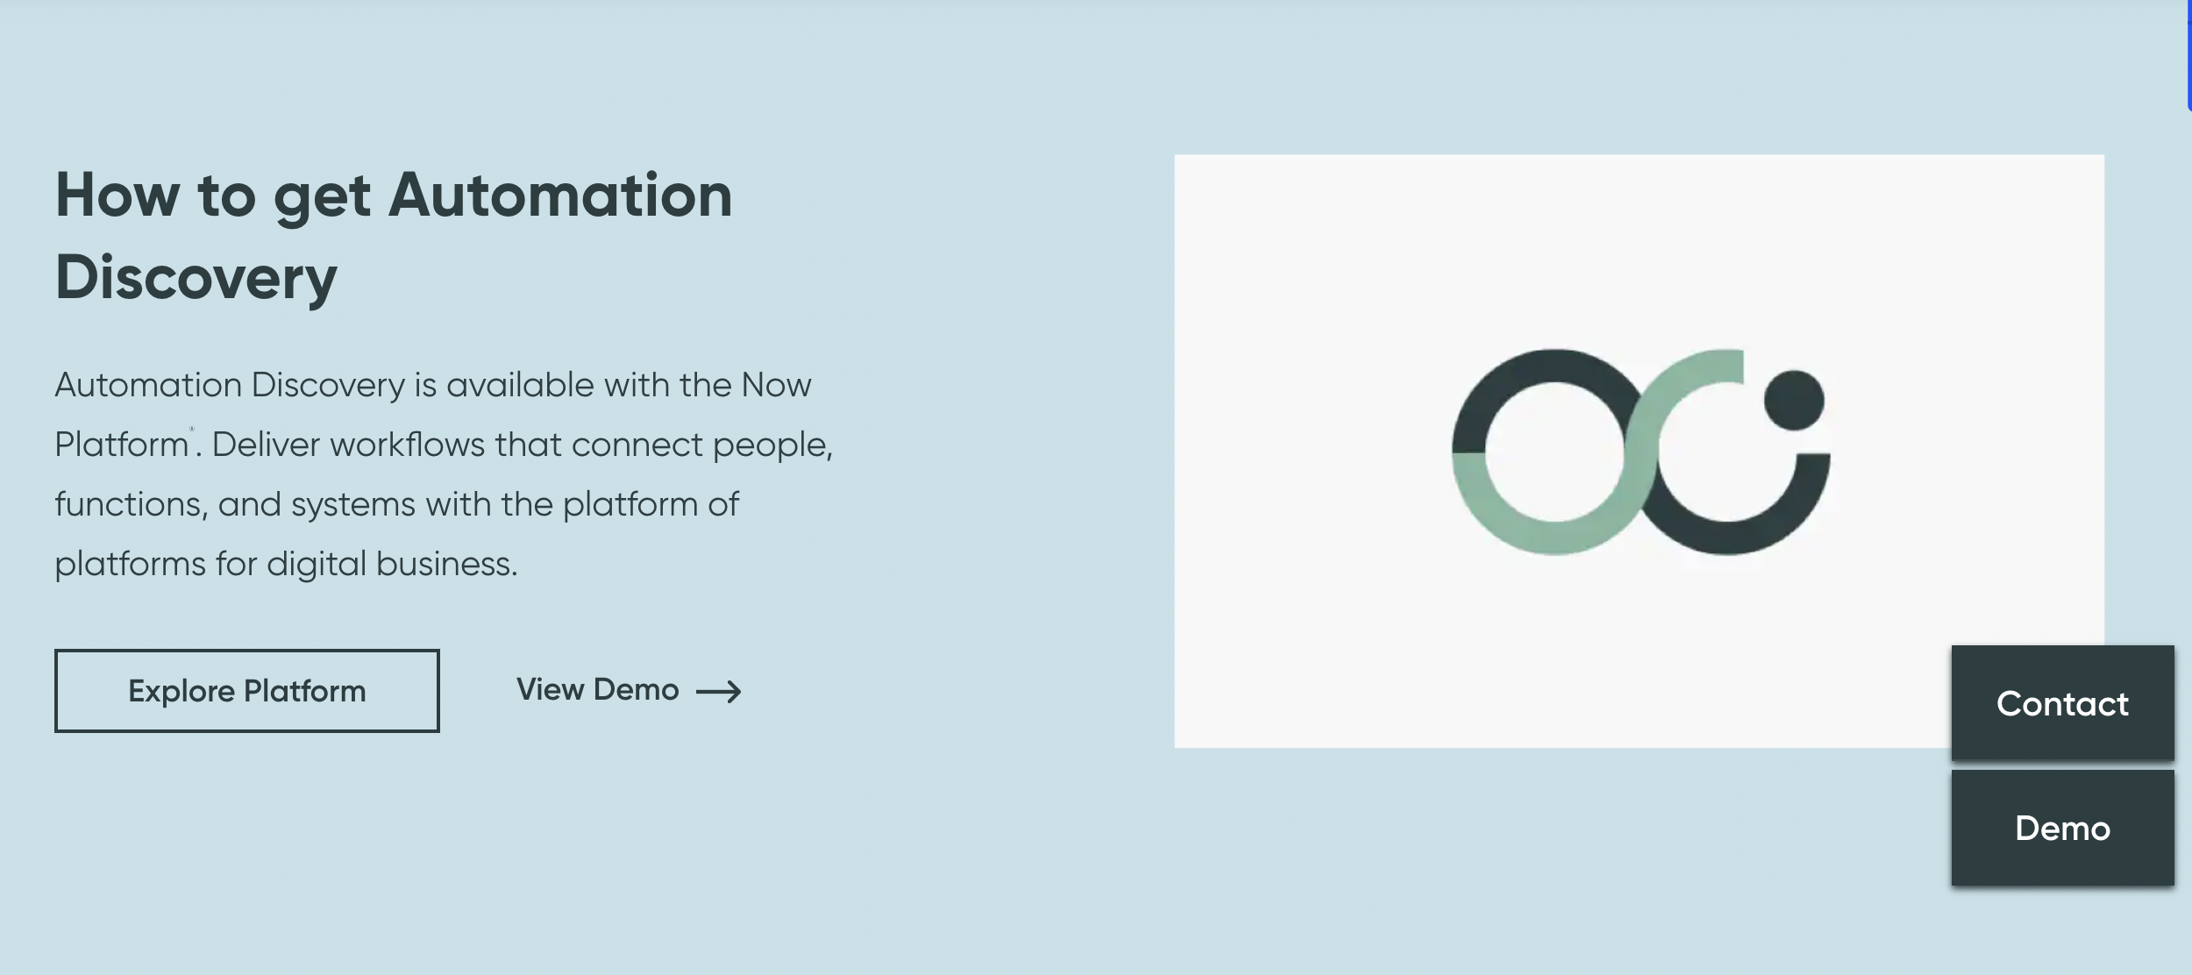
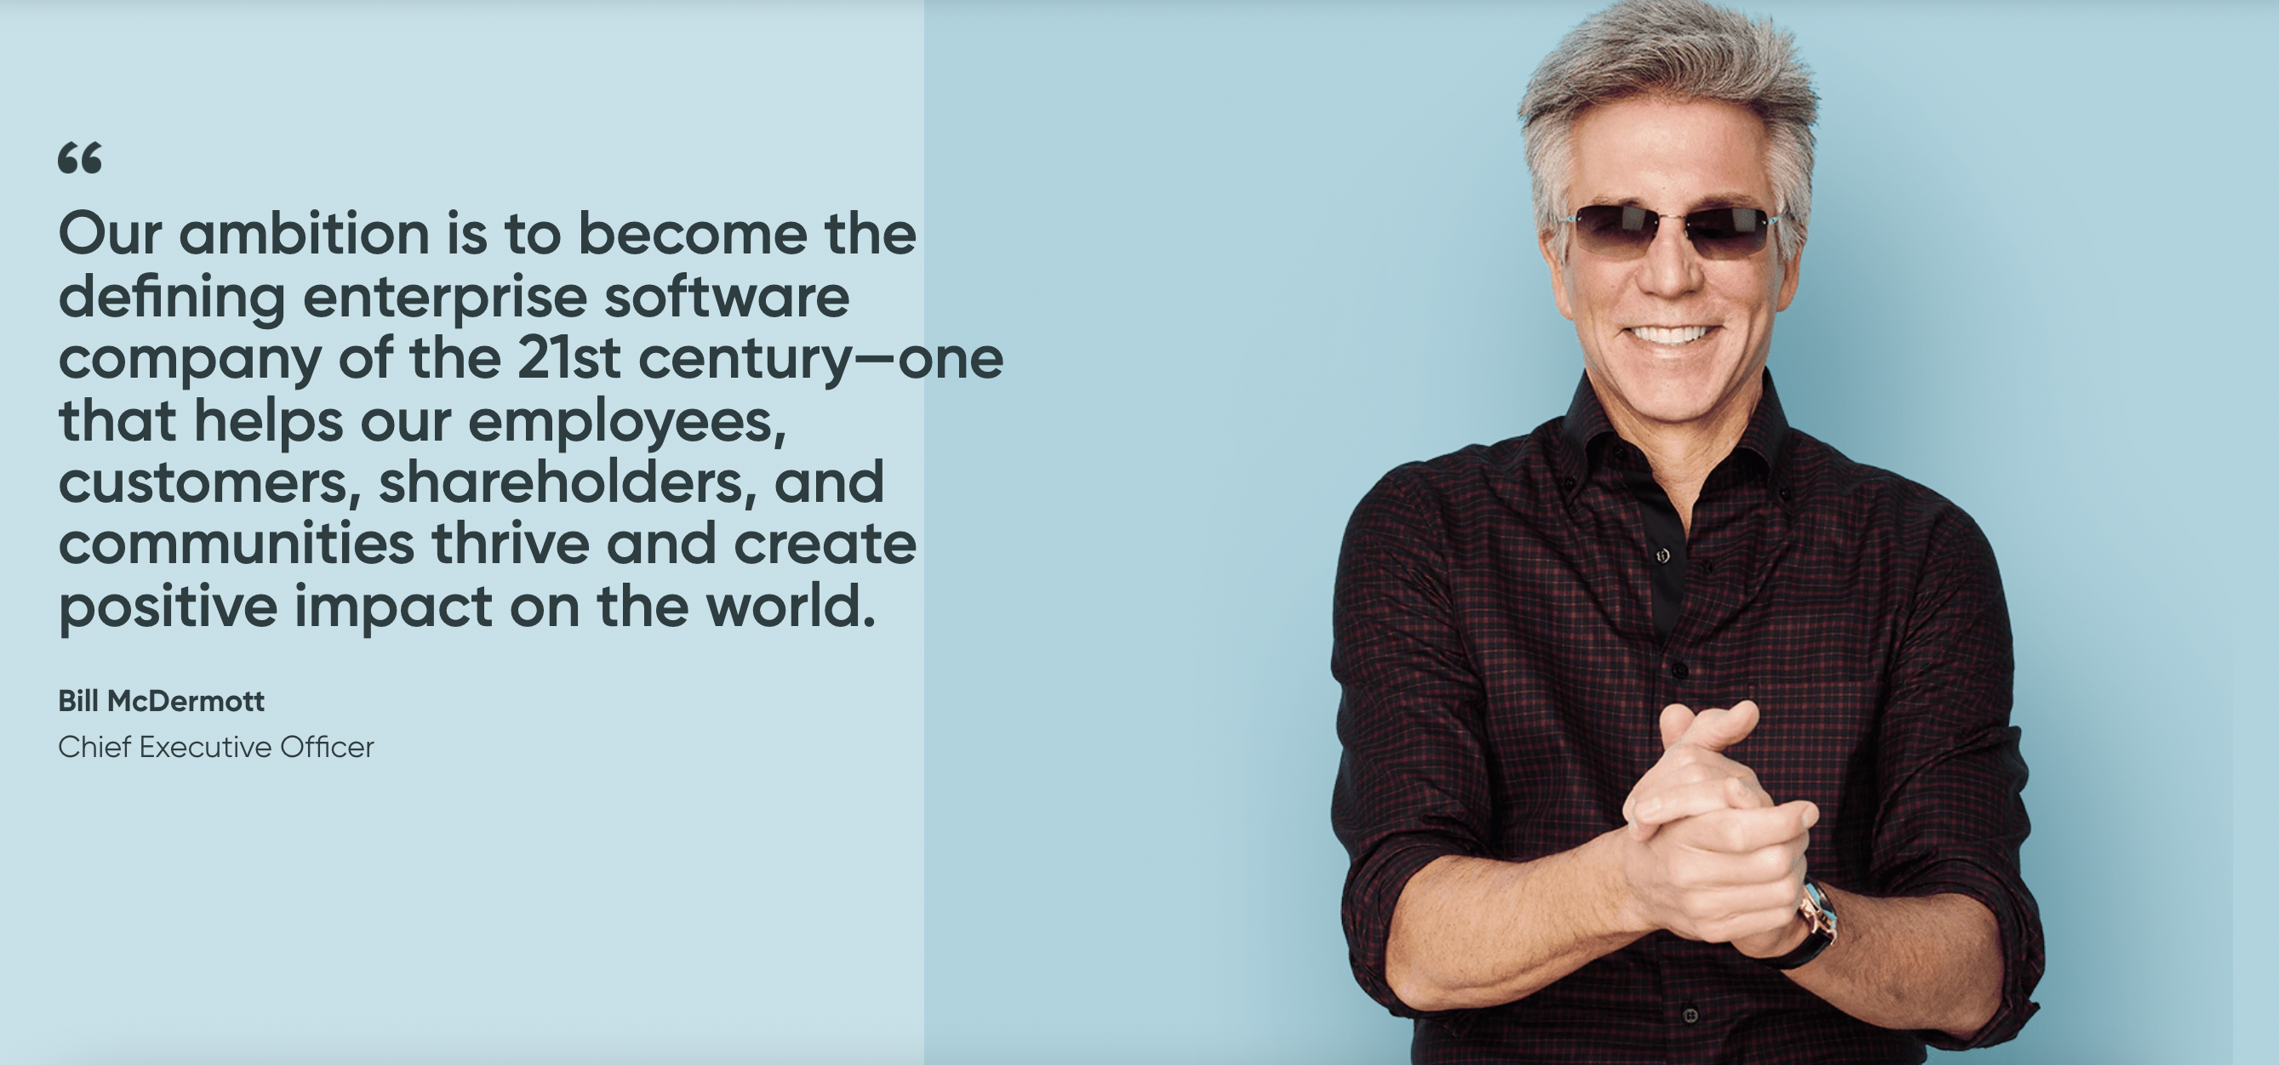

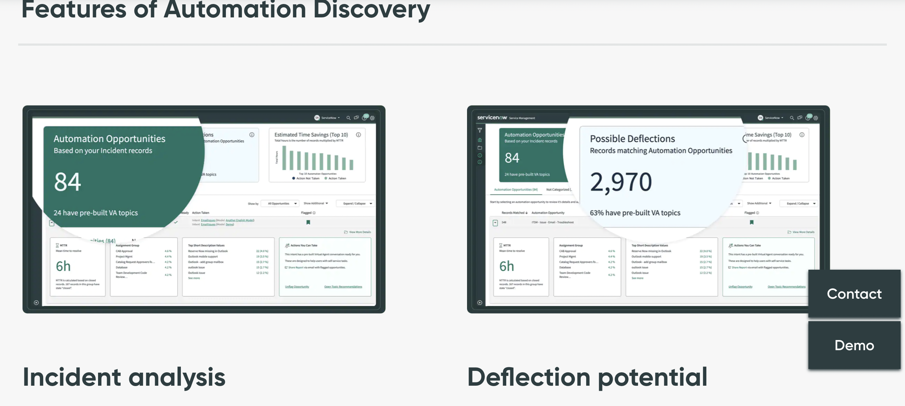
DNA of ServiceNow
Keep the DNA of the client ServiceNow (You will find some examples : simple, sober, colorfull)

Slide 8





Inspiration - Themes
Digital transformation
Acceleration

