Slide 1
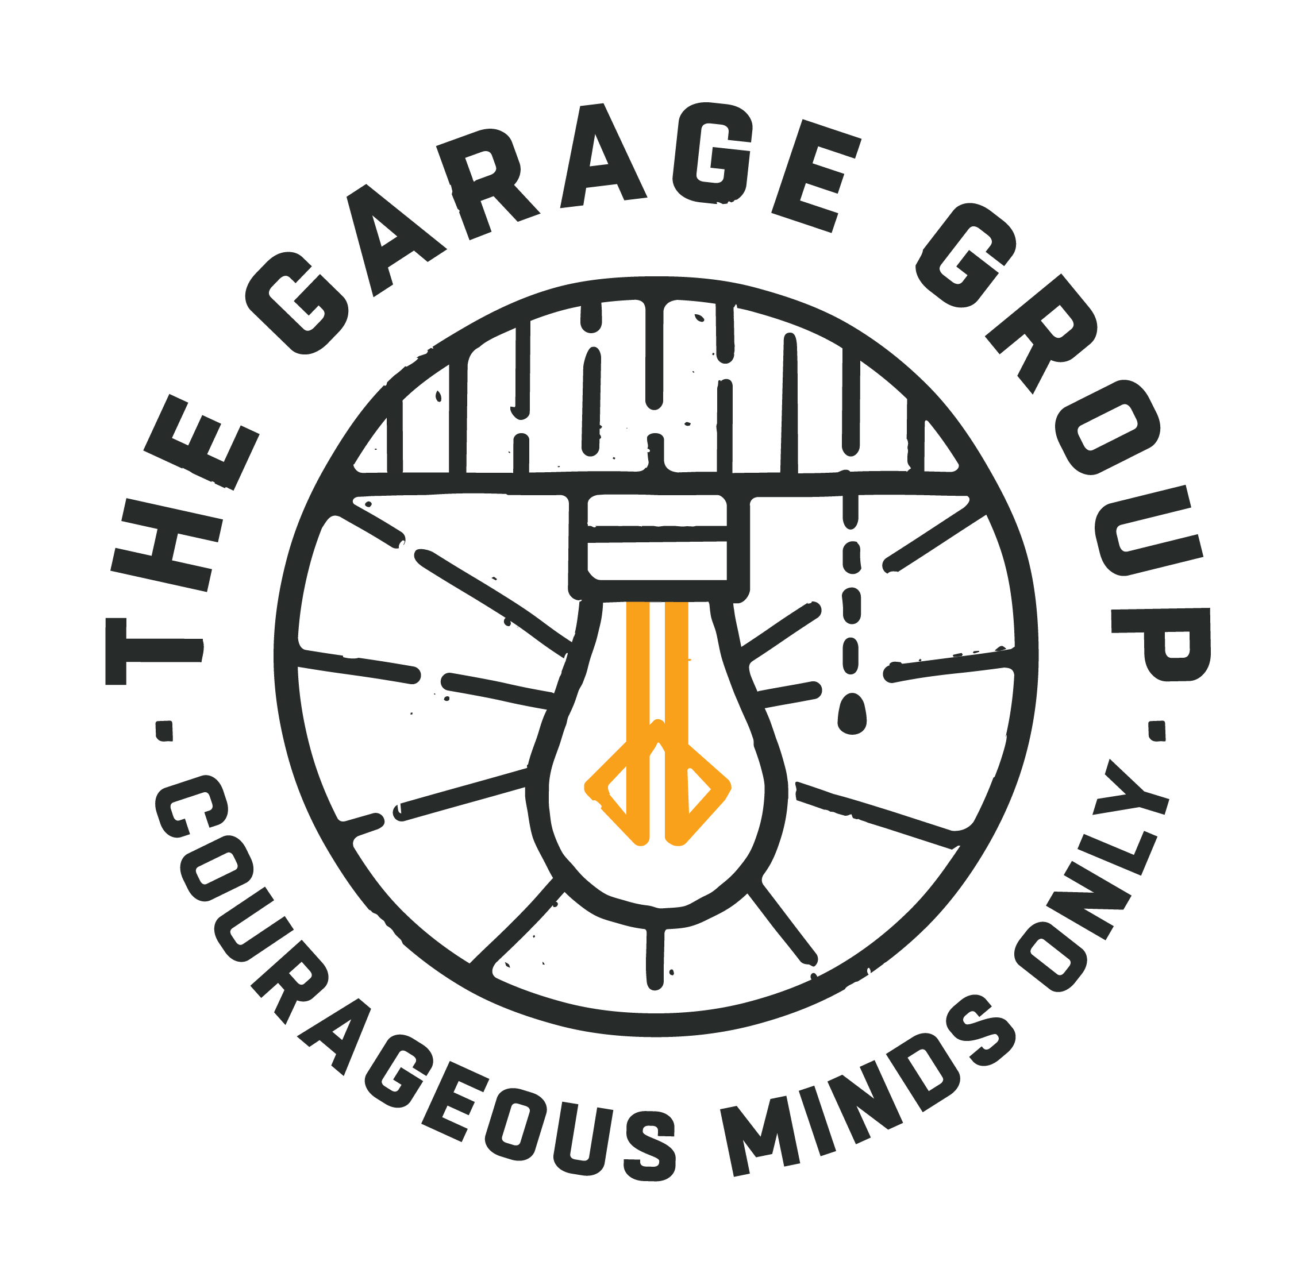
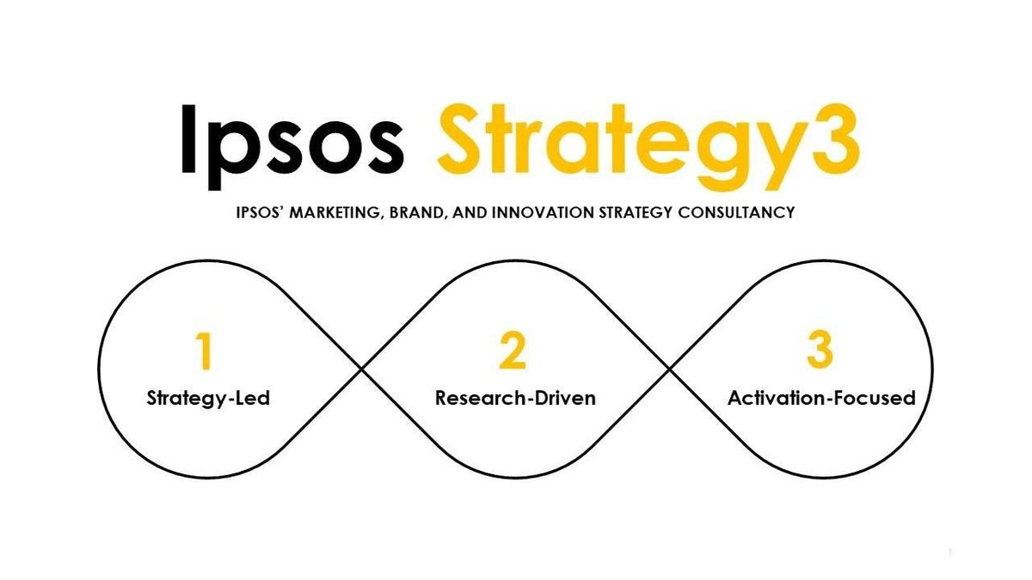




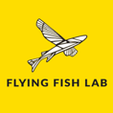
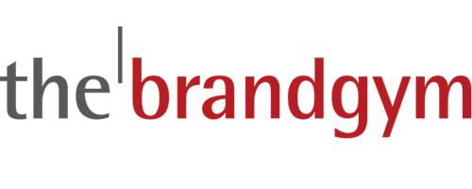
SOME CONSULTANCIES IN MY COMPETITIVE SET
Wordmark logos
Pictorial logos
Abstract logos

Slide 2
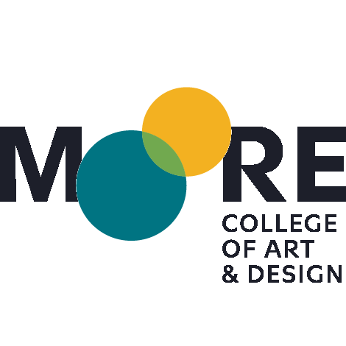
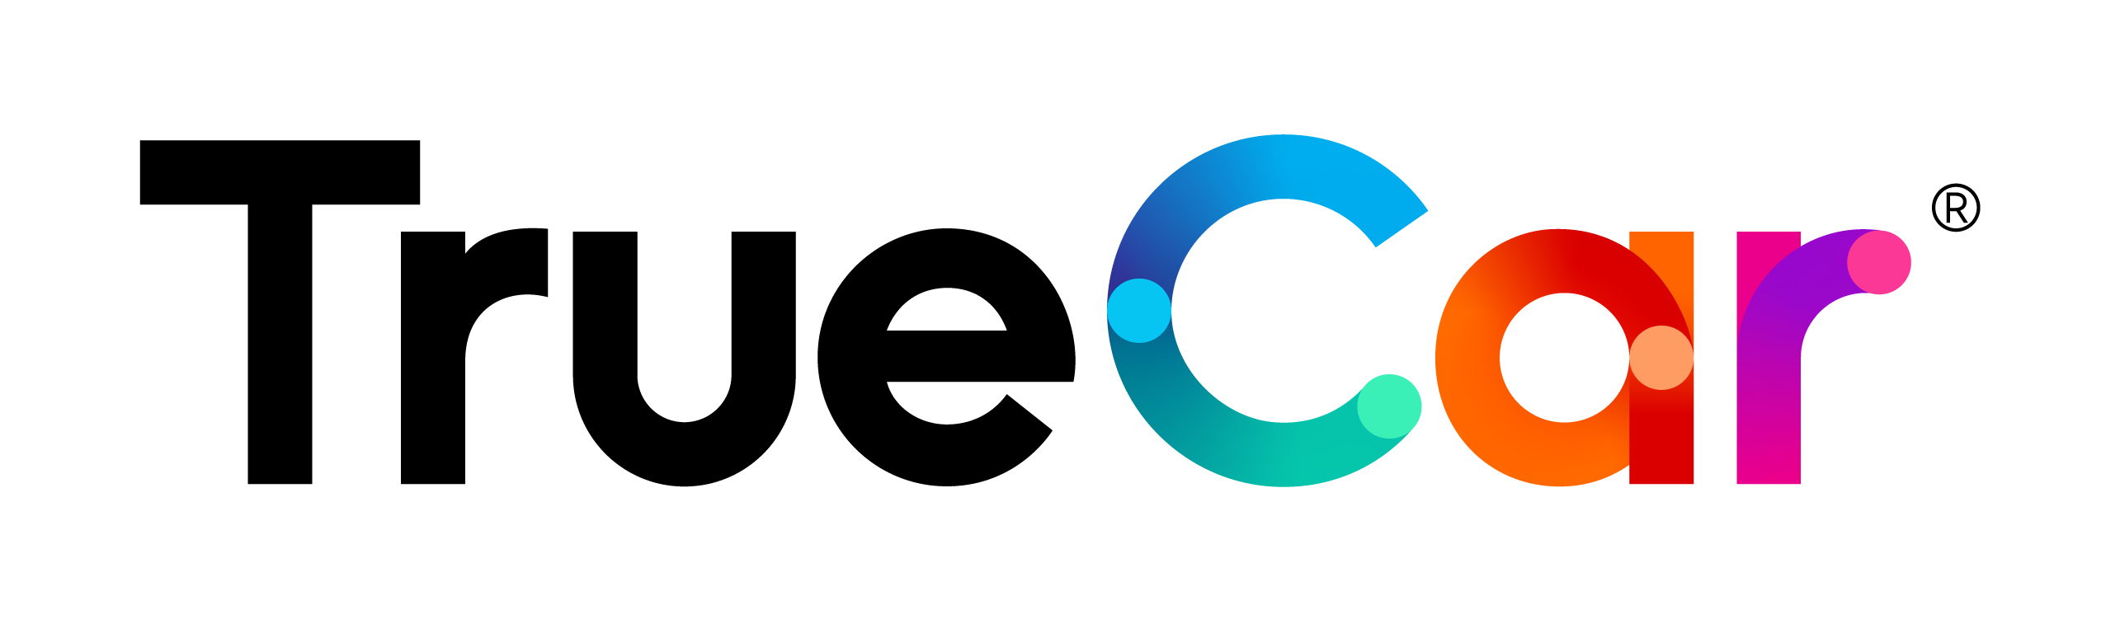
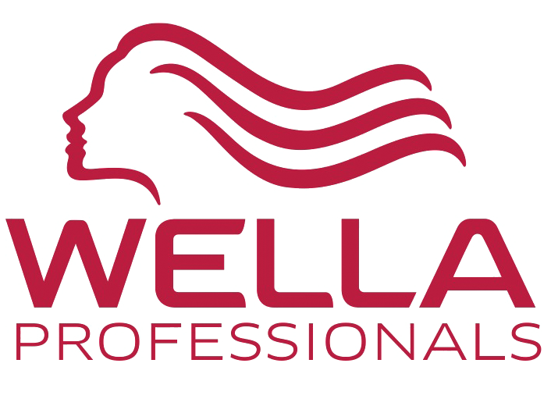
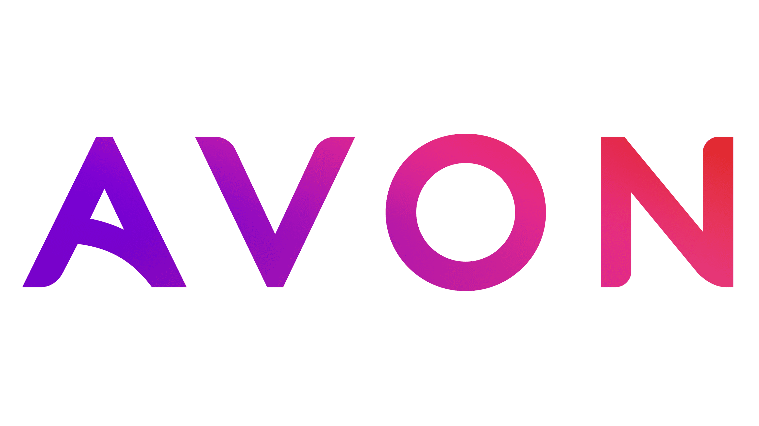
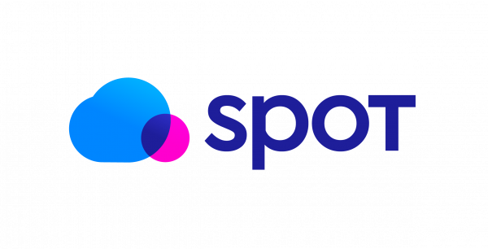
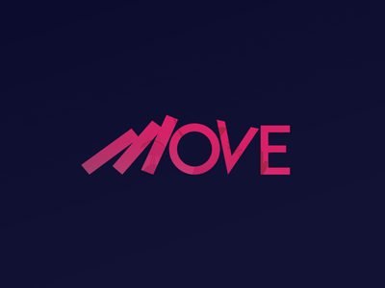
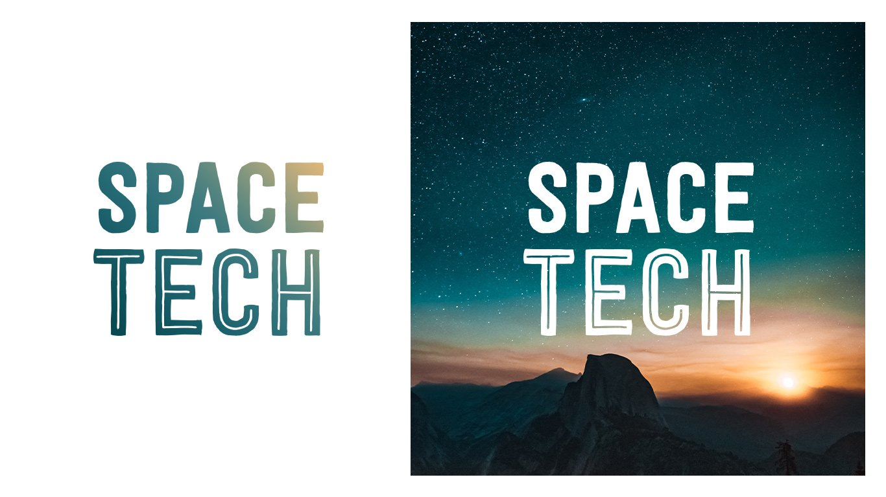
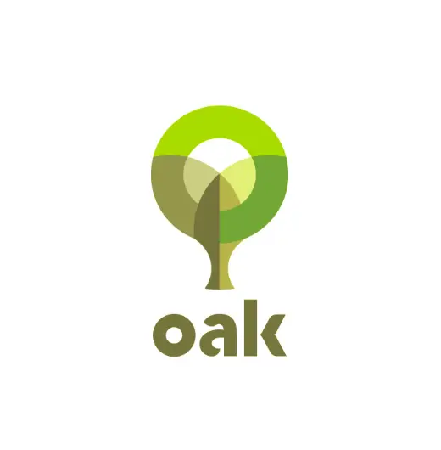
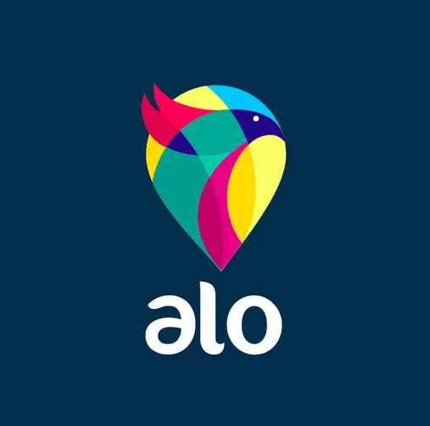


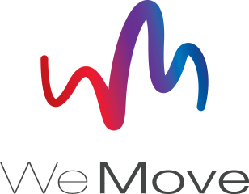
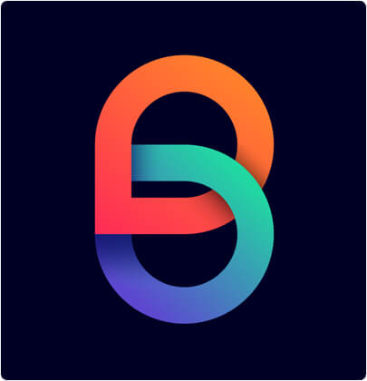
CURRENT DESIGN TRENDS I LIKE
Gradient color techniques
Static Motion
Overlapping Geometry
3D & Isometric

Slide 3
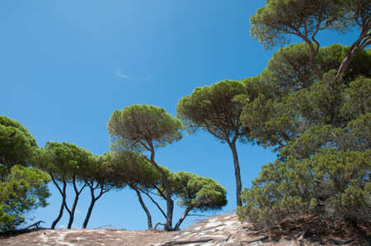
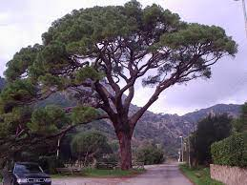
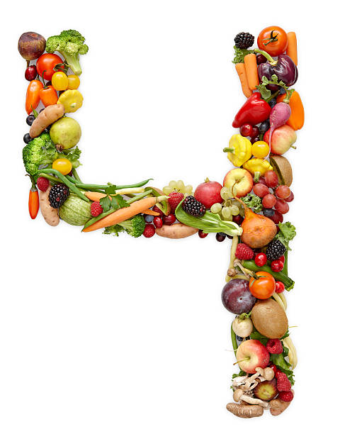
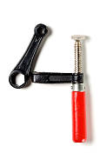
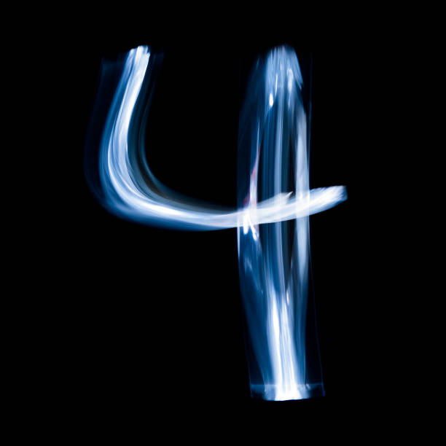
ROQUEFORT ”PARASOL PINE” DESIGN ROUTE (Decorative, executional)
Roquefort les Pins, the inspiration for “Roq4,” is full of Parasol Pines. They are tall, poetic, majestically beautiful trees that look like a “parasol” umbrella.
Perhaps there is a way to make render the “4” so it hints at an abstract Parasol Pine. Note: the 4 can be written with “open branches” vs a closed pointed ‘loop.’ (hard to find on the internet)

Slide 4
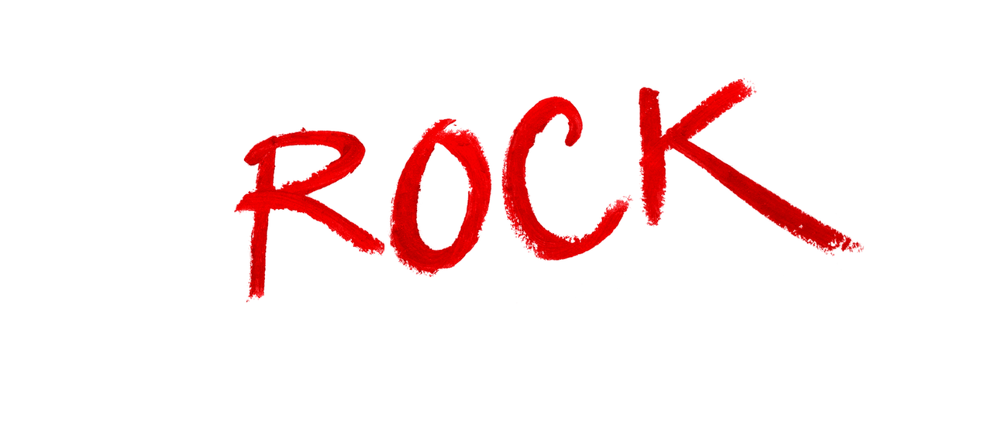

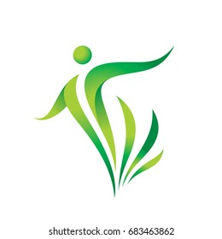
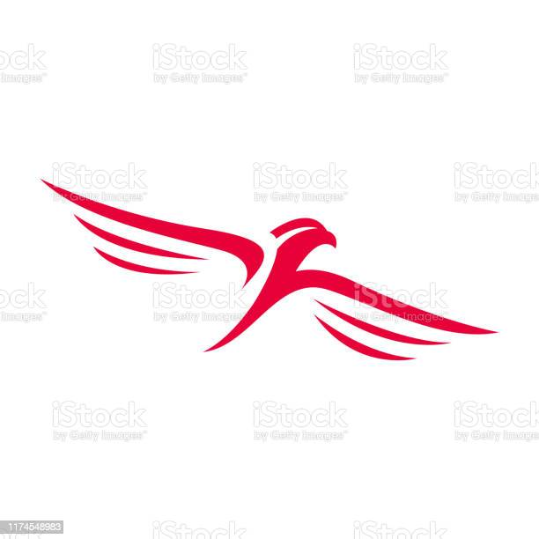

”ROCK DANCING / MOVEMENT” DESIGN ROUTE (feeling, tone & manner)
I’d like to infuse some freedom / agility / dynamism / enthusiasm in the tone & manner of the logo design, so people get the let’s rock (let’s just do it and have some fun!) / “rock it” (it’s awesome) aspects of the secondary meaning of the company name: “rock for tomorrow.”
Maybe there is something in freedom of movement? Birds flying towards the future?
But, please, no ”hard rock,” rockets, or anything associated with negative aspects of rock culture like drugs, sex, rock ’n roll, etc.

Slide 5
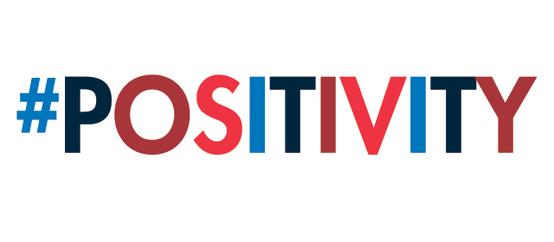




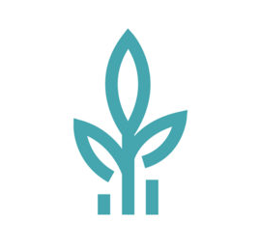
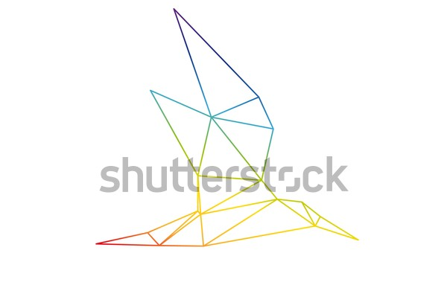


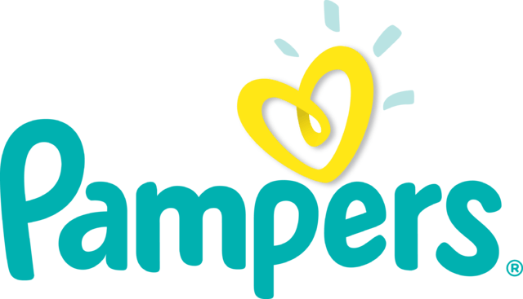
”TOMORROW” DESIGN ROUTE (conceptual /intellectual)
Another possible route is to leverage ideas encapsulated in the notion of tomorrow ....
Positivism
Growth / Soar
Bright new day

