Slide 1


ECSSETX
Epoxy Coating Supply Southeast Texas

Slide 2
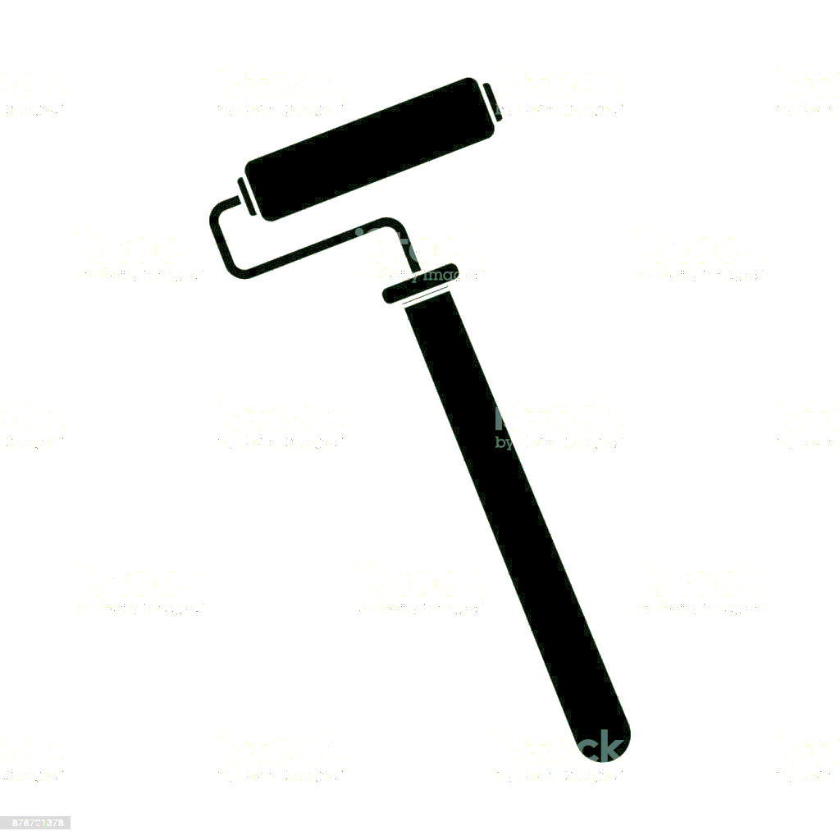
ECSSETX

Slide 3


ECSSETX

