Slide 1

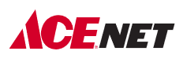
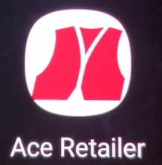
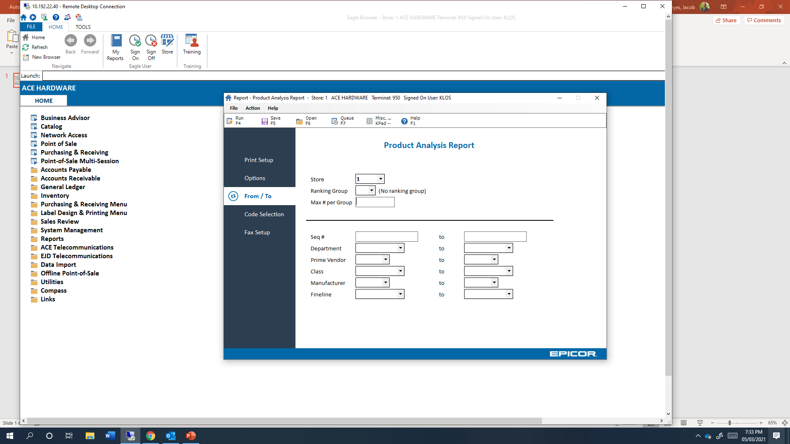
In-Aisle Customer Special Order Process
1
2
3
4
5
6
7
Enter Order
Step
Complete
POS Trx
Assemble
(when applicable)
In-Store Pick-Up
Order Entry
Receive
Invoice
Stage
System
Touchpoint
ACENET
- or –
Mobile App
Eagle
Mobile App
Eagle
Mobile App
Mobile App
Mobile App
Lead / Location
Designated Receivers in Back Room
Back Office Store Associate/ Back Office
Designated Staff / Staging Area
Designated Staff / Staging Area
Cashier or Sales Associate In-Aisle / Hub
Sales Associate In-Aisle / Hub
Cashier at POS / Hub
Review pick sheets and sort them by 1) in-store pickup, no assembly 2) assembly, and 3) delivery, no assembly
Cross-reference pick sheets against product
Receive orders via fulfill customer order feature
Actions
Search in Eagle by customer phone #
Import order into POS
Take 100% Deposit
Ring up items being taken today separately
Provide receipt to customer and thank them
Pull special orders via Sort and Seg feature
Scan totes with Special Orders
Print pick sheets
Reference order via pick sheets
Ensure no remaining balance due
Staple invoice to pick sheet
Physically assemble product
Advance order via Order Prep feature
Create Stock Reserve or Customer Priority Order
Ask about assembly and/or home delivery
Sell in item’s order multple
Communicate ETA
Customer arrives
Complete pick up via the Ready for Pickup feature
Locate order in staging area
Validate pick sheet, invoice, and order was paid in full
Thank customer
Outcomes
If order is an in-store pick up, notification sent to customer
If order is to be delivered, this moves order to Ready for Delivery status in mobile app
Delivery notification sent to customer on delivery date
Qty. On Hand decreased
Committed Qty. relieved
Sales transaction recorded
If in-store pick up, notification sent to customer
If to be assembled or delivered, orders are moved to Order Prep feature in mobile app
Order transmitted to Ace RSC
Order confirmation sent to customer
Order auto-sent to Eagle as a Special Order
Updates ACENET’s Deliveries & Services App
Creates SKU in Eagle, if it hadn’t existed
Committed Qty. updated
Deposit amount recorded in Eagle
Prepares product for invoicing and staging
Closed order
Happy customer

Slide 2
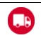
In-Aisle Customer Special Order Process
7
5
Enter Order
Miscellaneous
Deliver
System
Touchpoint
Epicor
- or –
ACENET
Mobile App
Lead / Location
Back Office Store Associate / Back Office
Designated Associate / Delivery Destination
Location code non-stocked special orders as ‘DNRSP’
Flag large quantities as unusual usage in ITR
Review open orders from POS or ACENET Customer Order Tracking
Action
Pack up product/paperwork
Create route in Needs Delivery feature
Load up delivery vehicle
Contact customer to provide time range
Validate pick sheet, invoice , and order was paid in full
Take signature where appliable
Take photo for unattended deliveries
Complete delivery in mobile app
Thank customer
Use this icon for Delivery
Outcome
Review the sales performance of special order items
Keeps items from being reordered
Addresses order point issues
Remedies overdue outstanding orders
Closed order
Happy customer

