Slide 1
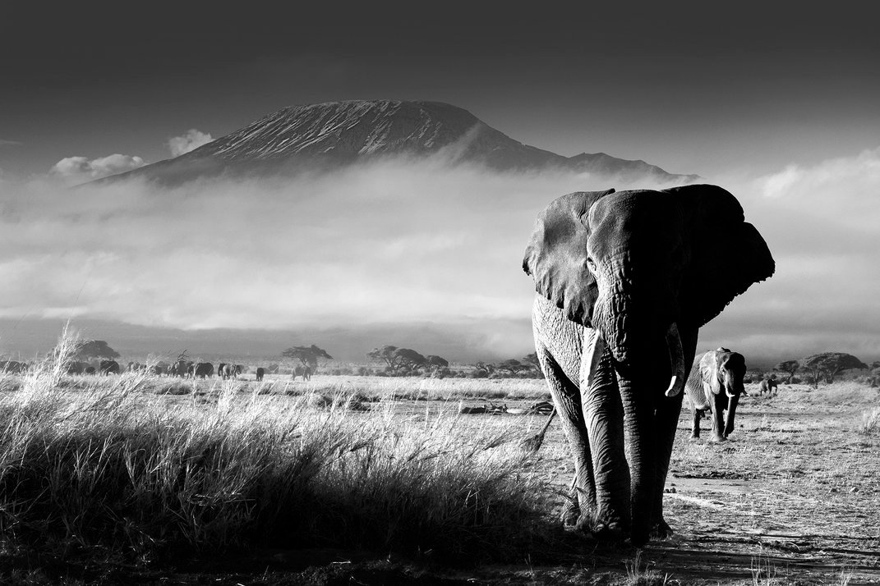
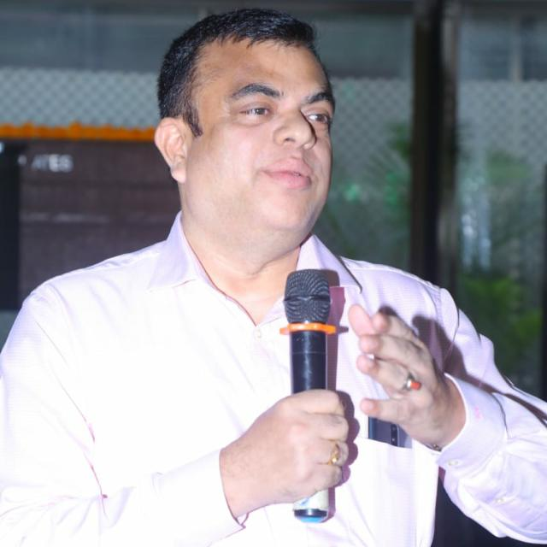
Hello! I am Gola.
My annual school exams are over, but I have to spend my entire summer vacation in the scorching heat of Nagpur, my hometown, as my father will get no leave this year.
Can you imagine my frustration? To kill my boredom, I have now started reading a Jim Corbett novel.
Suddenly my maternal uncle, aka Kushimama, called me to visit his place in Delhi. He also promised a few trips to Assam, Uttarakhand and North Bengal. It is indeed a great relief, what do you say?
Surprisingly, he wanted me to carry my passport as well. Something fishy? Who needs a passport to travel within India? Or, Kushimama has something else in mind?
Btw, he is a RAW agent, so he can do anything, right?
Do I sound greedy too at the prospect of a foreign trip?
Why don’t you follow me on my entire trip with Kushimama? Let me know how did you like my trip. Would you mind mailing your feedback to subrata0168@gmail.com?
TREASURES
Of
NANYUKI
TREASURES of NANYUKI
Kushimama & Gola’s Adventure Series: Book1
SUBRATA MUKHOPADHYAY
SUBRATA MUKHOPADHYAY

