Slide 1


  Indoor DOOH Audiences at Scale
WWW.ADSTASH.COM
BUY ON ADSTASH
Info@AdStash.com
MEDIA KIT 2021

Slide 2
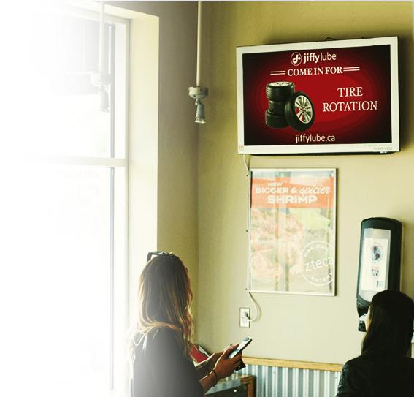








WHY GO INDOOR | it’s not just lockdowns
ending - recent uptick has been driven by the unique
effectiveness of indoor DOOH ad exposure.
It’s special...
It’s powerful...
And it works.
Dwell time measured in minutes, not seconds
Brand-safe
Engaged impressions, consumer attention, means...
2x increase in reach if added to Omni
-Channel
campaigns²
...Indoor DOOH 2x more likely to be seen, recalled, than traditional OOH¹
100% viewability by humans,
not bots
Not Skippable
https://mediatel.co.uk/news/2018/10/25/study-reveals-impact-of-combining-dooh-with-social-media-campaigns/
https://www.mediapost.com/publications/article/342285/mri-simmons-finds-adding-outdoor-to-mix-can-boost.html

Slide 3
AdStash offers advertisers easy, affordable access to North America’s largest indoor DOOH network, containing diverse audience segments while captivated in indoor environments

Slide 4
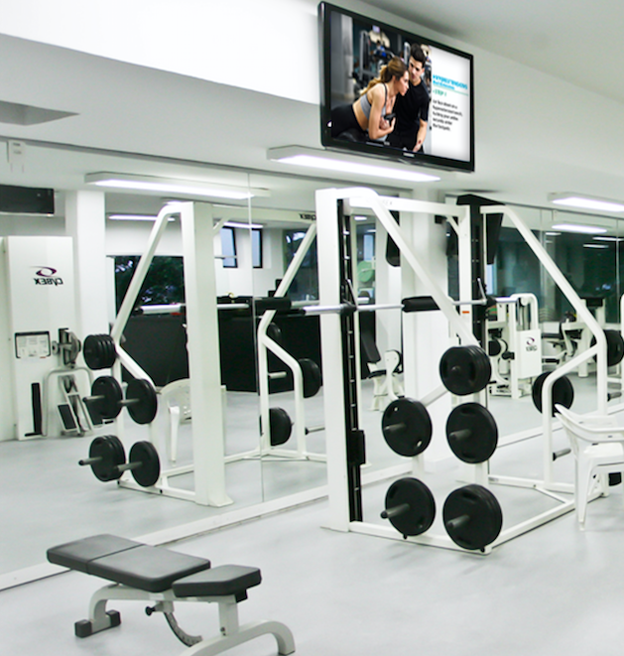
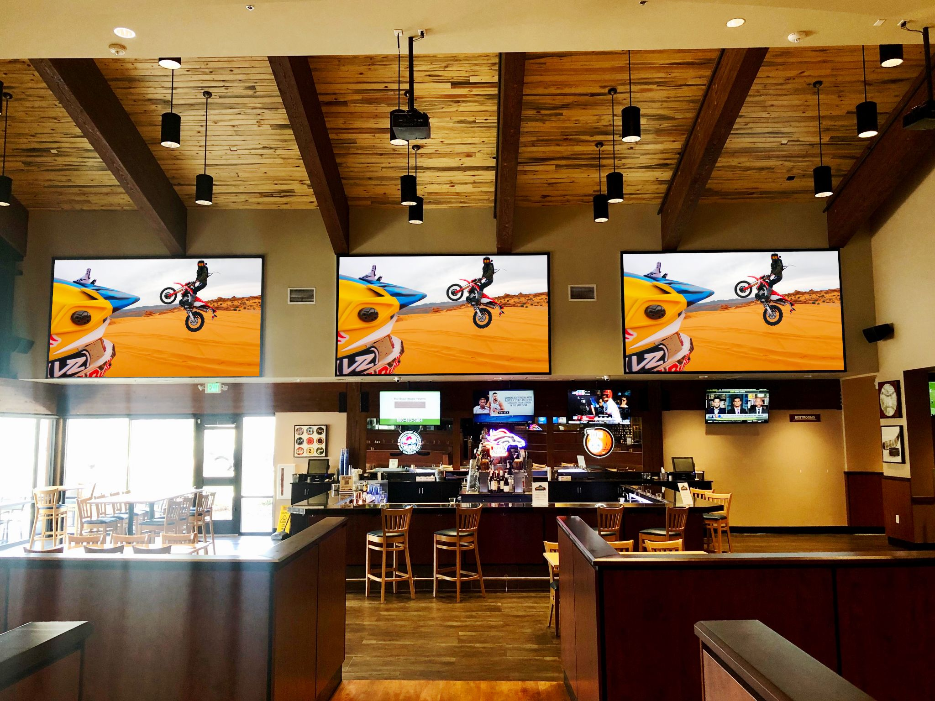
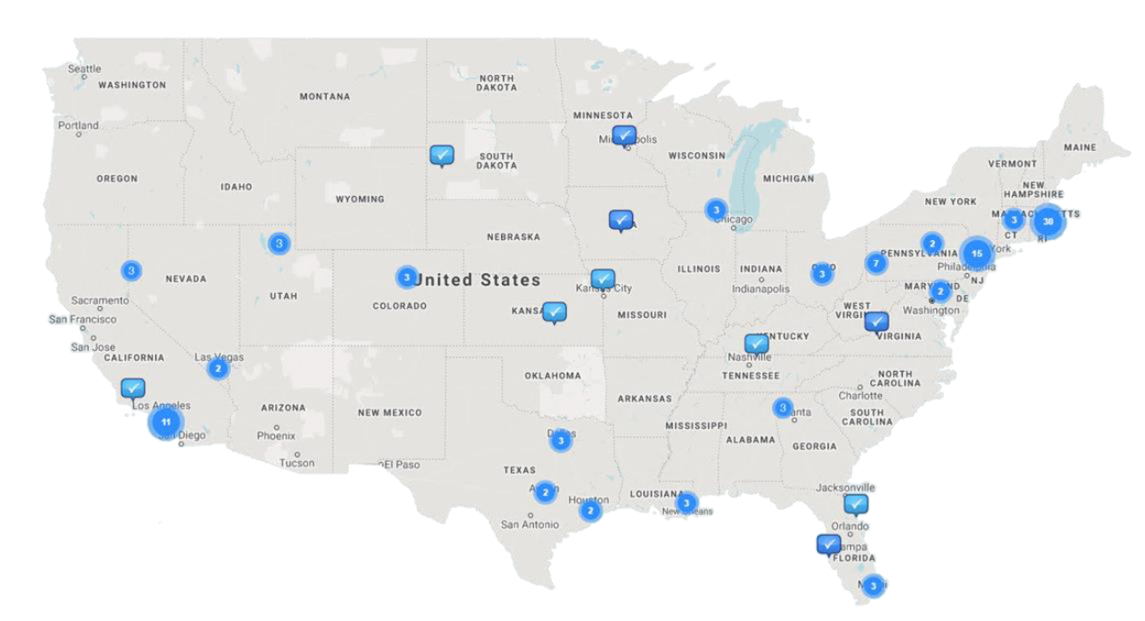
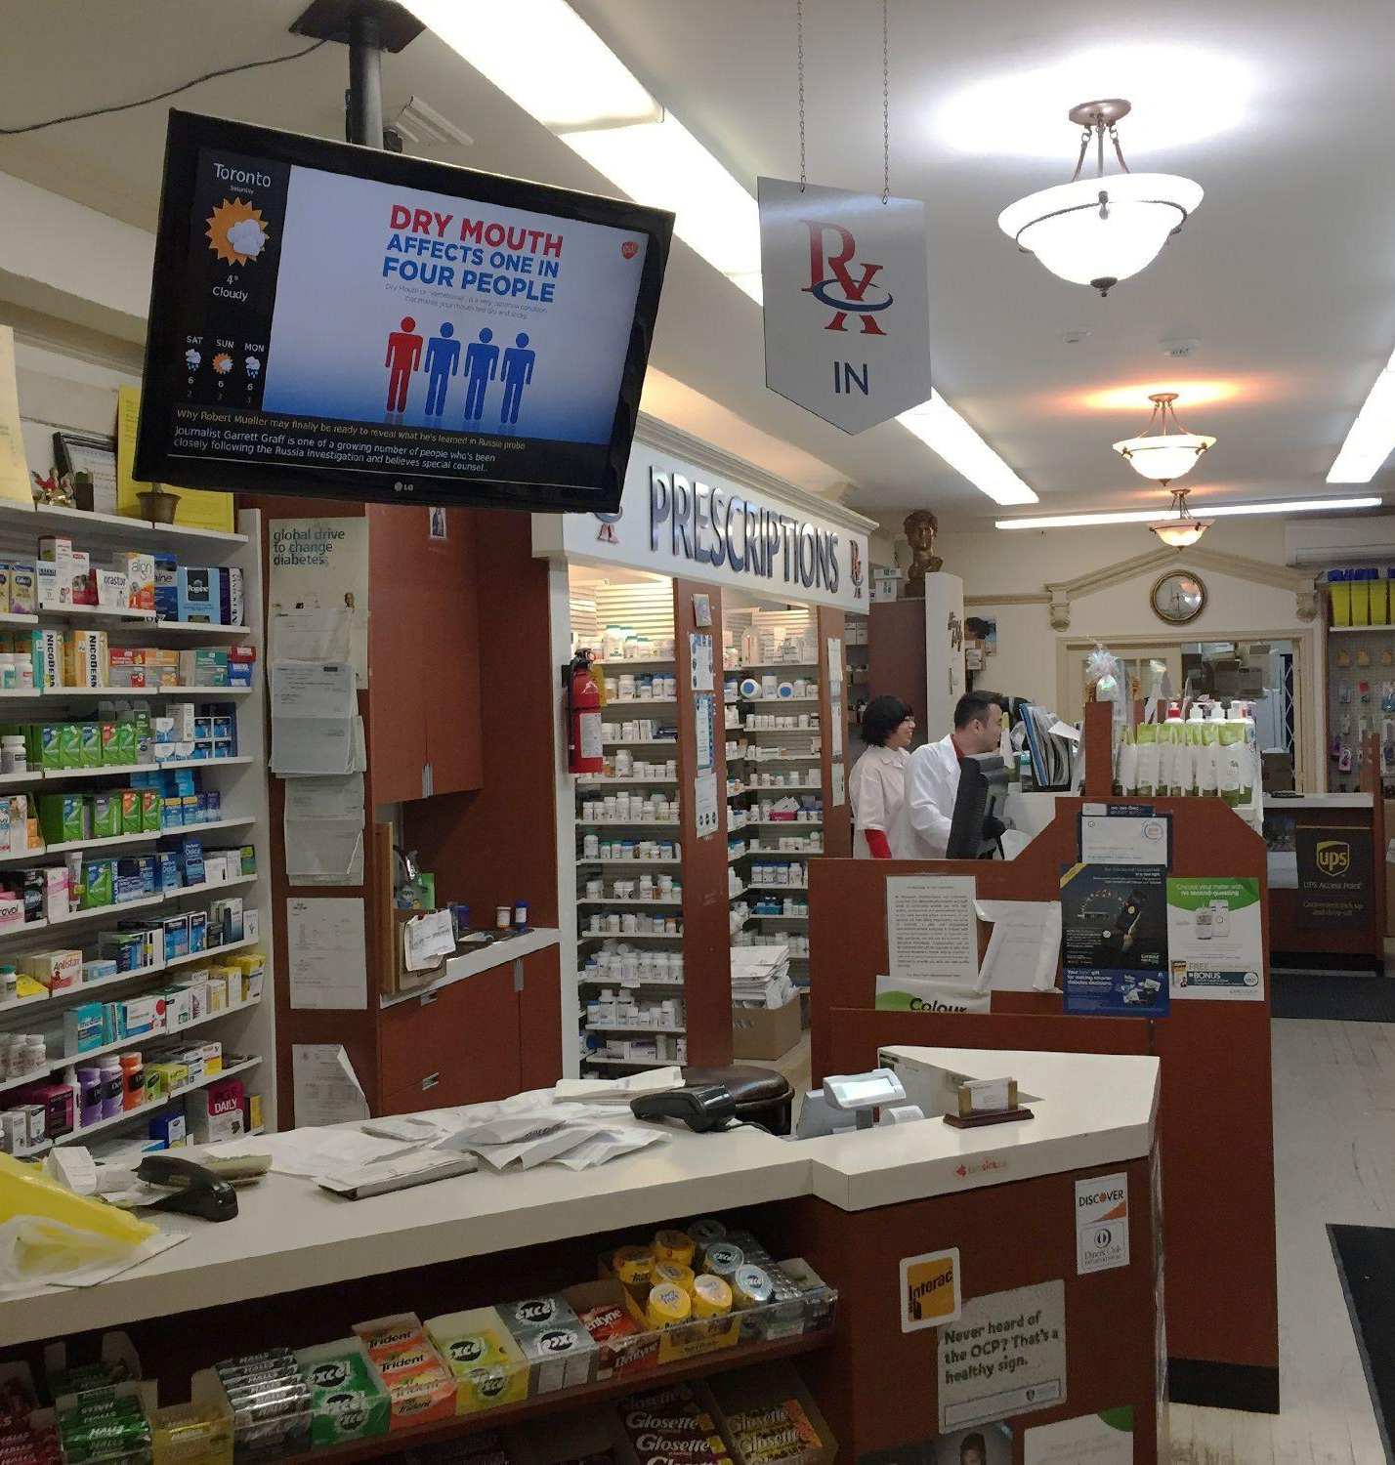
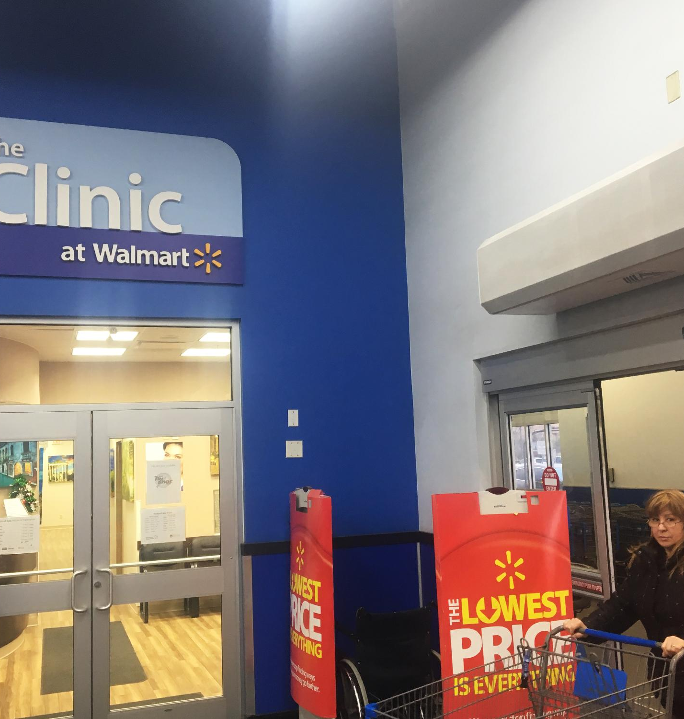
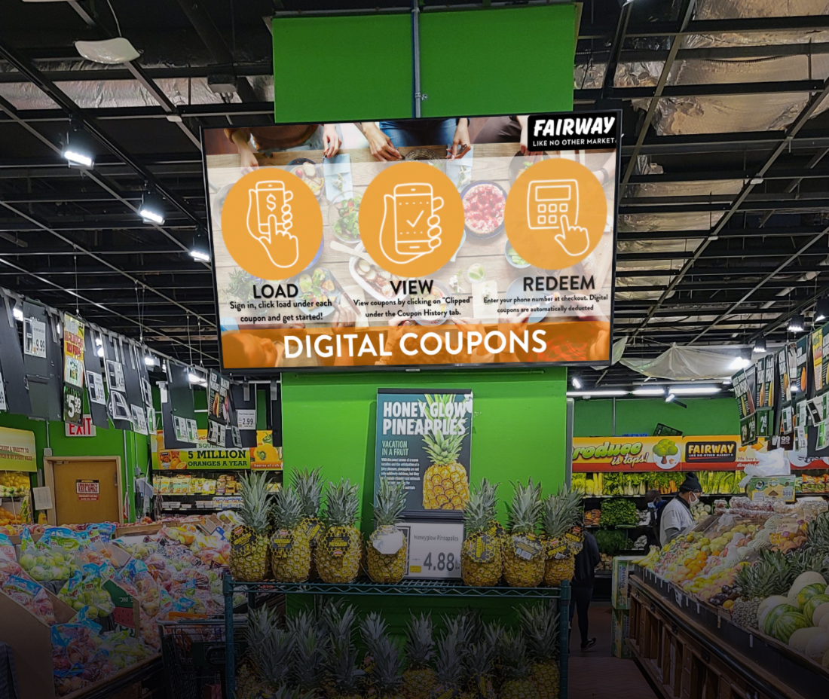
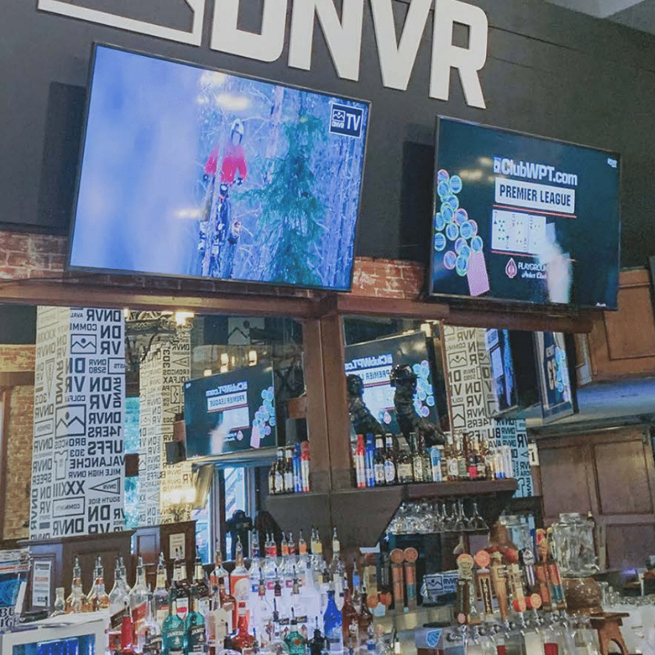
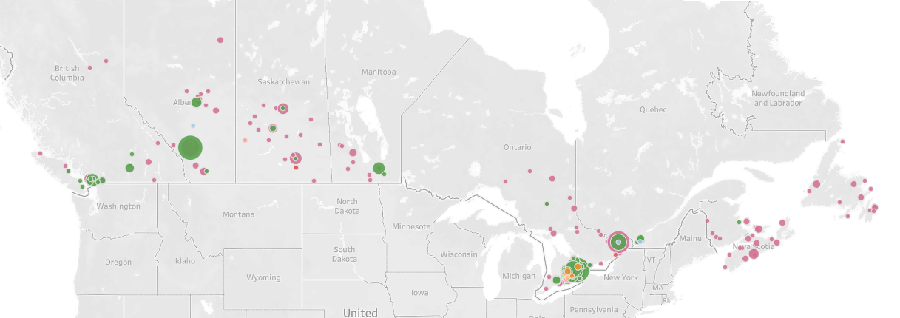

NETWORK | AdStash is your DOOH partner, connecting your partners and advertisers to a nation-wide network of premium, place-based screens.
Our nationwide network.
Our premium venue types.
12B+
12000+
Impressions Annually
Retail
screens
50+
16000+
DMA’s
Restobar screens
26,105+
2000+
Venues
Medical
screens
31,594+
4000+
Screens
Grocery
screens
Plus private airports, hockey arenas, records stores, and many more.

Slide 5

















HOW TO BUY | AdStash’s network and unique audiences are accessible however you buy your media.
...you can buy
anywhere...
Audiences...
...however
you’d like.
Direct Buying
High net worth
Sports Fans
And many more.
Open RTB
High dwell time
Programmatic Guaranteed or PMP

Slide 6
















ADVERTISERS | Brands that buy on our network.

Slide 7
ADSTASH | Key Takeaways
Adstash is:
North America’s largest and fastest-growing indoor DOOH screen network
Powerful enough to capture the attention of nationwide audiences at scale, specific enough to provide access to diverse audience segments
Programmatically-accessible, ensuring cost-efficiency, transparency and real-time optimizations
Flexible enough to get any DOOH campaign or integration up and running quickly and without issue
The Right Time.
The Right Message.
The Right Audience.

Slide 8
DIGITAL MEDIA FORMATS | Specifications
Network
Content Specifications
Ad Content Play Suggestions
Indoor, 32 –73” Screens
Full Screen Take Over
Sold programmatically
No Blacklisted Advertisers
Approval Upon Venue Review
1920 pixels (w) x 1080 pixels (h) 16:9
1080 pixels (w) x 1920 pixels (h) 9:16
Static: PNG, RGB, encoded. JPG or H.264
Video: .MP$ / encoded .MOV
Will repurpose TV spots, banner ads; transcode ill-fitting static creatives
15 second
30 second
60 second
The Right Time.
The Right Message.
The Right Audience.

Slide 9
Thank you.

