Slide 1
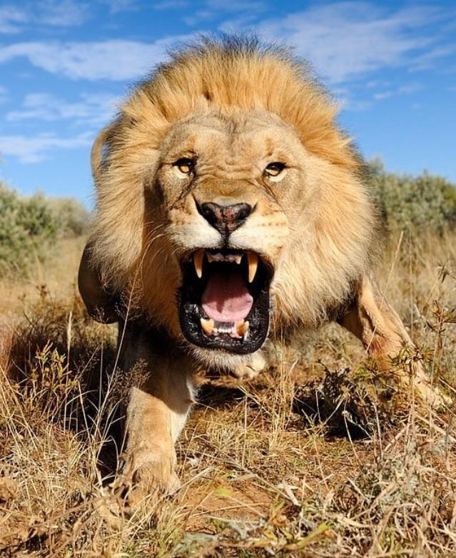


We experience the stressor.
Our brain interprets the stressor:
- Is it a threat?
- Is it friendly?
- Should I flee or fight or freeze?
Our brain creates the appropriate stress response: physical, mental, emotional

Slide 2
We experience the stressor.
Our brain interprets the stressor:
- Is it a threat?
- Is it friendly?
Our brain creates the appropriate stress response: physical, mental, emotional

Slide 3
We experience the stressor
Our brain interprets the stressor
Our brain creates the stress response: physical, mental, emotional

Slide 4
We experience the stressor
Our brain interprets the stressor
Our brain creates the stress response: physical, mental, emotional

Slide 5
Charging Lion
We experience the stressor
Yup – it’s a threat
Our brain interprets the stressor
Better run!
The stress response: physical, mental, emotional

