Slide 1
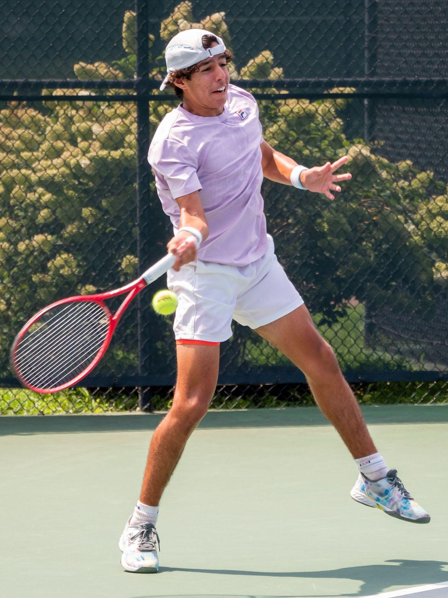
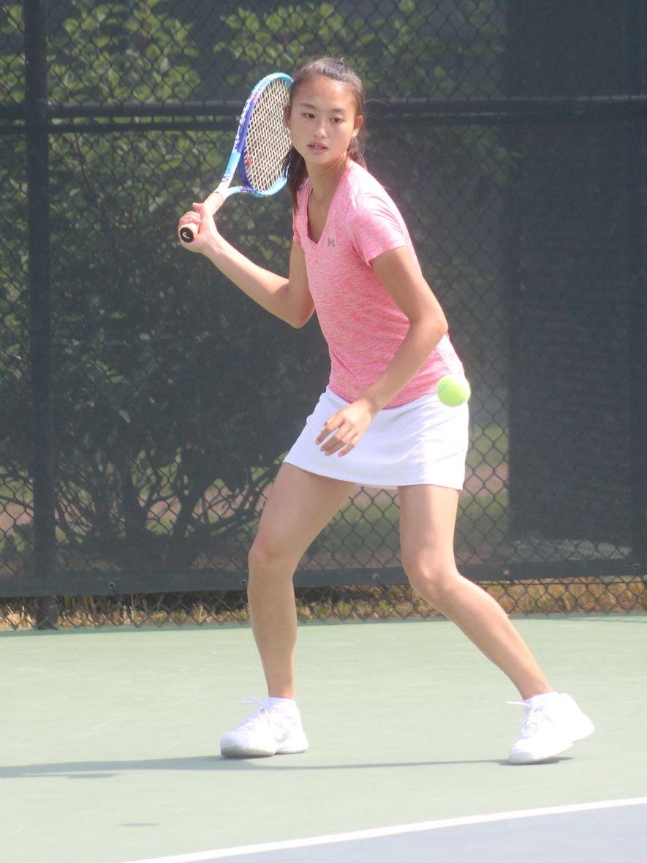
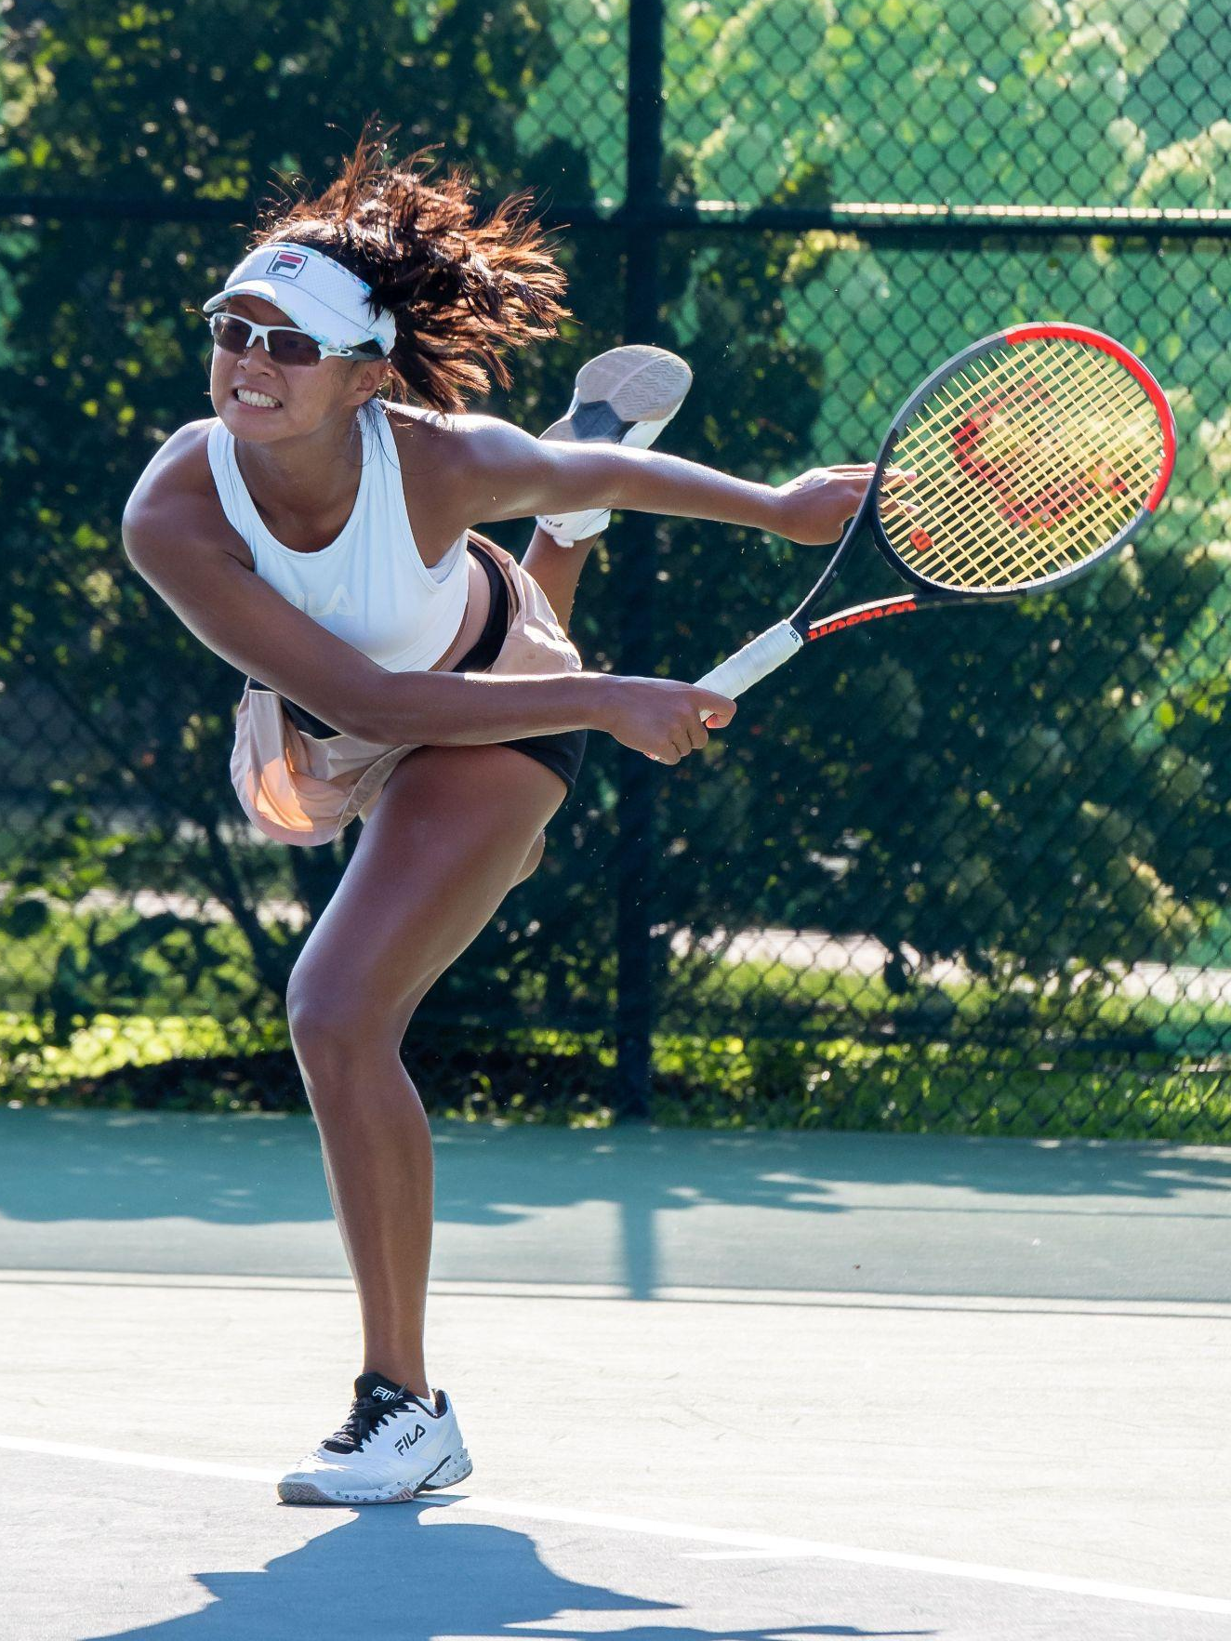
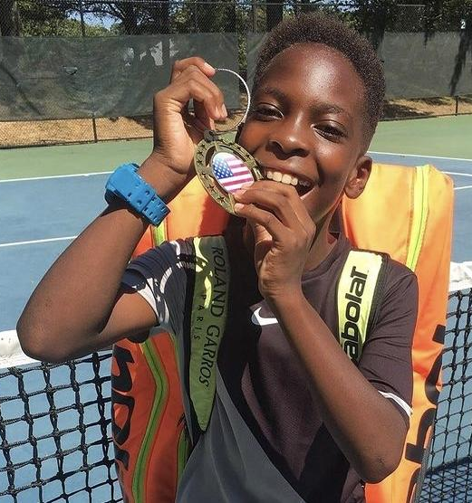
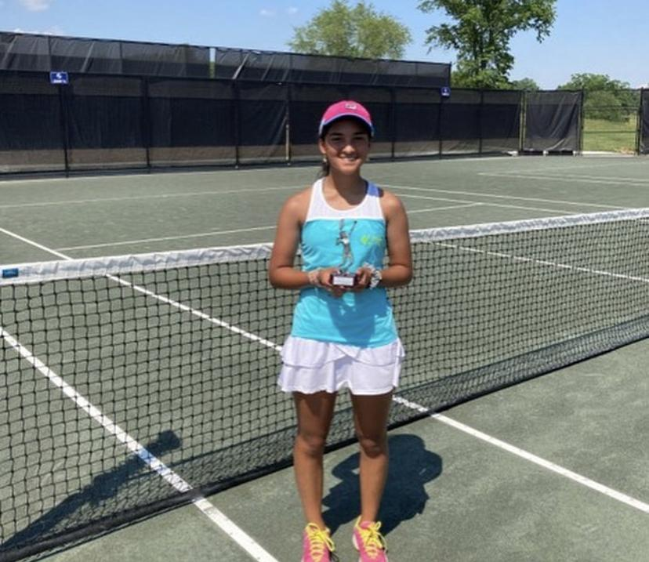
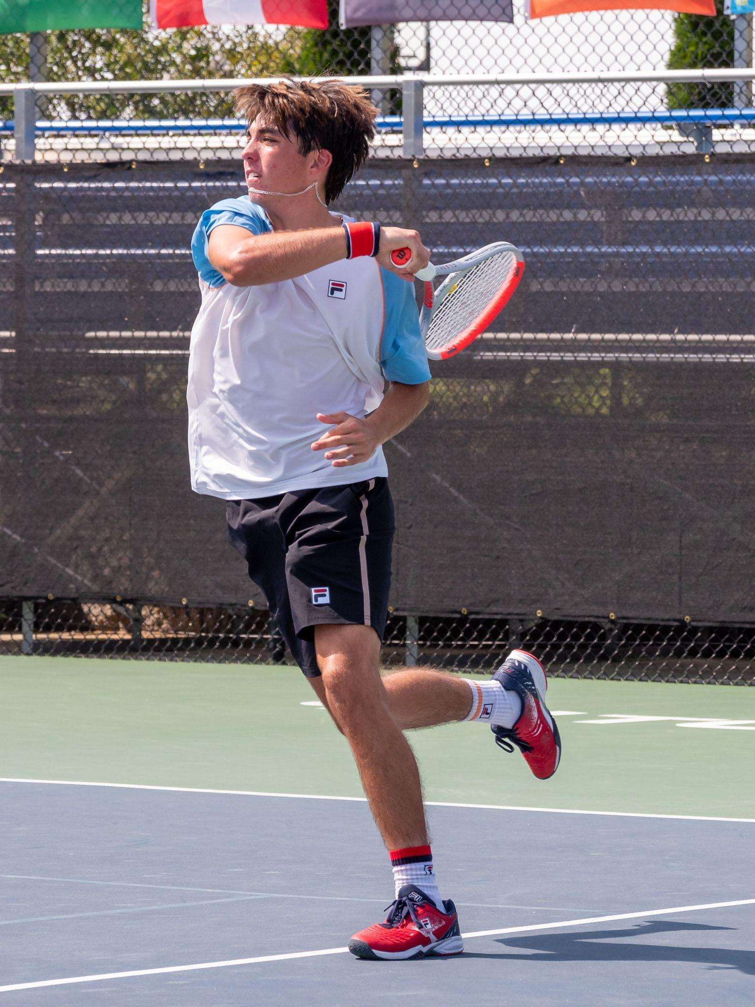
Distinguished Current Champions Program Players
Cyrus Mahjoob - National Top 50 Boys 12s, 14s, 16s
Kallista Liu – National Top 50
Girls 18s
Cindy Zhao – National Top 50 Girls 14s, 16s
Coy Gray - Mid-Atlantic Top 10 10&Under
Ryan Colby - National Top 50 Boys 12s, 14s, 16s, 18s, 2021 B18s National Clay Court Champion
Carolina Castro - National Top 50
Girls 12s

Slide 2

























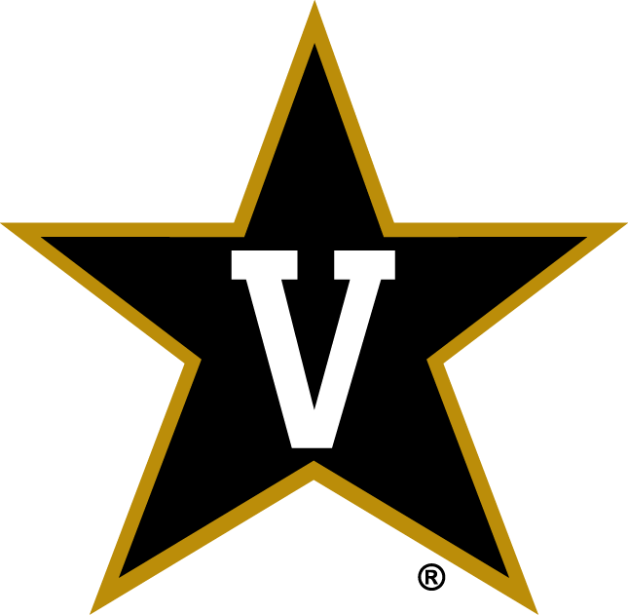



Step V- Graduates and College Scholarships
In the past 20 years:
270 graduates earned college scholarships/academic aid for a collective value of 22 million dollars
Notes:
National college tennis landscape compared to other collegiate sports - the dearth of scholarship money, especially for men

Slide 3
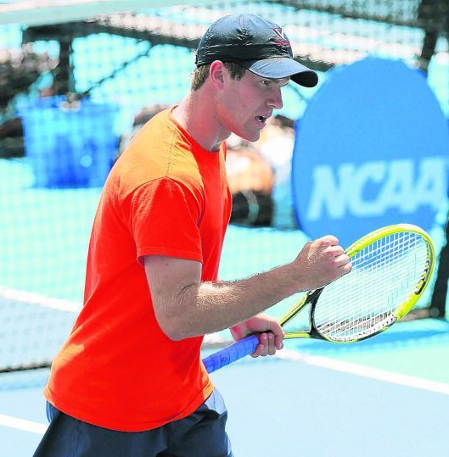
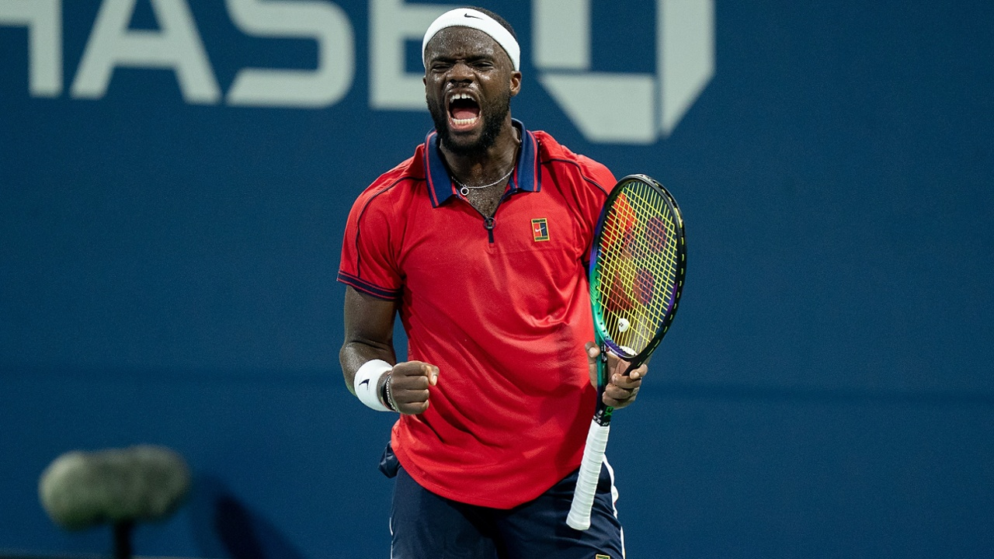
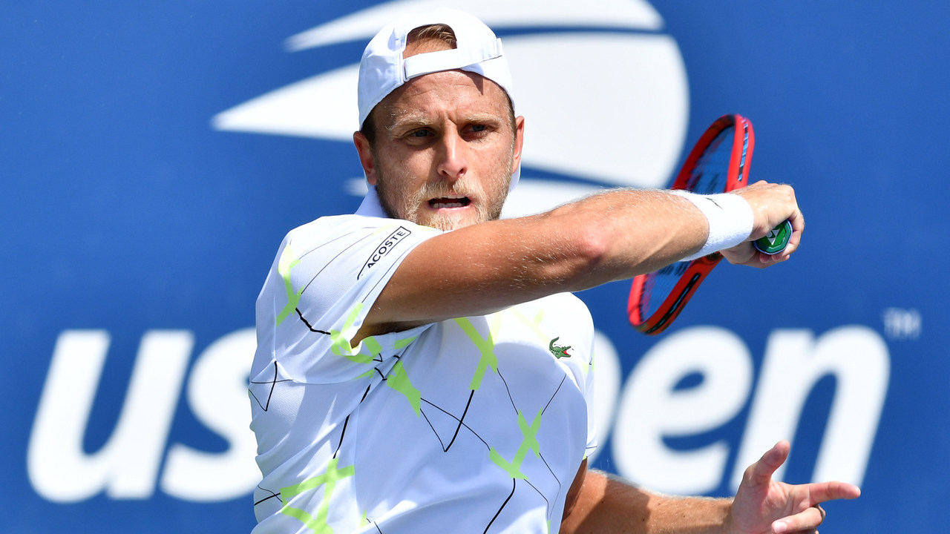
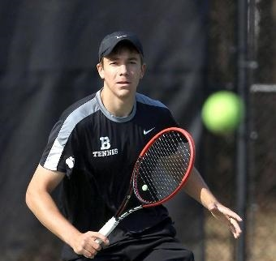
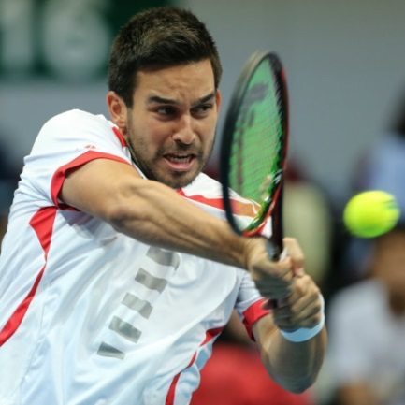
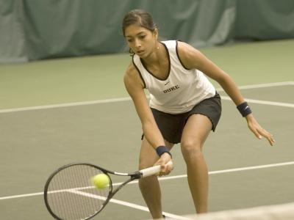
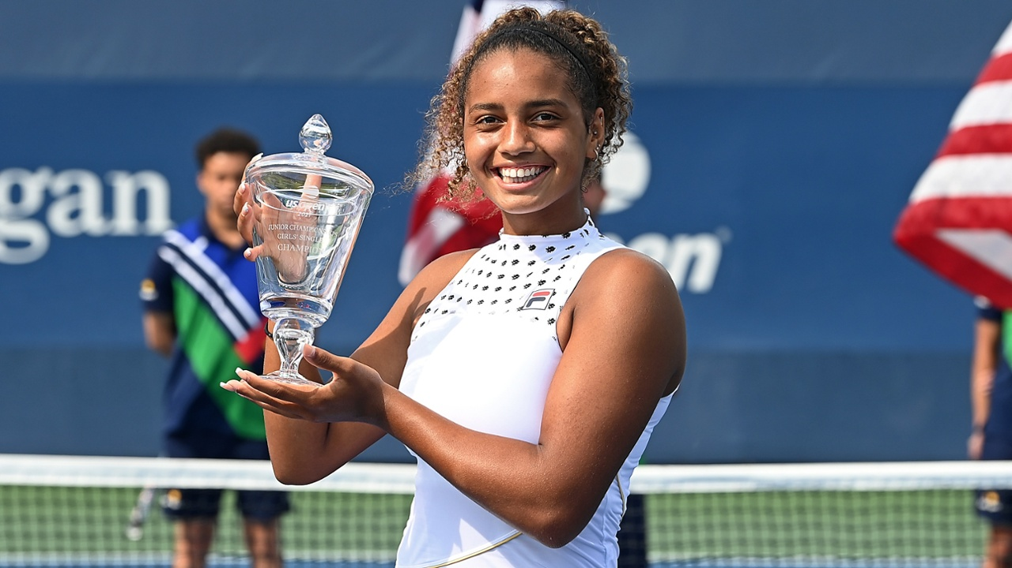
Step V - JTCC in College and Professional Tennis
Mitchell Frank – UVA, Two time winner of NCAA Team Championship, 3 time All-American
Denis Kudla – Career high #53 ATP Singles, reached Round of 16 Wimbledon 2015, 2016 Olympian
Frances Tiafoe- Career High #29 ATP singles ranking, youngest American male to win ATP Title since 2002 (Delray Beach, 2018), QF 2019 Australian Open, 2020 Olympian
Robin Montgomery ITF World Ranking # 2
2021 US Open Juniors Singles and Doubles Champion
WTA 25K Las Vegas 2020 Champion
2019 Junior Orange Bowl Champion
Luke Tercek - Bowdoin College, Winner of 2016 NCAA DIII Team Championship, 2 time All-American
Treat Huey – UVA, 16 finals on the ATP World Tour, reached career-high doubles world ranking #18 in 2016
Tara Iyer – Duke University, Winner of 2009 NCAA Team Championship, #350 WTA Ranking
Notes:
JTCC Champions To Date
115 graduates
Combined $13 million in scholarship funding

