Slide 1
It was my fault
I see that now

Slide 2
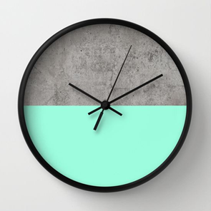
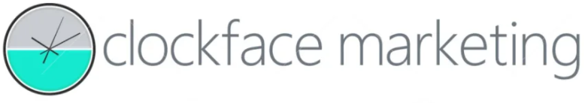
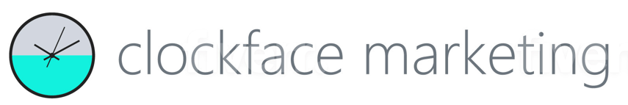
I though rendering this clock design as a graphic logo would be simple, clean and crisp
I was wrong. The results were so simplistic and flat,
I can’t use them

Slide 3

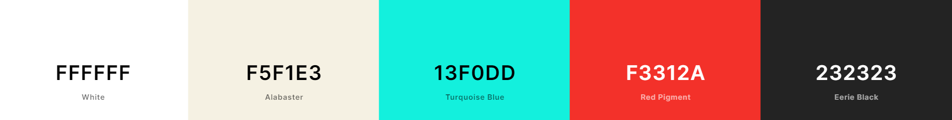
So this is how I’ll try again.
Start with this jump-off point.
Use this colour palette as a guide.
Then go for it
I want to reimagine this clock and title as a graphic logo. That’s where you come in – thank you
Details:
Font Segoe UI Light ( always lower case )
Font Colour HEX 6c757d
Black rim + hands of clock HEX 232323
Upper half of clock HEX D2D7DF
Lower half of clock HEX 13FODD
Guide only – expand or tweak at will
Clock only ( for adaptation to a favicon )
Dark copy white background
Dark copy transparent background
Reversed white_copy dark background
Reversed white_copy transparent background
Each with JPEG for e-signature, PNG for digital & socials & EPS for print + JPEG optional for other stuff, please
clockface marketing
Our HEX Brand Design Palette FYI

Slide 4

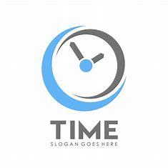
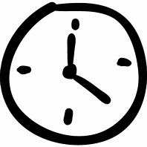
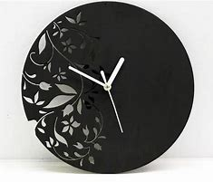
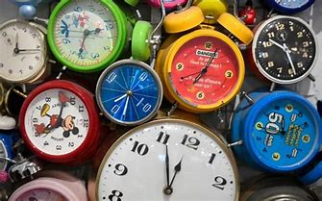

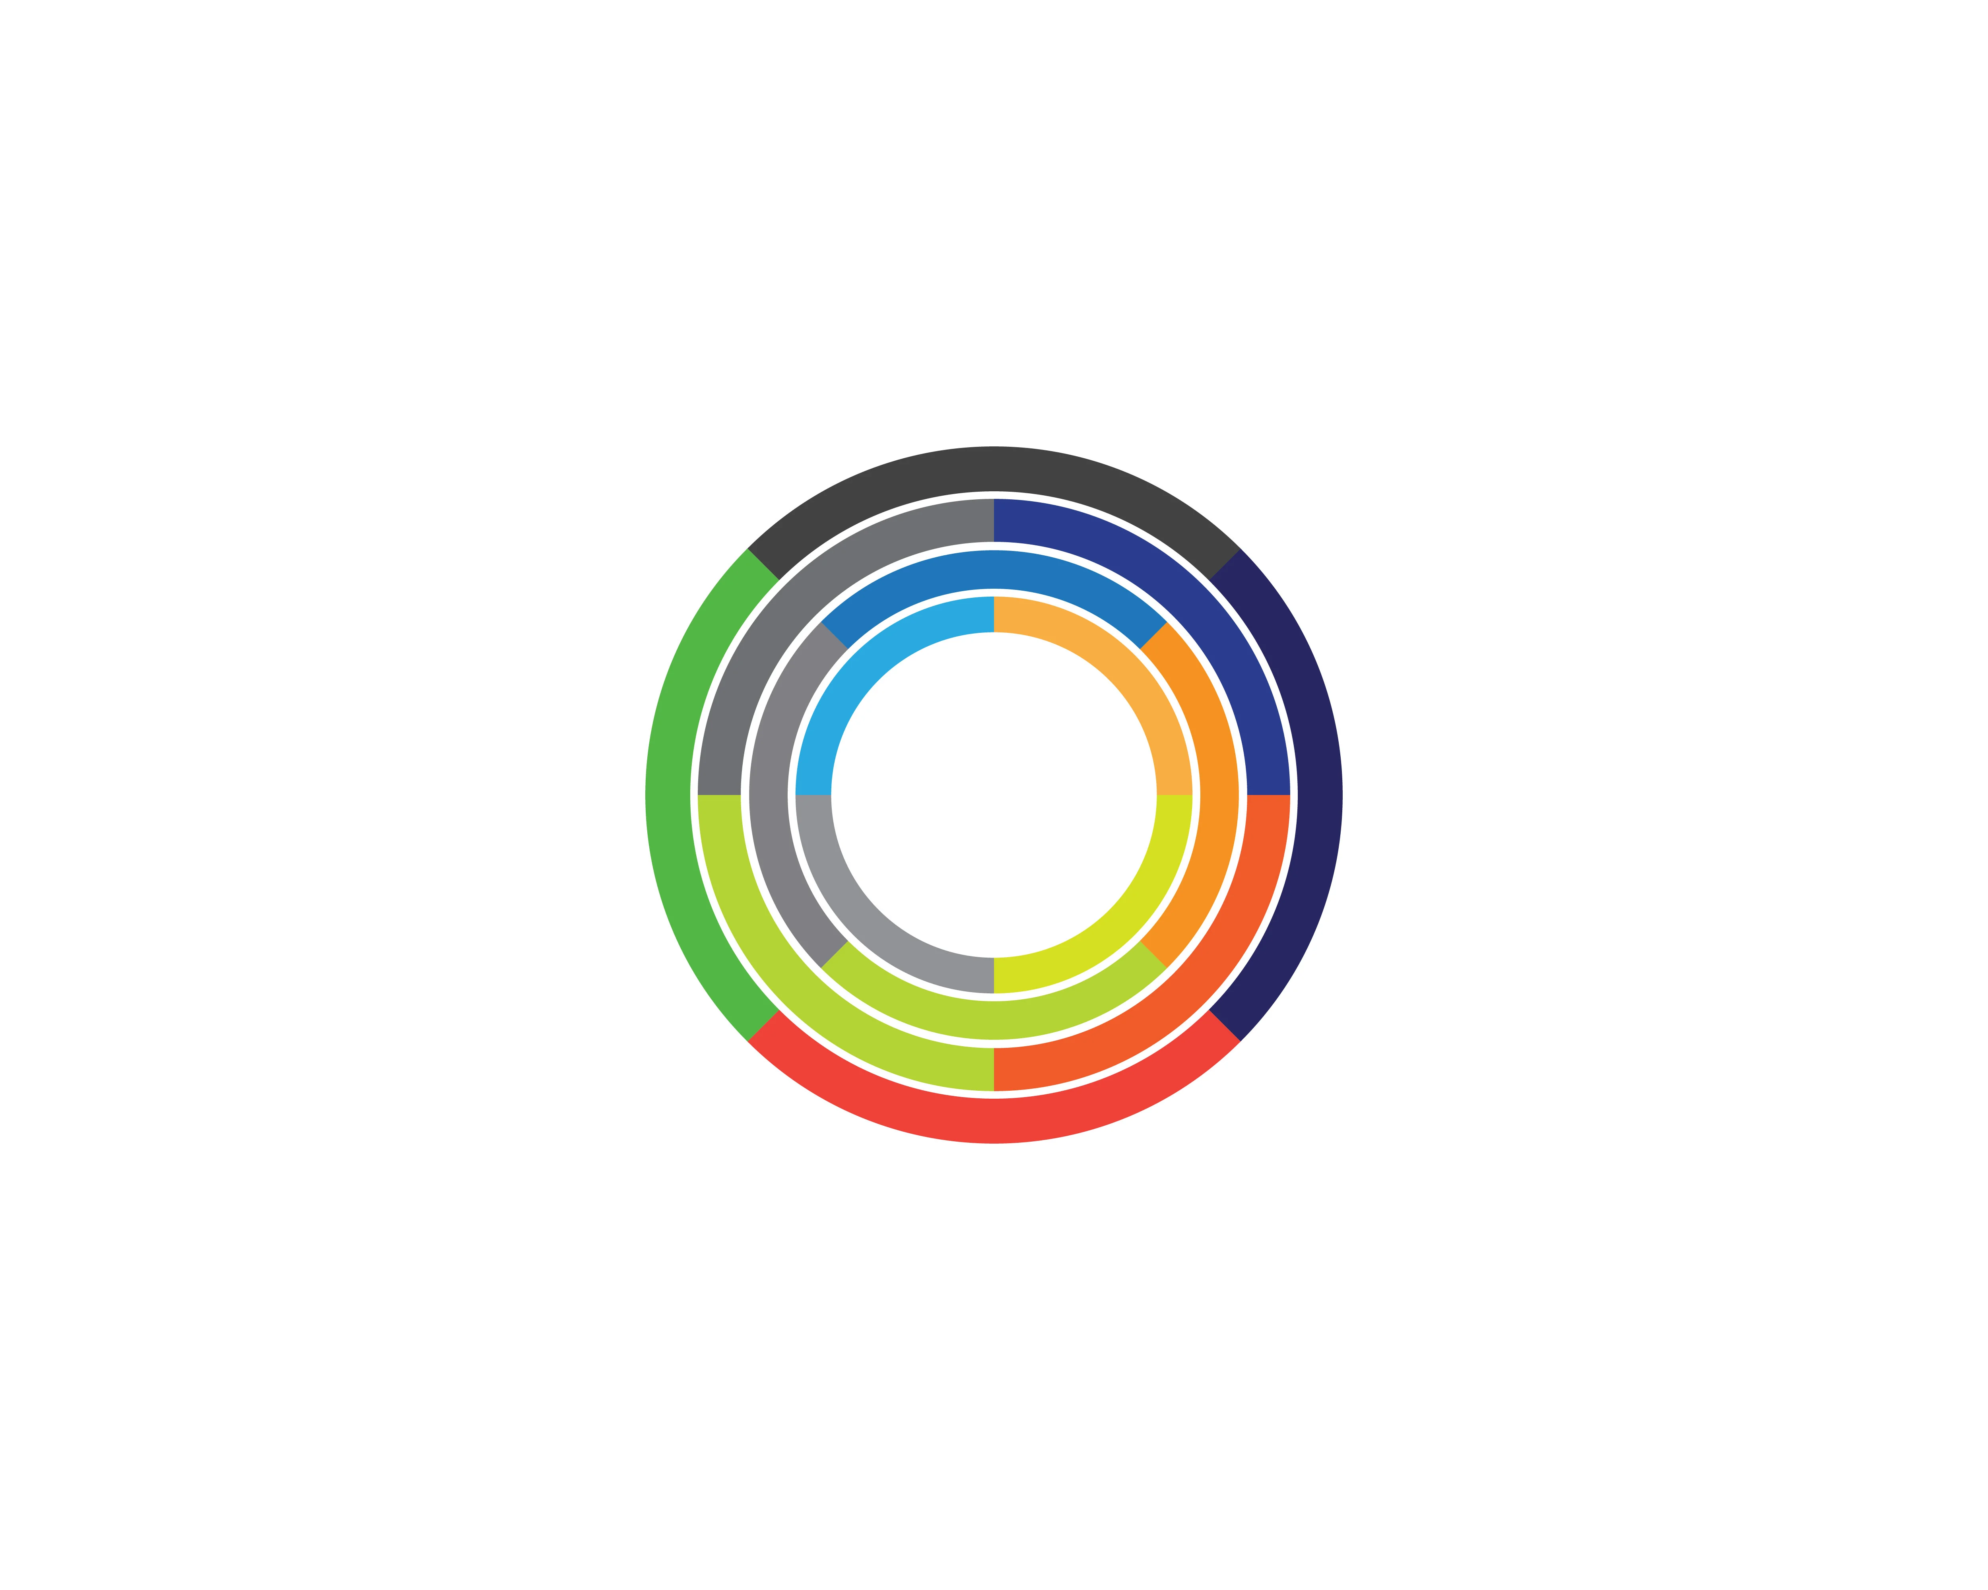
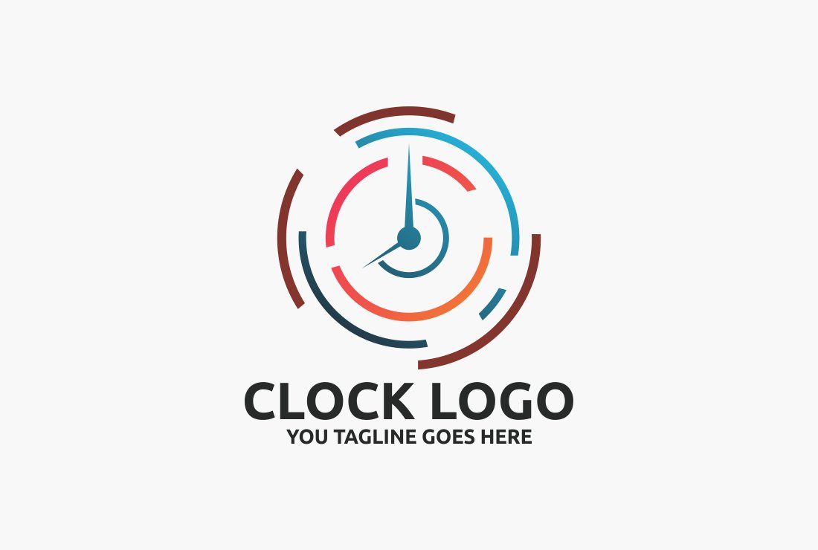
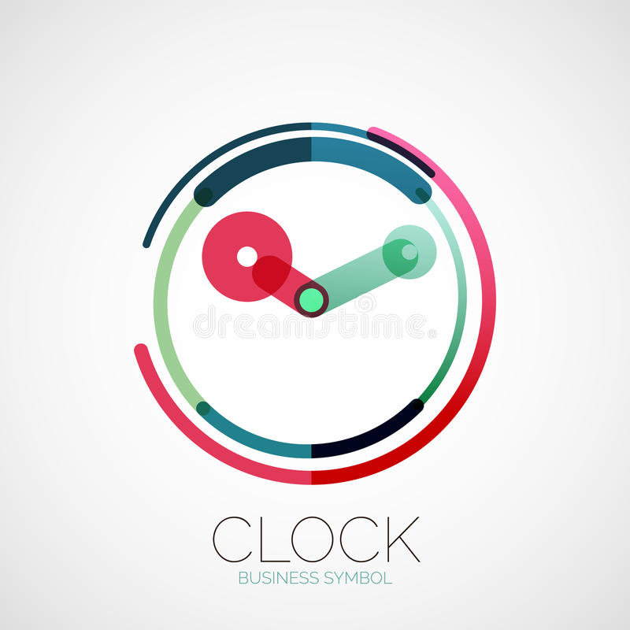
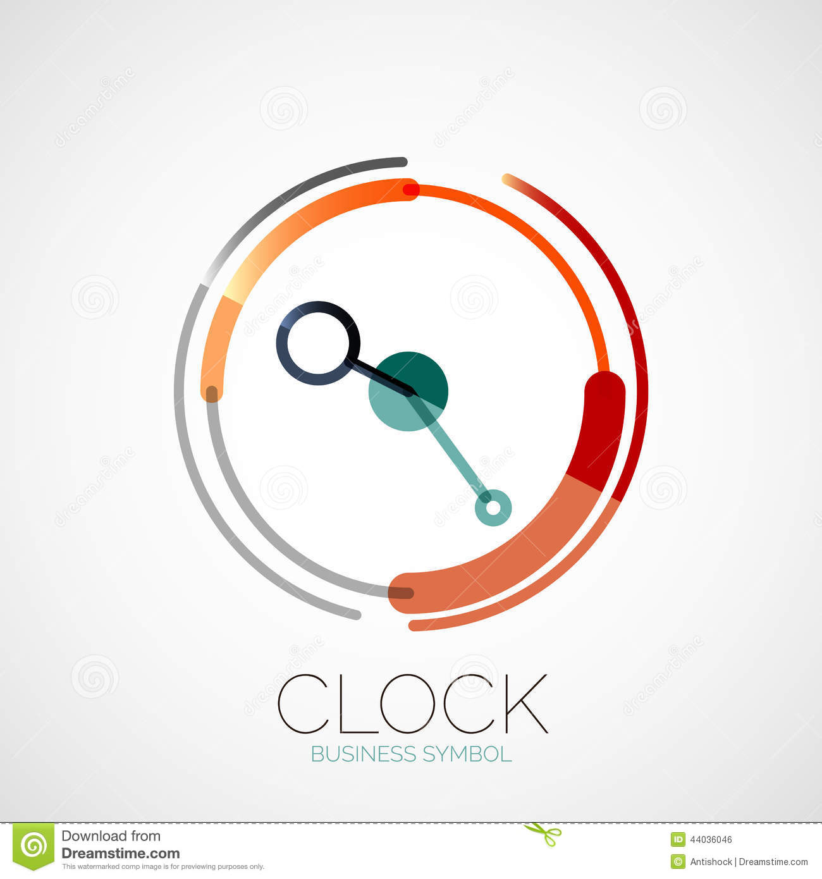
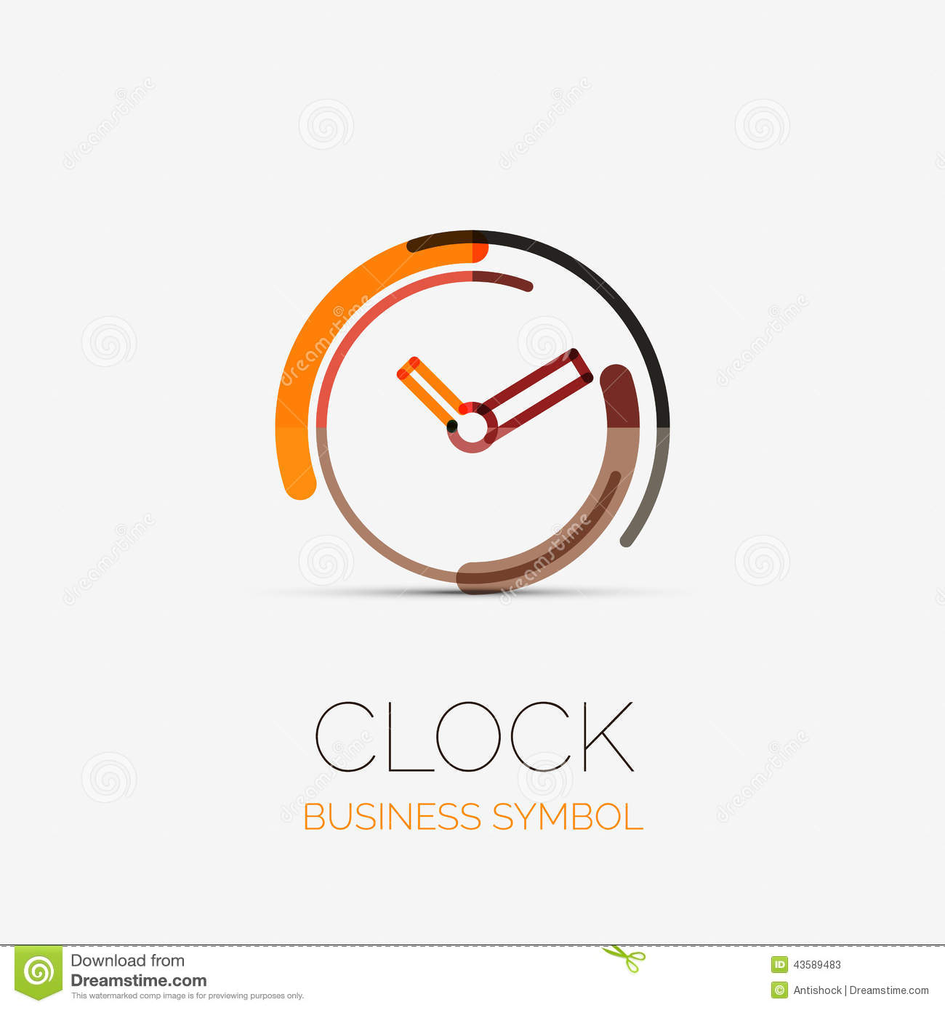
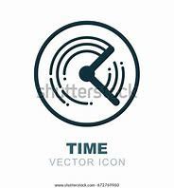

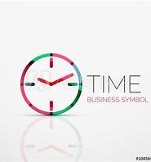
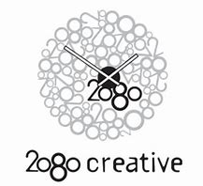
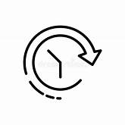

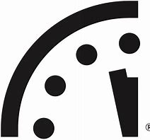
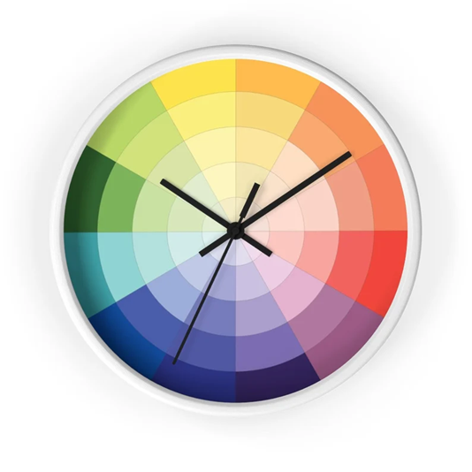
Logo Mood Board

Slide 5
2. clockface marketing Animation Brief
Element 1 Upper half (grey)
Imagine each shape in the clock logo as a different piece e.g. a grey half circle, an aqua half circle, black hands and a black rim. Then imagine they ‘glitch’ out of alignment for a moment. The lower half colour glitches from HEX 13F0DD to HEX F3312A then everything reverts to the normal logo
This repeats once every 5 – 10 seconds so it’s mostly still
clockface marketing doesn’t change at all. Only the logo
Here’s a reference idea. And here’s another one. Perhaps a little less exaggerated, please
Format 1 is a low-res animated execution for e-signatures e.g. GIF
Format 2 is a high-res animated execution that can be featured on a website landing page formatted so a web designer would cry with happiness if given it to use ( or I could just upload it to a standard page building wizard or template )
Element 2 Lower half (aqua)
clockface marketing
Element 4 rim
Element 3 hands
THEN THIS WILL FOLLOW
AS A NEXT STEP WITH SOMEONE

