Slide 1
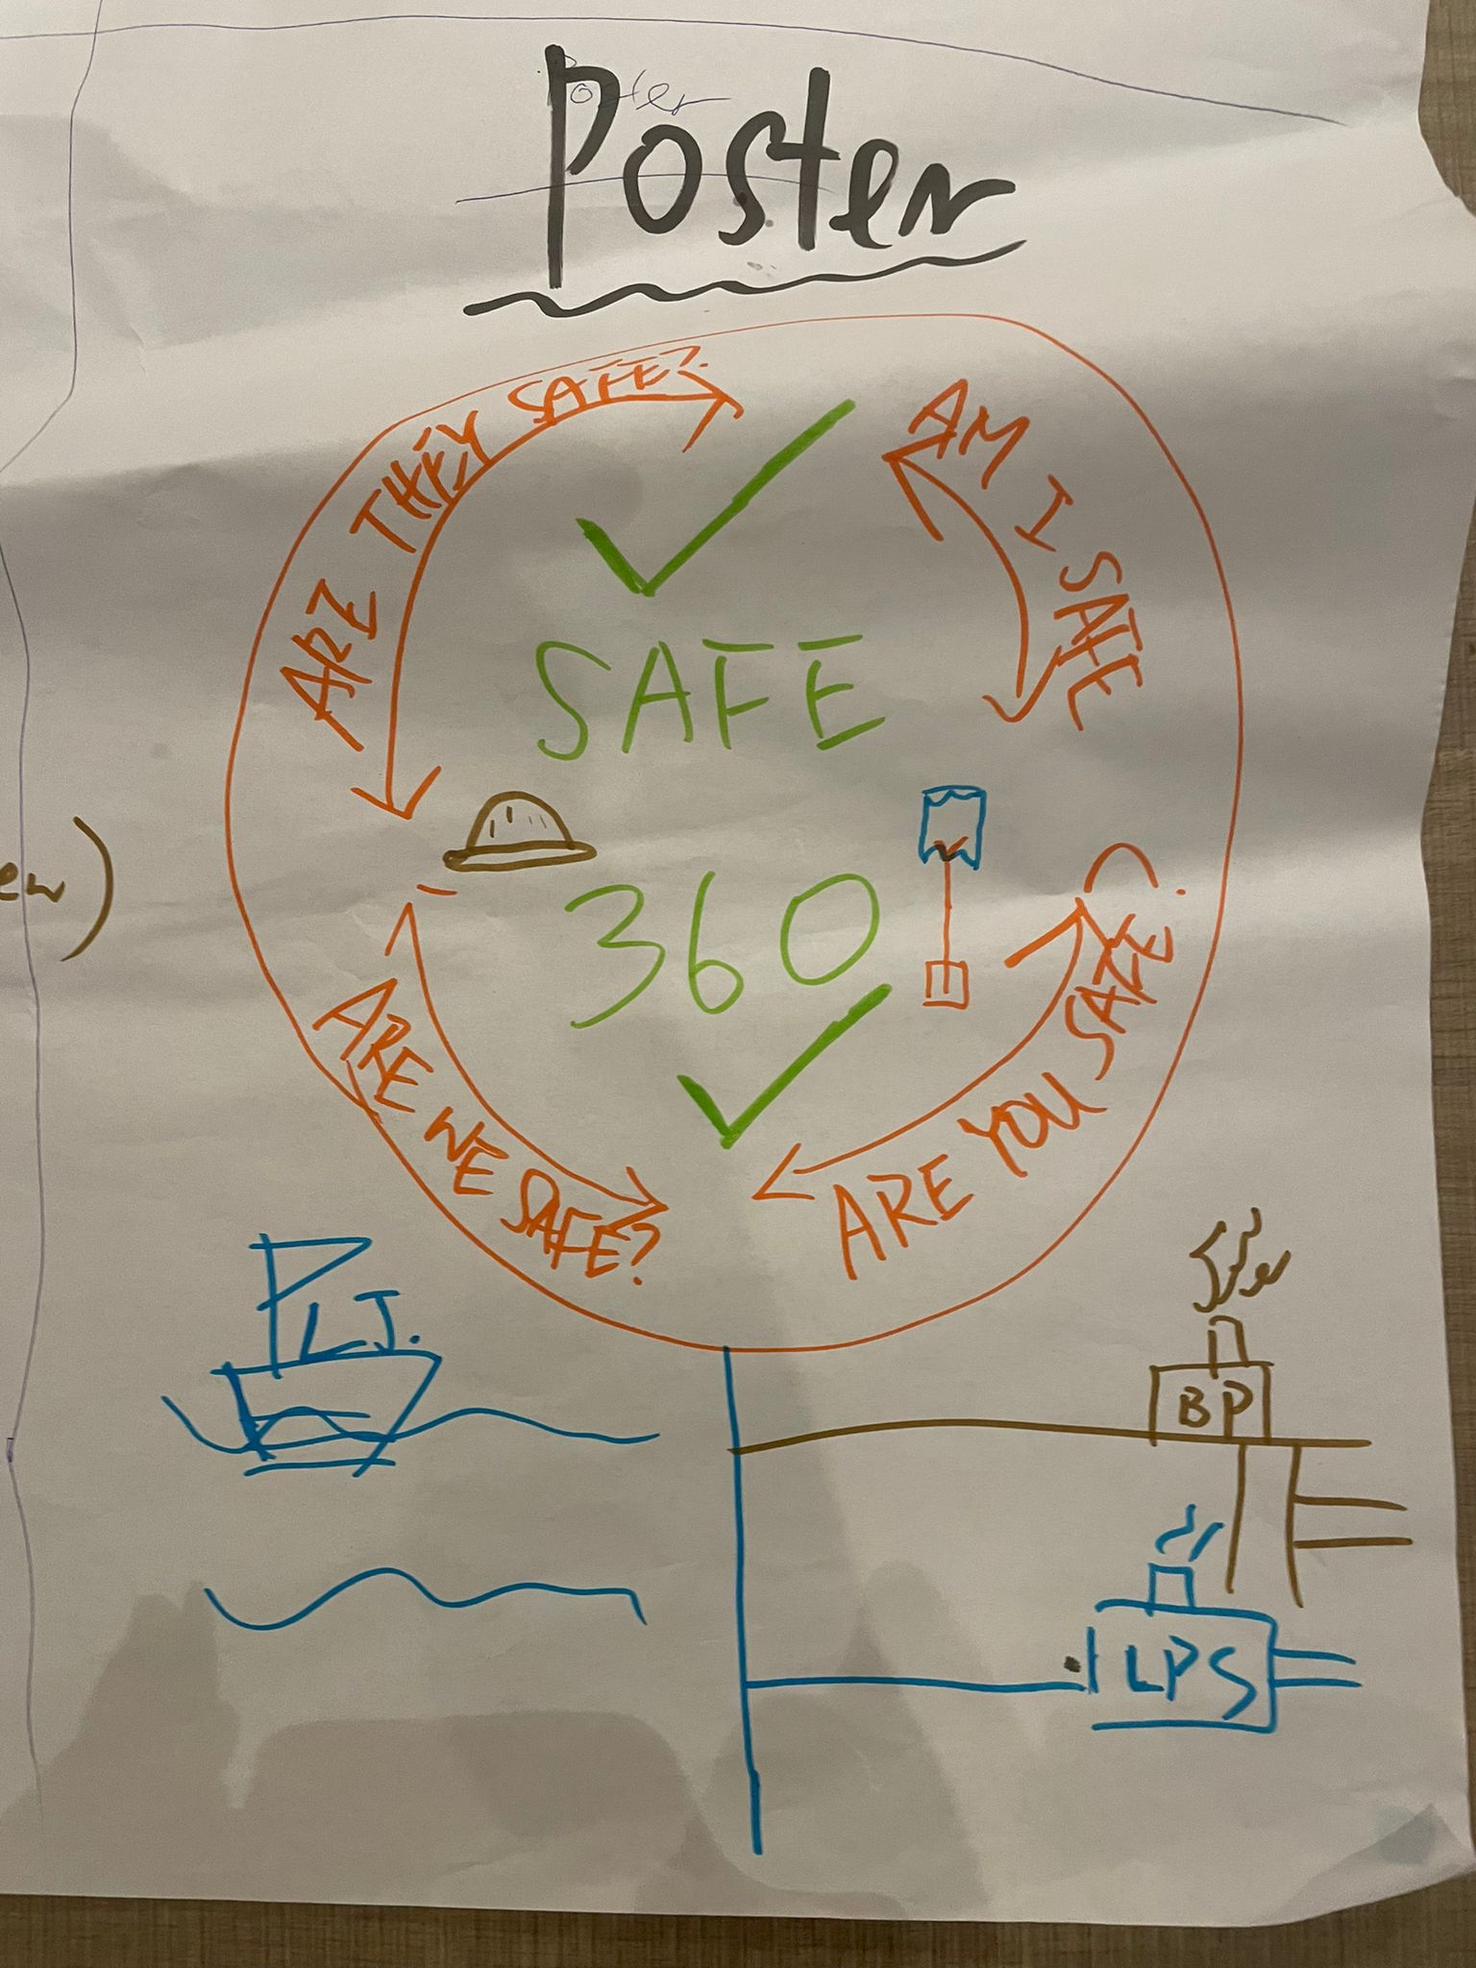
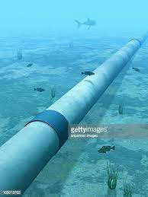
ARE YOU SAFE 360™
Notes:
The poster is a safety poster
The top is represent a flower and the
bottom the stem.
The stem is 3 pipelines.
One going to Black point power station
And the other one Lama Power station
To the left is a construction vessel
Make the bottom look like a transparent
Ocean with fish etcLike in the photo.
The pipelines are in the ocean.
The ship is on the ocean and the
PowerStation's are on land.
The whole poster needs to look hand drawn
GET CREATIVE ☺
The safety flower
Helmet
Shovel
Pipelines
And also stem of flower
BPPS is a power station
LJ is a construction vessel on water
LPS is a power station

