Slide 1

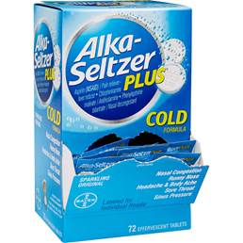
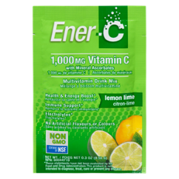
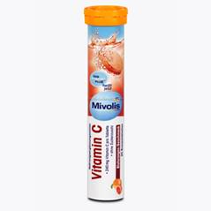
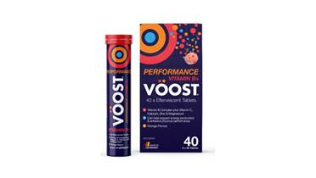
Here’s an ingredient supplier with a good look.
Could use this as a template to start;
Make the upper swoosh SOLID…
And the lower swoosh goes from larger to smaller circles itself;
And we could stack the name, the same way they have here, where FIZZY is a bigger font, than TABS.
Fits nicely in circle.
Then like this picture here but not exactly….the circle of our logo, could also be the tablet…fizzing away.
So like take upper right 10% of the circle on the OUTSIDE of the circle, have 3-7 fizzy bubbles leaving the circle.
Others to inspire by:

