Slide 1
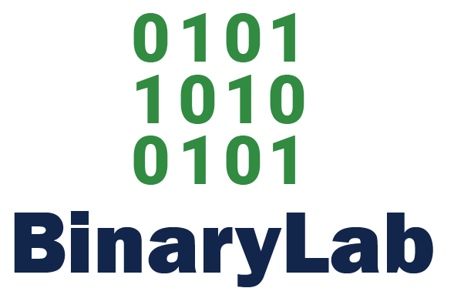

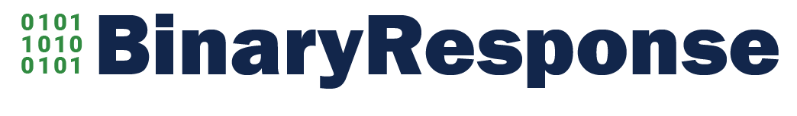
Naming - Binary
Entity Group Name
www.binarylabllc.com
Managed Services and Infrastructure Consulting
www.binarynetworksllc.com
Cyber Prevention and Remediation
www.binaryshieldllc.com
(Future) Business Analytics
www.binaryresponsellc.com

