Slide 1
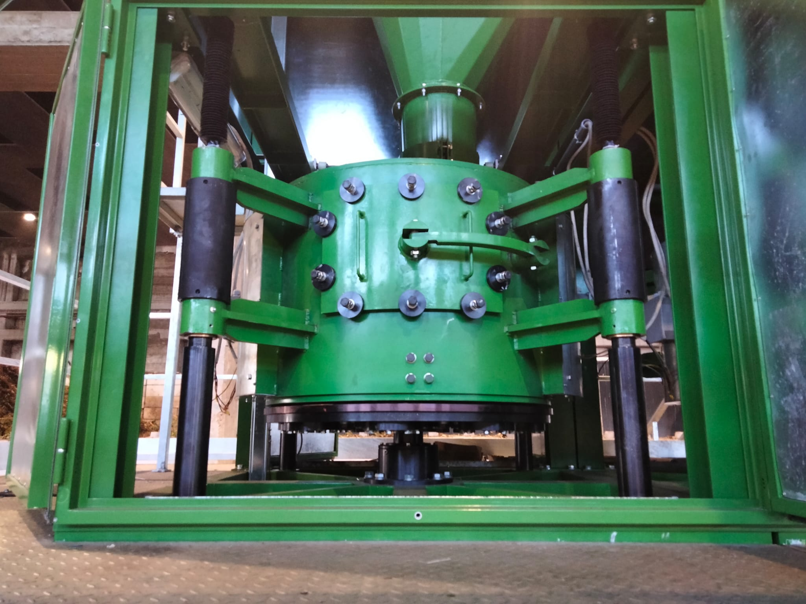

AttritorMill
Waste 2 Resource
INNOVATIVE TECHNOLOGY FOR THE MICRONIZATION OF MUNICIPAL SOLID WASTE

Slide 2
EXECUTIVE SUMMARY
AttritorMill is a machine with innovative and exclusive features, able to process materials both from selected waste and undifferentiated urban waste, downstream of the mechanical treatment, through a mechano-chemical technology that - through a micronization process - alters its molecular structure, contributing to its stabilization and sanitation.
Main advantages:
ORGANIC WASTE
materials’ sanitation and stabilization with the reduction of the total viable count below the threshold of 1000mgO₂Kg SWh in 24-72 hours, compared to curing cycles that typically require a timeframe between 25 and 35 days;
weight reduction resulting from the reduction of the moisture content from 30 to 35% compared to the entry level;
volume reduction from 40 to 60% with an output size <20mm.
SOLID WASTE
Output SRF – End of Waste UNI CEN 15359 compliant;
weight reduction from 15 to 20%, depending on input’s moisture level;
up to 70% volume reduction with an output size <15mm.
The AttritorMill system is to be placed inside the Biological Mechanical Treatment plant (BMT) downstream of the shredding system and has the characteristics to be used also as a mobile plant.
The characteristics of the output were analyzed by independent specialized laboratories and universities that have confirmed its full compliance with both UNI CEN 15359 standards and the TVC limits imposed by the regulations for landfill.

Slide 3
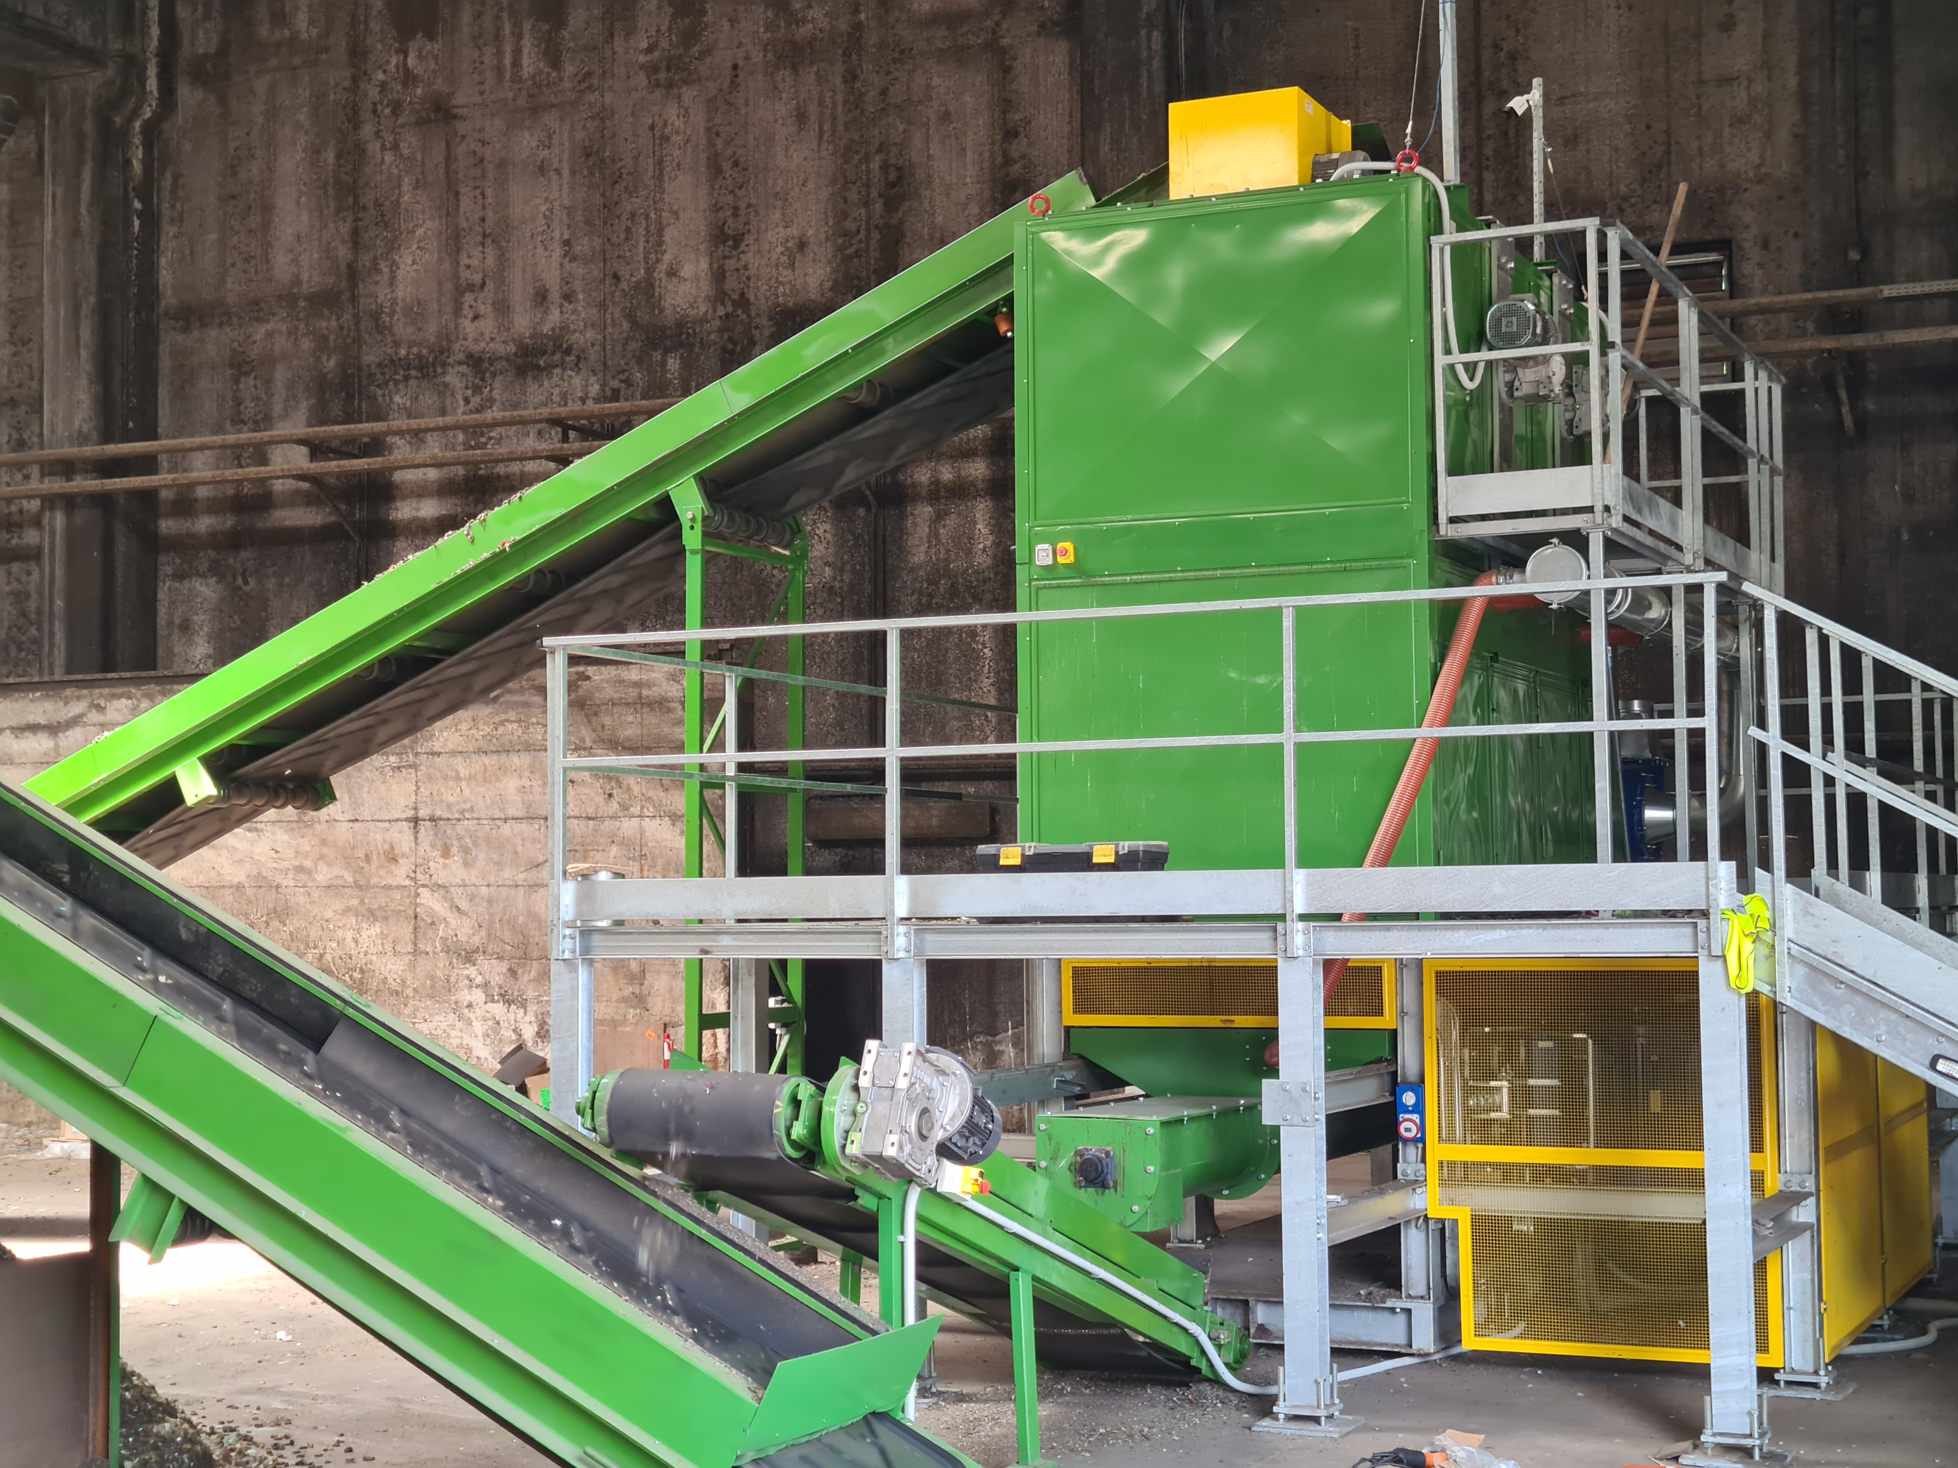
THE MACHINERY
AttritorMill is an innovative technology - covered by international patent - created for the treatment of different types of waste (undifferentiated, dry waste and organic waste). The machinery is composed of one or more treatment "chambers" that can be integrated to reach the most suitable quantitative requirement for each operator. The processing process uses the heat generated by the friction of a marble system to stabilize and standardize the waste. Compared to other systems, it has significant advantages in terms of operating costs, treatment time and weight reduction. In addition, the product of the processing, as far as the dry waste is concerned, is classified SRF - Fuel (according to UNI EN 15359/2011) with a size of 10-15mm and therefore ceases to be waste (EOW), with the possibility of being delivered to specific energy production plants (such as cement factories and power plants).
the unique advantages of AttritorMill and its applications
Production of SRF Fuel EoW
Reduction of time for lowering the Total Viable Count
Waste refining
Volumetric reduction
Homogenizing output material
Weight reduction
Low cost of operation

Slide 4
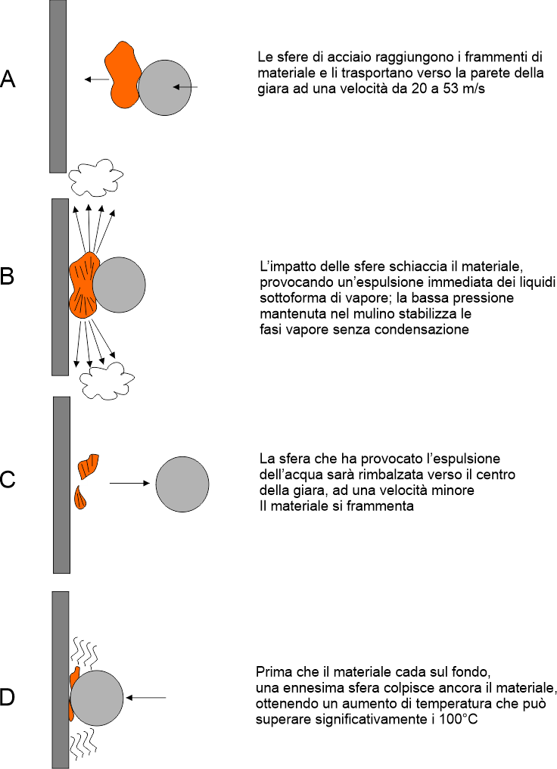
MICRONIZATION TREATMENT PHYSICS
The AttritorMill process was developed by professionals, in collaboration with leading public research Institutions, to develop the most suitable methodologies to refine waste.
The physics of the new hybrid micronizer system grinds by means of special steel grinding masses of different diameters, thrown at high speed on the waste particles. The steel masses, thrown at speeds of several tens of meters per second towards the chamber shell, meet the fragments of material to be ground and crush them on the surface of the shell. The crushing pressure reaches many thousands of atmospheres, as has been verified experimentally.
The impact of steel spheres causes fracturing of fragile materials, while water-rich elastic materials undergo strong compression, which causes the water to be expelled quickly. The water takes the form of vapor, which is sucked up by the air treatment system and evacuated.
the steel balls reach the material fragments and push them towards the wall of the chamber at a speed of 20-53m/sf
the impact of the balls crushes the material with the immediate expulsion of liquids in the form of steam; the low pressure in the mill stabilizes the steam phases avoiding condensation
the sphere that caused the water expulsion and the fragmentation of the material will be bounced with a lower speed towards the inside of the chamber
multiple spheres hit it again before the material falls to the bottom, resulting in an increase in temperature that can exceed 100°C

Slide 5
ANTI BACTERIAL ACTION
The extremely fast increase of pressure and temperature of the particles determines a radical and almost immediate reduction of bacterial load on the material.
This results from the thermal and pressure stress induced on the individual bacterial colonies and, at the same time, from the reduction in the amount of water and nutrients available to the bacterial colonies. The marked reduction of bacterial activity has been detected by analyses carried out in several independent laboratories, which have shown an average reduction of 70% of the bacterial total viable count below 1000mg O₂ threshold after maximum 48-72 hours
The effect of radical and rapid reduction of the bacterial viable count is a peculiar and exclusive feature of the AttritorMill treatment system.

Slide 6
INTEGRATION OF AttritorMill INTO THE MECHANICAL BIOLOGICAL
TREATMENT PROCESS
While in classic MBT the treatment in the bio-cells tends to consume the organic substance by means of bacterial colonies within 25-35 days treatment, with AttritorMill machinery the same bacteria and their nourishment are destroyed by the mechano-chemical action of the treatment; this immediately reduces the bacterial count of the waste - and its smell - as well as prevents a subsequent proliferation of bacteria.
MBT (mechanical biological) | AttritorMill (Micronizer Mill)
The MBT uses the fermentation of waste (aerobic or anaerobic) to consume the organic fraction, reducing it to CO2, water, methane, ammonia and other gases and thus reduce the bacterial load | AttritorMill uses the high impact pressure of the grinding masses to transform the organic fraction, reducing it to water-soluble fragments, thus reducing the bacterial load
In MBT, the material is preheated to temperatures above 55°C for three days as a "sterilization" treatment, killing some of the bacteria present. | In the AttritorMill plant the material is treated at high pressure: more than 1000 atmospheres of impact pressure, which physically destroy cells and bacterial colonies and at the same time demolish the large molecular chains of proteins that make up the food of bacterial strains.
In MBT the material remains in the biocells under tilting and spraying of air and water up to a reduction of viable count below 1000mg O₂; normally this value is reached between 25 and 35 days. | In the AttritorMill plant the material, after the micronization treatment, is stationed for 2-3 days to reach an viable count below 1000mg O₂.

Slide 7
BAT COMPLIANCE
In the BAT (Best Available Technologies) compendium, under the item concerning the treatment of organic waste of municipal waste, mechanical biological plants are explicitly mentioned, where the putrescible organic fraction is managed by aerobic or anaerobic treatment systems, aimed at reducing the organic fraction and significantly and permanently reducing the active organic content. In this context, the European Commission, on December 21, 2005, adopted the final Communication 666/2005, "Sustainable use of resources: a thematic strategy for the prevention and recycling of waste" which places two essential points:
reduce negative environmental impacts of waste
reduce of biodegradable waste destined for landfill
reduce greenhouse gas emissions

Slide 8
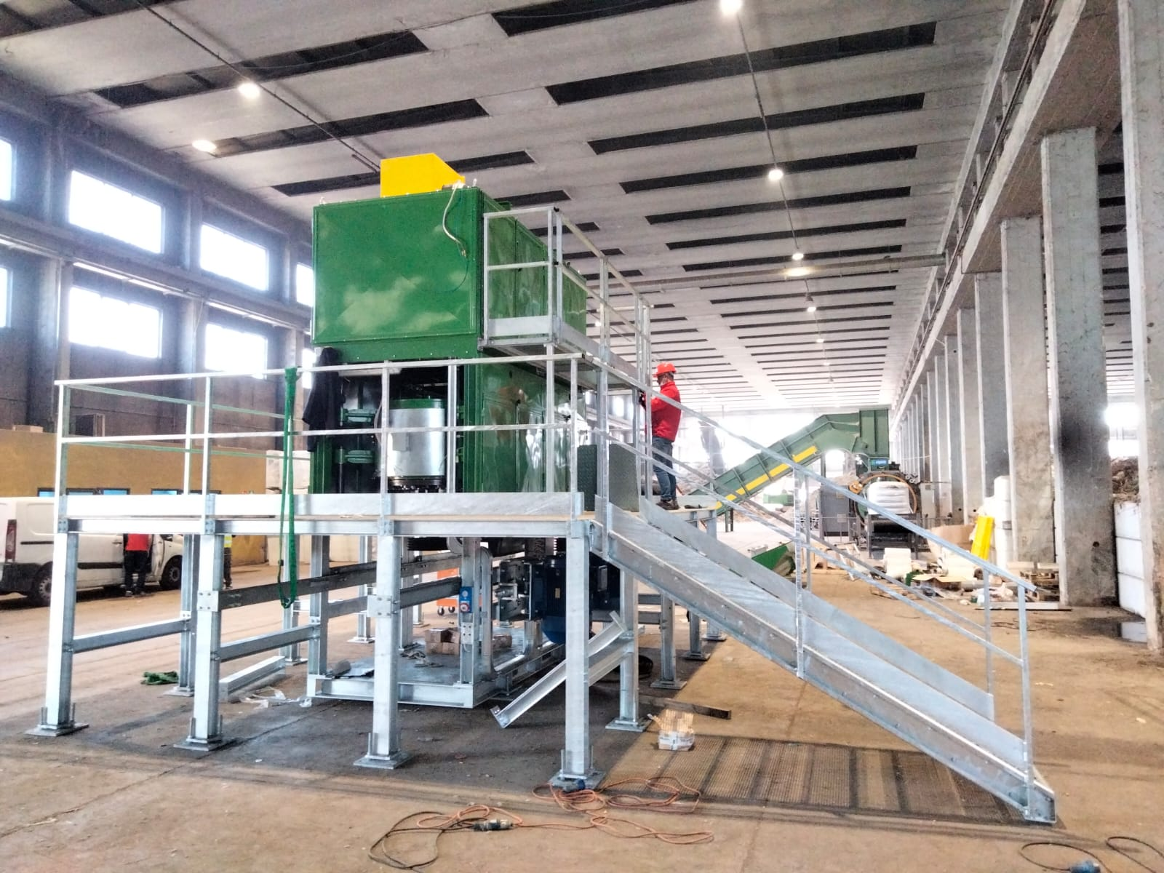
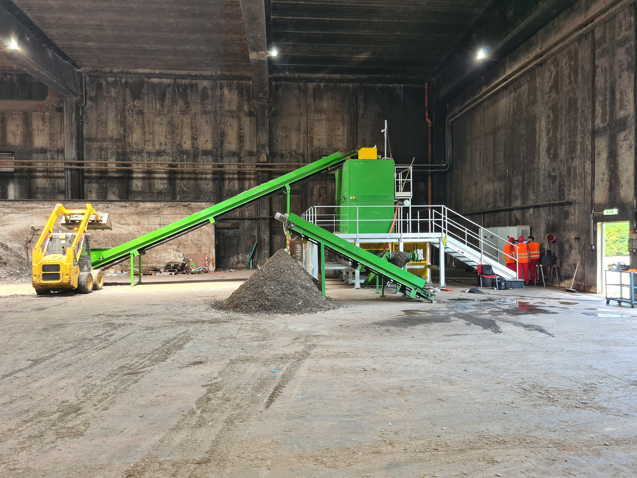
WATER RIDUCTION
The action of AttritorMill is twofold:
It acts with isothermal compression actions: the water is expelled in the form of vapor, thus decreasing the weight and volume of the treated materials.
At the same time, the particles are compressed and defibrated, increasing the internal temperature due to the isochore effect.
In saturated materials the total water content can be reduced by up to 30-35%.

Slide 9
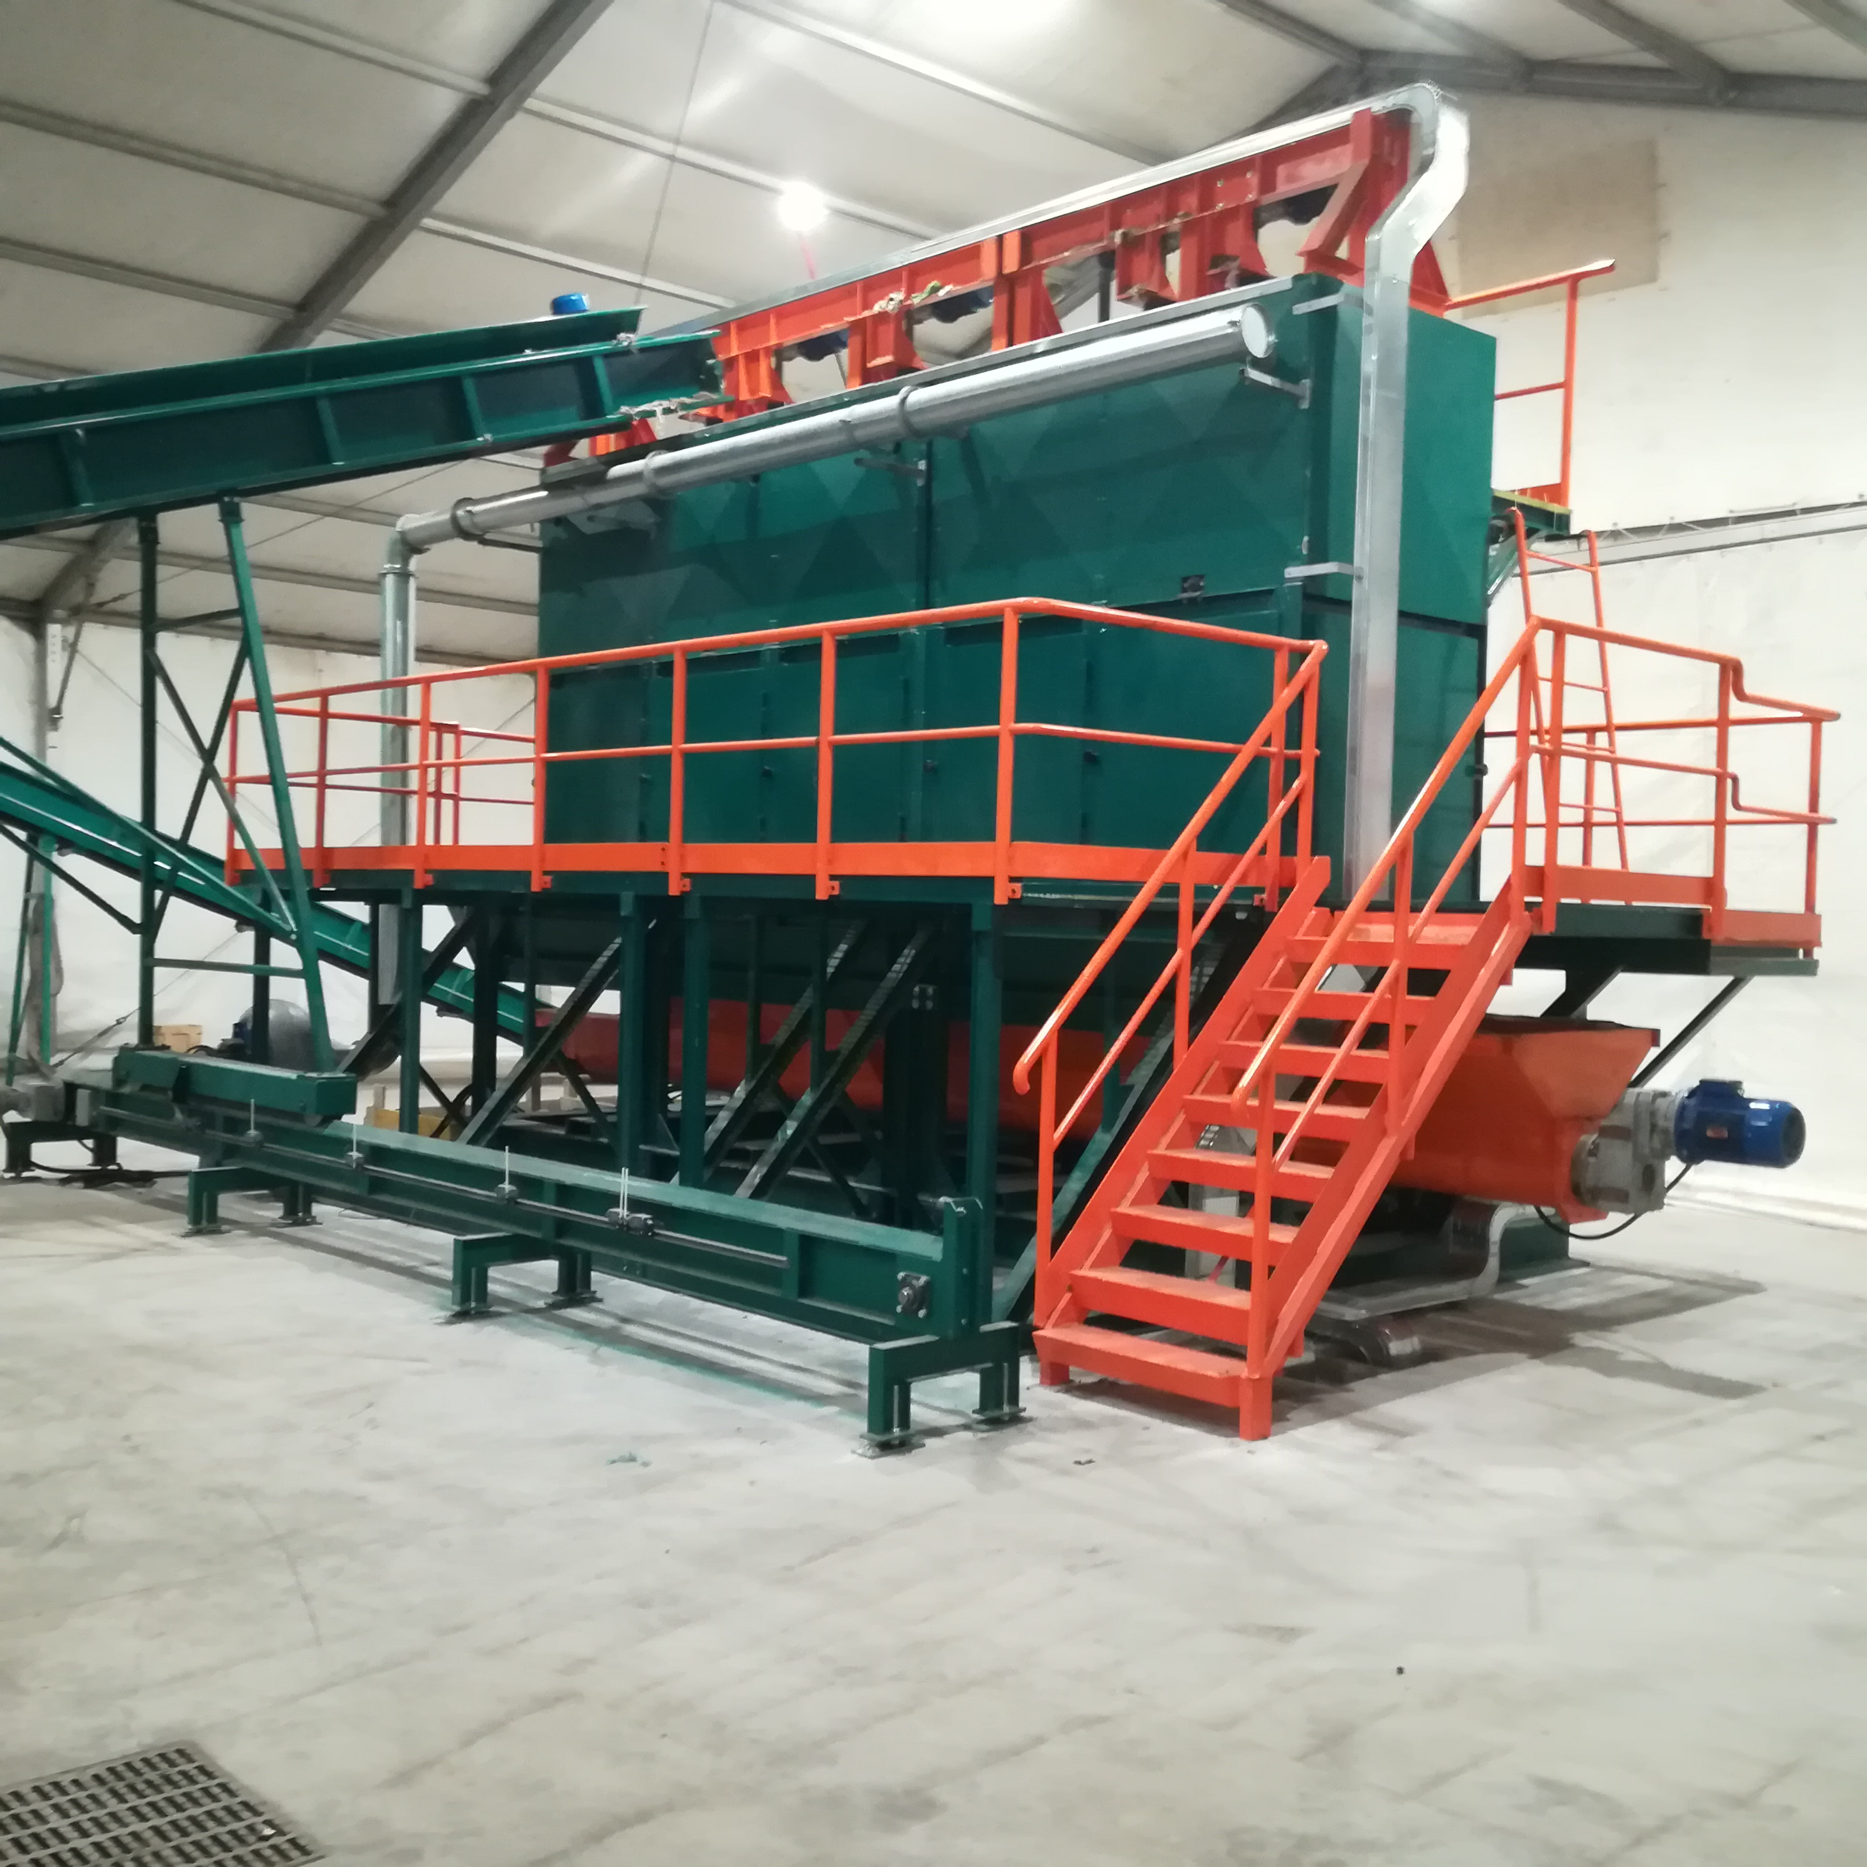
THE SOLUTION FOR WET WASTE
AttritorMill is the ideal solution for the treatment of waste from mechanical treatment, whether originating from separate waste collection or not, in order to accelerate the rotation of the material, reduce operating costs and increase the useful life of the plants.
AttritorMill integrates perfectly into existing MBT plants to reduce waste sanitation time.
BENEFITS:
Absence of thermal processes
Absence of water consumption
Absence of chemical additives
Absence of eluates
Absence of smells

Slide 10
PLANT TECHNICAL SPECIFICATIONS
AttritorMill MODULAR MACHINERY - 4 CHAMBERS TYPE
Input capacity
Single chamber: 1,8t/h a 2t/h
Total system: 7,2t/h a 8t/h
Control system: PLC
Energy consumption: 36kWh/t
Measures
Lenght: 8.000mm
Width: 4.000mm
Height: 5.000mm
Weight: 13.000Kg

Slide 11

CONTACTS
Mario Reale
Chief Technical Officier
mail: mariorealeambiente@gmail.com
cell: ..+39 371 115 6063
HEAD OFFICE BRANCH
P.za Iolanda, 1 Via A. Bertoloni, 41
95129 Catania (CT) 00199 Roma (RM)
Italy Italy
RealSpa Srl

