Slide 1

Tripod Ventures, LLC
Quarter 2, 2021

Slide 2
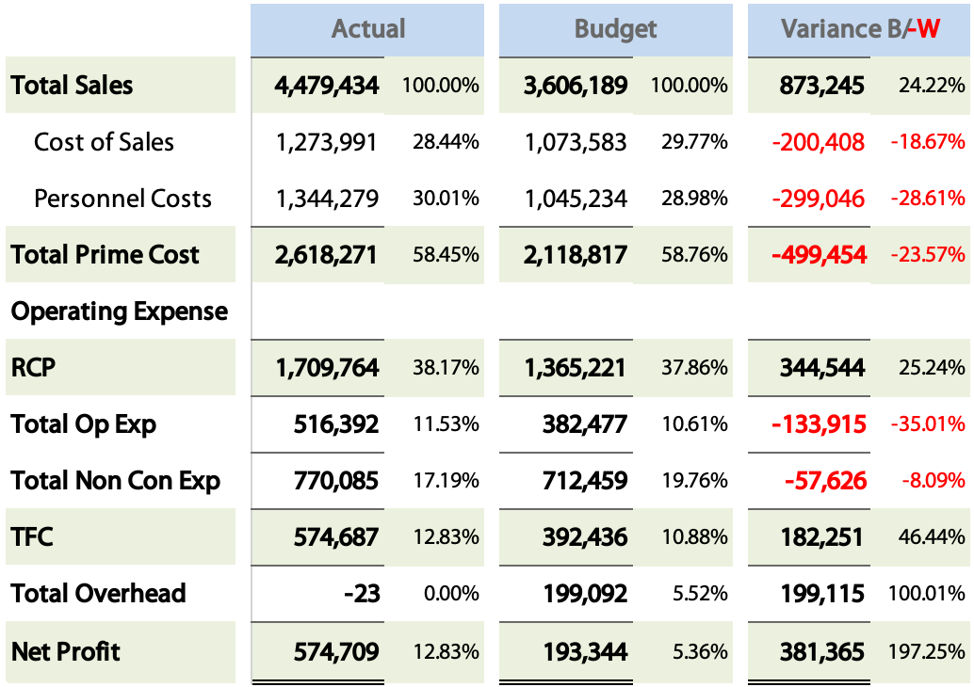
Qtr. Actual vs Budget

Slide 3
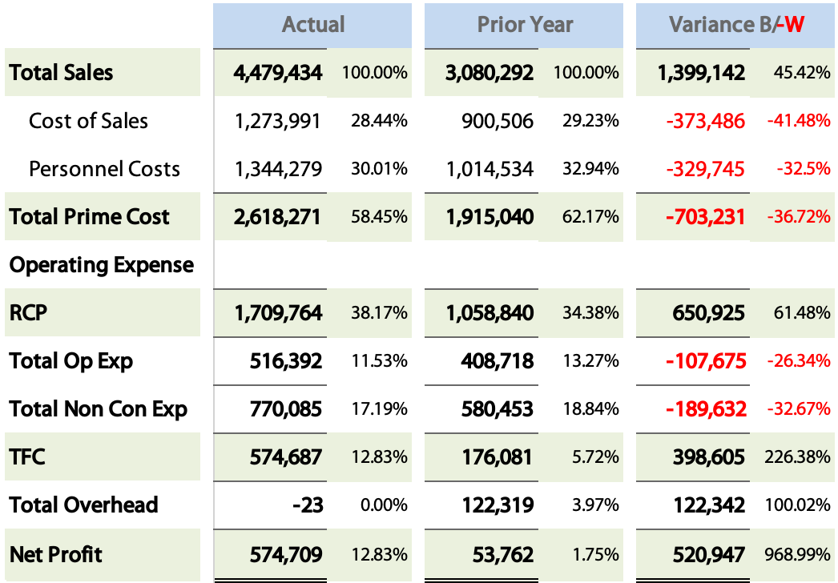
Qtr. Actual vs Prior Year

Slide 4
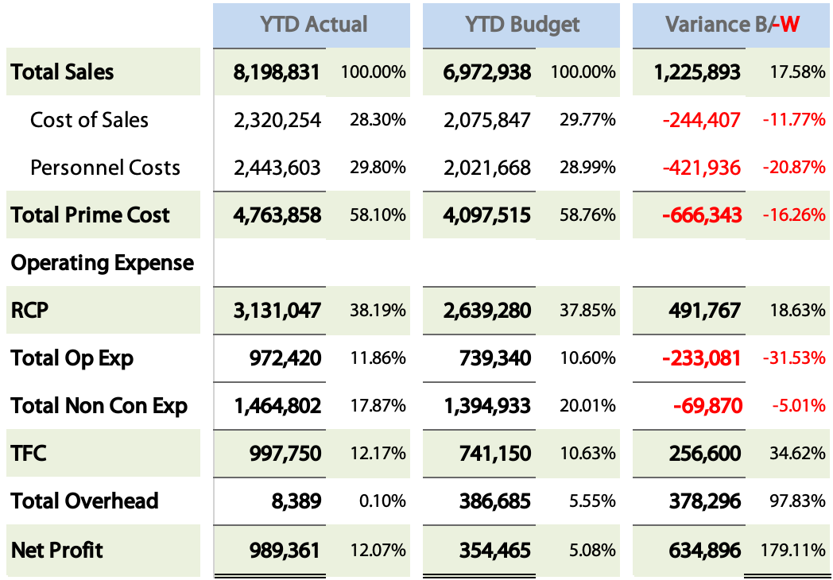
YTD Actual vs. Budget

Slide 5
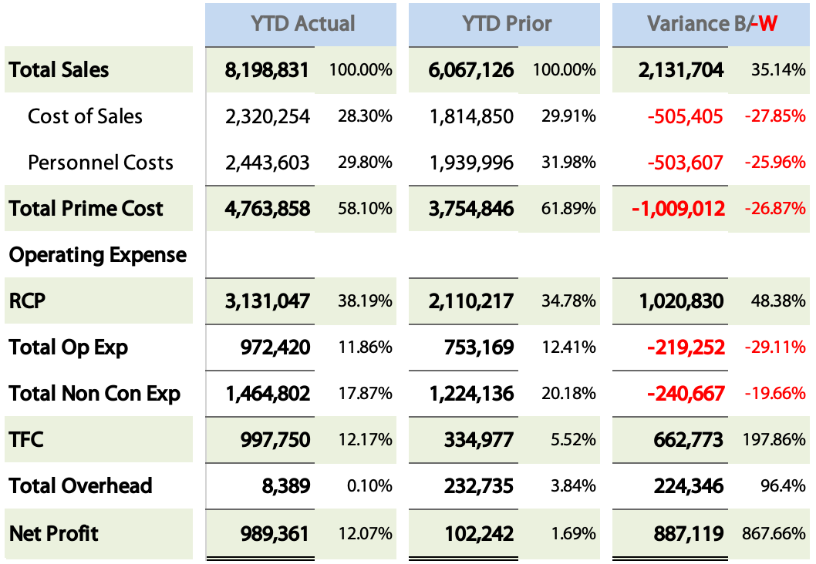
YTD Actual vs. Prior

Slide 7
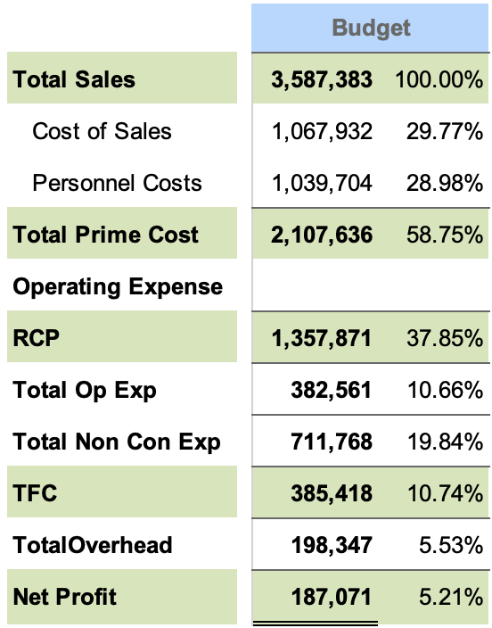
Qtr. 3 - 21 Budget

Slide 8
Go Forward Step Plan
Key Focus Items
Bench building process followed for people growth.
Review CapX projects for year end
Prepare NRO management team for Sandhill and Falcon
KMG Support Team
Kyle Gerstner – CEO
Doug Tuder – COO
Paula Amsden – Controller
Amanda Pollard – Human Relations
Wade Long - Operations Services Manager

Slide 9
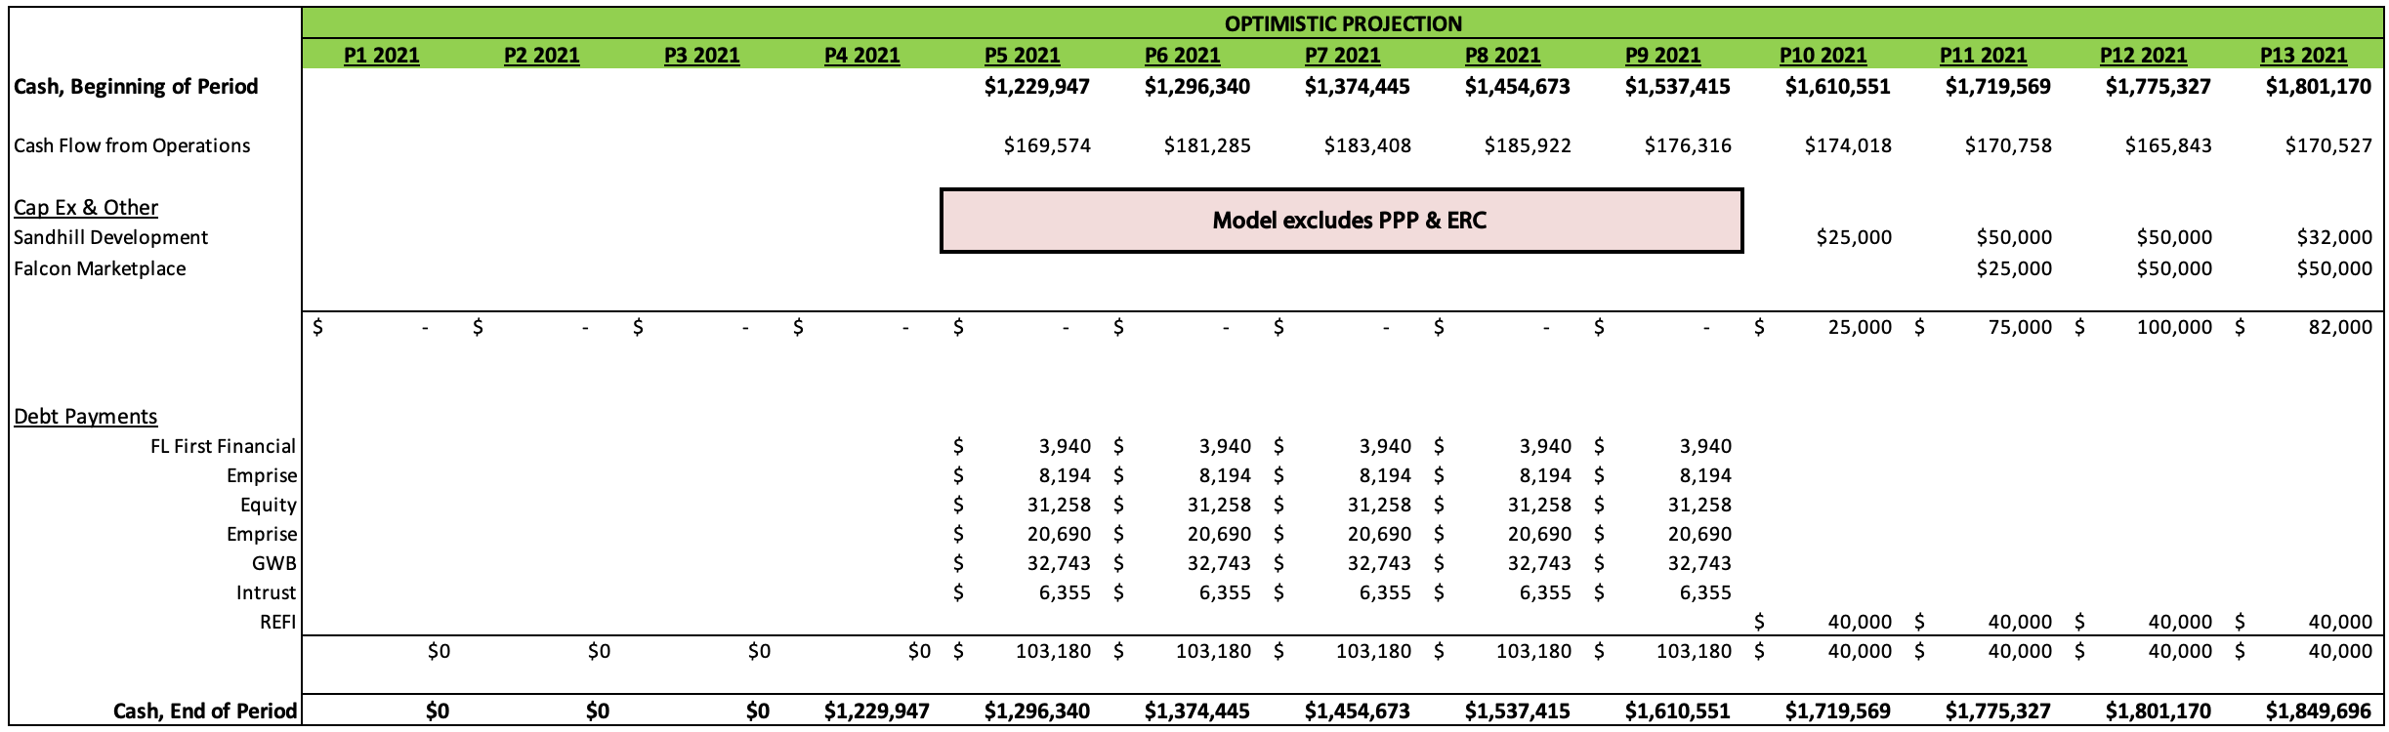
2021 Updated Cash Flow Model

Slide 10
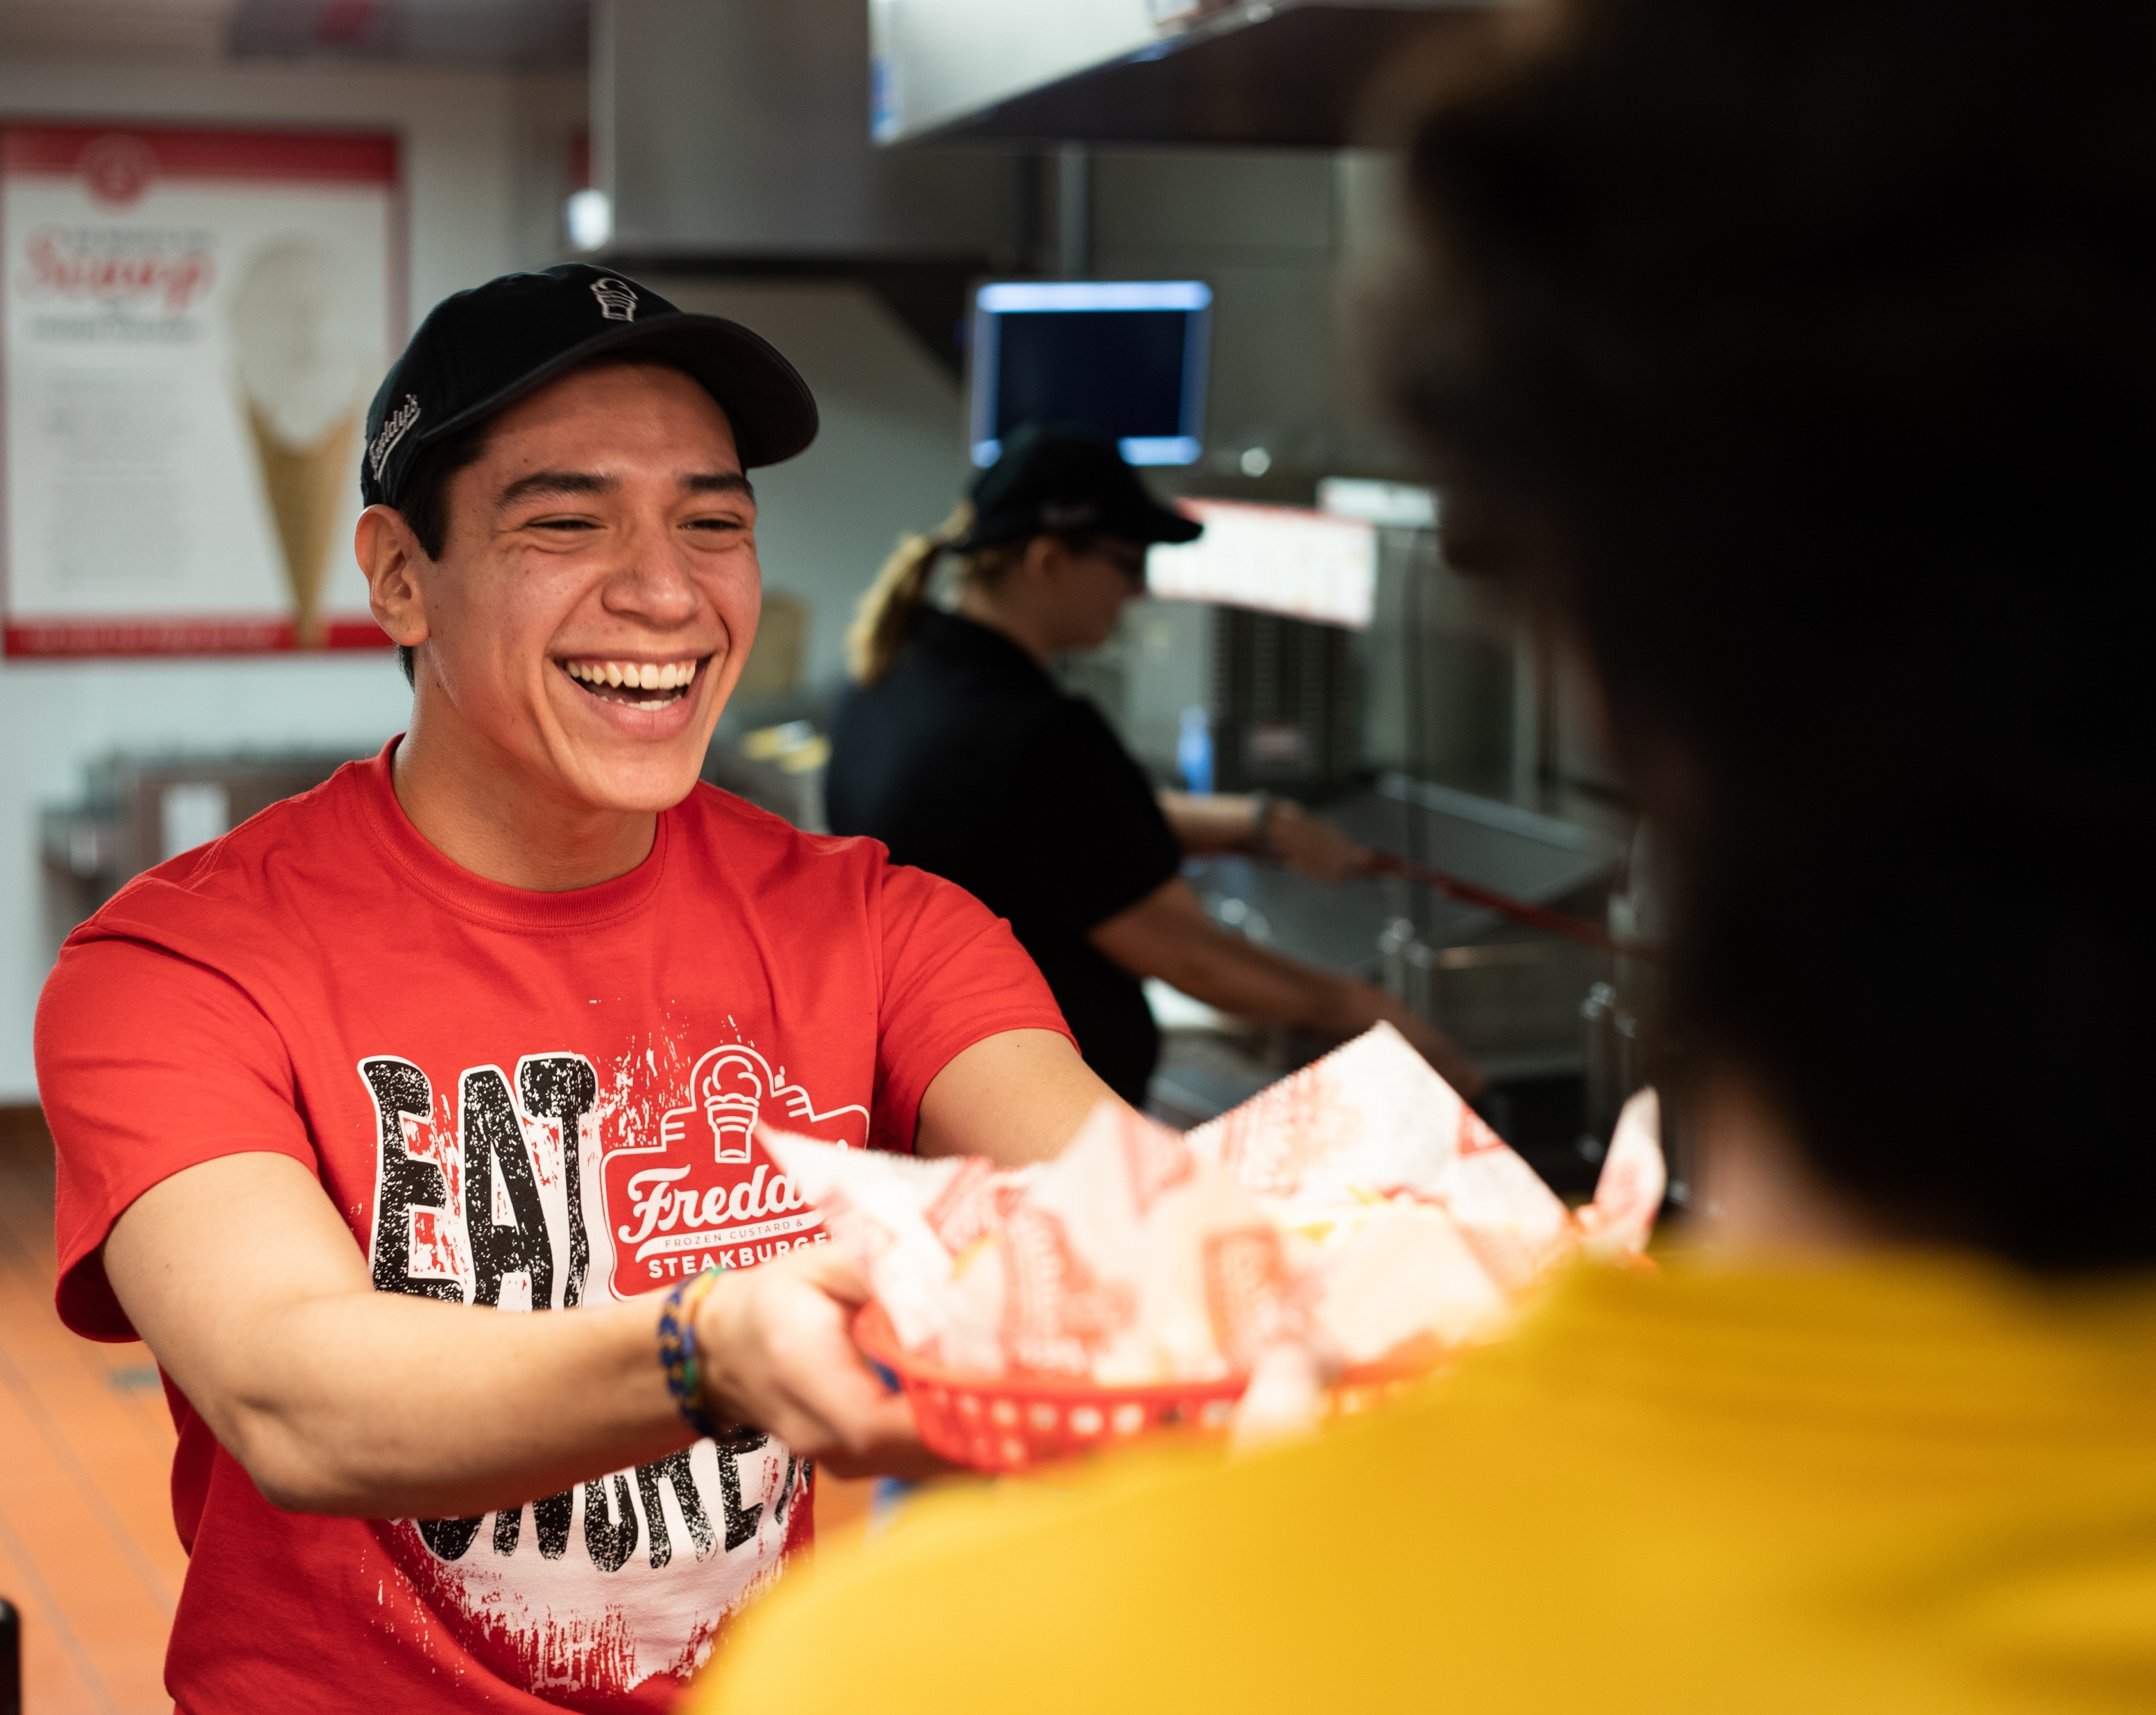
Current Cash Holding
Current Cash as of 8/25/21
Wells Fargo
  Checking: $1,532,893
Great Western Bank
  Money Market: $931,358
  KMG DC Checking: $99,934
Total Cash: $2,564,190
2020 ERC Credit: $1,053,536
  Anticipated Deposit: Q1-22
2021 ERC under review

Slide 11
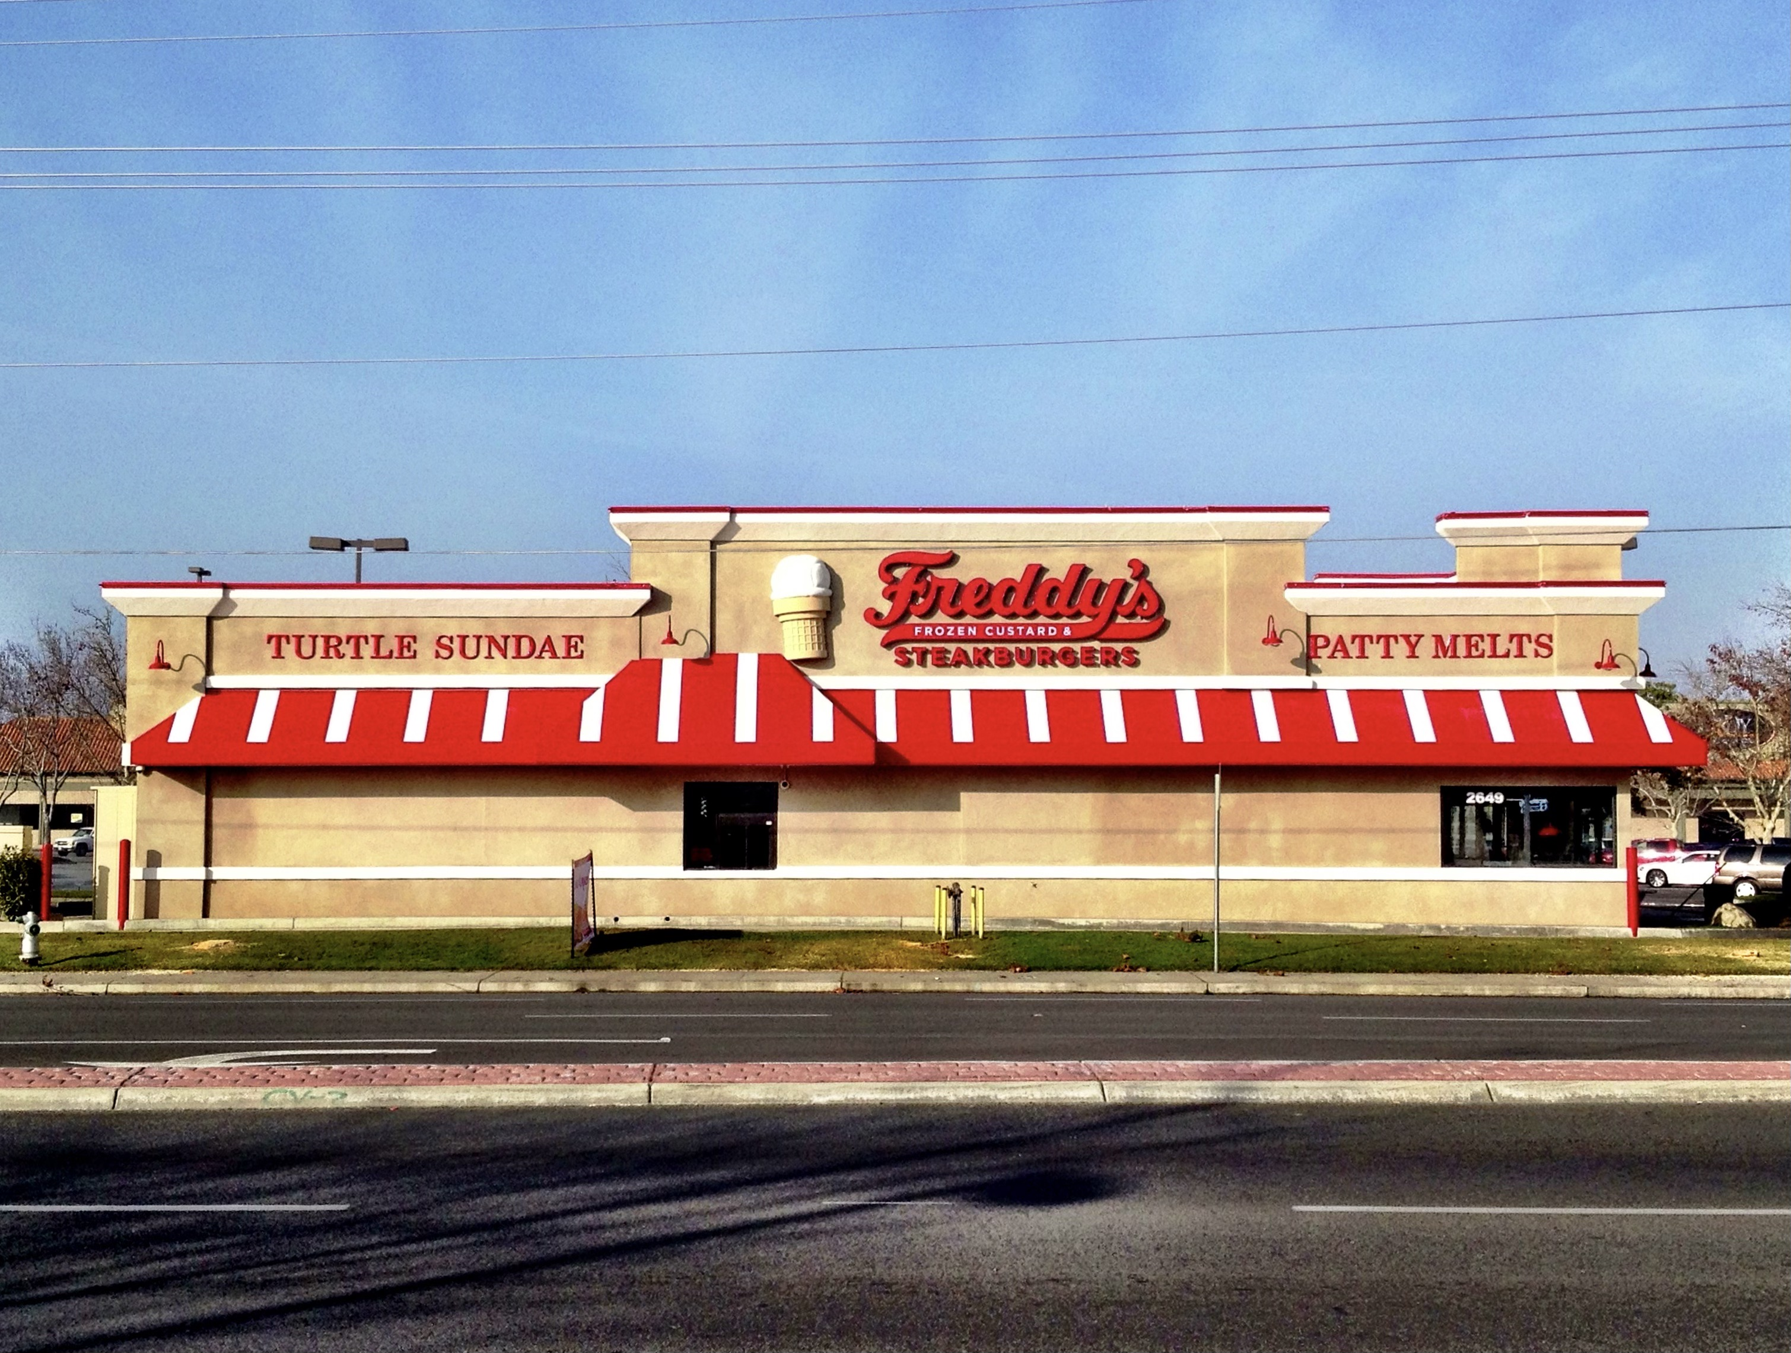
Calloway
At PSA Phase to Sell
Sales Price: $1.1M
Current Debt: $89k
Target Date: 10/6/21
Approved by Freddy’s Corp
Freddy’s Calloway

Slide 12
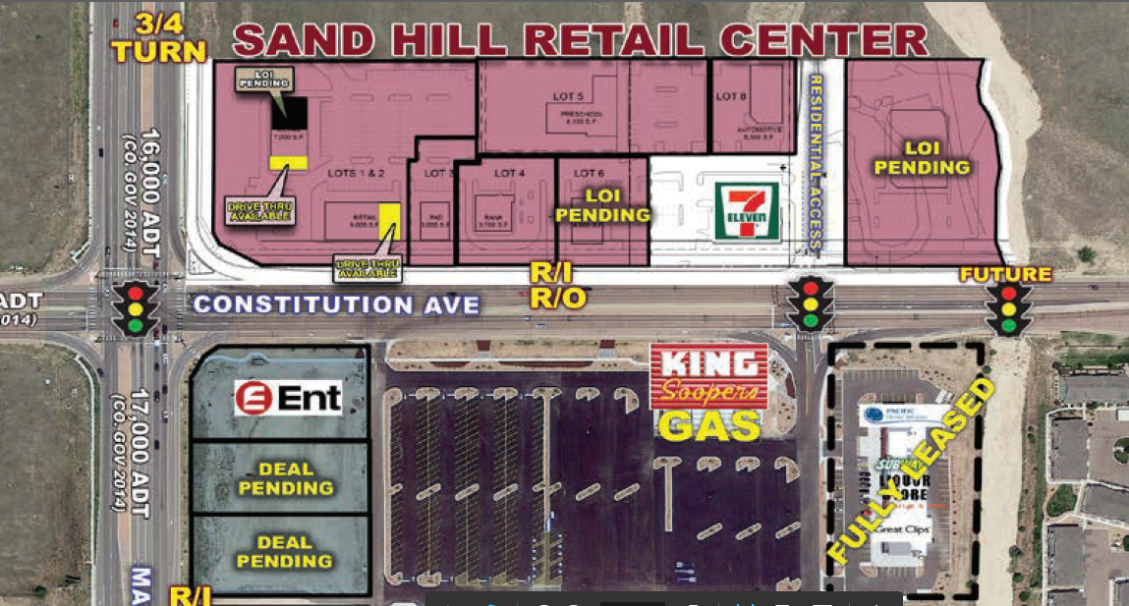
Sand Hill – Colorado Springs, CO
2,600 sqft End-Cap with Drive-Thru
Total Project Est.: $950k
Funded debt: $635k
Equity: $160k
Soft Cost Cash: $155k
TI Return: $99k
Projected opening Qtr. 2, 2022

Slide 13
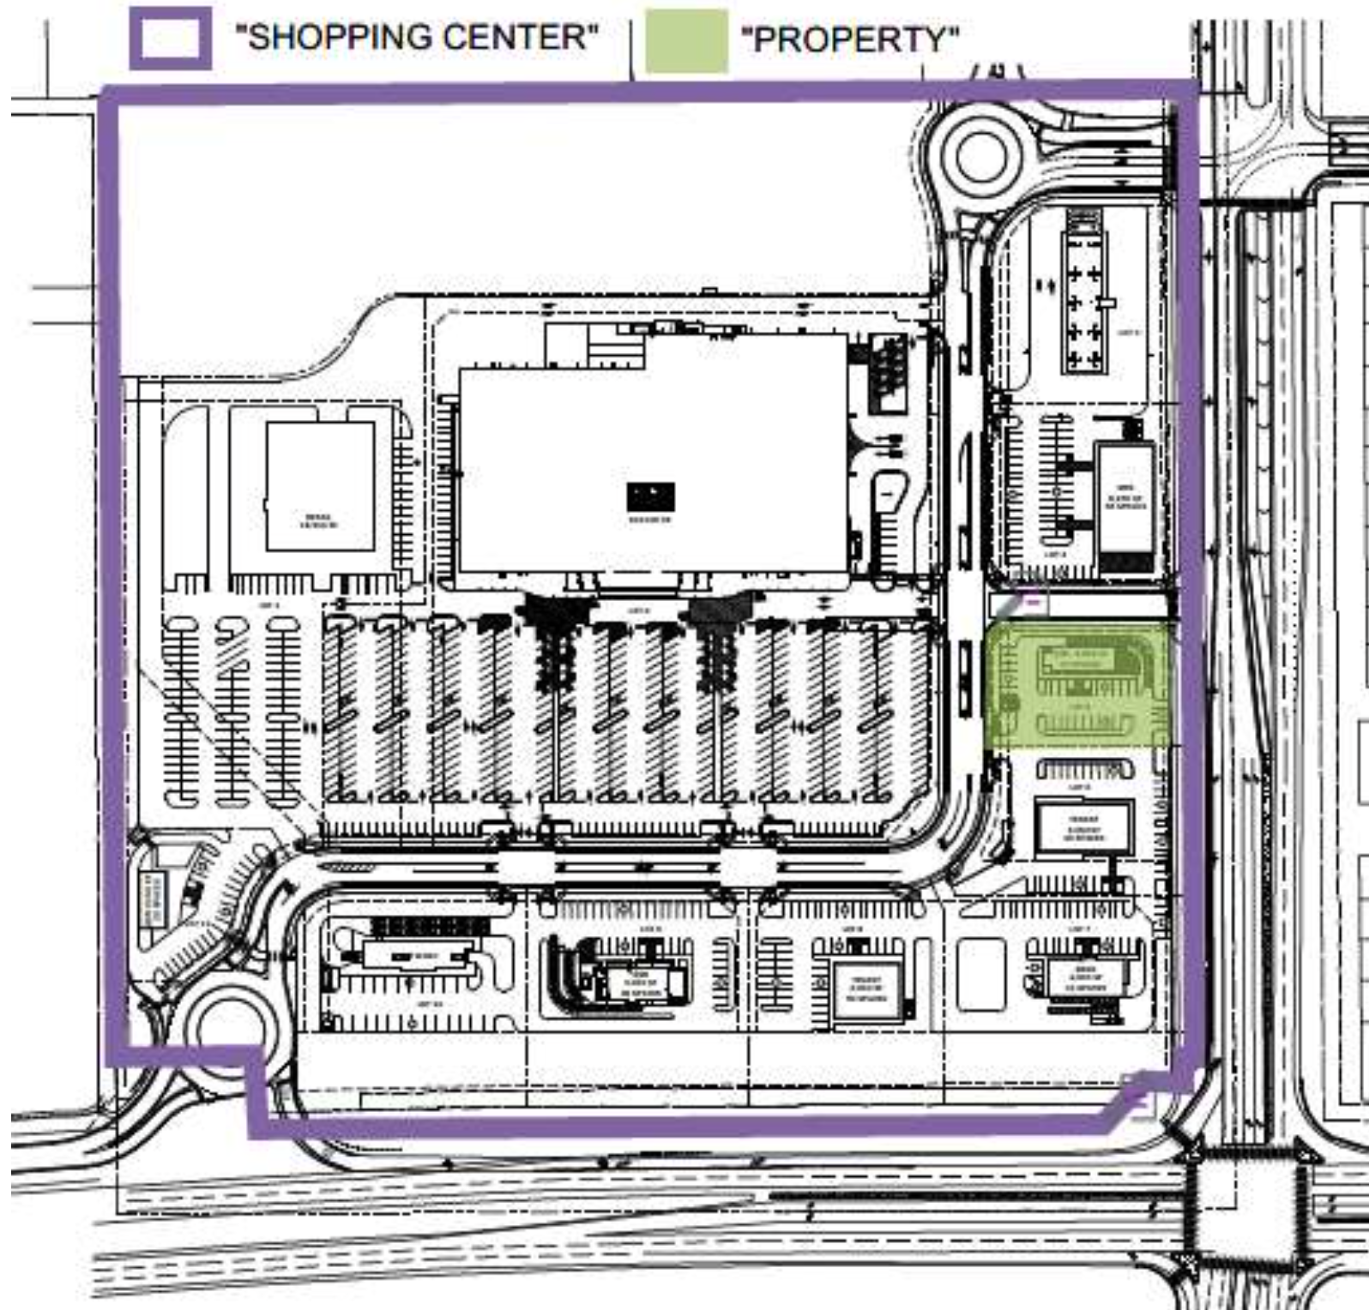
Falcon – Falcon, CO
PSA to acquire .78 acr & construct 3030 sqft bldg.
Real Estate
Total Investment: $1.025M
Purchase Price: $1M
Soft Cost: $25k
Funded Debt: $800k
Equity: $200k
RE Development
Total Investment: $500
Funded Debt: $400k
Equity: $100k
Freddy’s
Total Investment: $1.1M
Funded Debt: $758k
Equity: $188k
Soft Cost: $157k
Projected opening Qtr. 3, 2022

Slide 14

Real Estate Partner
  Source & fund opportunities
  Manage development process
  Turn over a turn key Freddy’s
  Reduce capital needs to FFE
  Able to finance debt in lease over 20 yrs
  Faster pace of development than internal

Slide 15
Florida Development Plan
Fleming Island
  Under Review
Durbin Creek – LOI
  Target: Q3-23
Yulee – LOI
  Target: Q3 - 23

Slide 16
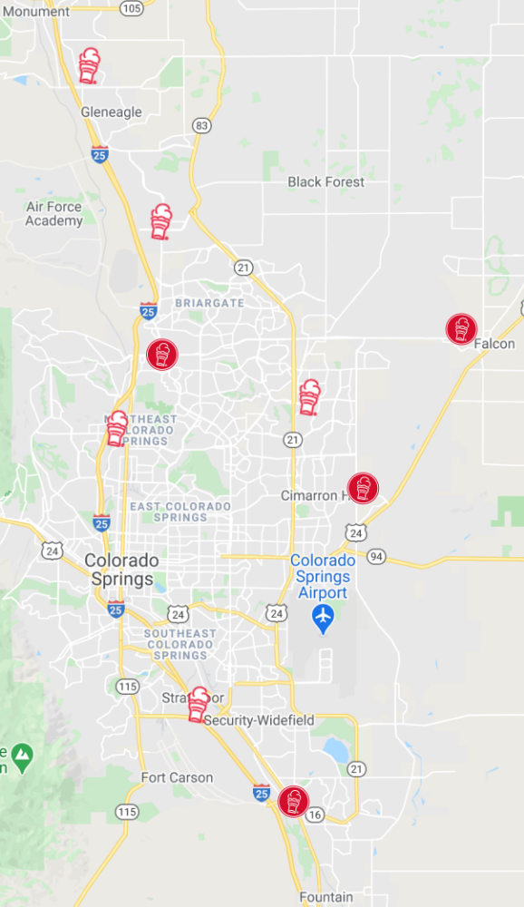
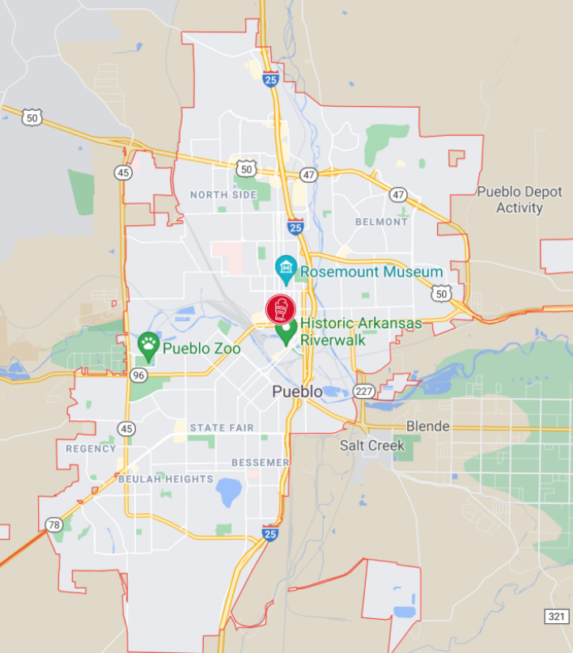
Colorado Development Plan
Sandhill (Lease)
  Q2-22
Falcon (PSA)
  Q3-22
Pueblo
  Target: Q4 - 24

Slide 17

Tripod Ventures Merger into KMG Double Cheese LLC
Target Transition Date: Monday September 6, 2021
Senior Debt Refi: $3.93M
  Floor of 3.00%
    5 yr fixed: (225bps + 5yr treasury)
Development Line: $800K
  Converts to above structure
Equity Line: $730K
  Converts to above structure

Slide 18
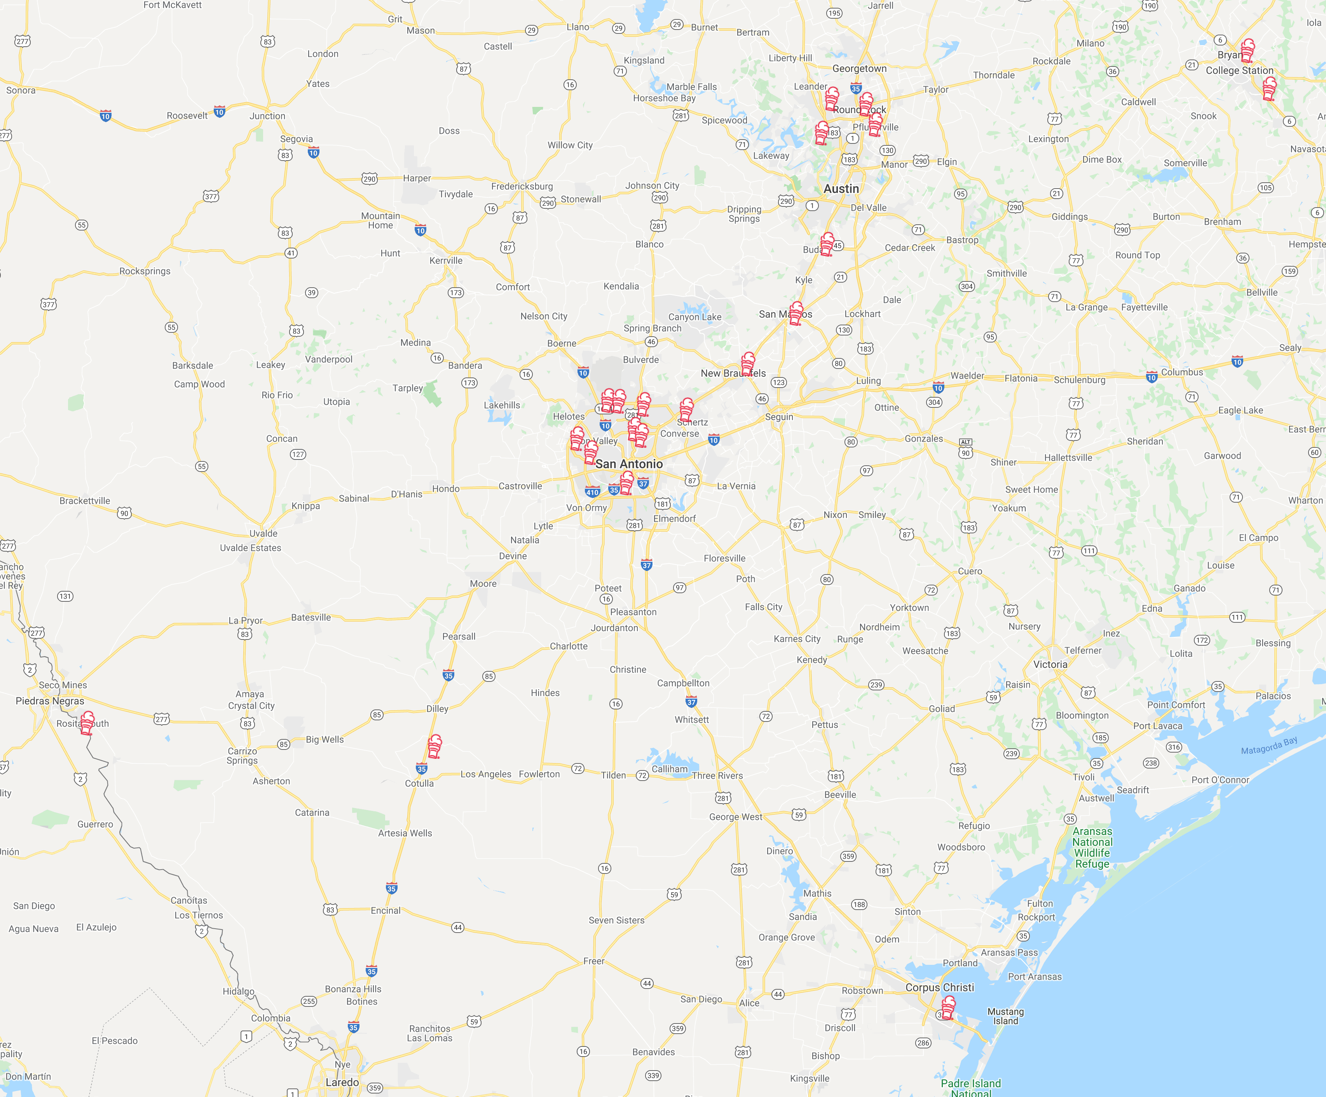

Opportunities
M&A Target
To acquire a Franchise group with 21 operating units
Development territory: 50+ units
Target Price $20M - $25M
Equity Raise: $2M

Slide 19
Calendar
Tax Planning Meeting
  End of October
2022 Budgeting
  End of November
Quarter 3 Meeting Date (Qtr 3 ends 9/8/21)
  October 20th, 2021
KMG Double Cheese Internal Announcement
  October 6, 2021

Slide 20
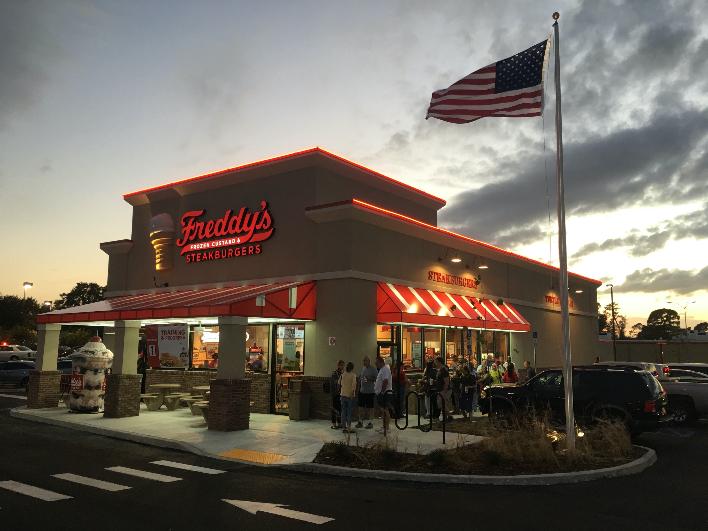
Questions?

