Slide 1

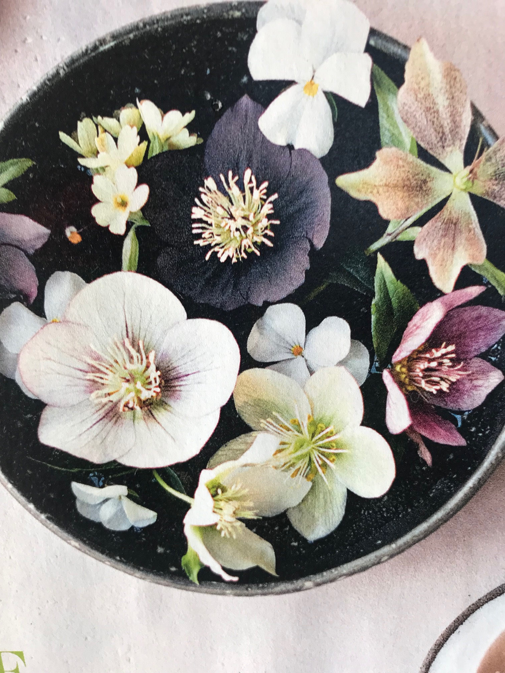
Colors here are in this pictures are perfect for the logo
The green, the pink, the black the white etc.

Slide 2
