Slide 1

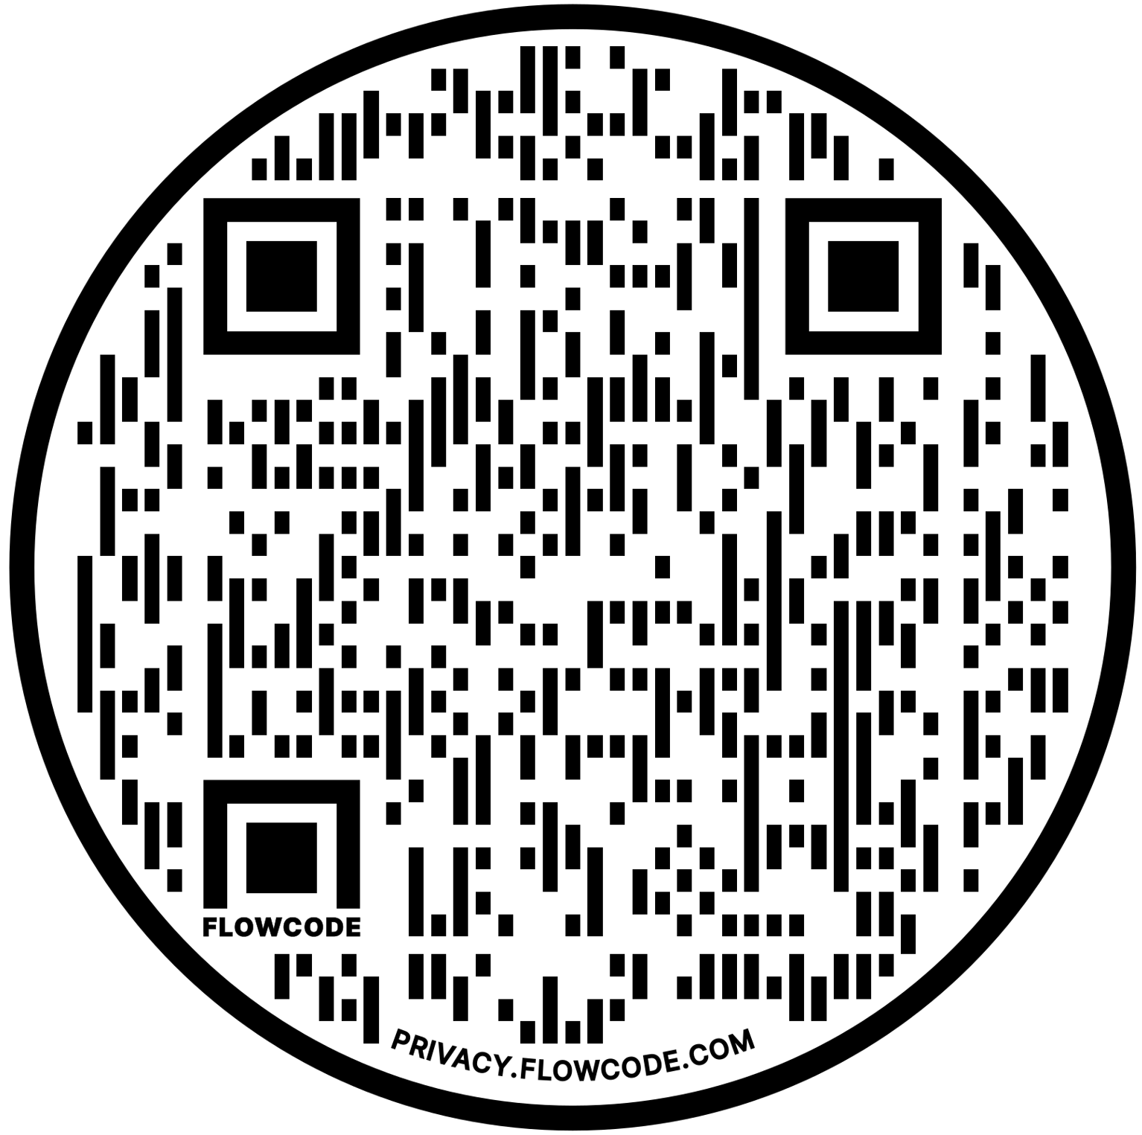
DO YOU NEED BED BUG TREATMENT SERVICES?
SCAN THE QR CODE OR VISIT THE LINK BELOW TO VIEW OUR TRUSTED SERVICE PROVIDERS IN YOUR AREA.
WWW.ECOPEST-SUPPLY.COM/TREATMENT
Large headline
We want to emphasize “FREE INSPECTIONS” over the other checkmarks
FREE INSPECTIONS
IDENTIFICATION
TREATMENT
We want to include related/applicable imagery for bed bug treatment or inspections.
Our logo can be included in a small, subtle way.
This will be a single-sided 12.7 x 12.7cm product insert card.
REMOVAL

